Slide 1
READ THIS FIRST
Hello everyone! This PowerPoint has my notes on each slide. You can see them if you DO NOT open the presentation, but instead look at it in the mode that you can edit. I hope if you are using a Google format you can still see the notes. There are also several video clips here. I hope this helps. -Ackerman

Slide 2
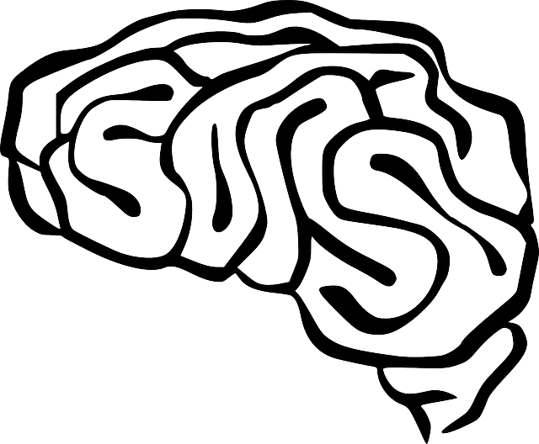
QUICK Write - Name some “REALLY SMART PEOPLE” and list characteristics that make them intelligent. What do you think is the definition of intelligence?
DO NOW
Intelligence: ability to learn from experience, to think rationally, & to deal w/the environment effectively
Notes:
Define intelligence - list on board- Explain psychologists have a definition of intelligence but of course have several theories. Give definition

Slide 3
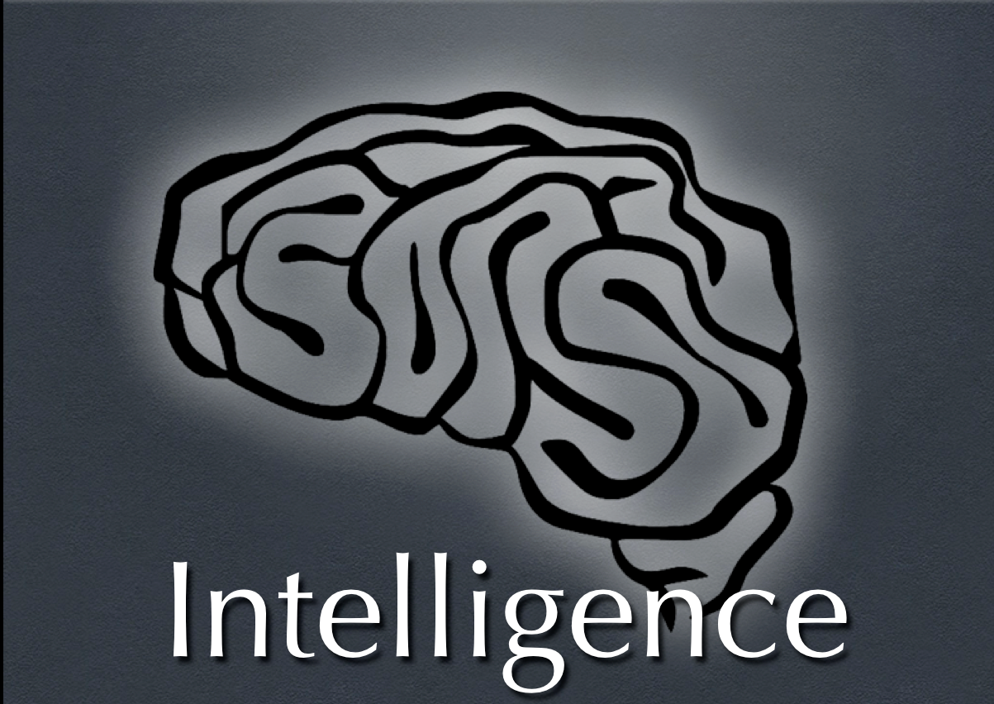
Essential Question: How is intelligence defined?
Notes:
Lecture Notes Key: ^ means discuss before notes
v means discuss after notes

Slide 4
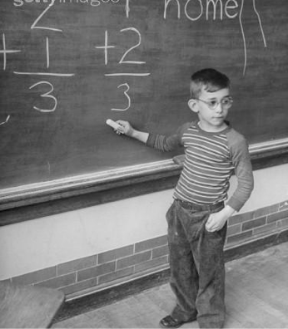
What is Intelligence?
• Intelligence - ability to learn from experience, to think rationally, & to deal w/the environment effectively
It is NOT achievement.
Achievement – knowledge & skills gained from experience
Notes:
Ask the question - what is intelligence?
--A lot of people would say characteristics that are actually “achievement” rather than intelligence. Achievement focuses on the things that you know & can do. It involves specific content, such as Spanish, calculus, history, psychology, biology, art, music or computers.
---It also has to do with experience. If you spent much of your time reading about the Civil War, then you will probably do well on a test about that period in U.S. history. You will have gained knowledge on the subject of the Civil War. But if you were tested on the Revolutionary War instead, you might not do as well. That would be because you had more content knowledge of the Civil War.
---Although intelligence is not the same as achievement, intelligence can provide the BASIS for achievement. Intelligence makes achievement possible by giving people the ability to learn.
--V Intelligence - Within that general definition, however, psychologists have a number of differing theories about what, exactly, makes up intelligence. & that’s what we are going to cover in this section.

Slide 5
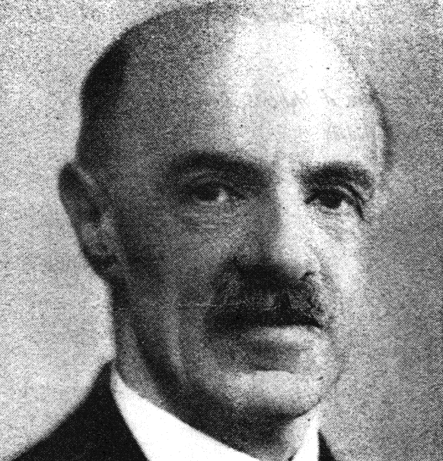
Theories of Intelligence
Spearman’s Two-Factor Theory
• G factor & S factor
• G = general intelligence, or abilities to reason & solve problems.
• S = specific factors that account for particular abilities.
Notes:
^100 years Ago a psychologist by the name of Charles Spearman suggested that all the behaviors we consider to be intelligent have a common underlying factor.
He Studied I.Q. Tests. He labeled this factor G. The g factor represents the abilities to reason & to solve problems. Spearman noted that people who do well in one area usually do well in others. Even though most people do better at some things than others.
= Thurstone - American psychologist, Louis Thurstone, believed that 7 separate factors make up intelligence. He called them primary mental abilities. These primary mental abilities are:

Slide 6
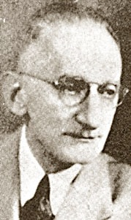
Theories of Intelligence
Thurstone’s Theory of Primary Mental Abilities
• Louis Thurstone – 7 separate factors of primary mental abilities.
• Visual & Spatial relations
• Perceptual speed
• Numerical ability
• Verbal comprehension
• Memory
• Word fluency
• Deductive reasoning & Inductive reasoning
Notes:
Thurstone - American psychologist, Louis Thurstone, believed that seven separate factors make up intelligence. He called them primary mental abilities. These primary mental abilities are:
Visual & Spatial - ability to picture shapes & spatial relationships
Perceptual speed - the ability to understand perceptual information rapidly & to see the similarities & difference between stimuli
Numerical ability - the ability to calculate & recall numbers
Verbal meaning - knowledge of the meanings of words
Memory - the ability to recall information such as words & sentences
Word fluency - the ability to think of words quickly for such tasks as rhyming or doing crossword puzzles
Deductive reasoning - the ability to derive examples from general rules
Inductive reasoning - ability to derive general rules from examples
-----Thurstone believed that people can be high in one factor & low in another. (Good at math, bad at English)

Slide 7
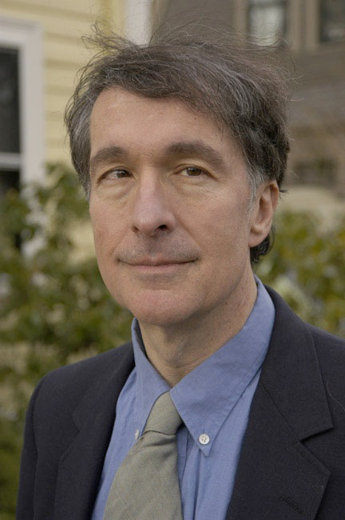
Theories of Intelligence
Gardner’s Theory of Multiple Intelligence
Howard Gardner – 8 different kinds of intelligence within us
1. Linguistic intelligence
2. Logical mathematical intelligence
3. Visual spatial
4. Body kinesthetics
5. Musical rhythmic
6. Interpersonal intelligence – sensitivity to others’ feelings (good w/people)
7. Intrapersonal intelligence - insight into own feelings
8. Naturalistic - “in tune” with nature -aware of the environment.
Notes:
Gardner not only looked at I.Q. Scores, but at lifetime successes.
Gardner refers to each of these as intelligence because they are all so different - also he believes that each kind of intelligence is based in different areas of the brain. It could explain how a person doesn’t do so well in school, but in any given social situation, they can get along well with anyone, may be well liked etc.
Although intelligence normally intact - they can function independently and develop further than the others.
Linguistic - typically good at reading, writing, telling stories and memorizing words along with date
Logical math - Logic, reasoning, numbers and critical thinking. It’s also linked to the g-factor
Visual Spat - spatial judgment and the ability to visualize in imagination - A persons internal map for navigation. Navigating in a city, forest, or interior decorating - imaging objects in places.
Body Kinesth - control of one's bodily motions and the capacity to handle objects skillfully - sports, dance, acting
Music Rhy- Sensitivity to sounds, rhythms, tones, and music. People can sing, play musical instruments, & compose music.
Interpers - interaction with others - People in sales, politics, counselors, and teachers
Intrapers - one's strengths/ weaknesses are, what makes one unique, being able to predict one's own reactions/emotions.
Naturalistic was added later - An environmentalist would be high in this
Criticism: According to Gardner a person could be intelligent musically or athletically. Critics however say that these people have skills & talent & that is not the same thing as being intelligent because they cannot help in school or in many kinds of jobs.

Slide 8
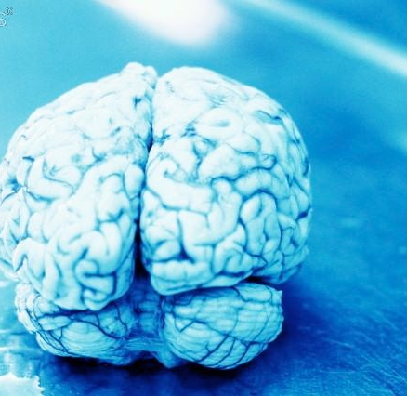
What’s the Difference between Thurstone’s & Gardner’s Views?
Thurstone -
7 factors combined make up intelligence.
Gardner -
8 intelligences are independent of each other.
Notes:
Gardner refers to each of these as intelligence because they are all so different - also he believes that each kind of intelligence is based in different areas of the brain. It could explain how a person doesn’t do so well in school, but in any given social situation, they can get along well with anyone, may be well liked etc.

Slide 9
Identify the Intelligence
Explain each person’s intelligence using Gardner’s eight intelligences using your notes and/or book.
(Name) is ….. because…..
Caution : Many of these people have more than one type, however each description will guide you towards one particular intelligence. Types will only be used once.

