Slide 1
Essential Question
How do humans learn, and how do experience and association
contribute to the learning process?

Slide 2
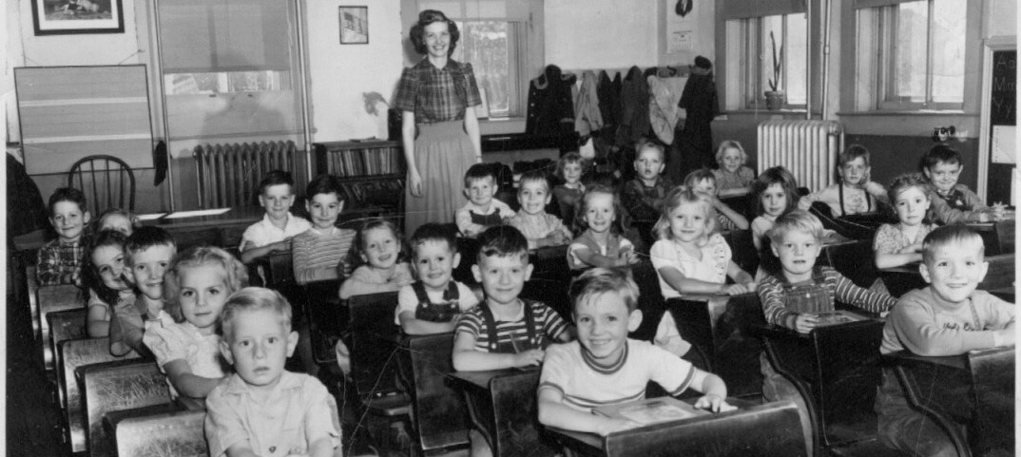
Conditioning - Learning
Associative Learning - Learning that certain events occur together.
- 2 types - Classical Conditioning & Operant Conditioning

Slide 3
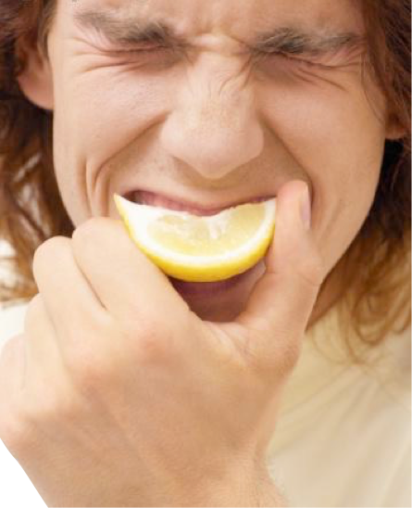
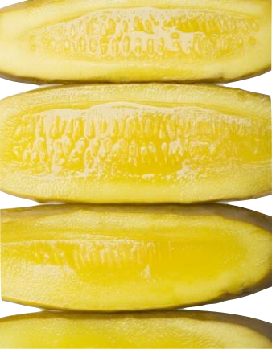
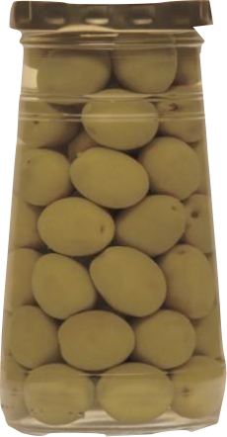
Notes:
Mouth watering?
This is Classical Conditioning. A simple form of learning in which one stimulus (in this case, the thought of the food) comes to call forth the response (your mouth watering) usually called forth by another stimulus (the actual food). This occurs when the two stimuli have been associated with each other.
The Earliest findings about Classical conditioning resulted from research similar to this food experience.

Slide 4
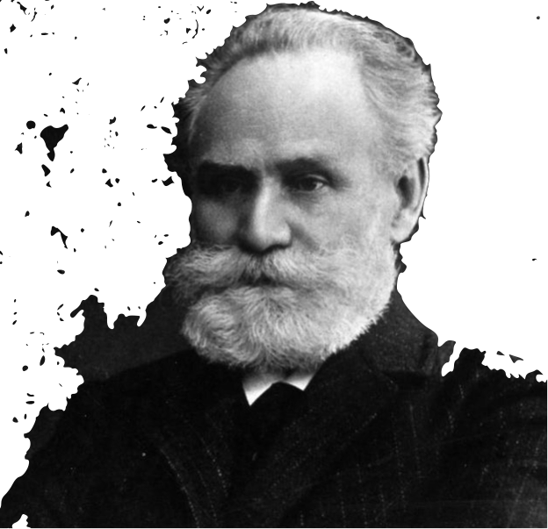
Notes:
This is Ivan Pavlov. Pavlov was a Russian researcher investigating the digestive system. He didn’t set out to learn about learning. It was a mistake. When he made his discovery in the field of learning, he was studying the digestive system through saliva.
He knew that by setting meat on a dogs tongue, they would salivate because salivation aids in the digestion process. It allows food to slide down our throats into our stomach easier. However he soon realized that dogs didn’t always wait until they received meat(it was actually meat powder) to start salivating. Sometimes they would salivate when an assistant entered the laboratory. Why? Because the dogs had learned from experience that these events - the clinking of the trays, the arrival of the assistants meant that food was coming.
So the experimenting began. Pavlov isolated the dog in a small room, secured it in a harness, and attached a device to divert its saliva to a measuring instrument. (Click for animation to show dog in harness)
From the next room, they presented food—first by sliding in a food bowl, later by blowing meat powder into the dog’s mouth at a precise moment.They then paired various neutral stimuli (NS)—events the dog could see or hear but didn’t associate with food—with food in the dog’s mouth. If a sight or sound regularly signaled the arrival of food, would the dog learn the link? If so, would it begin salivating in anticipation of the food?

Slide 5
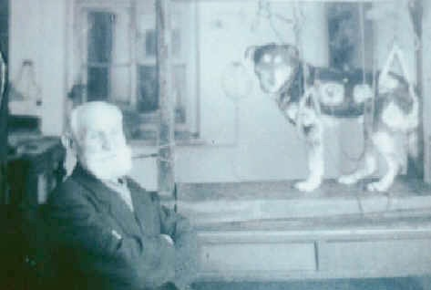
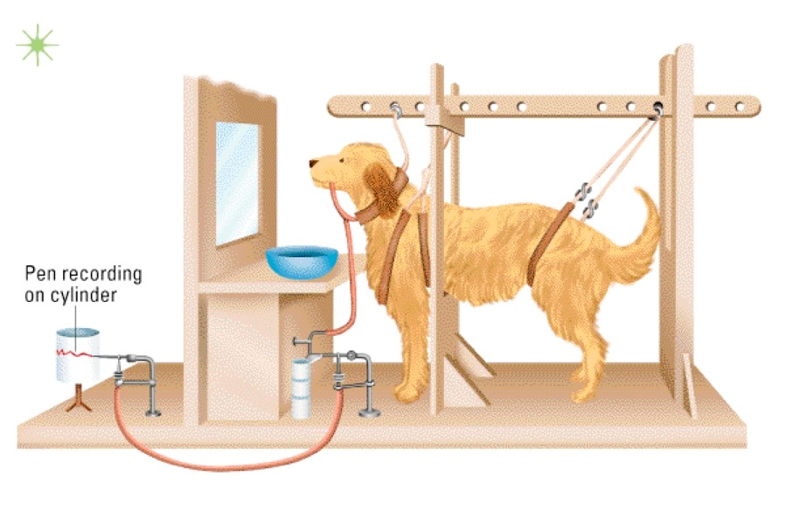
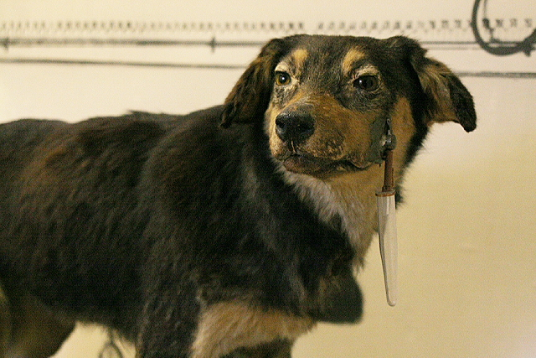
I. The Elements of Associative Learning
Conditioning
Trial
Salivation
Test
Trial
Salivation
Notes:
Pavlov then asked the question, could they learn to salivate in response to any stimulus that signaled meat?
The stimulus was a ringing of a bell. He strapped the dogs into harnesses and rang a bell. Then about half a second after the bell rang, meat powder was placed on the dogs tongues. As expected the dogs salivated in response to the meat powder. Pavlov repeated this several times.
Then he changed the procedure. He sounded the bell but did not follow the bell with meat. Yet the dogs salivated anyway. They had learned to salivated response to the bell.

Slide 6
I.The Elements of Associative Learning
Classical Conditioning - learning where a neutral stimulus is paired w/a Unconditioned Stimulus(US) and elicits a conditioned response (CR).
Conditioning
Trial
Salivation
Test
Trial
Salivation

Slide 7
I.The Elements of Associative Learning
Unconditioned Stimulus (US): A stimulus that has the ability to produce a specified response before conditioning begins.
(Food ) (SALIVATION PRODUCED BY FOOD)
Unconditioned Response (UR): A response produced by a natural stimulus.
Conditioned Stimulus (CS): an initially neutral stimulus that comes to produce a new response
because it is associated with the US. (Bell)
Conditioned Response (CR): the
response produced by the CS.
(Salivation Produced by the Bell)
Notes:
Unconditioned stimulus - cases a response that is automatic, not learned.
Unconditioned response - natural response or automatic response - not learned.
Terms to know - conditioning simply just means learning
Conditioned response is learned response
Taste Aversion - learned avoidance of food. We have learned that dislike of certain foods that made us sick in the past.
Aaron’s Velveeta Cheese story.
This is Charlie. When Charlie was three she loved Butterfingers. When everyone in his house was sleeping, Charlie snuck into the kitchen and began eating an entire bag of Butterfingers. Needless to say Charlie vomited and felt ill. Charlie cannot stand Butterfingers now. What is the US, UR, CS, CR?

Slide 8
a.Extinction
After conditioning has taken place, repeatedly presenting the CS (bell) w/o the US (meat) will make the CR (salivating) weaker & eventually make it disappear.
Notes:
Pavlov found that with repeated ringing of the bell without meat - the salivation stopped. This is called extinction.
Example: a car alarm. A car alarm may be set off so often by accident, that the car owner no longer rushes to look at the car or call the police

Slide 9
b.Reconditioning
relearning of a conditioned response after extinction w/o more pairings.
1 or 2
CS-UCS
pairings-
Conditioned
Response
Extinguished
Response
Notes:
In reconditioning, it only takes one or two pairings with the conditioned stimulus to reignite the conditioned response.

Slide 10
c.Spontaneous Recovery
Following extinction, the CR (?) reappears at reduced strength if the CS (?) is presented again after a rest period.
Time
- days-
Conditioned
Response
Extinguished
Response
Notes:
An extinguished response isn’t necessarily gone forever. They may pop up after a while. Spontaneous recovery happens when the conditioned response reappears after the Conditioned stimulus is presented again AFTER A RESTING PERIOD.
Example: After the response of salivating at the sound of the bell had been extinguished in Pavlov’s dogs, a day or two passed during which the dogs did not hear the bell at all. After this rest period, the bell was rung again. Even though the salivation response had earlier been extinguished, it was now back. It was, however, a little weaker than it had been when it was in full force - the dogs had less saliva.

Slide 11
The Office - Identify the…
US –
UR –
CS-
CR -
Offering of Mint
Holding out Han
Computer Sound
Holding out Hand
https://vimeo.com/244555885

