Slide 1
Learning Target
I can synthesize the three layers of consciousness into one saying.

Slide 2
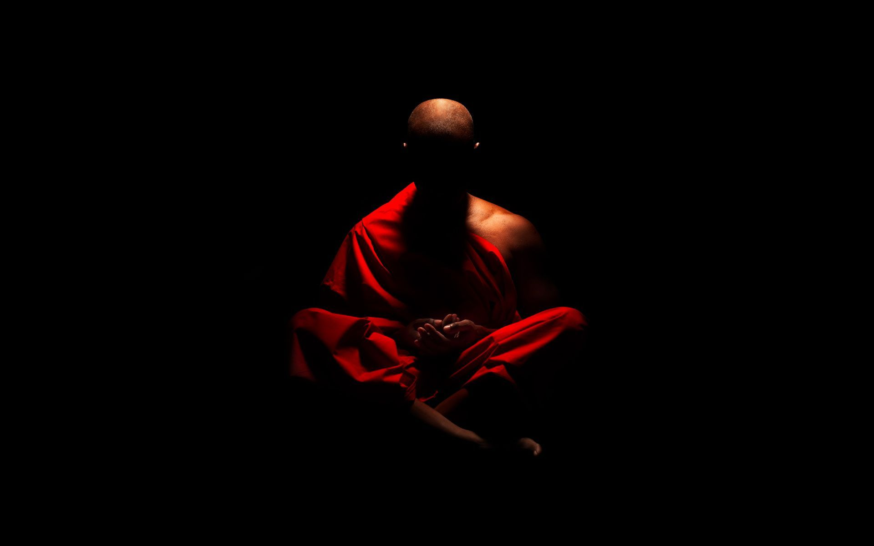
Consciousness
Do Now
In your opinion what is Consciousness?

Slide 3
Consciousness
Essential Question – How do you know you exist?

Slide 4
Consciousness
Consciousness as Sensory Awareness
Aware of your environment
Consciousness as Direct Inner Awareness
Being aware of things inside yourself.
Consciousness as a Sense of Self
a sense of self in which we are aware of ourselves & our existence
Notes:
Students don’t write this, however I explain these concepts.
Generally the term consciousness means awareness. But there is more than one type of awareness. Thus, the term consciousness is used in a variety of ways. Sometimes consciousness refers to sensory awareness. At other times, consciousness may mean direct inner awareness. A third use of the term consciousness refers to the sense of self that each person experiences

Slide 5
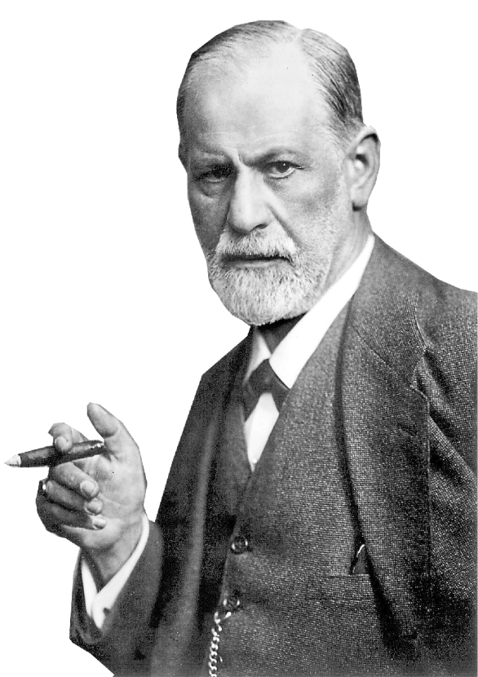
Consciousness

Slide 6
1. Conscious - awareness of oneself & one’s environment
2. Preconscious - info not in the conscious (or what you are thinking at the moment), but can be retrieved. Ex: What did you do last night? You can retrieve that info (memories, stored knowledge)

Slide 7
Conscious - awareness of oneself & one’s environment
2. Preconscious - info not in the conscious (or what you are thinking at the moment), but can be retrieved. Ex: What did you do last night? You can retrieve that info (memories, stored knowledge)
3. Unconscious Level or subconscious - Unacceptable thoughts, memories, wishes in which we are unaware, but still control our behavior. This info is hidden.

Slide 8
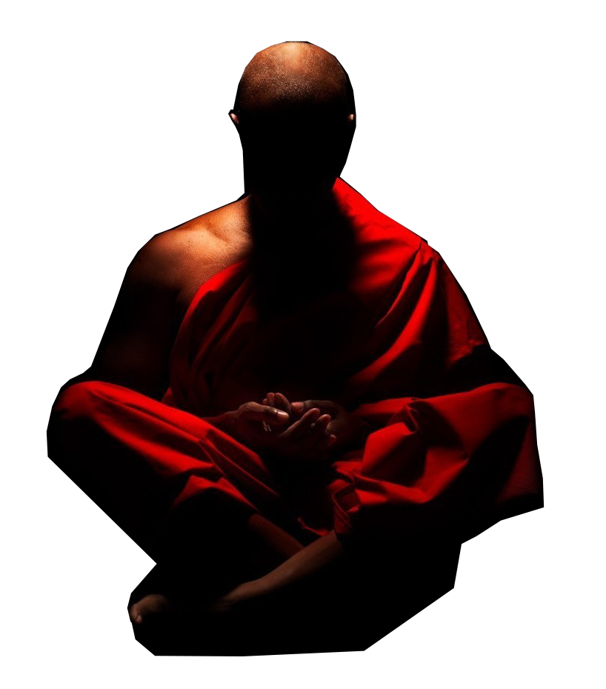
Consciousness
Conscious - awareness of oneself & one’s environment
Shhh. . . Listen
Nonconscious - mental process that goes on in which the individual is unaware.
- Basic biological functions
- heart rate, breathing
- No control over these functions
- not aware of them
Notes:
The Nonconscious Level
Many of our basic biological functions exist on a non conscious level.
For example, even if you tried, you could not sense your fingernails growing or pupils in your eyes adjusting to light. You know that you are breathing in and out, but you cannot actually feel the exchange of carbon dioxide and oxygen. Yo blink when you step from the dark into the right, but you cannot feel your pupils growing smaller. It may be just as well that these events are non conscious. After all, how much can a person hope to keep in mind at once?

Slide 9
Altered States of Consciousness
Altered States of Consciousness when a person’s sense of self or sense of the world changes
1. sleep/dreams
2. psychoactive drugs
3. hypnosis
4. meditation
5. biofeedback
Notes:
Altered States of Consciousness
The word Consciousness sometimes refers to the waking state - the state in which a person is awake. Yet there are also several altered states of consciousness, in which a person’s sense of self or sense of the world changes. When you doe off, you are no longer conscious of what is going on around you. Sleep is one altered state of consciousness. Other altered states of consciousness occur through psychoactive drugs, meditation, biofeedback, and hypnosis. That’s what we are going to talk about next.

