Slide 1
READ THIS FIRST
Hello everyone! This PowerPoint has my notes on each slide. You can see them if you DO NOT open the presentation, but instead look at it in the mode that you can edit. I hope if you are using a Google format you can still see the notes. There are also several video clips here. I hope this helps. -Ackerman

Slide 2
Should we use Gardener’s Theory of Multiple Intelligences to help us structure your classes? Why or Why not?

Slide 3
What do we have in the class?
Linguistic
Bodily-
Kinesthetic
Intrapersonal
Logical Mathematical
Spatial Visual
How might this change the debate?
Musical
Interpersonal

Slide 4
Essential Question: How is intelligence defined?
Intelligence
Notes:
Lecture Notes Key: ^ means discuss before notes
v means discuss after notes

Slide 5
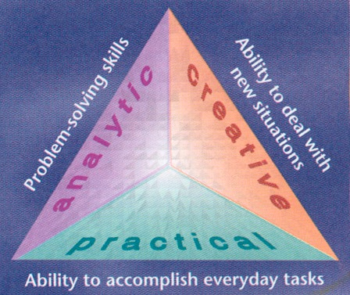
Theories of Intelligence
Sternberg’s Triarchic Theory
• Analytic - ability to solve problems
• Creative - ability to deal
w/new situations
• Practical - ability to accomplish everyday tasks
Notes:
Usually we must use more than one of these three types of intelligence at the same time.
---Use your practical intelligence to plan for a project. Every day. There is more than one solution or several methods to a solution.
---Analytic intelligence would be used to interpret the results of the exp. Problem Solving - School math, business math
Creativity - compose music, write a novel. It would be used to design a display for your project.
***He said that companies and universities should not select people solely on basis of tests that test the analytic abilities. There is little relation to peoples daily experiences

Slide 6
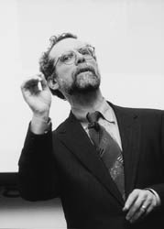
Theories of Intelligence
Emotional Intelligence
Daniel Goleman
5 factors involved in academic or occupational success. (emotional intelligence )
• Self Awareness – Ability to recognize own feelings.
• Mood management – ability to separate one from unpleasant feelings
• Self motivation – ability to move ahead w/confidence & enthusiasm.
• Impulse control – ability to delay pleasure until the task at hand has been accomplished
• People skills – ability to empathize, understand, communicate & cooperate w/others.
Notes:
Chad’s Story - Psychologist Daniel Goleman is interested why smart people are not always as successful as might be expected. So he proposes another kind of intelligence: emotional intelligence. Emotional intelligence consists of five factors that are involved in success in school or on the job.
Self-awareness - we know when we are happy or sad. Better to cope with feelings
Mood management - most of the time we cannot control when we are mad, but we can manage that anger. We can distract ourselves not to dwell on that anger.
Self motivation - People who are self motivators sometimes accomplish more than people who obtain higher scores on intelligence tests.
Impulse control - a student who resists the temptation to watch television until their homework is done may do better in school than a student who puts off homework until later.
People skills - people skills help us get along with others, & getting along with others helps us In school & on the job.

Slide 7
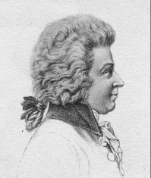
Theories of Intelligence
Overlapping Intelligence
Listening to complex or playing a musical instrument helps other cognitive functions such as spatial reasoning.
Mozart Effect
Notes:
Mozart Effect - an experiment done in 1993 showed that listening to 10 minutes of a Mozart piano sonata on several occasions enhanced college students’ scores on spatial reasoning items of tests they were given. This is still in debate. But, if you play read and play music, that’s another story.
A study recruited 19 3-4 year olds. Researchers gave their children eight months of music lessons, including singing & use of a keyboard. Another 15 children served as a control group - they received no music lessons. After the music course was completed, the researchers gave all of the children a task in which they had to put pieces of a puzzle together to form a complete object. The scores of all 19 children who had had the lessons significantly exceeded those of the 15 children who had not received the training in music.
Why? One suggestion is that parts of the brain overlap each other therefore developing other skills as well. *** Not separate, only interact , but they overlap.

Slide 8
Theories of Intelligence
Overlapping Intelligence
Listening to complex or playing a musical instrument helps other cognitive functions such as spatial reasoning.
Mozart Effect
Notes:
An embedded link to a 4:20 minute YouTube video about Music and the Brain begins here.
Mac users, click on black circle to open browser and view the YouTube video about Music and the Brain.
Original Link: https://www.youtube.com/watch?v=J1yAlP1eP-w&list=PL0b0E54MkXkS66qt60Yq2_c7Av0ADqoH9&index=3
Mozart Effect - an experiment done in 1993 showed that listening to 10 minutes of a Mozart piano sonata on several occasions enhanced college students’ scores on spatial reasoning items of tests they were given.
Another study recruited 19 3-4 year olds. Researchers gave ther children eight months of music lessons, including singing & use of a keyboard. Another 15 children served as a control group - they received no music lessons. After the music course was completed, the researchers gave all of the children a task in which they had to put pieces of a puzzle together to form a complete object. The scores of all 19 children who had had the lessons significantly exceeded those of the 15 children who had not received the training in music.
Why? One suggestion is that parts of the brain overlap each other therefore developing other skills as well.

Slide 9
Theories of Intelligence
Review Questions
1. What is the difference between achievement & intelligence
2. What is the difference between Gardner’s & Thurstone’s theories?
3. Describe two factors of intelligence as specified by Spearman’s theory.
4. Which two of Gardner’s intelligences do you MOST possess?
Answer these questions in your spiral.
Include the question in your answer.
Be prepared to share
5. Choose one of the five theories on intelligence you believe best explains intelligence. Write a paragraph explaining why you like that theory the best.
Notes:
Review Questions from the notes

