Slide 1
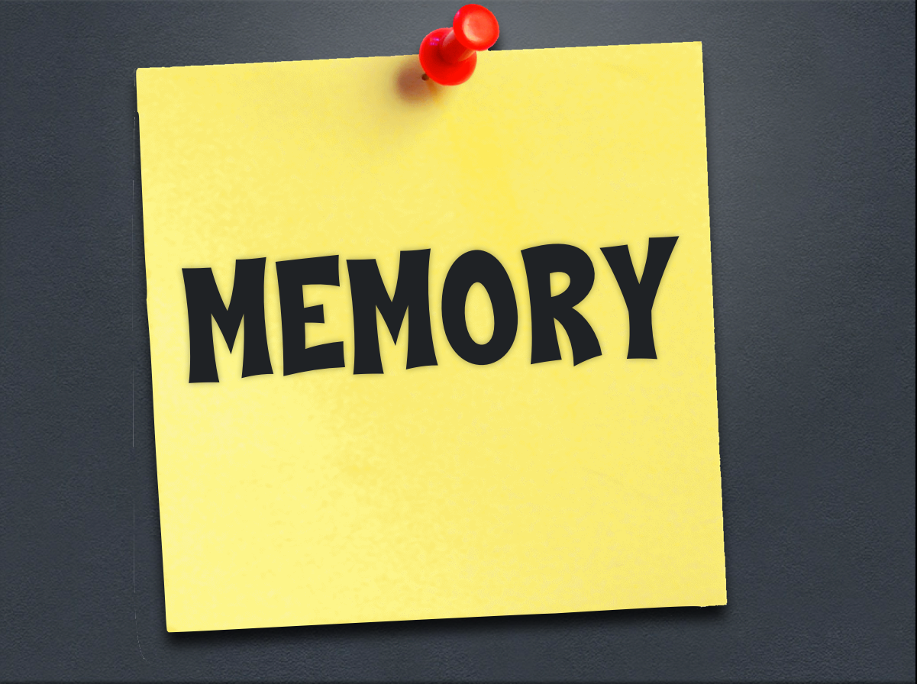
ES: How do we process memories?
Notes:
Lecture Notes Key: ^ means discuss before notes
v means discuss after notes

Slide 2
1. Encoding
3. Retrieval
2. Storage

Slide 3
1. Encoding - translation of information into a form that can be stored in memory
Visual Codes, Acoustic Codes, Semantic Codes
OTTFFSSENT
OTTFFSSENT
One,TwoThree,Four, Five. . .
Notes:
V - Encoding - Like a computer, when you write a paper on the computer, it doesn’t actually store little letters and words on your floppy disk. It ENCODES the information onto the disk.
There are three types of codes we you for memorization they are visual, acoustic and Semantic
STOP!! Look at the group of letters on the screen, try to remember them.
One person may have tried to remember them visually (using a visual code) that is: you may have tried to keep a mental picture of the letters in your mind.
Another person may have tried to remember the letters would to read the list to yourself and repeat it several times either out loud or silently. This is an example of Acoustic Codes.
Lastly, ladies and gentlemen, one person may have even tried to remember these letters by attempting to make sense of these letters, or figure out what they mean. Example may be finding a word that begin with each of the letters in the list and then make up a sentence using those words, such as, “Only Tiny Tots Feel Friendly etc. This way it may be easier to remember the phrase other than a bunch of random letters.
Remembering this would be hard, but if I were to tell you that each of those letters stood for the first letter of the series of numbers from one through ten, you probably wouldn’t have forgotten.

Slide 4
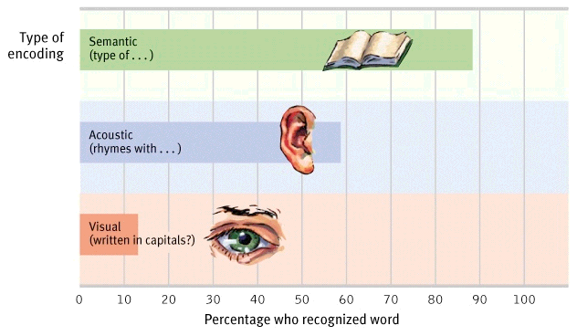
Encoding Continued

Slide 5
2. Storage - maintenance of encoded information over time.
• Maintenance rehearsal - repeating
• Elaborative rehearsal - relating new information to old information.
• Organizational Systems - memories become stored & arranged in your mind for future use
Notes:
V Storage - Also like a computer - If we want to store the information we receive, we have to save it to the hard drive, or store the information in our brain. With the computer however, we must tell it to “SAVE”. With us, we store the new information using a variety of different ways or strategies. These are very similar to the ones used in encoding.
Maintenance rehearsal - Repeating information over and over again to keep from forgetting it.
The more time repeating and rehearsing the longer it will stay with us.
Who can give me an example of what we might try to remember by doing this? Telephone number.
Actors and actresses rehearse their lines again and again until they know it as well as they possibly can.
Elaborative rehearsal - This is a much more effective way of learning. Ex. If you take spanish or french or another language, you may be encouraged to use new vocabulary words in sentences instead of just repeating them.
V Organizational Systems - just like a computer you store information in files. . . And those files may have files.
When you think of animals - you may go into your animal file and choose a file labeled birds, and with in the birds file you could recall the names of several types of birds. Your brain organizes objects according to common features.

Slide 6
3. Retrieval - the process of recalling information from memory storage.
-Recall - retrieve info from memory w/o help
-Recognition - recognize from a list of alternatives
What’s the Capital of North Dakota?
What’s the Capital of Minnesota?
a. St. Paul
b. Minneapolis
c. Brockville
d. Duluth
Notes:
Retrieval - Again this is like a computer - In order to retrieve information stored in a computer, we have to know the name of the file and the rules for retrieving information. We need similar procedures. Some info we know so easily that it is impossible to forget (friends and families names for example), but some information such as a mathematical formula may be a little bit more difficult - so we have to use some of the of those codes.
Remember the group of letters I gave you earlier? What were they? You used the semantic code to remember, and that’s what we sometimes have to do in order to retrieve the information in storage.
Make a chart of three types of memory - label each column with one of the kinds of memory discussed in the section. Complete the chart by supplying a definition, one fact and two examples for each kind of memory. Read out loud for other students to identify.
^ Context-Dependent Memory - Have you ever been to a place that brought back old memories? Maybe you went back to your old elementary school, or an old neighborhood where you used to live. (Summer experience) This is called. . .
V Some memories are dependent on the place or environment where they are stored. If I hadn’t returned back to Minnesota where they were encoded, I probably would not have ever remembered them.
Talk about the pool Experiment - remembering numbers --- It suggest that the ability to retrieve memories is greater when people are in the place or situation in which they stored the memories to begin with.
Another study showed that students do better on tests when they study for a test in the room where the test will be given.
One last thing regarding Context-Dependent Memory - In a trial, some lawyers will ask a witnesses to describe a crime, they ask the witnesses to describe the scene as clearly as possible. Police will sometimes take witnesses to the scene of the crime in hope that the visit will improve their memories that they witnessed.

Slide 7
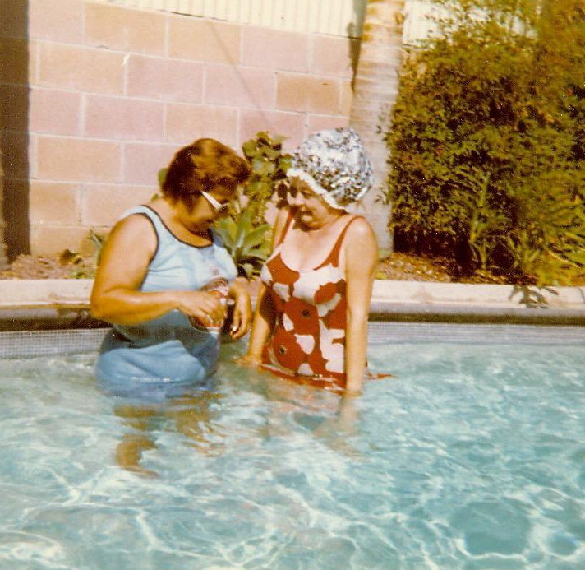
Retrieving Memories
Context-Dependent Memory -
Info is more easily retrieved in the context in which it was encoded & stored. ( Tests)
Notes:
^ Context-Dependent Memory - Have you ever been to a place that brought back old memories? Maybe you went back to your old elementary school, or an old neighborhood where you used to live. (Summer experience) This is called. . .
V Some memories are dependent on the place or environment where they are stored. If I hadn’t returned back to Wisconsin where they were encoded, I probably would not have ever remembered them.
Talk about the pool Experiment - remembering numbers --- It suggest that the ability to retrieve memories is greater when people are in the place or situation in which they stored the memories to begin with.
Another study showed that students do better on tests when they study for a test in the room where the test will be given.
One last thing regarding Context-Dependent Memory - In a trial, some lawyers will ask a witnesses to describe a crime, they ask the witnesses to describe the scene as clearly as possible. Police will sometimes take witnesses to the scene of the crime in hope that the visit will improve their memories that they witnessed.

Slide 8
Retrieving Memories
State-Dependent
Memory -
memory where info is more easily retrieved when in the same physiological or emotional state as when the memory was originally learned. (ex. Happy exp., drugs)
Notes:
^ State-dependent memories - Not only do people tend to retrieve memories better when they are in the same place they were in when they first stored the memories, but people also retrieve memories better when they are in the same emotional state they were in when they first stored the memories. These are called. . .
Example - an experiment in 1981 gave people a list of words to memorize to people who were happy and sad states. They found that people who were in the same emotional state as they were when they learned them, did better.
Not only is memory better when people are in the same moods as when the memories were acquired, it is also better when people are in the same state of consciousness. That is - Things that happen to somebody under the influence of a drug may be remembered most accurately when the person is back under the influence of that drug.

