Slide 1
Do Now – Left Side
Mind Dump
With a partner you have two minutes to list as many facts as about Classical Conditioning. Number each fact. Both people keep the list in their notebooks.

Slide 2
Summarize
At your table combine your Mind Dump with your group. As a group use the white board to write a write a three sentence summary of Classical Conditioning. Consider what are the most important parts. What do people need to know?
Include vocabulary!
BE READY TO SHARE

Slide 3
Learning Target
I can summarize Classical Conditioning
I can identify the US, UR, CS, CR
I can identify ways Psychologists approach phobias.

Slide 4
Classical Conditioning Demo
Classical Conditioning occurs in humans and nonhumans and is produced by a variety of different stimulus-response relationships.
For this demo I need a volunteer that will not mind being squirted in the face by water.

Slide 5
cup, can, lime, CAN, dish, girl, chalk, can dish, CAN, key, screen, ran, desk, CAN, knob, bag, tape, CAN, dish, clip, CAN, air, ban, cheese, CAN, crane, wheel, fire, CAN, dish, king, cape, apple, CAN, dog, blue, can, dish, CAN, take call, brick, pair, CAN, spin, chair, CAN, camp, CAN, dish, CAN, bridge, scale, can, fan, board, CAN, cool, three, horn, disk, CAN, can, cast, test, pen, dime, CAN, dish, van, can, card, stand, meat, pad, can, sword, juice,, can, dish, rock, smoke, grease, dish, keep, kid, tan, dice, hole, set, eye, friend, wax, bill, bulb, dish, class…..

Slide 6
Apply it
Unconditioned Stimulus
Unconditioned Responses
Conditioned Stimulus
Conditioned Response
Water squirted in face
Flinching, squinting
The word can
Flinch, squint

Slide 7
Apply it
Acquisition - after repeated pairings with water can elicits the conditioned response
Generalization – student begins to flinch at words like can, ban, cap….
Extinction – when the word can is uttered several times with out water
Spontaneous recover – long string of words with out can... Then CAN elicits a response

Slide 8
Apply
Jamie was talked into riding on the roller coaster when she was 12. The ride absolutely terrified her. Now whenever she geos to the amusement park, she breaks into a cold sweat f she even looks at the rollercoaster.
Unconditioned Stimulus
Unconditioned Response
Conditioned Stimulus
Conditioned Response
Riding a Rollercoaster
Fear
Sight Rollercoaster
Fear

Slide 9
Apply
Kim was sick all night after eating a bad fried oyster. Now, she says, the smell of ANYTHING frying makes her feel nauseated.
Unconditioned Stimulus
Unconditioned Response
Conditioned Stimulus
Conditioned Response
Bad Fried Food
Getting Sick
Anything Fried
Nauseated

Slide 10
Apply
Sinbad was frightened when a barking spaniel lunged at the fence as Sinbad walked by. The next day, when Sinbad’s mother started to lead him by the house where the spaniel lives, Sinbad began to tremble and whimper.
Unconditioned Stimulus
Unconditioned Response
Conditioned Stimulus
Conditioned Response
Barking Spaniel
Frightened
Home of the Spaniel
Tremble and Whimper

Slide 11
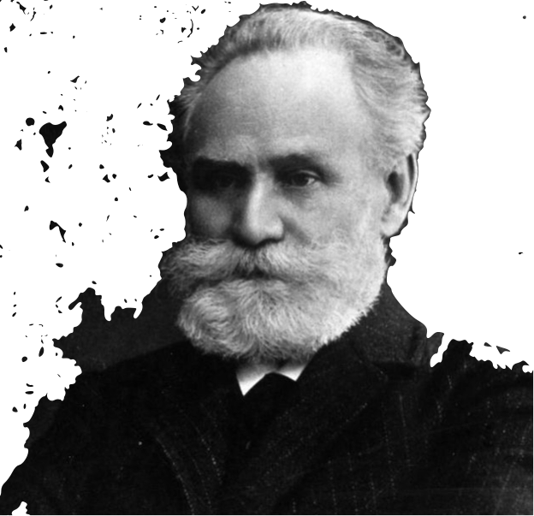
Phobias and Treatment
Notes:
This is Ivan Pavlov. Pavlov was a Russian researcher investigating the digestive system. He didn’t set out to learn about learning. It was a mistake. When he made his discovery in the field of learning, he was studying the digestive system through saliva.
He knew that by setting meat on a dogs tongue, they would salivate because salivation aids in the digestion process. It allows food to slide down our throats into our stomach easier. However he soon realized that dogs didn’t always wait until they received meat(it was actually meat powder) to start salivating. Sometimes they would salivate when an assistant entered the laboratory. Why? Because the dogs had learned from experience that these events - the clinking of the trays, the arrival of the assistants meant that food was coming.
So the experimenting began. Pavlov isolated the dog in a small room, secured it in a harness, and attached a device to divert its saliva to a measuring instrument. (Click for animation to show dog in harness)
From the next room, they presented food—first by sliding in a food bowl, later by blowing meat powder into the dog’s mouth at a precise moment.They then paired various neutral stimuli (NS)—events the dog could see or hear but didn’t associate with food—with food in the dog’s mouth. If a sight or sound regularly signaled the arrival of food, would the dog learn the link? If so, would it begin salivating in anticipation of the food?

Slide 12
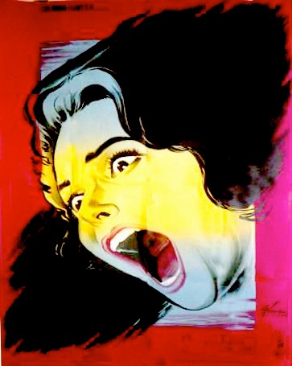
II.Uses of Classical Conditioning
1. Flooding - a person is exposed to the harmless stimulus until fear responses to that stimulus are extinguished
Notes:
Flooding is based on Extinction - remember in extinction, after a stimulus has occurred without a unconditioned response, the conditioned response will eventually go extinct.
A person who is afraid of heights might look out from a sixth-story window until she or he is no longer upset by it. Or. . .

Slide 13
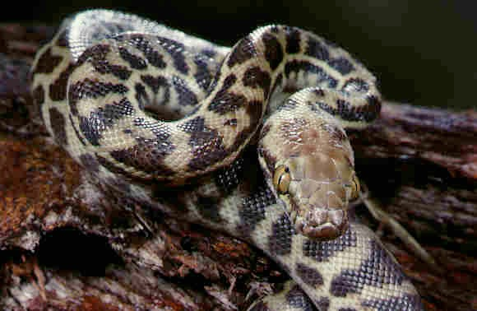
II.Uses of Classical Conditioning
with Classical Conditioning
2. Systematic desensitization - people are taught relaxation techniques. Then are gradually exposed to the feared stimulus using the relaxation technique
Notes:
A person with a fear of snakes might be put in a room with lots of harmless snakes crawling around in the room.
It’s quite effective, BUT very unpleasant. When people fear something, forced exposure to it is the last thing they want. For this reason, psychologists usually prefer to use systematic desensitization
People who fear snakes are shown pictures of snakes while they are relaxed. Once they can view pictures of snakes without losing the feeling of relaxation, they are shown some real snakes from a distance. Then after some more time, the snakes are brought closer, and eventually the peopl no longer fear snakes.
This takes longer, but its not as unpleasant.

Slide 14
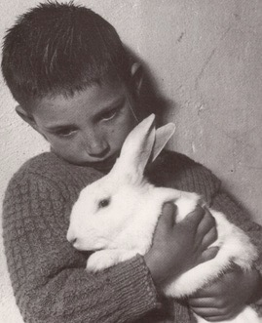
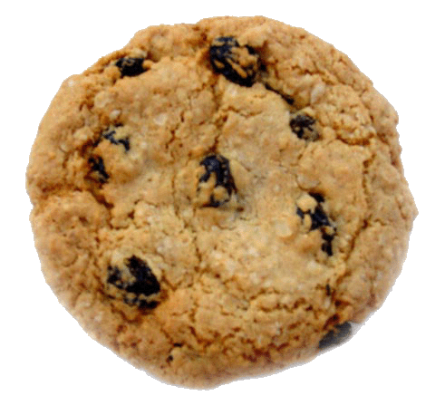
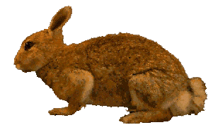
II.Uses of Classical Conditioning
Counterconditioning - a pleasant stimulus is paired repeatedly with a fearful one, counteracting the fear.
Notes:
An experiment in 1924 - used a 2 year old boy named Peter, who was afraid of Rabbits. They gradually brought a rabbit closer to the boy while they fed the boy candy and cookies. The boy seemed nervous about the rabbit, but he continued to eat his treat. Gradually, the animal was bought even closer. Eventually, the boy ate treats and petted the rabbit at the same time.
---Apparently his pleasure at eating the sweets canceled out his fear of the rabbit.

Slide 15
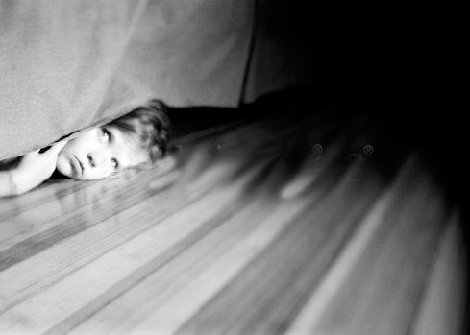
II.Uses of Classical Conditioning
Bell and Pad Method
US =
UR=
CS=
CR=
Bell
Wake-up & preventing urination
bladder tension
Wake-up & preventing urination
Notes:
Classical conditioning can also be used for some kids, usually around 5 or 6 who still wet the bed. The problems is that they do not wake themselves up when the feel bladder tension.
Bell & Pad Method - In this method, a child sleeps on a special pad. Urination causes a bell to ring and wakes up the child . After a couple of weeks, the child is conditioned to wake up in response to bladder tension Child instructed to turn off alarm and go to the rest room
Bell (US) Wake-up and tightening muscles to prevent urination (UR)
Bodily sensations (CS) Wake-up and tightening muscles to prevent urination (CR)

Slide 16
John B. Watson and Little Albert
US =
UR=
CS=
CR=
Loud bar sound
Fear/Crying
White rat
Fear/Crying
Notes:
Label the US, UR, CS, CR while watching video.
Ask the class what the result of Albert’s fear through generalization? All white fuzzy furry things.

