Slide 1
Do Now
Quick Write: Based on the Crash Course you watched last night should we have daily naps at school?

Slide 2
Napercise
Notes:
Keep in mind that businesses, airports, malls, etc are all investing in sleep. They have sleep pods, and sleep rooms to help boost creativity and energy.

Slide 3
Are you Sleeping enough?
I need an alarm clock in order to wake up at the appropriate time.
It’s a struggle for me to get out of bed in the morning.
Weekday mornings I hit snooze several times to get more sleep.
I feel tired, irritiable,a nd stressed out during the week.
I have trouble concentrating and remembering.
I feel slow with critical thinking, problem solving, and being creative.
I often fall asleep watching TV.
I often fall asleep in boring meetings or lectures in warm room.s
I often fall asleep after heavy meals.
I often fall asleep while relaxing after dinner.
Notes:
Cornell University psychologist James Maas has reported that most students suffer the consequences of sleping less than they should. To see if you are in the group, answer the following true/false questions.
If you answered true to three or more items, you probably are not getting enough sleep. To determine your seleep needs Maas recommends that you go to be 15 minutes earlier than usual every night for the next week- and continue to practice eby adding 15 minutes each week – until you wak without an alarm clock and feel alert all day.

Slide 4
Are you Sleeping Enough
11. I often fall asleep within five minutes of getting into bed.
12. I often feel drowsy while driving.
13. I often sleep extra hours on weekend mornings.
14. I often need a nap to get through the day.
15. I have dark circles around my eyes.

Slide 5
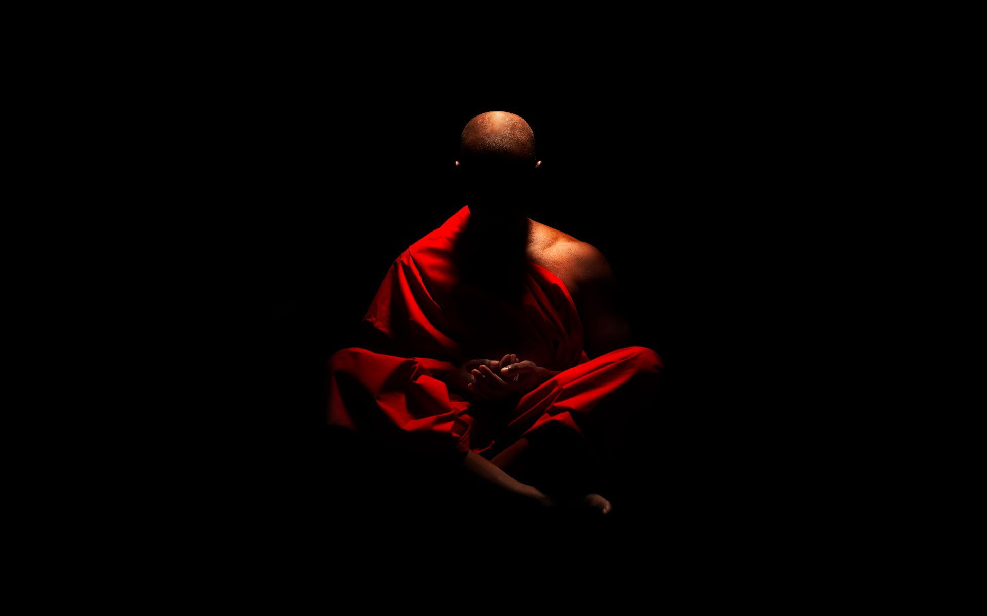
Consciousness
Essential Question: How do our biological rhythms influence our daily functioning?

Slide 6
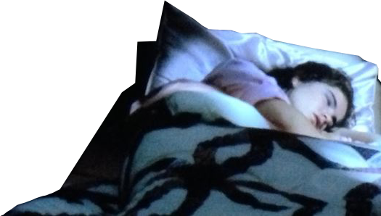
I. Sleep & Dreams
1.Biological Rhythm
circadian rhythm biological clock; regular bodily rhythms that occur on a 25-hour cycle.
Example: Body temperature rises during & wakefulness
Notes:
We spend about one third of our life asleep. And we don’t have a choice. Much of how people, animals, and even plants function by something called circadian rhythms, or biological clocks. The circadian rhythms in humans include a sequence of bodily changes, such as those in body temperature, blood pressure, and sweepingness and wakefulness, that occurs every 24 hours. The human circadian rhythms usually operate on a 25 hour day.
Example: body temperature falls to its lowest point between 3:00am and 5:00 am each day.
Circadian rhythm
Our bodies roughly synchronize with the 25-hour cycle of day and night by an internal biological clock called the circadian rhythm. We normally associate this cycle with day and night. We sleep during the night and are awake at day in a 24 hour earth cycle. But if you remove all the sleep/wake cues from the environment like, clocks, TV, sunrise and sunset, researchers have found that our actual sleep/wake cycle tends to be 25 hours. The reason this happens is unclear.
The circadian clock regulates our body and prepares us to sleep and wake. As morning approaches, body temperature rises, then peaks during the day, dips for a time in early afternoon (when many people take siestas), and begins to drop again in the evening. Thinking is sharpest and memory most accurate when we are at our daily peak in circadian arousal.
Age and experience can alter our circadian rhythm. Most 20-year-olds are evening energized. Their performance improvs across the day
Most older adults are morning people. Their performance declines as the day wears on. By mid-evening, when the night has hardly begun for many young adults, retirement homes are typically quiet. After about age 20 (slightly earlier for women), we begin to shifting from later night people to morning people. Women become more morning oriented as they have children and also as they transition to menopause. Morning types tend to do better in school, to take more initiative, and to be less vulnerable to depression

Slide 7
I. Sleep & Dreams
2.Stages of Sleep
STAGE 1
Between consciousness
and sleep
4 Stages of sleep
ranging from 90 to 110 minute cycles
NREM (non-Rapid Eye Movement) = Stages 1-3 No REM
1. Stage 1
- falling asleep
- light sleep
- theta waves
Notes:
As you begin to fall asleep, your body temperature decreases, your pulse rate drops and your breathing becomes slow and even. Gradually your eyes close and your brain moves into the first stage of sleep. Sleep researchers have found that we sleep in stages. Before 2007, sleep was divided into 5 stages, since then, sleep researchers combined two stages and now sleep is divided into four stages.
About every 90 minutes, you cycle through four distinct sleep stages. Sleep stages are measure by an EEG that detects brain waves.
Stage 1
Stage 1 is the stage of lightest sleep. As we enter stage 1 sleep, our pulse slows a bit and muscles relax, but our breathing becomes uneven and your brain waves grow irregular. Our brain waves slow down from an alpha rhythm to the slower pattern of theta waves. This transition may be accompanied by brief dreamlike images that resemble vidid photographs. Because stage 1 sleep is light, if we are awakened during this stage, we will probably recall these images and feel as if we have not slept at all. During the transition into stage 1, it is also common to experience hypnic jerks. The are those involuntary twitches that occurs just as we are beginning to fall asleep. It causes us to awaken suddenly for a moment.

Slide 8
I. Sleep & Dreams
2.Stages of Sleep
STAGE 1
Between consciousness
and sleep
5-15 Minutes
STAGE 2
Breathing, heart rate slows
Stage II - III
30 minutes each
- Delta Waves
- you are hard to wake up. (Children wet bed & sleepwalk during the end of stage 4.)
15 Minutes
STAGE 3
Very Deep Sleep - Delta Waves Voluntary Muscles activity is paralyzed
Notes:
If we are not awakened, we remain in stage 1 sleep no more than 20 to 40 minutes. Then we move into the second stage of sleep. Breathing and heart rate slows. There is no eye movement during this time and dreaming is very rare. The sleeper is quite easily awakened.
Stage 3 - During stage 3, sleep is deep, and the brain produces delta waves - the slowest of the four patterns. Stage 3 is during which someone would have the greatest difficulty waking us up. Dreaming is more common in this stage than in other stages of NREM sleep though not as common as in REM sleep. The content of these dreams tends to be disconnected, less vivid, and less memorable than those that occur during REM sleep. This is also the stage during which parasomnias or sleeping disorders like night terrors most commonly occur. After perhaps half an hour of stage 3 sleep, we begin a relatively quick journey back to stage 2 to stage to 1. About 90 minutes will have passed since we fell asleep. Now something strange happens.
REM Sleep: Suddenly, we breathe more irregularly, blood pressure rises, and the heart beats faster. Brain waves become similar to those of stage 1 sleep. This is a stage called rapid-eye movement or REM sleep, because beneath our closed lids, our eyes are moving rapidly. The preceding three stages are known as non-rapid-eye-movment, or NREM sleep because our eyes do not move as much during them.

Slide 9
I. Sleep & Dreams
2.Stages of Sleep
STAGE 1
Between consciousness
and sleep
REM SLEEP Rapid-Eye-Movement(Stg 4)
- High-frequency brain waves
- increased pulse & breathing
- paralysis of large muscles & dreaming
- may help w/learning & consolidating new memories
5-15 Minutes
REM STAGE 4
STAGE 2
Breathing, heart rate slows
Brain waves speed up, dreams, heart rate increase
Muscles activity is paralyzed
15 Minutes
STAGE 3
Very Deep Sleep - Delta Waves Voluntary Muscles activity is paralyzed
Notes:
Suddenly, we breathe more irregularly, blood pressure rises, and the heart beats faster. Brain waves become similar to those of stage 1 sleep. This is a stage called rapid-eye movement or REM sleep, because beneath our closed lids, our eyes are moving rapidly. The preceding four stages are known as non-rapid-eye-movment, or NREM sleep because our eyes do not move as much during them. Brain energy use in REM sleep equals or exceeds energy use in waking. The rate in non-REM sleep is 11–40% lower
Two brain chemical systems work together to paralyze skeletal muscles during this stage. This is important so we don’t act out our dreams.

Slide 10
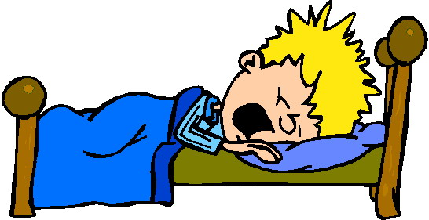
Quick Write - Summary
Using the notes we just took answer the first question again.
Should we have nap time at school? Use facts about sleep stages to support your answer.

