Slide 1
Essential Question : How do children cognitively develop?

Slide 2
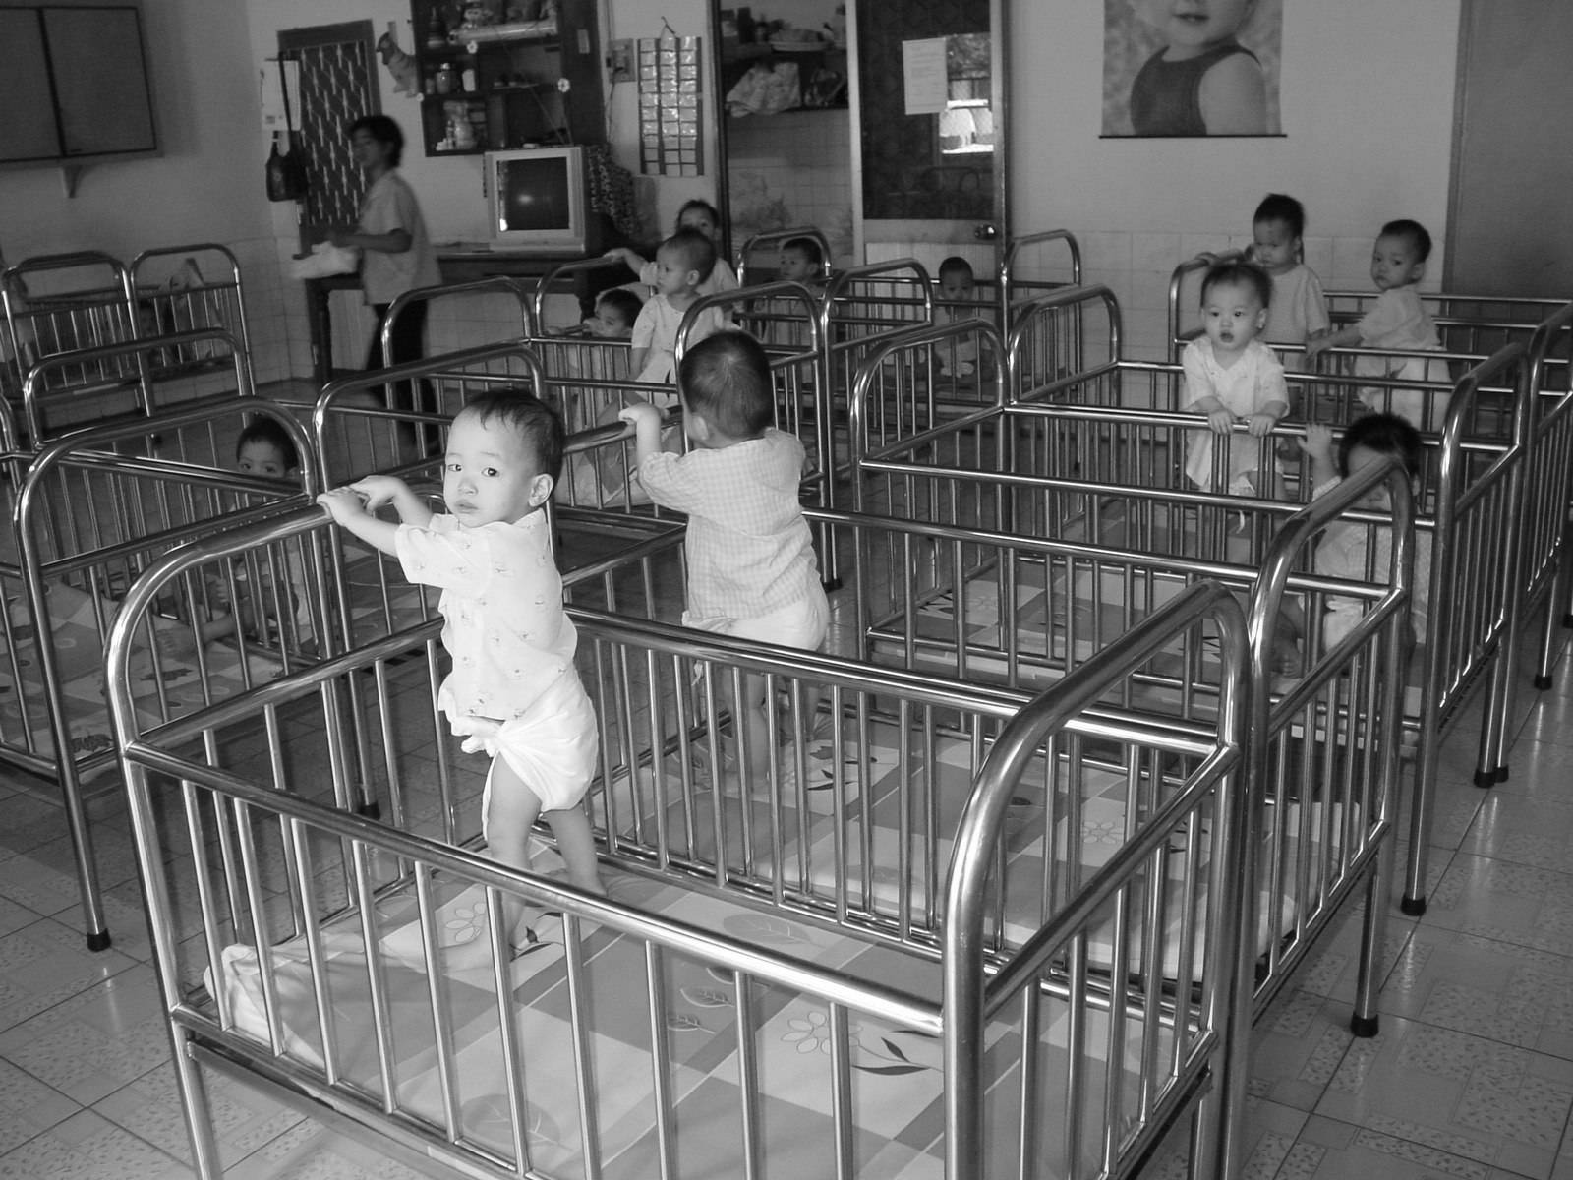
III. COGNITIVE
DEVELOPMENT
III. Attachment is Needed
Research Shows:
• Orphans w/o attachments w/adults
- lower I.Q. scores
- higher anxiety disorders
• unloved may become unloving
- many murderers report being neglected or battered as children
- 30% of abused children abuse their children
- physically/sexually abused increased risk for
- health problems
- psych disorders
- substance abuse
- criminality
Notes:
Students don’t have to right down this info, but it’s important to review –
During the 1970s and 1980s in Romania the communist dictator, forced people to have more babies. Many were unable to afford the children and families abandoned them to government-run orphanages with untrained and overworked staff. Child-to-caregiver ratios often were 15 to 1, so the children were deprived of healthy attachments with at least one adult. When tested in 1989, these children had lower intelligence scores and many more anxiety disorders. Dozens of other studies across 19 countries have confirmed that orphaned children tend to fare better on later intelligence tests if raised in family homes. This is especially so for those placed at an early age.
Most children growing up under adversity (as did the surviving children of the Holocaust) are resilient; they become normal adults. So do most victims of childhood sexual abuse. But others, especially those who experience no sharp break from their abusive past, don’t bounce back so readily. The Harlows’ monkeys raised in total isolation, without even an artificial mother, bore lifelong scars. As adults, when placed with other monkeys their age, they either cowered in fright or lashed out in aggression. When they reached sexual maturity, most couldn’t mate. If artificially impregnated, females often were neglectful, abusive, even murderous toward their first-born.
In humans, too, the unloved may become the unloving. Most abusive parents—and many condemned murderers—have reported being neglected or battered as children. Some 30 percent of people who have been abused later abuse their children.
Although most abused children do not later become violent criminals or abusive parents, extreme early trauma may nevertheless leave footprints on the brain. Abused children exhibit hypersensitivity to angry faces. As adults, they exhibit stronger startle responses. If repeatedly threatened and attacked while young, normally placid hamsters grow up to be cowards when caged with same-sized hamsters, or bullies when caged with weaker ones. Such animals show changes in the brain chemical serotonin, which calms aggressive impulses. A similarly sluggish serotonin response has been found in abused children who become aggressive teens and adults. Stress can set off a ripple of hormonal changes that permanently wire a child’s brain to cope with a malevolent world.
Such findings help explain why young children who have survived severe or prolonged physical abuse, childhood sexual abuse, or wartime atrocities are at increased risk for health problems, psychological disorders, substance abuse, and criminality. Abuse victims are at considerable risk for depression if they carry a gene variation that spurs stress- hormone production. As we will see again and again, behavior and emotion arise from a particular environment interacting with particular genes.

Slide 3
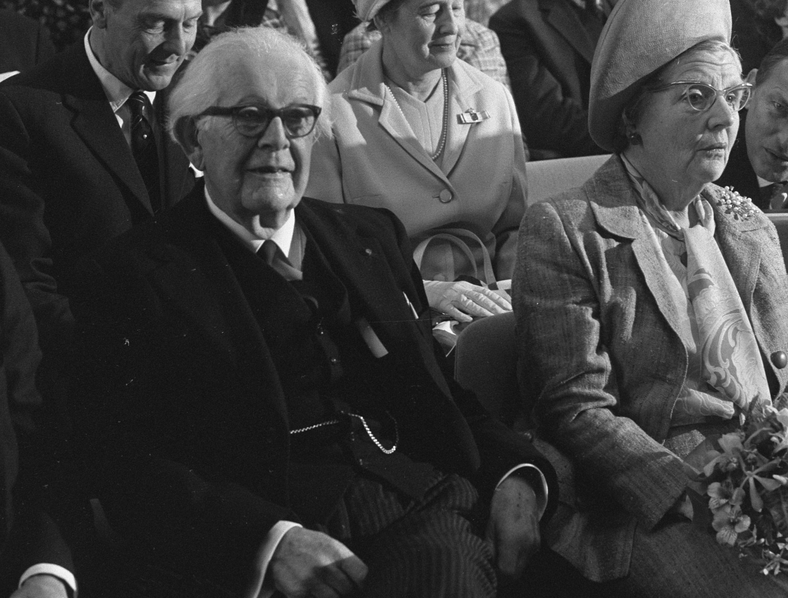
III. COGNITIVE
DEVELOPMENT
I. Piaget’s Cognitive Development
C. Piaget’s Four Stages of Cognitive Development
Stg 1. sensory-motor stage (0-2 yrs)
Experience the world through senses & actions (looking, hearing, touching, mouthing, and grasping)
Notes:
Jean Piaget - When Jean Piaget was in his early 20s, he was employed at the Binet Institute in Paris. (Stanford Binet intelligence tests) Here he worked on the Binet intelligence test, developing questions for kids. He found that gave certain types of wrong answers & that these answers fit patterns from child to child. He was so interested in these patterns that the study of children’s thinking became his life’s work.
Piaget believed that children’s thinking develops in stages. Some children are more advanced than others at a given age. However, the developmental sequence is the same for everyone. Piaget identified four stages in the sequence. They are sensorimotor, proportional, concrete operational, and formal operational.
Sensorimotor stage The behavior of newborns is mainly reflexive. They are able only of responding to their environment and can’t make behavior. After a month, infants begin to act with a purpose rather than just react. Infants begin to learn that there is a relationship between how they move and the results they sense and perceive.
The infant’s mental activity is confined to sensory functions. They can only think about objects in the “here and now,” directly sensing or acting on them. Three to four month olds are interested by their own hands and legs. They are entertained by watching themselves open and close their fists and sounds like a rattle. They like to investigate cause and effect relationships. They drop things and watch them fall to the ground.

Slide 4
III. COGNITIVE
DEVELOPMENT
Stg 1. sensory-motor stage continued
Object Permanence – understanding that an object exists even when they can’t be seen or touched.
*Until about 12 Months a child doesn’t have concept.
Notes:
1. infants at 3-4Ms are fascinated by their own hands & legs. They are easily amused by watching themselves open & close their fists. If they hear an interesting sound, such as a rattle, they might do something to sustain the sound. By 8 months, they are exploring cause-effect relationships. Hitting toys, & thus watching them move is an example.
“Out of Sight, Out of Mind” Before infants are six months old, objects out of their sight are truly out of their minds. The infants do not realize that objects out of sight still exist. They might stare at a stuffed animal, but if you were to put the stuffed animal behind a piece of paper, they would not look behind the paper or reach to find it. By 8 months to a year, however infants understand that things that have been taken away still exist.
Piaget did this by showing an infant an appealing toy and then flop his beret over it to see whether the infant search for the toy. Before the age of 6 months, the infant did not. By 8 months, infants began exhibiting memory for things o longer seen.

Slide 5
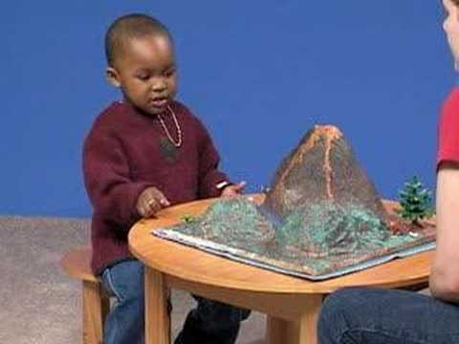
III. COGNITIVE
DEVELOPMENT
Stg 2. Preoperational Stage - ages 2-6
• Child begins to use language & symbols.
• Mental imagery (Child can draw images from their mind)
• Egocentrism – inability to see another person’s point a view
Example: Egocentrism
Notes:
• During this stage children begin to understand, create, and use symbols to represent things that are not present. They begin to play “pretend.” By the age 3 or 4, they can symbolize roles and play “house” or “doctor.”
• Children’s thinking is dominated by intuition and guesses. Between ages 4 and 7, children make intuitive guesses about the world but cannot distinguish between the physical and mental.
• They believe that inanimate objects are alive and have intentions, feelings, and consciousness—a belief called animism. The clouds go slowly because they have no paws or legs. Flowers grow because they want to. Empty cars feel lonely.
• They are egocentric; they believe that they way things look to them is also how they look to everyone else.
• They do not understand the logic of reversibility or complementarity
Example of one Egocentrism (dimensional thinking) - In other words, one dimensional thinking is when children see only one aspect of a situation at a time. This one dimensional thinking is the most evident in the fact these children do not understand the law of conservation.
Egocentrism is the inability to see another person’s point of view. They may think it becomes dark because it’s time to sleep. They don’t mean to be selfish.
Example When a preschooler sits down in front of the television, blocking everyone’s else’s view, he or she is not being rude. The child simply thinks you can see what they see.
Next Slide - Law of Conversation – When children are shown tow identical tall, thin glasses of water, each filled to the same level, they know that both glasses hold the same amount of water. However, if water from one of the tall glasses is poured into a short, squat glass, the children say that the other tall glass contains more liquid than the short one. They say this even if they have WATCHED the water being poured. Because they can focus only on what they are seeing at a given moment - and on one dimension at a time - they incorrectly think that the tall glass now contains more water than the short glass. **Their thinking is that it looks as if there is less water in the short glass & therefore it must be so. Take appearances at face value “what I see is what there is”

Slide 6
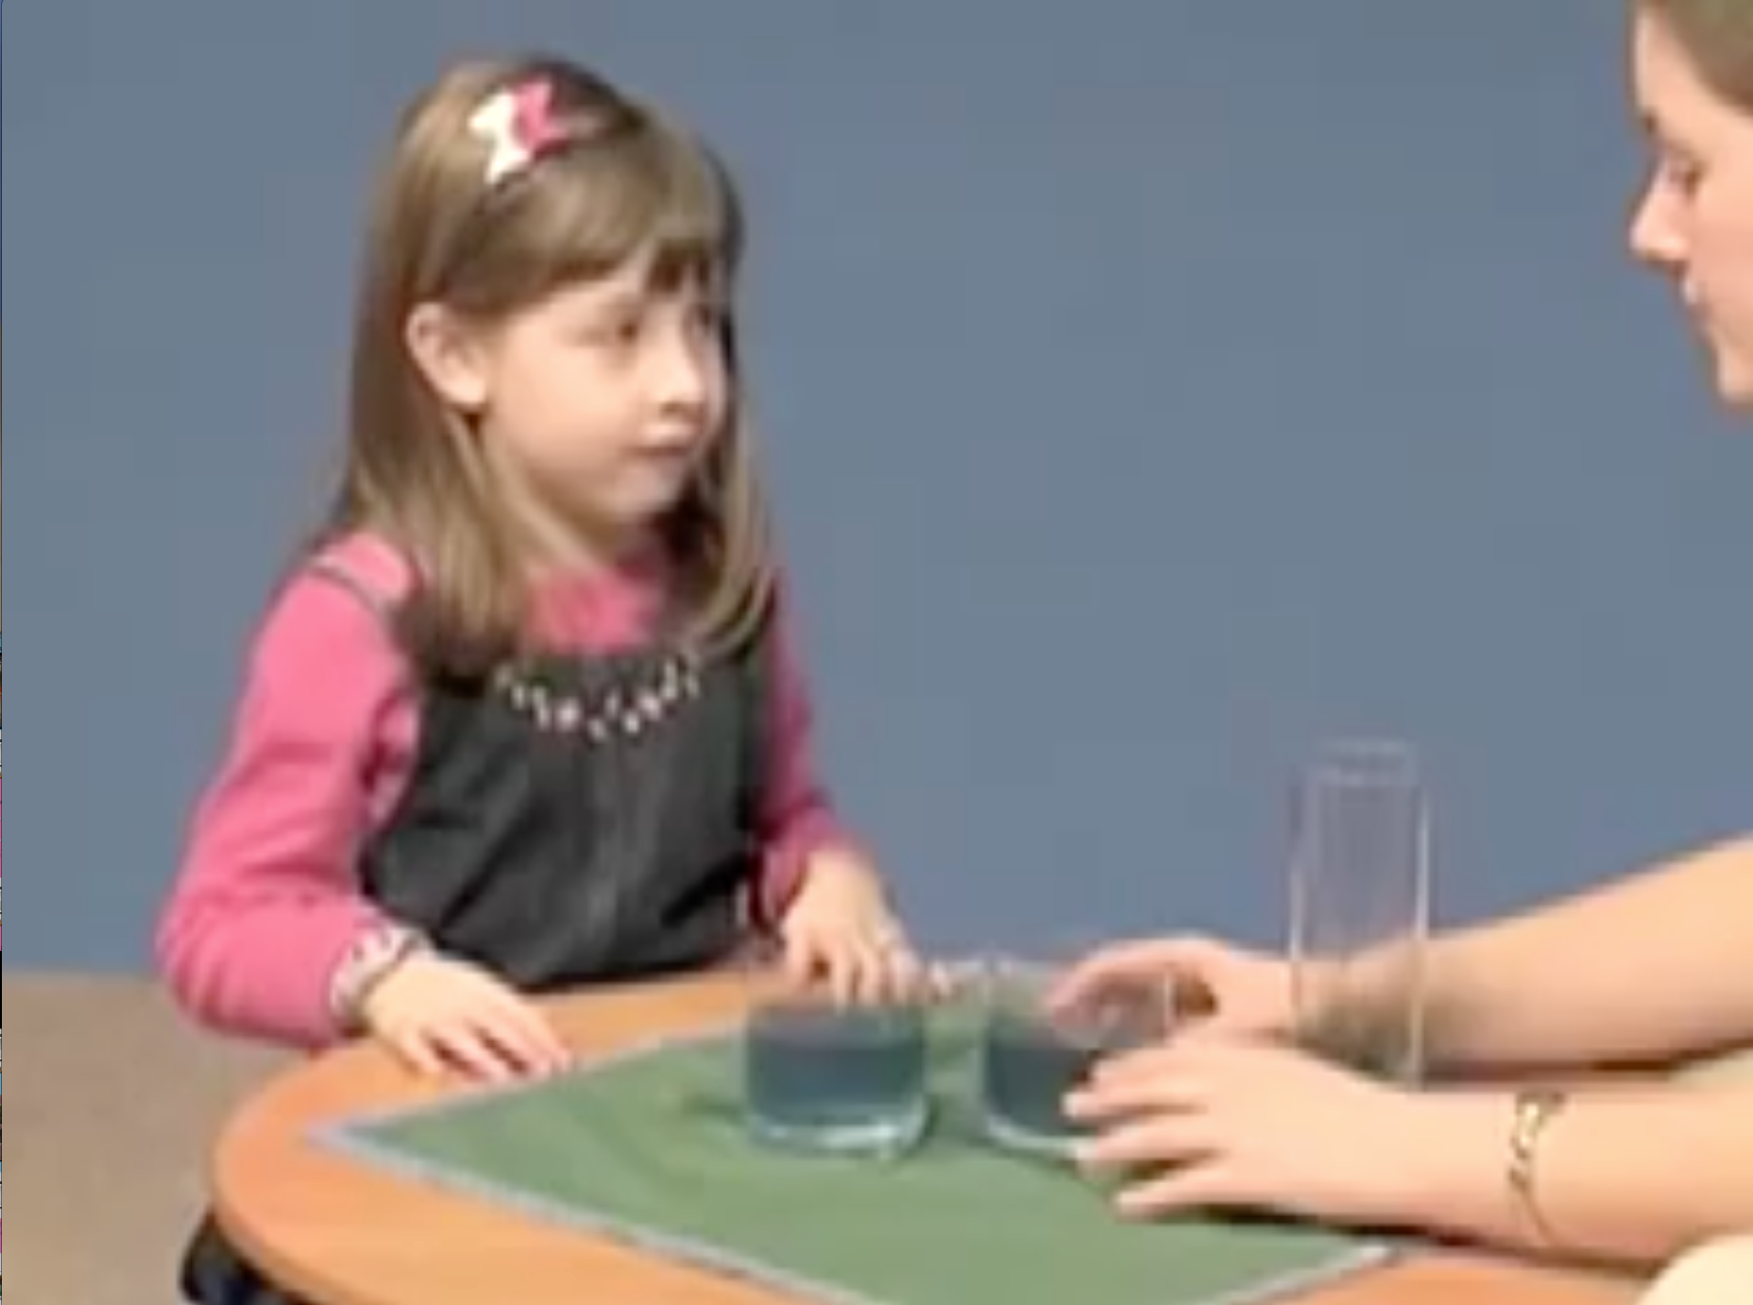
III. COGNITIVE
DEVELOPMENT
Stg 2. Preoperational Stage Continued
Law of Conservation - quantity of substances remain the same despite changes in their shape or arrangement
- (kids don’t understand)
Notes:
Another example of one dimensional thinking is in the fact these children do not understand the law of conservation.
Law of Conversation is when the quantity of substances remain the same despite changes in their shape or arrangement.
Example: When children are shown tow identical tall, thin glasses of water, each filled to the same level, they know that both glasses hold the same amount of water. However, if water from one of the tall glasses is poured into a short, squat glass, the children say that the other tall glass contains more liquid than the short one. They say this even if they have WATCHED the water being poured. Because they can focus only on what they are seeing at a given moment - and on one dimension at a time - they incorrectly think that the tall glass now contains more water than the short glass. **Their thinking is that it looks as if there is less water in the short glass & therefore it must be so. Take appearances at face value “what I see is what there is”
Click for video example

Slide 7
III. COGNITIVE
DEVELOPMENT
Stg 3. Concrete Operational Stage – 6–12 yrs
• Begin to learn law of conservation, multi-dimensional thinking less egocentric.
• Can do elementary arithmetic. .
EX 6 –2 = 4, because 4+2=6
Notes:
Children begin to show signs of adult thinking. Yet they are logical only when they think about specific objects, not abstract ideas. This is one reason why many teachers assign them hands-on projects. Seeing, touching, & manipulating objects often help concrete-operational children understand abstract concepts.
**They can understand law of conservation because they can understand that a short, wide glass might contain the same amount of water as a tall, thin glass. THEY CAN FOCUS ON Both the height and the width of the glasses at the same time. They can recognize that a gain in width compensates for a loss in height.
1. At this stage, children can use simple logic and perform simple mental manipulations and operations on things.
2. They can sort objects into classes or series by systematic searching and ordering.
3. They can perform logical operations, but only on real, concrete objects.
Next Slide_____________________________________________________________________________
Stg 4 - Thinking Abstractly - They realize can be compared & classified mentally just as objects can. EX. they understand what is meant by the unknown quantity x in algebra. They can work on geometry probs about lines and triangles w/o concerning themselves with how the problems relate to the real world.
several approaches - Many approaches to a problem - if one doesn’t work they know their can be another. They can think ahead imagining the results of different courses of action before deciding on a particular one.
***Piaget believed that Everyone goes through the stages in the same order, but not always @ the same age.

Slide 8
III. COGNITIVE
DEVELOPMENT
Stg 4. Formal operational 12 - adulthood
• Abstract & hypothetical thinking. Geometry
• Can think of several different approaches to solving problems
• Can examine the future
• Can formulate personal ideas & values
Notes:
Stg 4 - Thinking Abstractly - They realize can be compared & classified mentally just as objects can. EX. they understand what is meant by the unknown quantity x in algebra. They can work on geometry problems about lines and triangles w/o concerning themselves with how the problems relate to the real world.
several approaches - Many approaches to a problem - if one doesn’t work they know their can be another. They can think ahead imagining the results of different courses of action before deciding on a particular one.
***Piaget believed that Everyone goes through the stages in the same order, but not always @ the same age.

