Slide 1
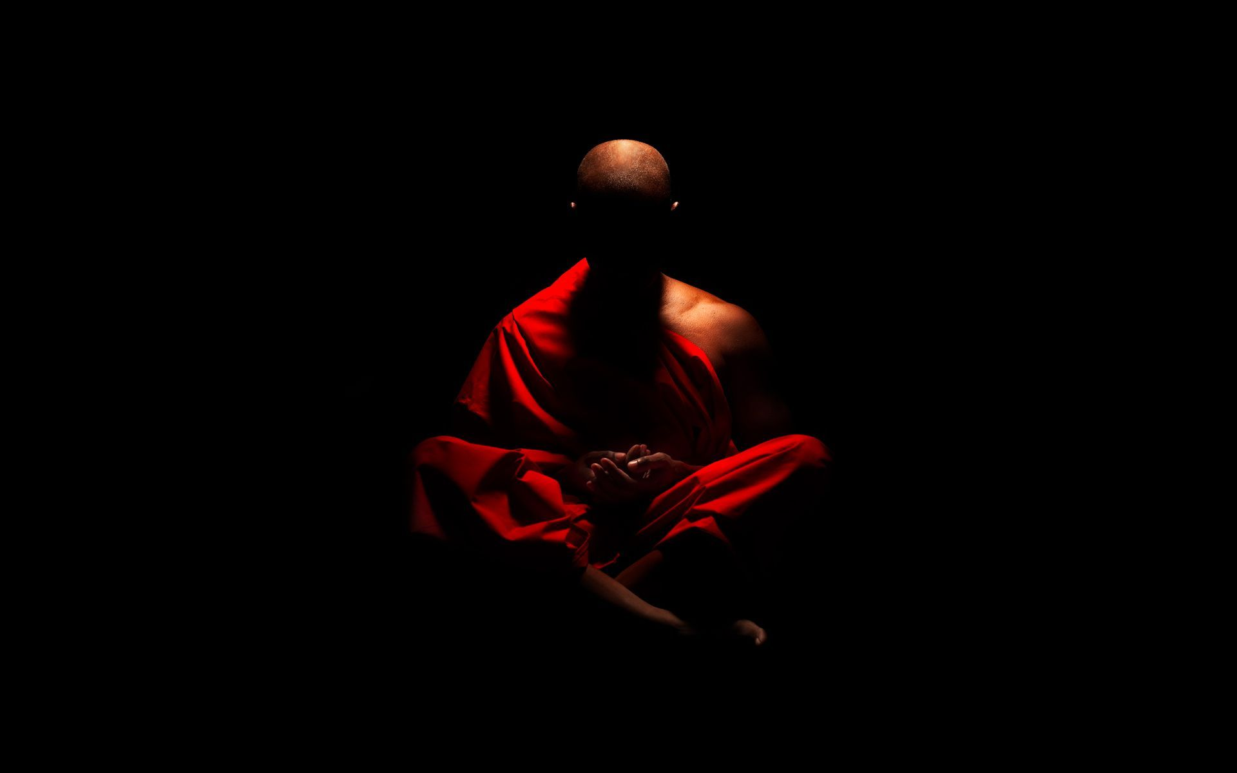
Consciousness
Essential Questions: How does sleep loss affect us, and what are the major sleep disorders?

Slide 2
sleep disorders
Sleep Disorder
Description
Nonlinguistic Representation
Notes:
Students complete chart using their notes. Last column, students draw an representation of each of the five sleeping disorders.

Slide 3
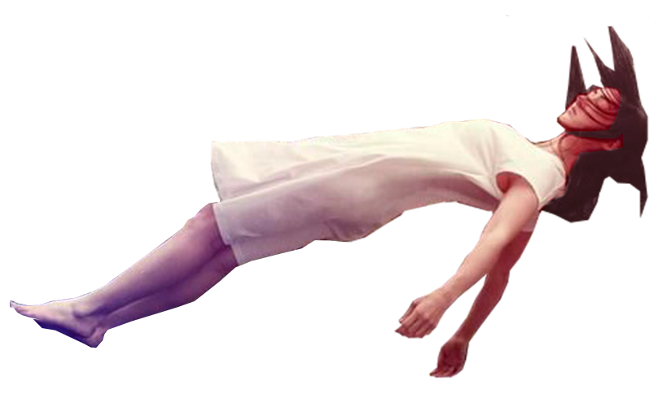
I. Sleep & Dreams
3. Sleep Disorders
INSOMNIA
Persistent problems falling asleep
- Affects 10% of the population
- Primary versus Secondary Insomnia
Notes:
Primary insomnia is insomnia that is NOT related to any medical, psychological, or physical condition
Insomnia: In the U.S. National Sleep Foundation “2008 Sleep in America” poll, 65 percent of respondents reported that, within the past year, they had experienced a “sleep problem” at least a few nights a week, and 44% said they had experienced at least one symptom every night or almost every night.
Common symptoms of insomnia include waking up feeling unrefreshed (49%) and being awake a lot during the night (42%).
Less frequently reported symptoms are difficulty falling asleep (26%) and waking up too early and not being able to get back to sleep (29%).
Some researchers attribute the increasing problem with insomnia to the aging of the U.S. population and to the growing demands placed on people. As the large baby boom generation gets older, sleeping problems will likely rise. As for stress and work, 25% of adults believe they cannot be successful and get enough sleep. About 7% of those with insomnia never tell their doctors.
Chronic Insomnia: When insomnia occurs most nights for three to four weeks, it is considered chronic. Chronic anxiety, depression, situational stress, and stimulus overload are among the important psychological causes of insomnia that account for about 50 percent of all cases. Drugs, including caffeine, alcohol, and nicotine, account for another 10 percent of all cases. Decongestants as well as drugs prescribed for asthma and emphysema may keep one awake. Medical problems lie behind another 10 percent of all cases.
Example: patients with congestive heart failure or emphysema may have breathing problems that keep them awake. Restless leg syndrome and related neuromuscular disorders may produce restlessness and muscle spasms that interfere with sleep. About 30 percent of insomnia cases occur for no apparent reason.
Referred to as primary insomnia, it is treated with behavioral techniques and, when necessary, medication.

Slide 4
I. Sleep & Dreams
3. Sleep Disorders
NARCOLEPSY
Suffer from sleeplessness & may fall asleep at unpredictable or inappropriate times
- Directly into REM sleep
- Less than .001 % of population
Notes:
Narcolepsy, or “Sleep Attacks.” Sleepy all the time, people with narcolepsy sometimes fall asleep without realizing it. The disorder afflicts 1 in 2000. Typically, its victims do not realize their sleepiness as a sign of disease and thus do not consult a physician. They may be diagnosed a full 10 to 15 years after their symptoms first appear.
William Dement reports the case of a woman with narcolepsy who once fell asleep 20 feet under water while scuba diving, and another of a fireman who had an attack while climbing a ladder to a burning building. Falling asleep in the middle of lovemaking is not unusual for people with narcolepsy.
Cataplexy: The most dramatic component of the syndrome is cataplexy—attacks of muscle weakness or near total paralysis. The sleep attack is often triggered by the intense emotion associated with stress, laughter, anger, or surprise. CBS’s 60 Minutes once broadcast an episode in which a man made a superb pool shot and suffered an attack. Later in an argument with his son he suffered another attack. Sleep attacks generally last less than 5 minutes but may last up to 20 minutes.

Slide 5
I. Sleep & Dreams
3. Sleep Disorders
NIGHT TERRORS
Wake up screaming and have no idea why
- Not a nightmare.
- Most common in children (boys) between ages 2-8
Notes:
Night Terrors. Both Night Terrors and sleep walking occur primarily in children and typically disappear by adolescence. However, they can continue into adult-hood. Parents who worry about the psychological significance of the episodes probably suffer more than their children, who typically wake up the next morning unaware that anything unusual has happened.
Nightmares are scary dreams that occur during REM sleep. The scare the sleeper, who usually wakes up from the movie like dream and have a vidi memory of the nightmare. Night terrors occur in stage 3 - deep sleep. They can last anywhere from five to twenty fie minutes and involve blood-curdling screaming, sweating, confusion and rapid heart rate. A person may run around a room while screaming with their eyes open. By morning, people usually have no memory of night terrors.
Laboratory studies indicate that these episodes occur in the first deep stage 3 sleep of the night and are generally associated with body movements and intense autonomic activation. Brainwave recordings indicate that both sleepwalkers and night terror victims are passing back and forth rapidly between sleep and wakefulness. Sleepwalking often occurs when people are very sleep deprived.

Slide 6
I. Sleep & Dreams
3. Sleep Disorders
SLEEPWALKING FACTS
Somnambulism
• The sleepwalker often has no memory of what happened
• The sleepwalker’s eyes are usually open
• It doesn't hurt a sleepwalker to wake them up
• Between 1% & 15% of the US adult population sleepwalks
• Sleepwalking is partly genetic
Sleep Walking
Most often occurs during the 1st hours of sleep & stage 4(deep sleep).
Night terrors sufferers more likely to sleep walk when older.
Notes:
Sleepwalking is a disorder in which a person is partly, but not completely, awake during the night. That person may walk or do other things without any memory of doing so. Sleepwalking is a disorder associated with children, although some adults may sleepwalk. Most children who sleepwalk do not have emotional problems and will outgrow it. Sleepwalking has been linked to stress, fatigue and the use by adults of sedative medicines. Sleepwalking may also be inherited.
Contrary to myth, it is NOT dangerous to wake a sleepwalker. However, because sleepwalkers are not fully conscious, and they will be disoriented.
Laboratory studies indicate that these episodes occur in the first deep stage 4 sleep of the night and are generally associated with body movements and intense autonomic activation. Brainwave recordings indicate that both sleepwalkers and night terror victims are passing back and forth rapidly between sleep and wakefulness. Sleepwalking often occurs when people are very sleep deprived.
These non-REM sleep disorders tend to run in families. One patient claimed that everyone in his family was a sleepwalker. He recounted the story of a family reunion at Christmas in which he found himself surrounded by all his sleeping relatives in his grandfather’s dining room.

Slide 7
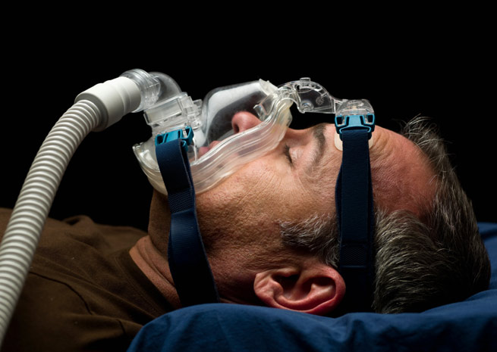
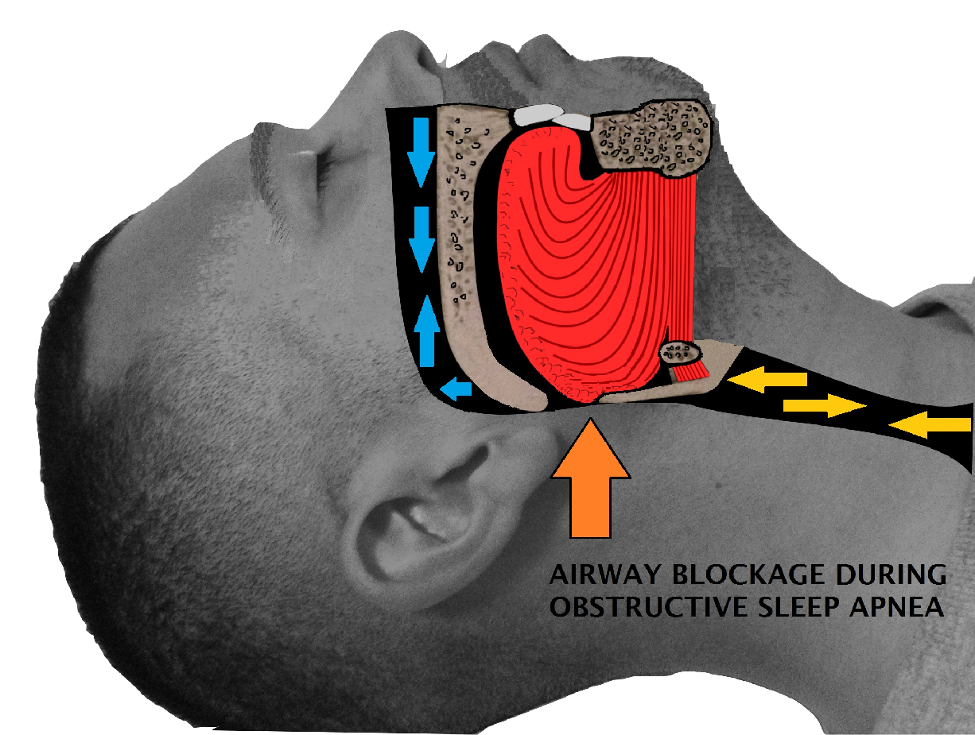
I. Sleep & Dreams
3. Sleep Disorders
CARBON
DIOXIDE
OXYGEN
SLEEP APNEA
A person stops breathing during their sleep.
- Wake up momentarily, gasps for air, then falls back asleep.
- Very common, especially in heavy males.
- Can be fatal
Notes:
Sleep Apnea: Apnea literally means “cessation of respiration.” It is a serious disorder, potentially life-threatening. In apnea, the change from wakefulness to sleep causes the central nervous system to cease functioning.
Two forms of apnea:
1. In central sleep apnea, after the individual falls asleep, the diaphragm stops moving because the brain no longer sends impulses to control it.
2. In upper-airway sleep apnea, breathing is blocked by loss of muscle tone in the tongue, throat, and larynx. Intermittent loud snoring frequently accompanies the disorder as the individual struggles to fill the lungs with air.
In addition, elevated blood pressure may occur, placing additional strain on the heart. After about 60 to 100 seconds of sleep, the person awakens and takes a series of choking breaths. As a rule, the arousal lasts a few seconds as the blood gases quickly normalize and the person returns to sleep. The cycle repeats itself throughout the night. Some patients may awaken as many as 500 times but may be so habituated to their disorder they are unaware of having awakened at all. They are oblivious to the fact that they cannot breathe and sleep at the same time. Others, however, do not return to sleep immediately after the apnea and complain of insomnia.
Treatment: Nasal CPAP (continuous positive air-way pressure) has proven successful with some victims. A fan provides a stream of air through a small plastic mask worn over the nose during sleep. Patients must sleep with the mouth closed, aided by a chinstrap. The forced air opens the constriction and allows a normal flow of oxygen into the lungs.
A Stanford surgical technique in which the large tongue muscle is pulled forward and away from the back of the throat has been successful.
A radio-frequency technology that shrinks tissue volume at the base of the tongue has also shown promise.
Sleep Disorders Summary: Laboratory studies indicate that these episodes occur in the first deep stage 4 sleep of the night and are generally associated with body movements and intense autonomic activation. Brainwave recordings indicate that both sleepwalkers and night terror victims are passing back and forth rapidly between sleep and wakefulness. Sleepwalking often occurs when people are very sleep deprived.
The night terror is typically accompanied by a blood-curdling scream that brings parents rushing to the child’s bed. The dazed and groggy child cannot report what is wrong. Typically, the child falls back to sleep more quickly than the parents and is normal the next day.
These non-REM sleep disorders tend to run in families. One patient claimed that everyone in his family was a sleepwalker. He recounted the story of a family reunion at Christmas in which he found himself surrounded by all his sleeping relatives in his grandfather’s dining room.

Slide 8
Share your images
Talk with a partner.
What did you draw to represent each disorder?
Steal images that help you remember the disorder.

