Slide 1
Bell Work 11/20—Page 28
Provide an example of Ike’s Massive Retaliation policy. Explain how it is an example | Provide an example of Ike’s Espionage policy Explain how it is an example
Notes:
Bell

Slide 2
1950’s Inventions

Slide 3
As a table, think of 5 new jobs that are created for each invention listed on your paper

Slide 4
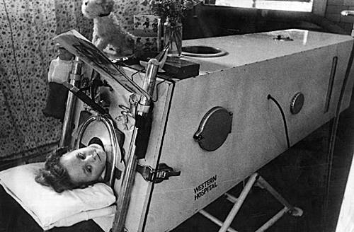
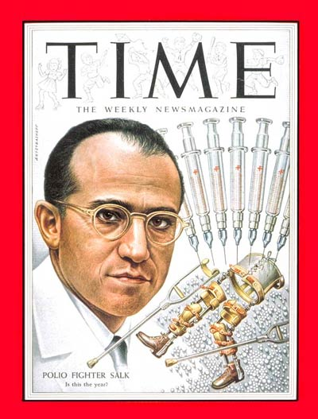
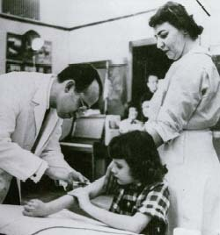
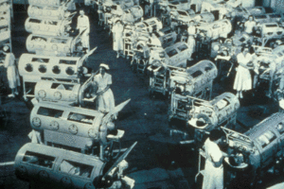
Medicine
Dr. Jonas Salk develops a vaccine against polio; advances in antibiotics and surgical techniques save countless lives.

Slide 5

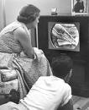
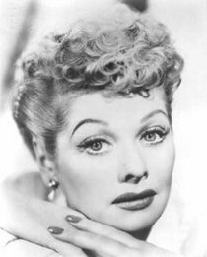
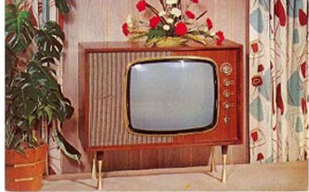
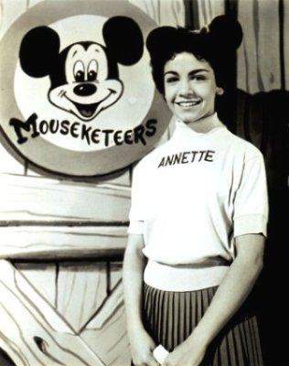
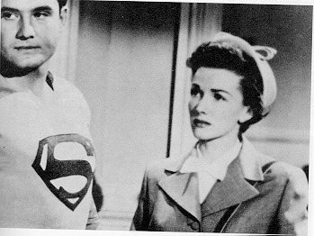

Television
Television becomes a popular and powerful medium.

Slide 6
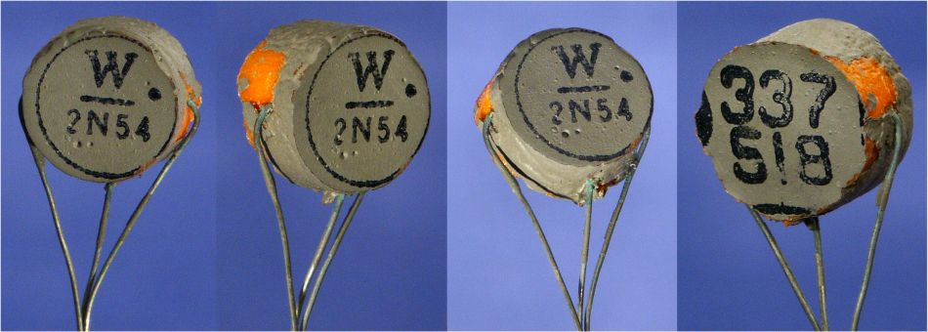
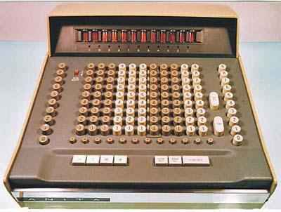
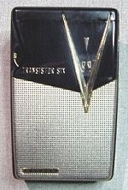
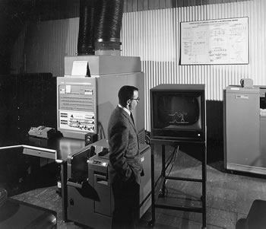
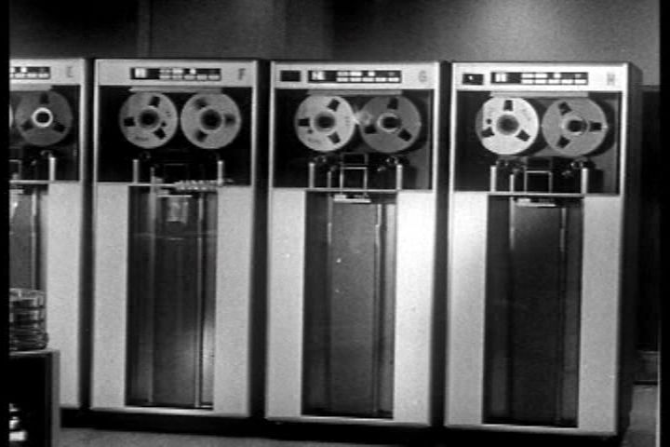
Computers and Electronics
The invention of the transistor, a tiny circuit device that amplifies, controls, and generates electrical signals, revolutionizes computers and radios.

Slide 7



Nuclear Power
Wartime nuclear research is put to peacetime use in nuclear power plants and nuclear-powered submarines.

Slide 8
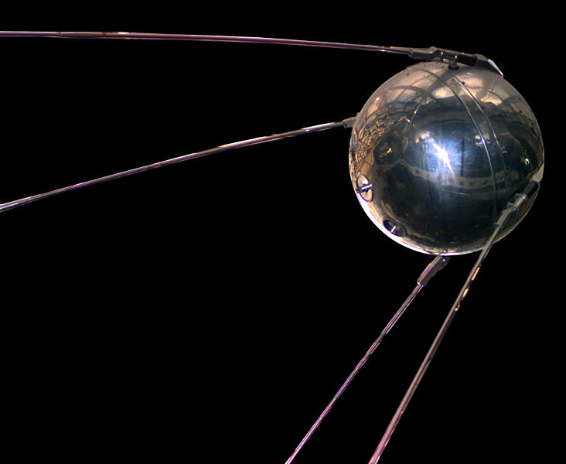
Sputnik
October 4, 1957
Means “Baby Moon”
First Satellite to orbit the Earth
  Won the Space Race!
Orbited every 96 minutes
  Later versions carried a dog!

Slide 9

US Response to Sputnik
1. NASA-Organized a space program for the country
2. NDEA-National Defense Education Act
  US would give billions for educating high-school students in Math and Science.

Slide 10
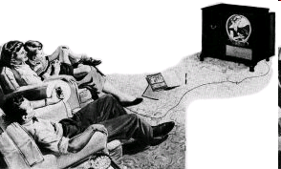
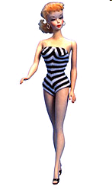
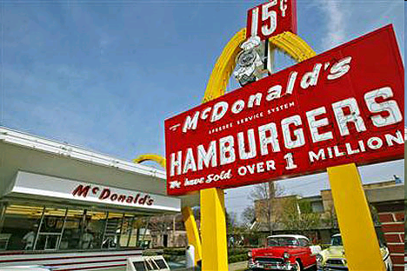

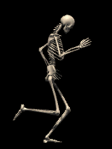


Interesting Inventions of the 1950’s
Barbie
McDonald’s
Computer
Transistor/Radio
Vacuum Tube
Polio Vaccination
Nuclear Power
Remote Control- plugged into TV
Answering machine
Super Glue
Mr. Potato Head
3-D Movies
Hair Spray
Plastic Grocery Bag
Instant Iced Tea
Saran Wrap
Nonstick Pan
Microwave Oven
Scotch-guard
Liquid Paper
Velcro
AA Batteries
Hula Hoop
Vinyl Band-Aid
Diet Soft Drink
X-Rays
Credit Cards
Frisbee

Slide 11

Effects of the Inventions

Slide 12
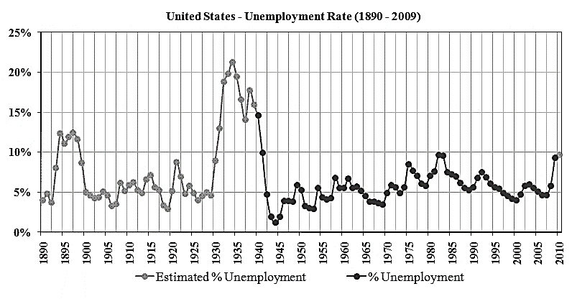
Low Unemployment

Slide 13
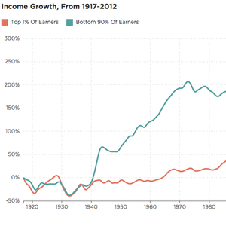
Low Unemployment = Higher Wages
Between 1945 and 1960, the average annual income per person, rose considerably.

Slide 14
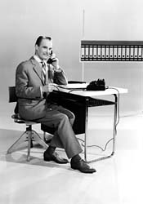
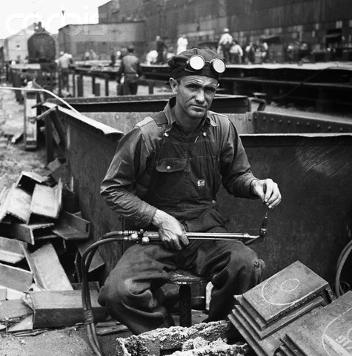
Changes in the Work force
White Collar Workers
Corporate expansion created more white-collar jobs.
Blue Collar Workers
New machines reduced the number of manual labor-intensive jobs.
Working conditions and wages improved.

Slide 15
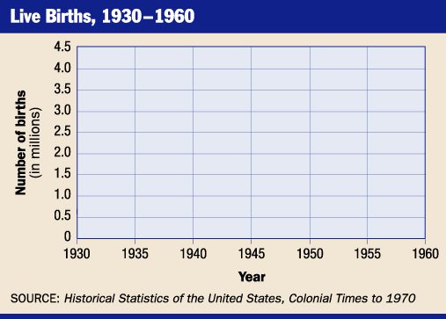
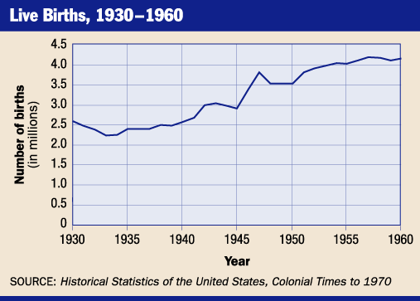
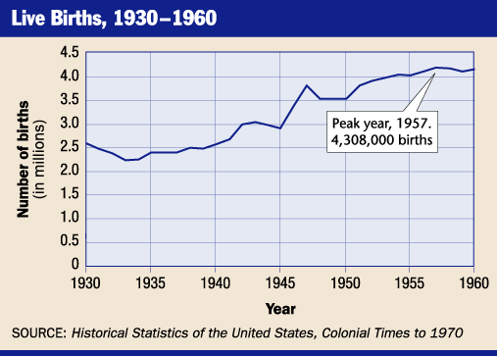
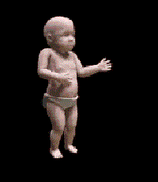
The Baby Boom
The baby boom, or rise in birth rates, that had begun in the 1940s continued into the 1950s.

Slide 16
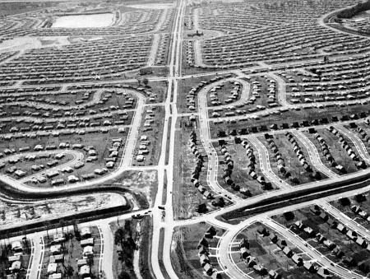
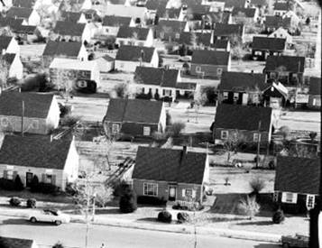
Suburbs
Suburban Growth
The GI Bill of Rights gave returning soldiers low-income mortgages, enabling many to buy homes in newly built suburbs.
  Residential community surrounding a city.

Slide 17
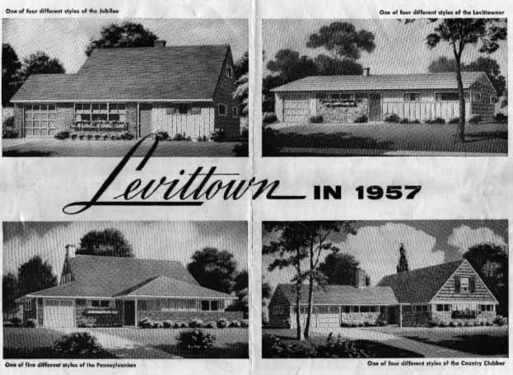
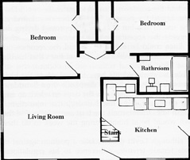
Levitt Towns
Developers such as William J. Levitt built entire communities quickly and on one mold, using preassembled materials.
Although most Americans enjoyed living in communities such as Levitt’s, others complained that the new developments lacked variety.

Slide 18
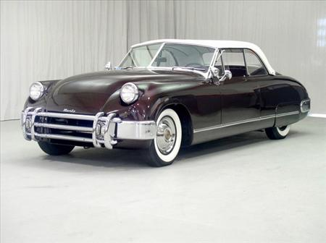
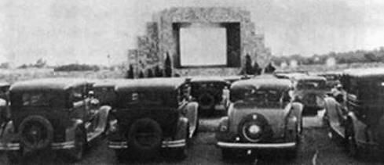
Cars and Highways
The growth of suburbs led more Americans to rely on cars for everyday transportation.
Cars became part of American culture as new businesses such as drive-in movies emerged.

Slide 19
B.W. 11/21
How did the Federal Aid Highway Act impact the economic boom of the 1950’s

Slide 20
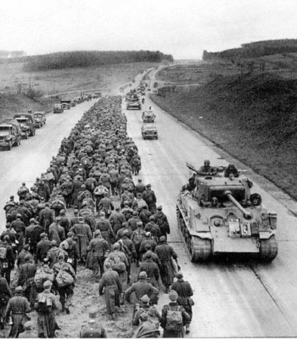
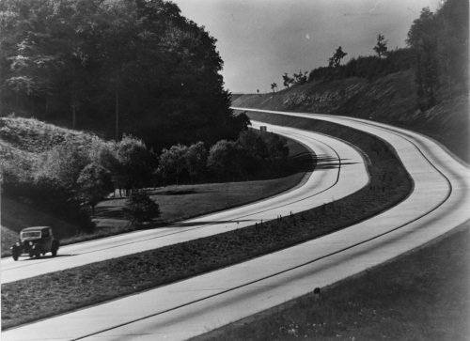
1956 Federal-Aid Highway Act
Inspired by the German Autobahn, Ike pushed for a bill the provided billions of dollars to build an interstate highway system.

Slide 21
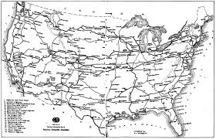
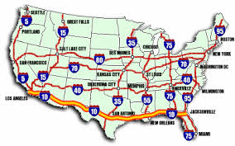

Slide 22
Interstate Highway Numbering
Numbers that are Even go East and West
  Ex: I-80, I-70, I-76
Numbers that are odd go North and South
  Ex I-79, I-95
Interstates that have 3 numbers are special!
An even number in front of an interstate means it connects in 2 places
  Ex: I-279, I-495
An odd number means that it connects in 1 place (Spur)
  Ex: I-579, I-376

Slide 23
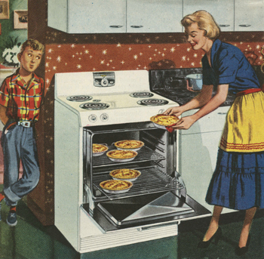
Social Conformity
Conform-to go along with the beliefs and ideas of the majority
Women were the “keepers of the suburban dream”

Slide 24



The good wife’s guide…

Slide 25
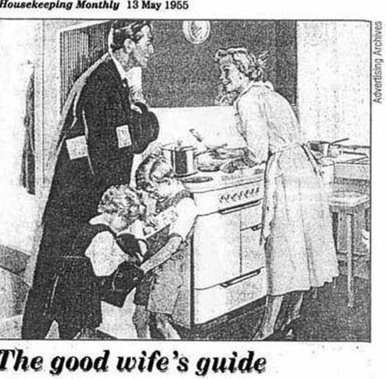
The following guide comes from a 1950s Economics textbook intended for high school girls preparing for married life.
It also was published in the magazine Housekeeping Monthly in May 1955

Slide 26
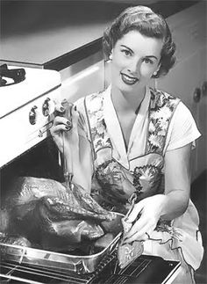
Have dinner ready. Plan ahead, even the night before to have a delicious meal ready, on time for his return. This is a way of letting him know that you have been thinking about him and concerned about his needs. Most men are hungry when they come home and the prospect of a good meal (especially his favorite dish) is part of the warm welcome needed.

Slide 27
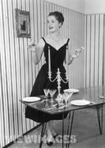
Prepare yourself. Take 15 minutes to rest so you’ll be refreshed when he arrives. Touch up your make-up, put a ribbon in your hair and be fresh-looking. He has just been with a lot of work-weary people.

Slide 28
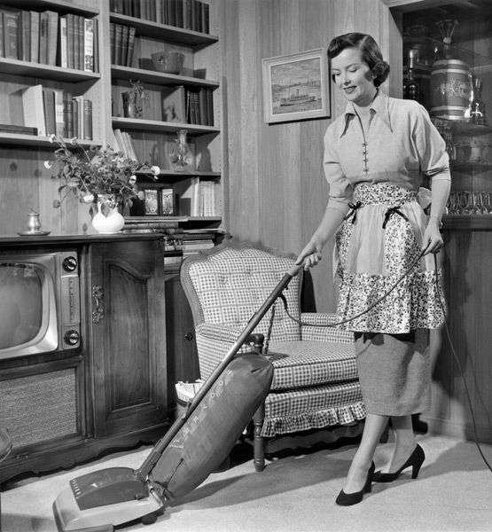
Clear away the clutter. Make one last trip through the main part of the house just before your husband arrives.

Slide 29
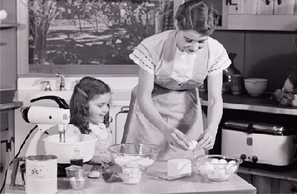
Prepare the children. Take a few minutes to wash the children’s hands and faces (If they are small), comb their hair and, if necessary, change their clothes. They are little treasures and he would like to see them playing the part. Minimize all noise. At the time of his arrival, eliminate all noise of the washer, dryer, or vacuum. Try to encourage the children to be quiet.

Slide 30
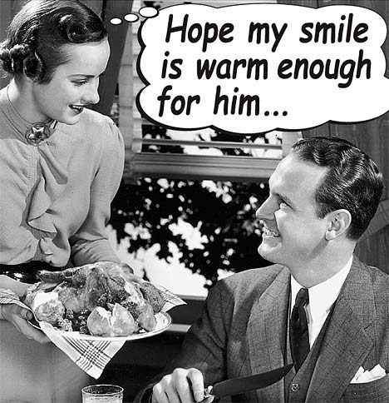
Greet him with a warm smile and show sincerity in your desire to please him.

Slide 31
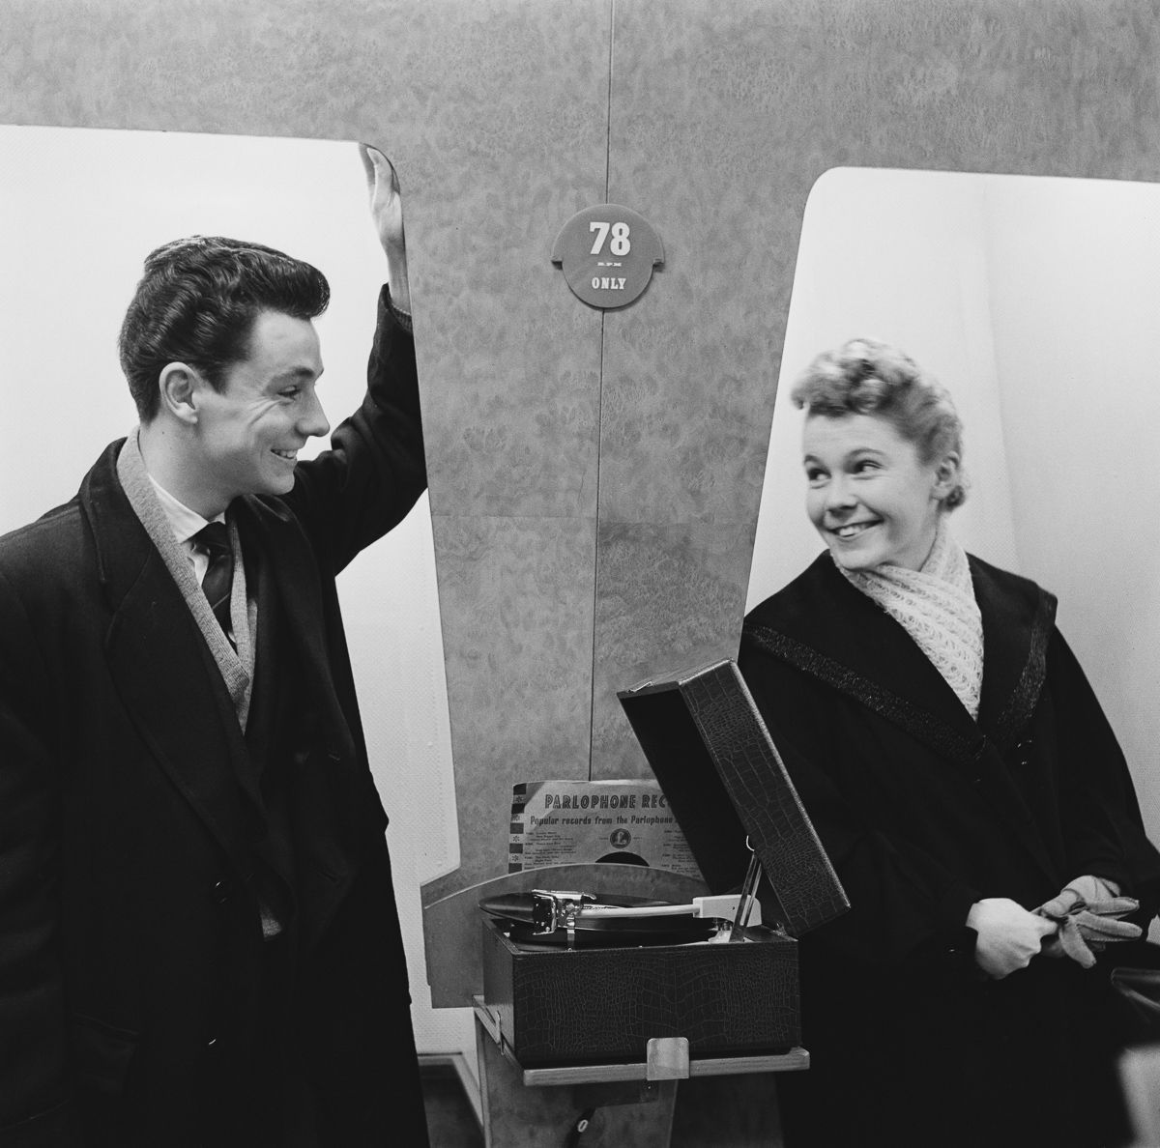
Listen to him. You may have a dozen important things to tell him, but the moment of his arrival is not the time. Let him talk first- remember, his topics of conversation are more important than yours.

Slide 32
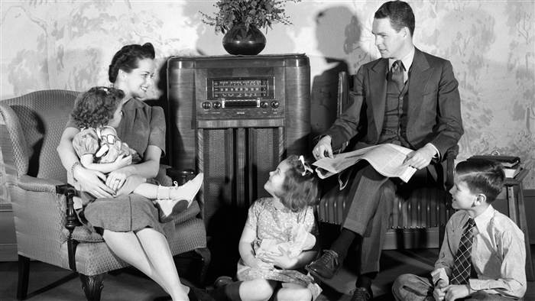
Make the evening his. Never complain if he comes home late or goes out to dinner, or other place of entertainment without you. Instead, try to understand his world of strain and pressure and his very real need to be at home and relax.

Slide 33
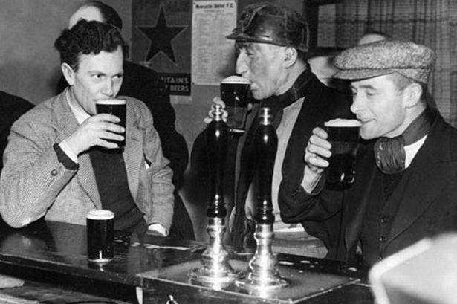
Don’t complain if he’s late home for dinner or even if he stays out all night. Count this as minor compared to what he might have gone through that day.

Slide 34
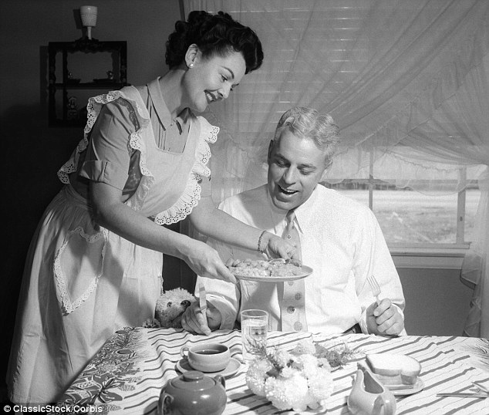
Arrange his pillow and offer to take off his shoes. Speak in a low, soothing and pleasant voice.

Slide 35
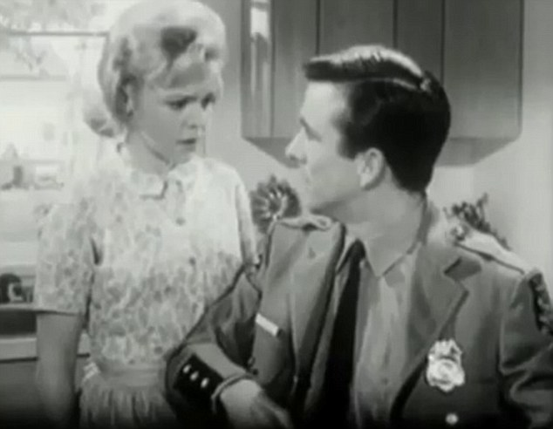
Don’t ask him questions about his actions or question his judgment or integrity. Remember, he is the master of the house and as such will always exercise his will with fairness and truthfulness. You have no right to question him.

Slide 36
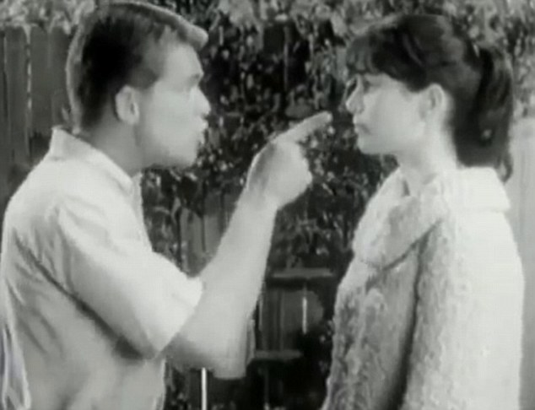
A good wife always knows her place.

Slide 37



Teens wore poodle skirts, saddle shoes, and ponytails.

Slide 38

Teens wore jeans with t-shirts and flat tops.

Slide 39

American Car Culture
After the rationing of WWII, inexpensive and plentiful fuel and easy credit led many to buy cars
By 1960, over 60 million Americans owned autos

Slide 40

The 1950’s Diner

Slide 41
Rebels
The Generation Gap
The generation gap was the cultural separation between children and their parents.

Slide 42


GREASERS
During the 1950s there was a rise in, juvenile delinquency— criminal behavior of youths.
While most teens did not participate in any illegal activity, teens were stereotyped, especially if they had long hair and dressed in an alternative manner they were known as greasers

Slide 43







Iconic Movie Stars
Clip

Slide 44


Birth of Rock ’n Roll
In the 1950s, many teenagers rebelled against the middle-class suburban values, particularly conformity and wanted to be unique.
It was during this period that many youths turned to new and unconventional styles of music
Soon white artists began making music that was based on African American rhythm and blues
This form of music became known as rock ‘n’ roll and it became wildly popular with the nation’s teenagers

Slide 45



Elvis Presley
The King of Rock ’n Roll
Presley’s extraordinary popularity established rock ’n’ roll as an unprecedented mass-market phenomenon
His reputation as a performer endured up to his death in 1977 at the age of 42.
Graceland, his home in Memphis, is now a public museum visited by upwards of 600,000 people annually.

Slide 46





Rock ’n Roll
Little Richard
Jonny Cash
Chuck Berry
Buddy Holly
Jerry Lee Lewis
Nicknamed “The Killer” for his outrageous on-and-off-stage antics. Song

Slide 47



Artistic Movement
A group of mostly white artists, who called themselves the beats, highlighted the values gap that existed in the United States in the 1950s.
In 1957 beat writer Jack Kerouac published On the Road. This book described freewheeling adventures with a car thief and a con artist. The book shocked readers but went on to become a classic in American literature.

Slide 48


Beatniks
The word may have come from the group feeling beat down by American culture.
Followers, called “beatniks”, tended to shun work and sought understanding through Zen Buddhism, music, and sometimes drugs
http://www.youtube.com/watch?v=Ba9yazkl0UE
Beatniks often performed poetry or music in coffeehouses or bars

Slide 49

Malvina Reynolds “Little Boxes” 1962
The song is a political satire about the development of suburbia, and associated conformist middle-class attitudes.
"Ticky-tacky" is a reference to the shoddy material used in the construction of the houses.
Song

Slide 50



End of an Era
“The Day the Music Died”
February 3, 1959
  23 year-old Buddy Holly, 17 year-old Ritchie Valens, and
  28 year-old J.P. “The Big Bopper” Richardson die in plane
  crash near Fargo, North Dakota
  Referenced to in Don McLean’s 1971 song, “American
  Pie.”
Clip Clip

