Slide 1
Abnormal Psychology
Theories of Psychopathy

Slide 2
Learning Targets
Agenda
Homework
DSM Reading Quiz (Open note)
Consequences of Labels
Think Like a Psychologist: What Causes Mental Illness?
Theories of Psychopathy Stations
I can demonstrate what I understand about the DSM with a quiz.
I can analyze different theories of psychopathy

Slide 3
DSM Open Note Quiz 1
What does DSM stand for?
The DSM considers environmental events, medical conditions and ________ ________ for behavior as part of the diagnostic criteria.
Today treating psychological disorders focuses on the use of_____________.
What disorder was hotly debated, but not included in the DSM-5?
Name one of the two therapies used 70 years ago for people with depression or schizophrenia.

Slide 4
DSM Open Note Quiz 2
What does DSM stand for?
What “disorder” do families in China send their sons away for treatment? (This disorder is not officially a disorder.)
What two things are in the DSM?
Do all criteria need to be met for a diagnosis to be made?
The DSM considers environmental events, medical conditions and ________ ________ for behavior as part of the diagnostic criteria.

Slide 5
DSM Open Note Quiz 3
What does DSM stand for?
When is a disorder an official disorder?
Why is the new disorder, Disruptive Mood Dysregulation Disorder (DMDD), concerning to the psychological community?
Do all criteria need to be met for a diagnosis to be made?
Today treating psychological disorders focuses on the use of_____________.

Slide 6
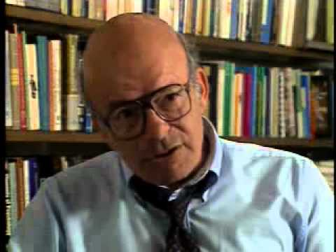
Consequences of Labels
Knowing provides hope and treatment options
Rosenhan effect
The label can determine how professionals perceive and react to person
Labeled person can begin to act differently - self-fulfilling prophecy
Stigmatization
Labels become stigmatized (Intellectual Development Disorder - Retarded - Idiot, Moron, Imbecile, Feeble Minded)
False stereotypes
Notes:
The DS<-5 provides the most up to date list and description of more than 250 psychological disorders. Each disorder has a label - a name- with symptoms and characteristics. Labels are convenient and efficient, but they “can be dangerous.
Benefits of labels
Target treatment
Help families with greater understanding/patience with troubling symptoms
Help families with hope/optimism - condition is known and can be managed
Dangers
Label can be predominant or prejudicial
1973 - Stanford University’s - “On Being Sane in Insane Places” David Rosenhan - he and seven other pseudopatients presented themselves to numerous psychiatric hospitals across the US with auditory hallucinations - hearing voices inside their heads saying - empty, dull and thud. No other symptoms. All admitted. After being admitted all were instructed to act normally, and no longer hear the voices. Longest stay 52, average 19. All diagnosed or labeled with schizophrenia. All discharged with schizophrenia in remission.
All pseudopatients reported feeling dehumanized - personal possessions randomly searched, observed while using the toilet
Denying that they had any illness to the staff was considered confirmation that they had an illness
Rosenhan demonstrated that
Once labeled the label itself can determine not only how professionals perceive and react to a person but also how the labeled persons themselves will begin to act differently - self fulfilling prophecy
Stigmatization
The label can be seen as a symbol of disgrace or dishonor for those labeled. One example is the disorder intellectual development disorder - used to refer to impairments of general cognitive or mental abilities. Used to be mental retardation, and before that idiot, moron, imbecile and feeble minded.
Culture contributes to the stigmatization of labels
False stereotypes - individuals with mental illness - are much less likely to exhibit violent than the average person. In fact, people with mental illness are much more likely to be victims of violence than those without a mental illness.

Slide 7
Think Like a Psychologist: What Causes Mental Illness?
Copy these questions.
Do the fields of psychiatry, neuroscience, and clinical psychology share an approach to understanding the the cause of mental illness?
What impact is a lack of shared approach likely to have?

Slide 8
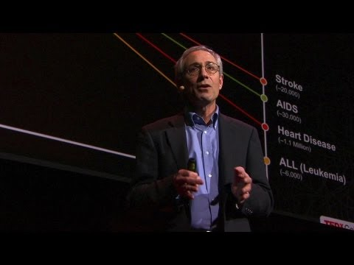
Think Like a Psychologist: What Causes Mental Illness?

Slide 9
Theories of Psychopathy Stations
Medical Model
Psychological Model
Psychodynamic Model
Cognitive Model
Humanistic Model
Diathesis-Stress Model
Socio cultural Model
Etiology - cause, set of causes or manner of causation of a disease or condition.
Notes:
During the last hundred years, a number of models or theoretical approaches have been introduced that attempt to explain the causes, or etiology, of psychological disorders. Most mental health professionals today do not rely exclusively on one approach. Instead , they use an eclectic or broad-based approach, trusting a combination of established approaches to diagnose and treat individuals with psychological disorders.

Slide 10
Theories of Psychopathy Stations
At each station complete the following:
Read the handout.
Work with your partner to make a one sentence description and symbol for each psychopathy.
Complete the Chart for each Psychopathy:
Name of Psychopathy | One sentence description | A Symbol to represent the Psychopathy | Any extra information you want to include

Slide 11
Theories Psychopathy Stations - Practice
Let’s do one together - Psychopathy: Sociocultural Model.
Read.
Highlight key information.
Underline claims.
What could be one sentence to describe this model. Look at the words you highlighted and claims you underlined.
Example - This model considers how one’s environment impacts them; what one culture may experience may not replicate in another culture.
Symbol?
Extra Information?
Cultural Relativism

