Slide 1
Welcome!
HW: Module 3 Outline
Upcoming: Notebook Due (all homework due) at the beginning of class on 09/17-18. Unit 1 Test 09/17-18.

Slide 2
09/10: Approaches
Levels of Analysis Notes
Approaches Posters
Describe psychology’s three main levels of analysis and related perspectives

Slide 3
Practice
Psychiatrists differ from psychologists in that they
a. help people cope with challenges and crises.
b. conduct research.
c. explore how we view and affect one another.
d. experiment with how people perceive, think, and
solve problems.
e. are medical doctors licensed to prescribe medication.
Notes:
E

Slide 4
Practice
Betsy works in a human resources department. She plans
training sessions, recruits people to work for the company,
and implements techniques to boost morale around the
office. Of the following, Betsy is most likely a(n)
a. developmental psychologist.
b. personality psychologist.
c. counseling psychologist.
d. educational psychologist.
e. industrial-organizational psychologist.
Notes:
E

Slide 5
Unit 01 - Overview (2-4%)
Psychology’s History (Today)
Psychology’s Big Issues and Approaches (Today, 09/10)
Careers in Psychology (On your own)
Unit Test: Wednesday 09/17-18

Slide 6
Prescientific Psychology
Ancient Philosophers
Socrates and Plato: mind and body are separate and the mind continues after the body dies.
Aristotle: knowledge isn’t preexisting, it grows from experiences and memory.

Slide 7
Scientific Psychology
2. Modern Science Begins
John Locke: tabula rasa - “a blank slate.”
Created EMPIRICISM: knowledge originates in experience, we should rely on observation and experimentation.

Slide 8
Modern Psychology
3. Psychology is now defined by current scientists as the, “science of behavior and mental processes.”

Slide 9
Levels of Analysis

Slide 10
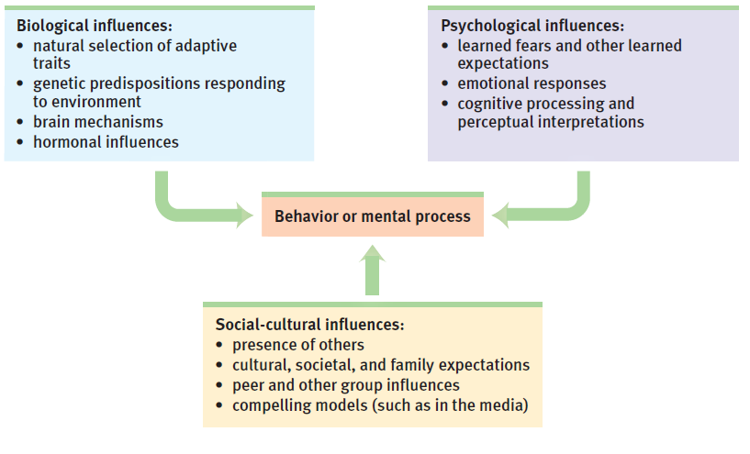

Slide 11
Practice: As a group, come up with a behavior and walk through explaining that at a biological, psychological, and social-cultural level.

Slide 13
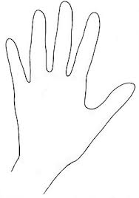
Psychological Perspectives - Psychoanalytic or Psychodynamic
THUMB: Psychoanalytic or Psychodynamic
Emphasis - unconscious mental processes, early childhood development, personality, attachment patterns, relationships
Freud - believed your childhood and the way you were raised by your mother was a primary influence. (Thumb is used because babies suck their thumb)
Freud

Slide 14
Psychological Perspectives: Biological
POINTER FINGER: Biological
Emphasis: the brain and nervous system
sometimes referred to as medical or neuroscience.
This is about brain structure and how heredity affects behavior. They study the edocrine system and how biology affects behavior and mental processes. (We use our pointer finger to point to the brain)
Brain

Slide 15
Psychological Perspectives: Behaviorism
Punish
MIDDLE FINGER: Behaviorism
Emphasis: role and influence of environment and previous learning to understand behavior
Watson, Skinner
Behaviorism is all about choices. Sometimes we make poor ones…hence middle finger.

Slide 16
Psychological Perspectives: Humanism or Existenial
RING FINGER: Humanism or Existential
- Emphasis - Each person is unique and makes choices
- Rogers, Maslow.
- Unconditional positive regard, acceptance.
Personal experience.
Ring finger as a reminder-Marriage
Personal Experience

Slide 17
Psychological Perspectives: Cognitive
BABY FINGER: Cognitive
Emphasis: how we mentally process information
How do we perceive and mentally represent the world?
Deals with perception, sensation, memory, intelligence, language, thought and problem solving.

Slide 18
Psychological Perspectives: Sociocultural
PALM OF HAND: Sociocultural
Emphasis - how do social and cultural factors affect behavior.
Studies ethnicity, gender, culture and socioeconomic status and how they affect behavior and mental processes.
(We hold onto these.)

Slide 19
Psychological Perspectives: Evolutionary
ARMS AND TRUNK: Evolutionary
Emphasis: How the natural selection of traits has promoted the survival of genes.
Behaviors are adaptable in order to continue the species (Wrist is the trunk of evolution)

Slide 20
Psychological Perspectives - Buttons!
Biological Perpective
What hormones and chemicals were pumped into your system to make you afraid of buttons?
Psychodynamic/analytic
In my past maybe when I was little I was kidnapped and all you can remember is the buttons on the man’s shirt and so you are now afraid of buttons.
Why might I have these fears?

Slide 21
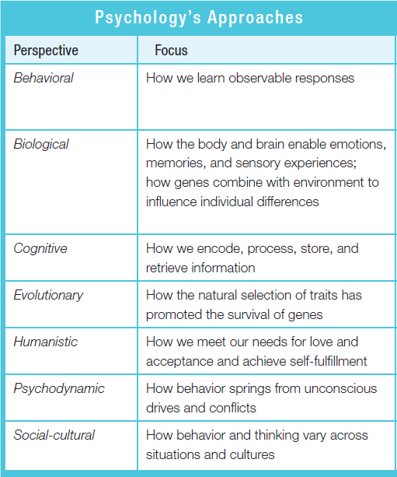
Buttons Fear

Slide 22
Expert Groups
In last column, you will use each perspective to explain my fear of buttons.
Within your group, read through the section on the psychological approach.
Together, your group will be making a chart to explain the approach to the class. Include a symbol clue for each
Make sure if your explanation includes any psychologist to list them on the poster!!!

