Slide 1
Abnormal Psych and Therapy
5. Psychological Therapies

Slide 2
Do Now
Read scenarios 1 - 8 on your table.
Using the description and the list of disorders determine what disorder each person may have.
Be ready to share your answers.

Slide 3
Essential Question:
To what degree are psychotherapeutic approaches similar and different regarding philosophy, techniques and effectiveness?

Slide 4
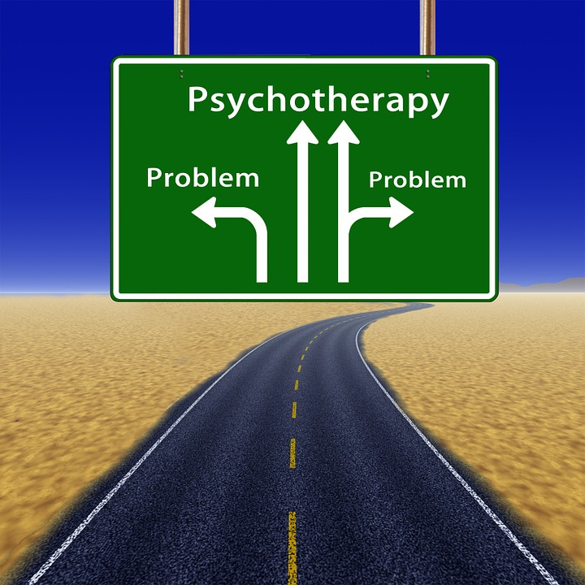
Treatment and Approaches and Modes
Psychotherapy - treatment of mental health problems through interaction between trained psychologists and those seeking help.
Eclectic approach - using a ideas from a variety of approaches
Notes:
There are many approaches to treatment
Some are more effective at treating anxiety issues such as social phobia
Many mental professional use an eclectic approach - taking ideas from a variety of both psychological
Four Approaches - psychodynamic, humanistic, behavioral and cognitive

Slide 5
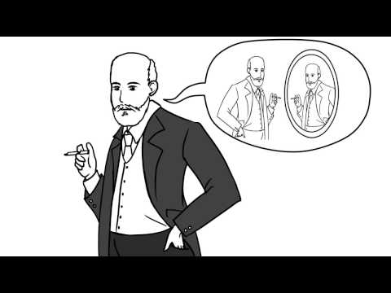
Treatment and Approaches and Modes
Psychodynamic Approach - gain insight by tapping into the unconscious
Freud - Psychoanalysis (dev. 1890s)-
Create a trusting environment
Based on neurosis
Notes:
In traditional psychoanalysis
Two to three session a week
Up to 7 years
Patient reclines on the couch while the psychoanalyst sits out of direct view, listening carefully and taking notes
It is an unequal partnerships with the psychoanalyst in a superior expert role
Based on neurosis - mental problems in one’s conscious life, stems from long-repressed childhood memories, trauma, feelings, or libidinal urges involving the Id.

Slide 6
Treatment and Approaches and Modes
Psychodynamic or Humanistic Approach continued
Insight Approach - central goal to help patients or clients gain insight into the underlying causes of their mental illness and use improved self-awareness to resolve psychological problems

Slide 7
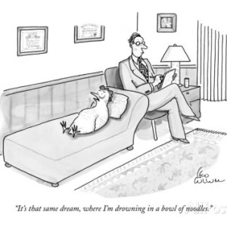
Treatment and Approaches and Modes
Psychodynamic approach continued
Two main techniques
Free association - patient is encouraged to say whatever come to mind
Dream analysis -
Manifest content
Latent content
Notes:
Free Association
Trust imperative
As trust increases the patient’s ego will lower its guard so that the true nature of the unconscious will begin bubbling up to the surface for the psychoanalyst to interpret and determine meaning
Dream analysis
Those who still practice strict Freudian psychoanalysis
What is consciously remember in a dream (manifest content) are symbolic representations of the unconscious forces, urges or conflicts (latent content). Job of a patient is to report the manifest content, and psychoanalysis determine the latent meaning.

Slide 8
Treatment and Approaches and Modes
Psychodynamic approach continued
Therapeutic rapport - trusting relationship with a therapist essential to overcoming resistance.
Transference - patient transfers his or her emotional issues unconsciously to the therapist and develops feelings(+/-) for therapist
Countertransference - therapist experiences an unconscious emotional response to the patient
Catharsis - intense emotional release
Notes:
A typical example of transference
Patient begins to relate to the therapist as a parent figure
The therapist must detect when transference is happening and in an emotionally neutral manner communicate to the patient that it is taking place then help the patient understand what it reveals.

Slide 9
Treatment and Approaches and Modes
Psychodynamic Therapies
Interpersonal psychotherapy - focuses on improving existing relationships. Used primarily with depression
Object Relations Therapy
Object = Significant Person in Client’s life
Relation = Emotional Problem Stemming from the relationship
Note: Therapist will often develop a nurturing/intense relationship
Notes:
Traditional Freudian psychoanalysis is not often used now for a number of reasons.
Psychodynamic therapies evolved from Freud’s original approach but today have much less emphasis on the id or superego and even less reliance on the central idea of sex or animalist aggression as an underlying unconscious impulse.
Instead, a psychodynamic therapist, though still bleeding strongly in the unconscious influences of the mind, will conduct therapy face-to-face, focusing more on current relationships.
Psychodynamic therapy usually only requires a once-a- week session with a total length measure in months, not years.
Psychoanalysis is not used much today
Lacks empirical research supporting its efficacy
Dream interpretations are extremely subjective
Can form a dependency on your therapist

Slide 10
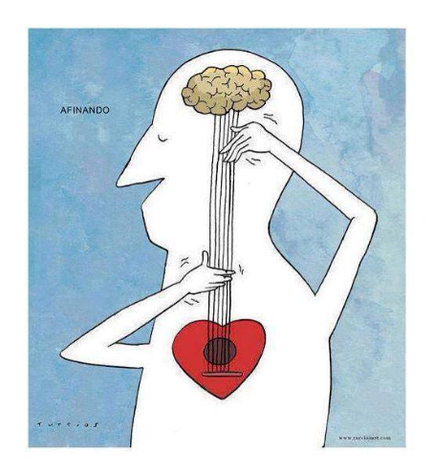
Treatment and Approaches and Modes
Humanistic Therapies
see people as fundamentally good
Goal: to get people to accept themselves
Focus: present and future

Slide 11
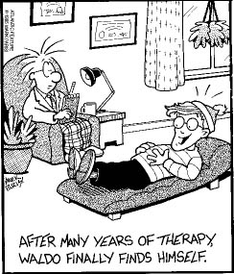
Treatment and Approaches and Modes
Humanistic Therapies
Person-Centered or Rogerian Therapy or Client- Centered
Carl Rogers - humans possess a fundamental drive to fulfill their potential
Therapist = non judgmental facilitator, no advice or interpretation
Four principles
Unconditional positive regard
Empathy
Congruence
Active Listening (reflection)
Notes:
Rogers believed a person's psychologically trouble life was caused by the divergence of the real self for the ideal self.
If a child’s upbringing is consumed by condition of worth, the child will lose the sense of his or her real self and become emotionally trouble in the ideal self as an adult.
The end result is a person who suffers emotionally from the loss of self, and this suffering can take many forms.
Four principles:
Unconditional positive regard - intended to reinforce to clients that they have value for who they really are. The client will steer the therapy, and it will be nondirective
Empathy - Show the deepest level of understanding through empathy - truly see, hear, feel and understand what the client is feeling
Congruence - honor an open, honest relationship with the patient.
Active Listening -

Slide 12
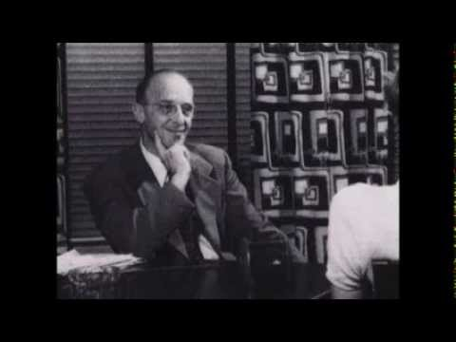
Treatment and Approaches and Modes
Client Centered Approach
**Click on the image to the right to get to the video link

Slide 13
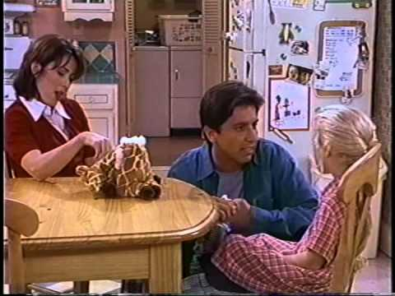
Treatment and Approaches and Modes
Example of Active Listening
**Click on the video link

Slide 14
Treatment and Approaches and Modes
Humanistic Therapies
Gestalt Therapy (Developed by Frederick and Laura Perls)
Focus: Client’s perceptions of their own feelings/sense of reality
Experiential and therapist-directed.
Empty Chair Technique - a dialog with a feeling they are having
Exaggeration - exaggerate a feeling to understand where it is coming from.
***Click on the video link
Notes:
The term gestalt (from the German word for “shape” or “form”) refers to the ability to perceive that the whole is greater than the sum of its parts.
Based on the belief that troubled people have lost a sense of their own wholeness and become stranger to aspect of their personality.
When people lose awareness of aspect of themselves they lose their ability to grow; they’ve become trapped behind a mask.

Slide 15
Treatment and Approaches and Modes
Behavior Therapies
Exposure Therapy (dev. By Mary Cover Jones 1924)
Use Classical Conditioning - pair a pleasant stimulus with the unpleasant stimulus - fear gone!
Joseph Wolpe developed a systematic desensitization.
Client practices deep relaxation.
Client created hierarchy of anxieties
Exposed to fear systematically
***Click on the video link on the right
Notes:
Insight Therapies assume that withimporves self-awareness comes a resolution of psychological problems.
In contrast action therapies therapies focus on providing practical solutions and teaching coping skills to help resolve psychological problems. Behavioral therapy and cognitive therapy are the most widely used action therapies.
Behavioral psychology is based on the theory that all human behavior- healthy and unhealthy - is learned. So behavioral therapy uses classical conditioning or operant conditioning to help clients unlearn maladaptive behaviors and replace with more adaptive or healthy behaviors.

Slide 16
Treatment and Approaches and Modes
Behavioral Therapy (continued)
Aversion Therapy
Unwanted behavior is associated with a stimulus to which the client has a great aversion.
**Click on the “Friends” video link to the right

Slide 17
Treatment and Approaches and Modes
Behavioral Therapy
Operant Conditioning (BF Skinner)
Learning voluntary behaviors results from positive or negative reinforcement or punishment
**Click on the video link on the right
Notes:
Example, intellectually disabled children or children with autism spectrum disorder or institutionalized adults can learn more appropriate social behaviors and life skills by being positively reinforced each time they display an approximate behavior or by being punished when they display undesirable behaviors.

Slide 18
Treatment and Approaches and Modes
Behavioral Therapy
Token economy systems
Tokens are earned for desired behaviors and exchanged for rewards
Often used in prisons, psychiatric hospitals or schools.
Modeling
Therapists demonstrate desired behavior to help clients learn behavior

Slide 19
Treatment and Approaches and Modes
Cognitive Behavioral Therapy - action therapy that believes that cognition leads to emotional responses and behavior
Situation
Thoughts
Emotions
Behavior
Guiding principle - psychological problems are caused by maladaptive thought processes
Notes:
Situation - Triggering Event - Overslept on day of final exam
Thoughts - Cognition - “I’m going to fail this class and lose my scholarship”
Emotions - Feelings - panic, dread, anger, remorse, guilt
Behavior - physiological response and action - increased heart rate, sweating avoids class

Slide 20
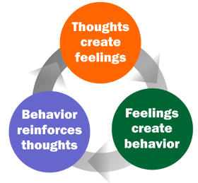
Treatment and Approaches and Modes
Cognitive Behavioral Therapies
Rational-Emotive Behavior Therapy (Albert Ellis)
Most psychological problems are based on irrational thoughts
Awfulizing - tendendency to irrationally overestimate or exaggerate a situation or event

Slide 21
Treatment and Approaches and Modes
Negative Views
“The world is a bad place, and I’m on my own.”
Cognitive Behavioral Therapy
Aaron Beck’s Cognitive Therapy
Helps depressed clients recognize dysfunctional cognitive distortions.
Cognitive distortions
Catastrophizing
All-or-none thinking
Personalization
Negative Views Of Self
“I’m bad at everything.”
Negative Views Of the Future
“I’ll never be successful at anything.”
Notes:
Today used for anxiety, eating and personality disorders.
Catastrophizing - If I don’t earn a 5 on my AP exam my life will be ruined
All or None Thinking - He didn’t call me back; I must be a loser
Personalization - The teacher did not call on me because she hates me
Used with depression, bipolar, anxiety, personality, drug dependency, smoking cessation, and some schizophrenia (delusional thinking and hallucinations)

Slide 22
Treatment and Approaches and Modes
Modes of Therapy
Group Therapy - 6 - 12 people come together under the direction of a counselor
Self-Help Groups - individuals come together without a facilitator (Alcohol Anonymous)
Family Therapy - family systems theory - every family member affects every other family member
Notes:
Group therapy can be a vital element to mental healing - knowing you are not alone. In a small group 6 -12 people with similar problems come together under the direction or facilitation of a trained therapist or counselor to discuss their psychological issues.
Benefits - not alone, counselor can monitor interactions and encourage healthy behaviors, and help them gain coping skills
Less expensive
Self Help - AA - 12 step program, with a sponsor who each individual can call for support
Duplicated by Narcotics Anonymous, Gamblers Anonymous, Overeaters Anonymous, Alzheimer’s support, depression, anxiety, anger management and families of ADHD children
Family Therapy

Slide 23
Homework
Time to start your homework -
Read Biomedical Approach and take some notes.

