Slide 1
Abnormal Psychology

Slide 2
Learning Target
Agenda
Complete Pscyhotherapy notes
How can we improve mental health in our community?

Slide 3
Biomedical Approach Quiz
Medications used to treat psychological disorders are called ____________________________, and are most effective when used in conjunction with therapy.
Electroconvulsive therapy is used in serious cases of depression and in cases of schizophrenia. It causes a seizure that in turn causes the brain to release a significant amount of _______ that immediately improve mood.
Psychotropic drugs reduce the symptoms but do not _____ the illness.
Long term use of psychotropic drugs can result in _____ ______ , a neurological disorder characterized by uncontrolled facial and tongue movments or arm or leg movements.
When can psychologists break patient doctor confidentiality?
Notes:
Psychotropic drugs
Neurotransmitters
Cure
Tardive dyskinesia (TD)
When the paitent poses a risk to the community or themselves or when a court orders the records be released

Slide 4
Are you struggling to see the difference between Rational-Emotive Behavior Therapy and Cognitive Therapy?
Cognitive Behavior Therapy
Think about a guy who avoids going out socially because he is afraid that he might not fit in and people won’t like him. The therapist asks questions like
how do you know you won’t fit it or be liked?
Can you think of similar situations where you were liked or you did fit in?
Maybe this time things will be different?
What are some of your strengths that people would notice and
Focus is getting the client to believe that if he did go out, he would likely be successful in that at least some people would probably like him.
Notes:
One key is between REBT and CBT is that CBT is usually focused on individuals working on what Dr. Albert Ellis called, the “inelegant” solution whereas REBT is mostly focused on individual’s working on the “elegant” solution.
Here is a practical example to understand the difference:
Think about a guy who avoids going out socially because he is afraid that he might not fit in and people won’t like him. In CBT, the therapist asks questions like how do you know you won’t fit it or be liked? Can you think of similar situations where you were liked or you did fit in? Maybe this time things will be different? What are some of your strengths that people would notice and like?” etc. As you can begin to see, the focus is getting the client to believe that if he did go out, he would likely be successful in that at least some people would probably like him.
In REBT, the client would be asked, “So let’s suppose that you did go out and you didn’t fit in that well and no one liked you. What is so AWFUL about that? Do you need to base how you feel about yourself on what others think about you? Could you imagine just being disappointed rather than a major catastrophe if your worst concerns about going out turned out to be true? As you can begin to see, REBT seeks to attack the underlying negative core beliefs associated with the individual’s sense of self worth.
Another key difference between Rational Emotive Behavior Therapy and Cognitive Behavior Therapy is the forcefulness modeled by the therapist in challenging negative beliefs and the encouragement of the client to similarly practice very forceful and passionate disputing of the negative beliefs. For example, strongly and loudly say something like “I prefer but never NEED the love, acceptance or approval of others.” “Whenever I don’t get what I really want, it is disappointing but NEVER AWFUL”.
These are but two keys examples of the differences between Rational Emotive Behavior Therapy and Cognitive Behavior Therapy.

Slide 5
Are you struggling to see the difference between Rational-Emotive Behavior Therapy and Cognitive Therapy?
Rational Emotive Behavior Therapy
Therapist Asks
- So let’s suppose that you did go out and you didn’t fit in that well and no one liked you. What is so AWFUL about that?
- Do you need to base how you feel about yourself on what others think about you?
- Could you imagine just being disappointed rather than a major catastrophe if your worst concerns about going out turned out to be true?
Focus is to attack the underlying negative core beliefs associated with the individual’s sense of self worth.
Notes:
One key is between REBT and CBT is that CBT is usually focused on individuals working on what Dr. Albert Ellis called, the “inelegant” solution whereas REBT is mostly focused on individual’s working on the “elegant” solution.
Here is a practical example to understand the difference:
Think about a guy who avoids going out socially because he is afraid that he might not fit in and people won’t like him. In CBT, the therapist asks questions like how do you know you won’t fit it or be liked? Can you think of similar situations where you were liked or you did fit in? Maybe this time things will be different? What are some of your strengths that people would notice and like?” etc. As you can begin to see, the focus is getting the client to believe that if he did go out, he would likely be successful in that at least some people would probably like him.
In REBT, the client would be asked, “So let’s suppose that you did go out and you didn’t fit in that well and no one liked you. What is so AWFUL about that? Do you need to base how you feel about yourself on what others think about you? Could you imagine just being disappointed rather than a major catastrophe if your worst concerns about going out turned out to be true? As you can begin to see, REBT seeks to attack the underlying negative core beliefs associated with the individual’s sense of self worth.
Another key difference between Rational Emotive Behavior Therapy and Cognitive Behavior Therapy is the forcefulness modeled by the therapist in challenging negative beliefs and the encouragement of the client to similarly practice very forceful and passionate disputing of the negative beliefs. For example, strongly and loudly say something like “I prefer but never NEED the love, acceptance or approval of others.” “Whenever I don’t get what I really want, it is disappointing but NEVER AWFUL”.
These are but two keys examples of the differences between Rational Emotive Behavior Therapy and Cognitive Behavior Therapy.

Slide 6
Treatment and Approaches and Modes
Modes of Therapy
Group Therapy - 6 - 12 people come together under the direction of a counselor
Self-Help Groups - individuals come together without a facilitator (Alcohol Anonymous)
Family Therapy - family systems theory - every family member affects every other family member
Notes:
Group therapy can be a vital element to mental healing - knowing you are not alone. In a small group 6 -12 people with similar problems come together under the direction or facilitation of a trained therapist or counselor to discuss their psychological issues.
Benefits - not alone, counselor can monitor interactions and encourage healthy behaviors, and help them gain coping skills
Less expensive
Self Help - AA - 12 step program, with a sponsor who each individual can call for support
Duplicated by Narcotics Anonymous, Gamblers Anonymous, Overeaters Anonymous, Alzheimer’s support, depression, anxiety, anger management and families of ADHD children
Family Therapy

Slide 7
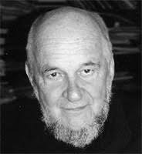
“If we are interested in the prevention of mental- emotional disorders, we must change those social conditions that produce these disorders.”
George Albee

Slide 8
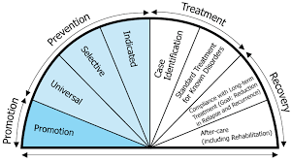
Brainstorm/Discuss: To what degree can our community mental health and preventative programs reduce the prevalence of mental illness?
COMMUNITY MENTAL HEALTH
Culturally Competent
Gender Competent
Community Based Support Programs
PREVENTATIVE
Social Determinants
Resilience
Continuum of Care
Parenting and Family Support
Notes:
APA includes specific guidelines to promote better cultural competence in the field:
Therapist needs to be self aware - aware of biases
Knowledge of the client’s cultural context
Knowledge of the persoanl factors unique to the client
Knowledge of appropriate interventions
Gender competence - ability to provide effective treatment by recogniing and effectively responding to the influence of gender factors in teh therapeutic relationship.
I.E. In Western Cultures, such as US, women are culturally trained to express such emotion as sadness and fear while males are taught to repress such emotions. Consequently how we express depression is different between the two genders.
Since the 1950s they started to deinstitutionalize Mental health care.
The 1963 Community Mental Health ACt marked a national shift toward establishing community mental health centers across the nation.
Community Support Programs comprise a sytstem of treatment ofthe severly mentally ill using a case maanger who coordinates the services and treamtents that each client needs to acive or maintain healhty funcitoning in their community.
Assertive Community Treatment teams provide specialized support, treatment and whatever else is needed to enable the person to achieve and maintqin community integration adn to prvent homelessness or rehospitalization. It includes:
Psychotropic drug management
Assertive community treatmnet
Employment support
Family support
Treatment for co-occuring disorders
Recovery orientation
Assissted outpatient treatment - civil court order requireing commmunit ymental health services. These choudl be court orded treatment plan tusually include psychiatric med and or attending treatment sessions.
AOT - In New York this is called Kendra’s Law - a Man with schizophrenia who was medicated for the disorder killed a woman name Kendra by pushing her ont othe path of a subway train. The state of NEw York passed Kendra’s Law to require psychiatric treatment fo rpeople with severe mental illness as condition for living in their community.
Assessing Community Mental Health
20 - 25% homeless suffere severe mental illness.
Some argue psychiatric facilities are replaced by the streets or jails.
Often - comorbidity - two or more psychological disorders at once. Substance abuse is often teh common disorder amont pwople with severe mental illness, and this factor has contributed to a dramatic increase in incarceration.
pREVENTATIVE
Social Determinants - factors such as poverty, violence, economic and political inequality, and even social media are associated with a rise in mental illness.
REsilence - ability of the individuals or communities to absorb the trauma associated with an event or crisis and essentially bounce back.
Crisis centers
Crisis hotlines
Continuum of Care
Parenting and Family Support

Slide 9
After this slide there are some bonus videos that a few of you asked for:
They provide you with a video about some of the disorders you could see on Monday’s test
*** If there is ever anything you want another resource to understand let me know.

Slide 10
Howie Mandel Talks About Living with OCD

Slide 11
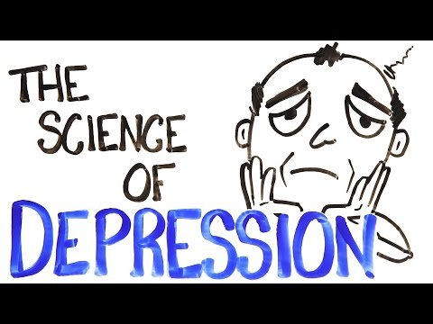
The Science of Depression

Slide 12
Personality Disorder

Slide 13
Bipolar Disorder

Slide 14
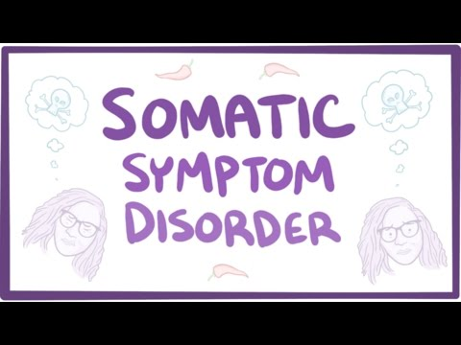
Somatic Symptom Disorder

Slide 15
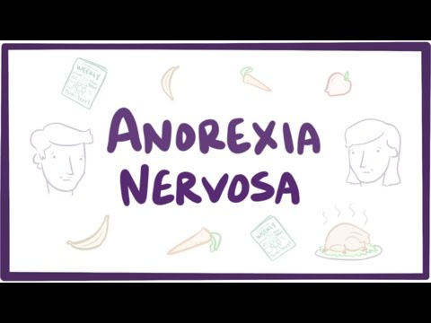
Eating and Feeding Disorders

Slide 16
There’s No Shame in Taking Care of Your Mental Health

