Slide 1
LEARNING TARGETS
We will…
-define and introduce SENSATION AND PERCEPTION
-take notes how we process VISUAL STIMULI

Slide 2
Introduction to Sensation and Perception Notes
Notes

Slide 3
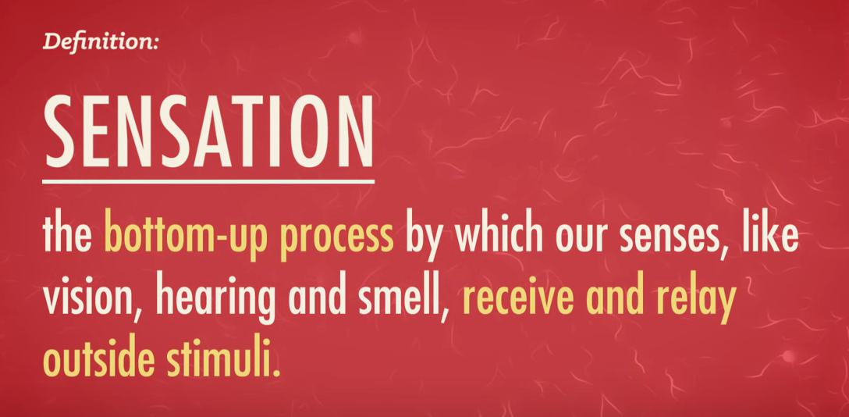

Slide 4
Crashcourse: Sensation and Perception Notes
https://www.youtube.com/watch?v=unWnZvXJH2o

Slide 5
Introduction to Sensation and Perception

Slide 6
Essential Question
How do people use their senses
to understand the
world around them?

Slide 7
Bottom-Up (information) Processing: begins with the sensory receptors and works up to the brain’s integration of sensory information
Top-Down (information) Processing: guided by higher-level mental processes (when draw on our experience and expectations
3

Slide 8
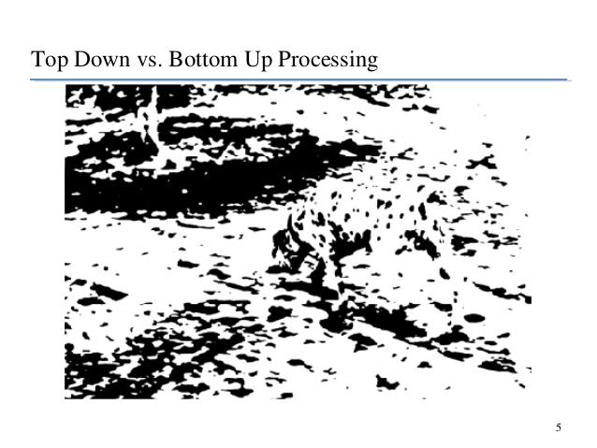

Slide 9
Psychophysics
Psychophysics: study of the relationship between physical characteristics of stimuli and our psychological experience with them.
Physical World | Psychological World
Light | Brightness
Sound | Volume
Pressure | Weight
Sugar | Sweet
7

Slide 10
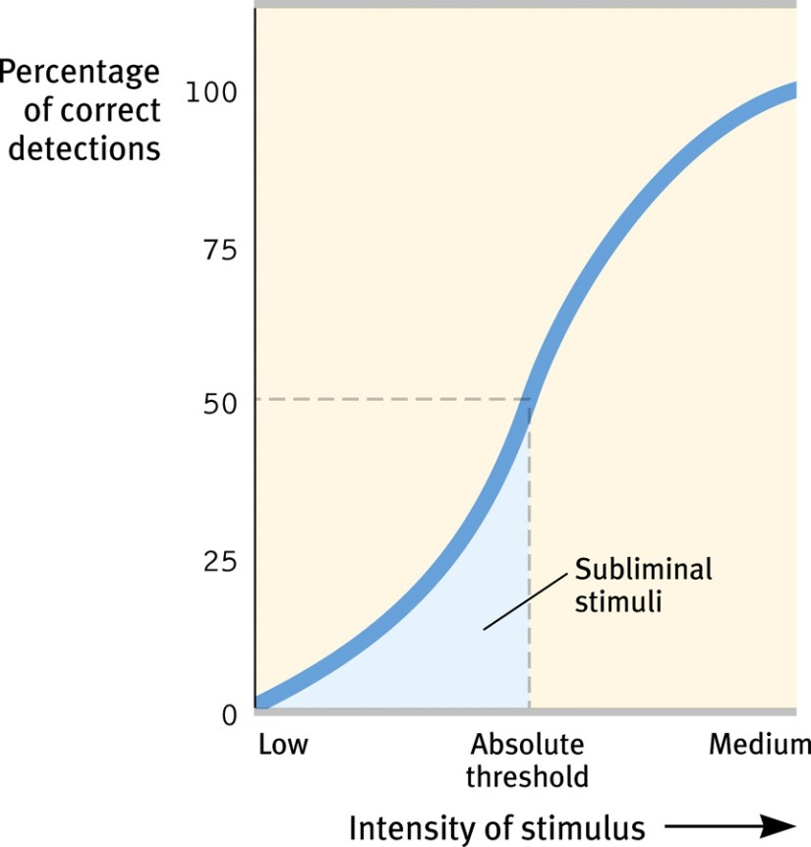
50/50 recognition point = absolute threshold *varies with age
Subliminal Threshold: when stimuli are below one’s absolute threshold for conscious awareness
8

Slide 11
*depends on signal’s strength + psychological state
*our ability to catch a faint signal diminishes after 30 minutes
-life/death consequences: airport scanners, doctors in IC units
9

Slide 12
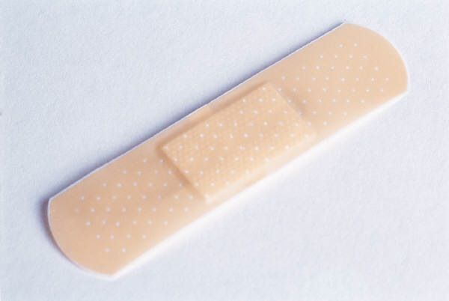
Sensory Adaptation
Sensory Adaptation: diminished sensitivity as a consequence of constant stimulation
12

Slide 13
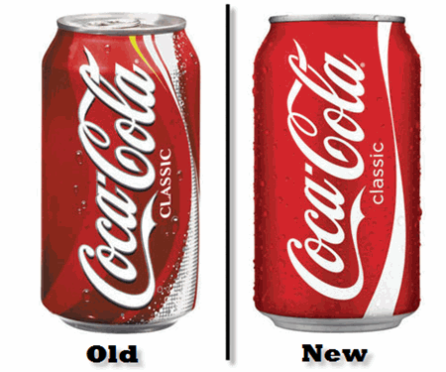
Difference Thresholds
Difference Threshold (Just noticeable different-JND)
minimum difference between 2 stimuli (detection 50% of the time)
Weber’s Law: principle that, to be perceived as different, 2 stimuli must differ by a constant minimum percentage (rather than a constant amount)
Stimulus | Constant (k)
Light | 8%
Weight | 2%
Tone | .3%
11

Slide 14
Vision
Finish crash course episode vision part

Slide 15
How Do We See?
Vision
transduction: conversion of one form of energy into another; the transforming of stimulus energies (like sights, sounds, smells) into neural impulses our brain can interpret
14

Slide 16
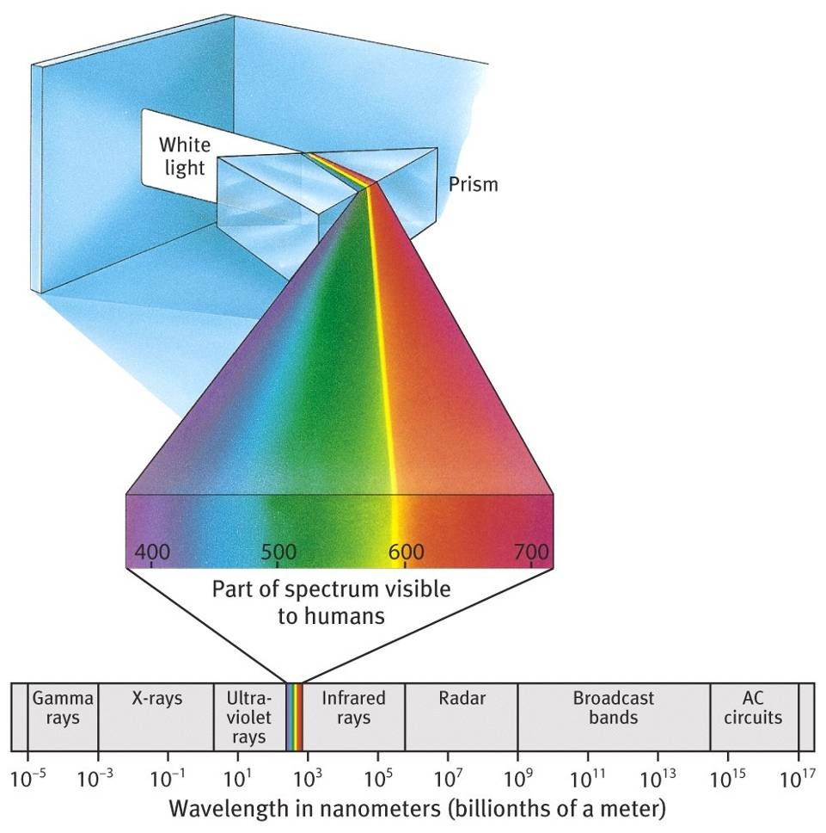
Visible
Spectrum
We don’t see color (pulses of electromagnetic energy we perceive as color)
Visible light is just a thin slice of the spectrum of electromagnetic radiation
2

Slide 17
Stimulus Input: Light Energy
Wavelength: distance from the peak of one light/sound wave to the peak of the next; determines hue (dimension of color)
Amplitude/intensity: amount of energy in a light/sound wave, which is determined by the wave’s amplitude (height); determines brightness
16

Slide 18
Stimulus Input: Light Energy
Violet
Indigo
Blue
Green
Yellow
Orange
Red
HUE
400 nm
700 nm
Short wavelengths
Long wavelengths
BRIGHTNESS
High intensity
Low intensity
17

Slide 19
Structure of the Eye
cornea: protects the eye and bends light to provide focus
pupil: adjustable opening in center of eye through which light enters
iris: muscle that expands and contracts to change the size of opening (pupil) for light
lens: focuses the light rays on the retina (through accommodation)
retina: light-sensitive inner
surface of the eye
18

Slide 20
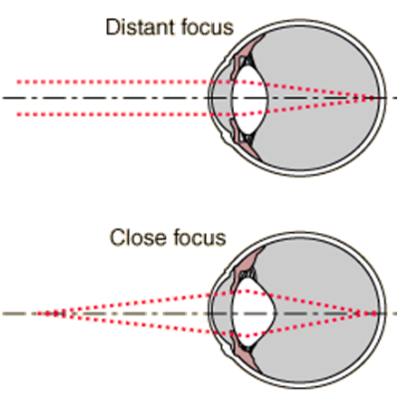
The Retina
rods: detect black, white, gray; necessary for peripheral and twilight vision
cones: detect fine detail and colors; function in well-lit conditions
blindspot part of retina where there are no receptor cells
accommodation:
The process by which the eye’s lens changes shape to focus near or far objects on the retina
20

Slide 21
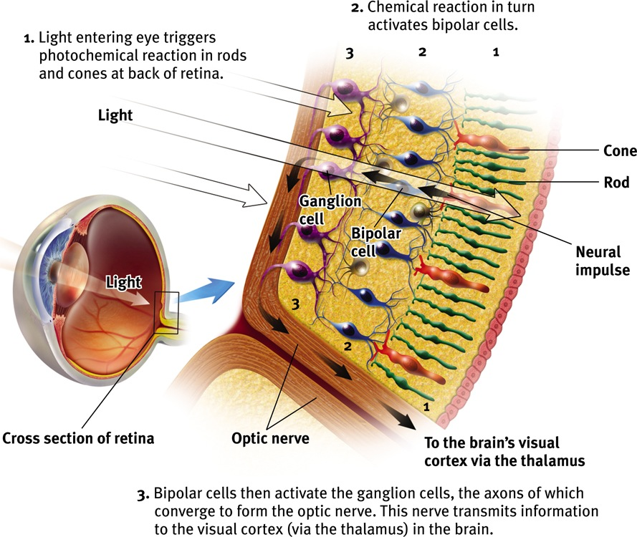
7

Slide 22
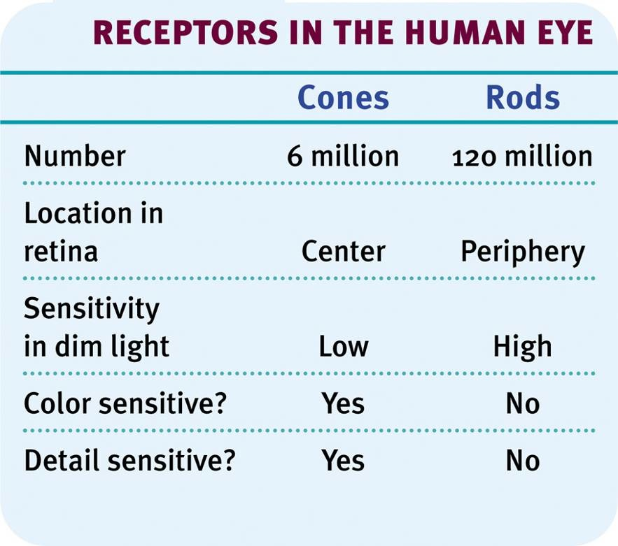
8

Slide 23
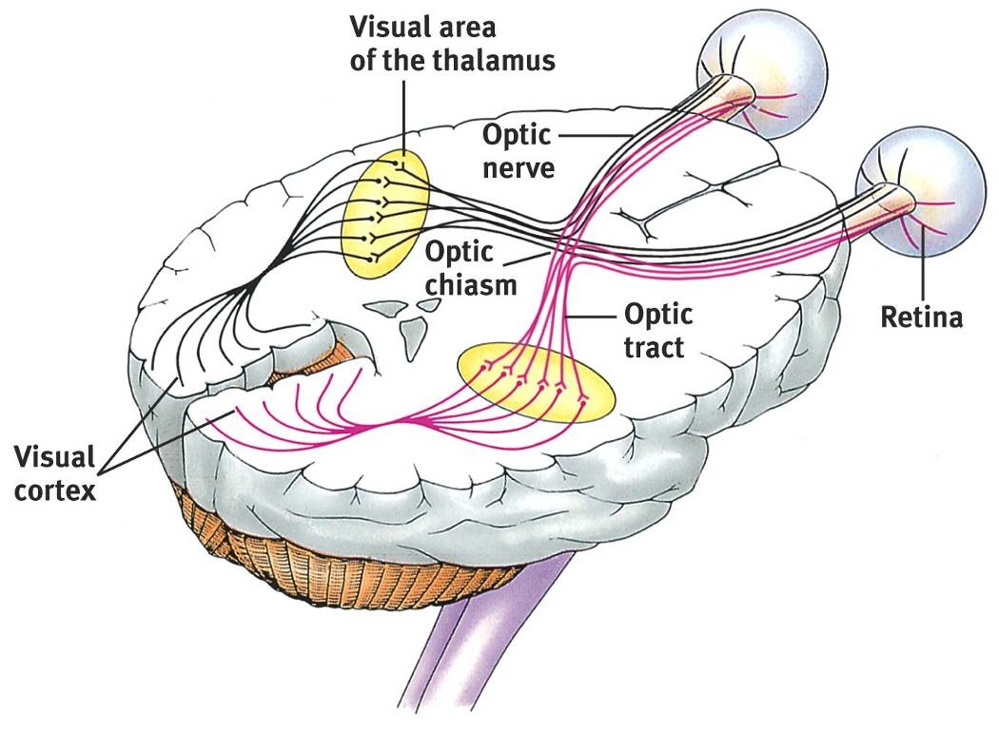
Visual Information Processing
9

Slide 24
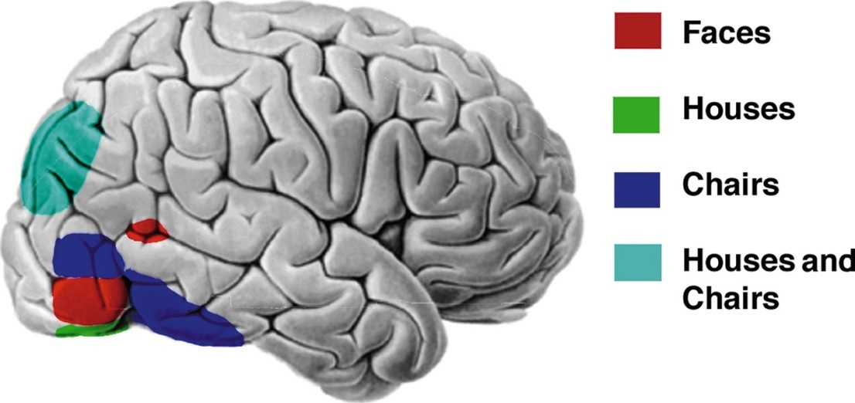
Visual Information Processing
feature detectors: nerve cells in the brain that respond to specific features of the stimulus, such as shape, angle, or movement
pass info to other cortical areas (eg: temporal lobe processes faces)

Slide 25
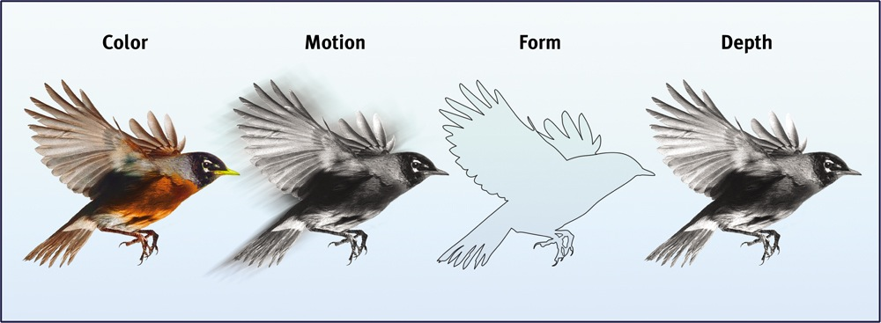
Visual Information Processing
parallel processing: processing of many aspects of a problem simultaneously
*housed in different parts of brain: some can function while others don’t

Slide 26
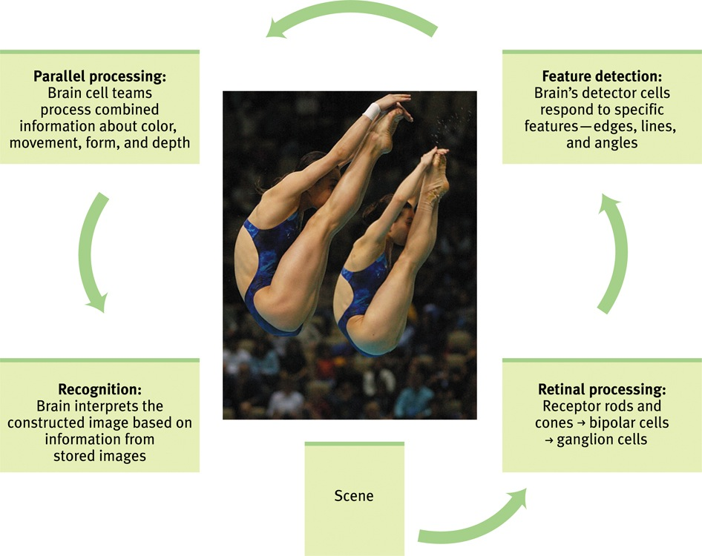
From Sensation to Recognition
12

Slide 27
Color Vision
EQ: How do we see in color?
27

Slide 28
Color Vision: 2 Theories
(Young-Helmholtz) Trichromatic theory: the eye contains 3 receptors that are sensitive to red, blue and green
any color can be formed by combining light rays of these 3 colors
red sensitive+ green sensitive =yellow
BUT
some who are color blind to red and green still see yellow…how???
23

Slide 29
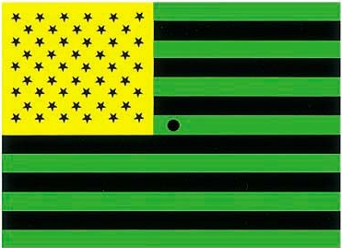
(Hering’s) Opponent-Process Theory: opposing retinal processes
3 sets of opponent colors (red-green; yellow-blue; white-black) enable color vision
some neurons turned on by red/off by green and vice versa
24

Slide 30
Opponent-Process Theory

Slide 31
Solution?
Color processing occurs in 2 stages
1) retina’s red/green/blue cones respond to different color stimuli (trichromatic theory)
2) those signals are processed by the system’s opponent process cells before getting sent to the visual cortex (opponent-process theory)
23

Slide 32
HOMEWORK
Label structures and functions of the EYE and EAR

