Slide 1
Essential Question
In what way does operant conditioning reinforce behavior?

Slide 2
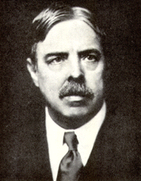
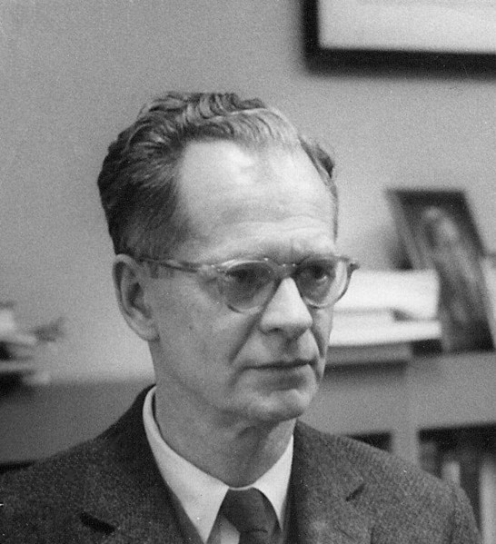
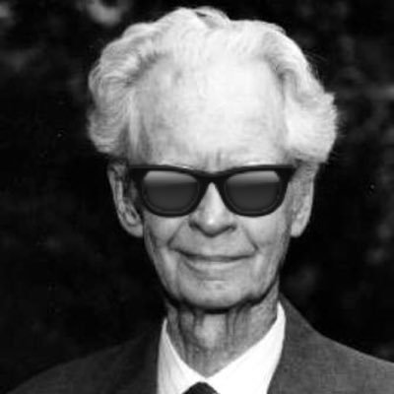
Operant Conditioning
Emphasizes how we can control behavior by responding to actions
Started with Law of Effect
Rewarded behavior is likely to recur
Skinner expanded these ideas to develop behavioral control
Edward Thorndike
B. F. Skinner

Slide 3
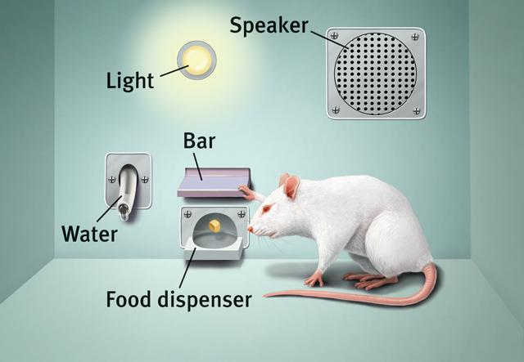
Operant Chamber (Skinner’s Box)
Reinforcement: increases or strengthens the event that follows
Shaping: providing small steps to get to the desired behavior

Slide 4
Reinforcement
Positive Reinforcement
When you give something to encourage behavior.
+ and +
Negative Reinforcement
When you take something away to encourage behavior
- and +

Slide 5
Punishment
Positive Punishment
When you give something to discourage behavior
+ and -
Negative Punishment
When you take something to discourage behavior
- and -

Slide 6
Reinforcement
Continuous Reinforcement
Reward after every desired response
High acquisition, high extinction
Partial (intermittent) Reinforcement
Reward some of the time
Slow acquisition, low extinction

