Slide 1
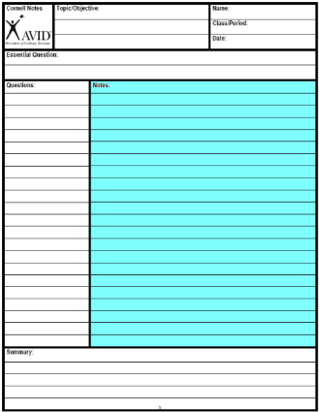
Divide notes into 4 “chunks” of information that go together.
Create a test question in the left-hand column for each chunk

Slide 2
Bell Work 1/30
Answer on the left side of page 5 of your Notebook
Design a Museum Exhibit
Focus on the most important aspects of the event
Include at least 3 Artifacts (objects)
Write a one or two word description of each artifact

Slide 3
Conspiracy Groups
The Government:
Spy (CIA and FBI)—Blames them for the Bay of Pigs
Military: want to invade Cuba and Vietnam
Politicians: Silver Spoon
The Cubans : Castro
Lee Harvey Oswald: Wants Fame
The Mafia:
Failure in Cuba
Bobby’s crackdown
The KGB(Russians): Khrushchev

Slide 4
Conspiracy Theories
Each Table has a Conspiracy Theory---You will have 15 minutes at each table to accomplish these tasks in your notebook:
Write down 5 facts about the Motive
Write down 5 facts about the Evidence that backs that motive up.

Slide 5
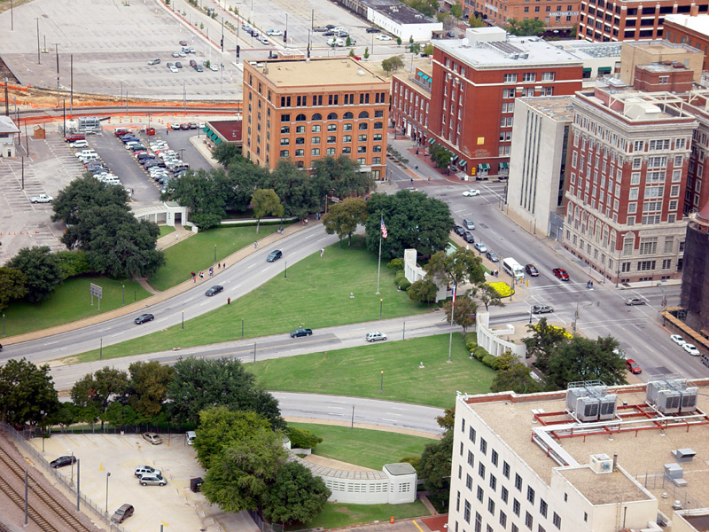
The Motive List or describe the reasons this person/group would want Kennedy dead.
The Evidence List or describe the proof that backs up this theory.
Each Table has a Conspiracy Theory---You will have 15 minutes at each table to accomplish these tasks in your notebook:
Write down 5 facts about the Motive
Write down 5 facts about the Evidence that backs that motive up.
Notes:
4 out of 178 witnesses claimed to hear shots coming from multiple directions

