Slide 1
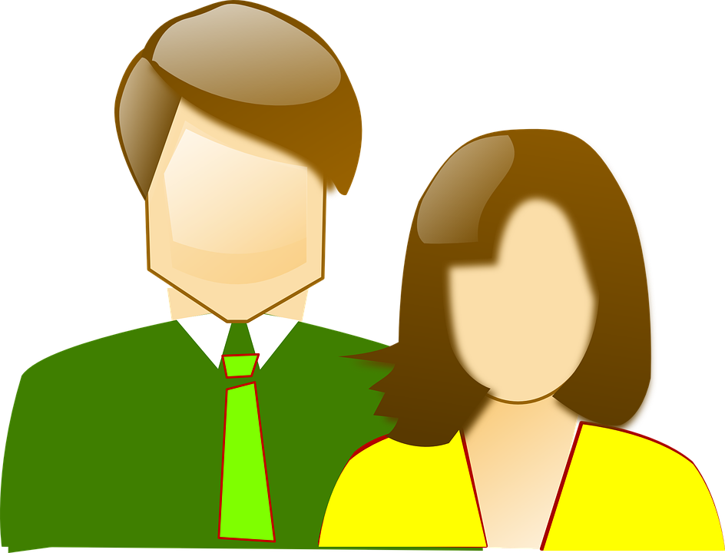
Do Now: Quick Write - Who are you more like your mother or father? Explain.

Slide 2
Agenda and Learning Target
Do Now
Theories of Personality
Personality Test
I can
- Explain the different traits in a personality test .
take a Personality test to determine my type.

Slide 3
Essential Question: How can knowing personality theories help us understand ourselves and others?
Notes:
Bell Question - Who are you most like, your mother or your father?
Discuss personality traits using the next slide. . .

Slide 4
Personality - Patterns of feelings, motives, & behavior that set people apart from one another.
Five Approaches
Trait Theory
Psychodynamic Theory
Learning Theory
Humanistic Theory
Learning Theory
Notes:
Write Shy and outgoing n the board. Explain these are two basic personality traits. Read definition of the word trait aloud. Ask students to list some more traits. “Personality Theorists believe these make up personality. Show on board with arrows. Personality Theorists disagree with on how people come to possess certain traits and not others.

Slide 5
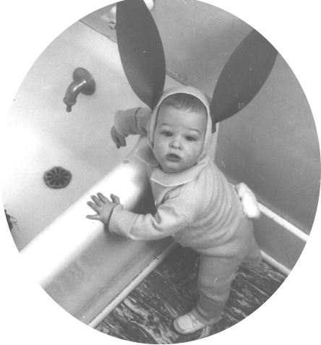
Trait
• aspect of personality that is reasonably stable.(shy, optimist, outgoing. . .)
• personality traits are fixed from an early age & account for consistent behavior in different situations
Notes:
V Traits are assumed to account for consistent behavior in different situations
Consistent - a “shy” person my consistently try to escape social situations.
Many theorists have been involved in identifying and cataloging human traits.

Slide 6
Ancient Greek physician - personality traits result from combinations of humors(fluids) in the body
4 basic humors
• Yellow bile = choleric - quick tempered
• Blood = sanguine- warm, cheerful
• Phlegm = phlegmatic - cool and sluggish
• Black bile = melancholic - thoughtful
To restore proper health, these must
be equalized.
Notes:
Certain diseases and disorders were believed to reflect a lack of balance in these humors. Methods such as bloodletting and vomiting were recommended to restore the balance of fluids and one’s own health.

Slide 7
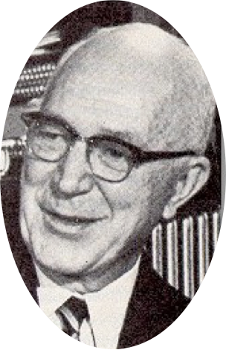
• Traits are the building blocks of personality
- a person’s behavior is a combination of specific traits.
Notes:
^In the 1930s, psychologist Gordon Allport searched through a dictionary to find every term that could describe a person. He cataloged some 18,000 human traits from a search through lists of descriptive words. He found that most were similar in meaning like hostile, nasty, and mean. So if you were to think of a person you know, and quickly jot down the personality traits that describe him or her, you would probably be able to capture your friends personality using only about seven trait labels, the rest would be redundant.
- some traits were physical - short blonde
- some were behavioral - shy and emotional
- some were moral - honesty

Slide 8
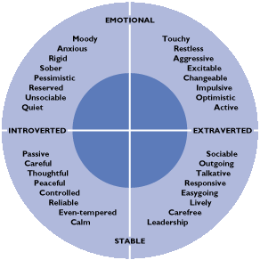
1. Introversion - extroversion
- Introverts - imaginative, look inward for their own ideas rather than to others.
- Extroverts - active, self-expressive, gain energy from social interaction.
2. Emotional Stability - Instability
Notes:
EYE-sink
Introversion and Extroversion were first proposed by Carl Jung, who we will learn about later. (These two concepts are the first letter on your personality test. You were either an I or an E - an Introvert or an Extrovert.
Eysenk Studied both normal and disordered personalities. From his studies he concluded that personality can be described in terms of three basic factors or dimensions.
Emotionality-Stability - Stable people are usually reliable, composed & rational - Unstable, agitated and unpredictable.
At one extreme, people who exhibit such characteristics as moodiness, restlessness, worry, anxiety & other negative emotions.
On the opposite end, people are calm, even-tempered, relaxed and emotionally stable. (called neuroticism)
Psychoticism - high on this scale, people show attributes as cruelty, hostility, coldness, oddness, and rejection of social norms. Low on this scale do not show any of these things.

Slide 9
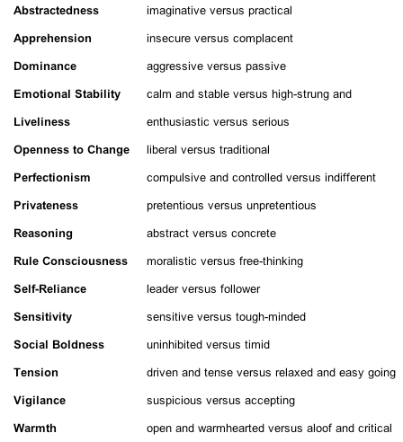
Identified 16 basic source traits for human personality
Surface traits - obvious traits, (tidiness, friendliness)
Source traits - underlying traits that cause surface traits.
Notes:
Raymond Catell studied groups of people identifying certain obvious traits such as integrity, friendliness, and tidiness. He called these obvious traits SURFACE TRAITS.
He then noticed that clusters or groups of surface traits seemed to occur together. (If a person showed one trait in a cluster, he or she usually showed the others in the cluster as well.
SO he said that a single, underlying trait gives rise to all the traits in each cluster. He called these underlying traits SOURCE TRAITS
He finally settled on 16 source traits that would enable psychologists to predict people’s behavior in various situations.

Slide 10
E. The Big Five
Five Basic Personality Dimensions
Introversion - Extroversion
Emotional stability - instability
Conscientiousness - carelessness
Agreeableness - disagreeableness
Openness to experience - closed mindedness
Notes:
^ Psychologist continue to disagree about which personality types are the most basic. However, nearly all psychologists would agree that the BiG FIVE personality dimensions are important in defining a person’s psychological makeup. These are the Big 5 -
Trait theorists try to describe personality, but it doesn’t explain where these traits came from or how we get them.
Today they focus on describing traits, and have brought up the value of matching us to educational programs and jobs on the basis of these personality traits. Example by identifying students’ abilities and traits, school counselors can help students make important schooling and jobs decisions
***Psychologists also believe that these BIG 5 are established at an early age and remains stable through life.

Slide 11
Review: TRAIT THEORY Main features:
- Focus on cataloging traits
- Examine where traits come from
- Which traits are predominant
Doesn’t describe the origin of people’s personality
Notes:
Focus on Identifying, measuring and classifying similarities and differences in personality characteristics of traits
Criticism - Pigeonholing people according to oversimplified characteristics AND It

Slide 12
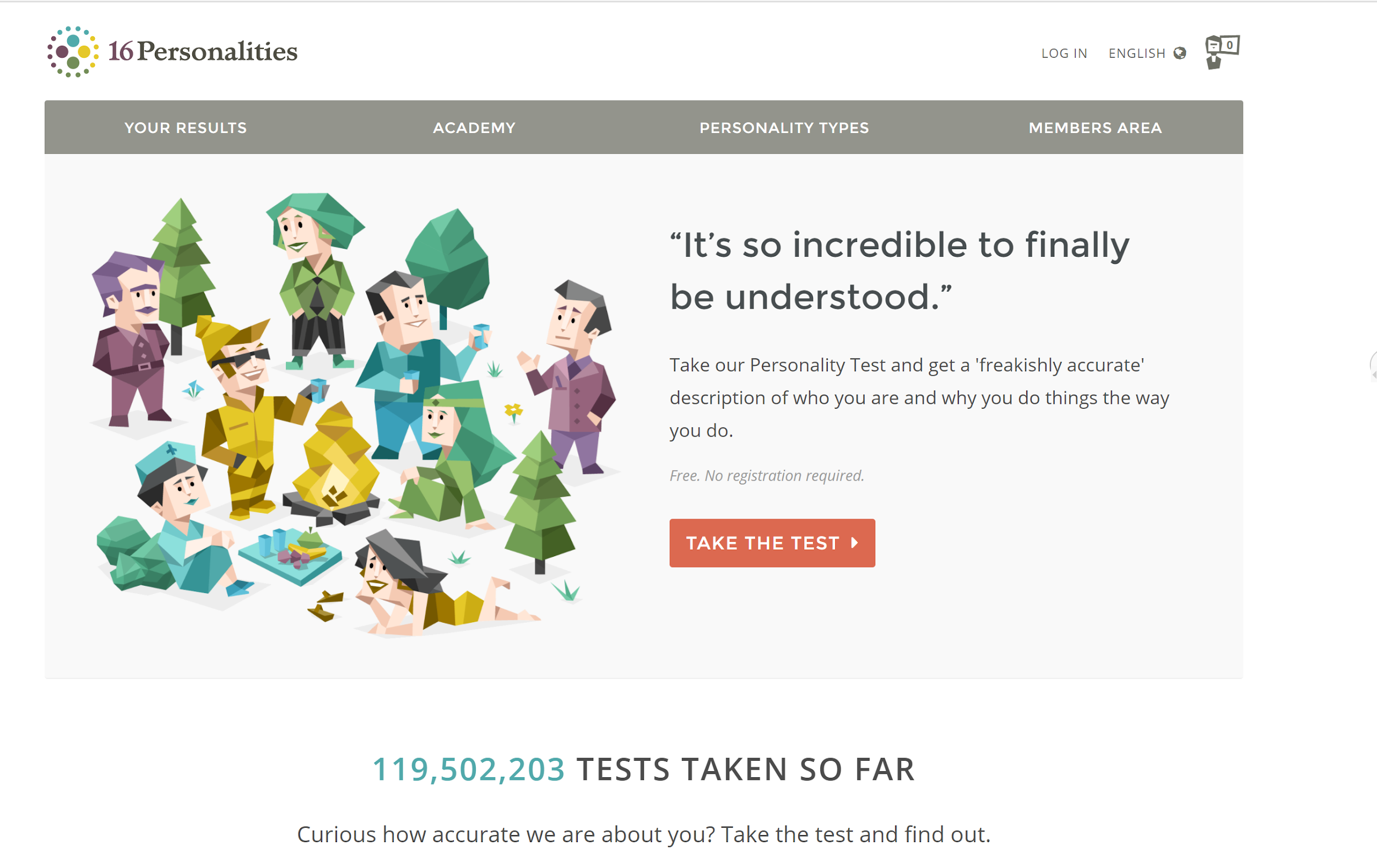
What is your Personality?
Take the 16 Personalities Test (Myer’s Briggs) at https://www.16personalities.com/
Write down your personality type.
Read your description. Do you agree with it? Why or why not?
Who else is your type?
*** Play around a bit with this. It’s pretty fun

