Slide 1
ETHICS
Test Information
Genie Story
Documentary
Debrief
Research Methods
Describe the ethical guidelines that safeguard human research participants.

Slide 2
GOOD MORNING!
HW: Study for Exam
Upcoming:
Test on 10/03

Slide 3
Exam Information
50 Multiple Choice/1 FRQ
Content: modules 5, 6, 7 and 8.
Study advice:
Practice questions in textbook (answers posted today
Flashcards
Talking through essential questions
Lots of resources online! Careful - some information may not be accurate.

Slide 4
Discussion Points (Pg. 68)
American Psychological Association Ethical Standards in 2009:
Obtain potential participants’ informed consent
Protect them from physical or emotional harm and discomfort
Keep information about individual participants confidential
Fully debrief people (explain the research afterward)

Slide 5
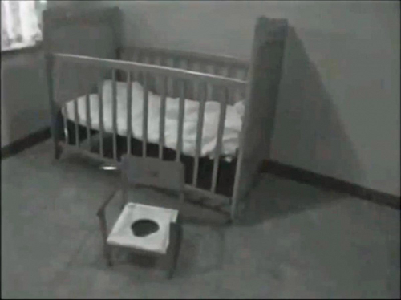
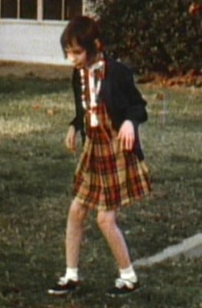
Background on Genie

Slide 6
Documentary Notes
Note: This documentary uses the term, “mentally retarded,” to refer to Genie. That is not a term that is appropriate to use now. Today, we use the term intellectually disabled.
Observations
Questions

Slide 7
Discussion Questions
Was Genie able to provide consent? Who in Genie’s life should have authorized consent?
Were the psychologists keeping her best interests in mind? What about the claims of abuse made against the psychologist? Were they valid?
To what extent did the team go to protect her identity?
Can we count the research, that didn’t come to a conclusion, as a proper debrief of the research?

Slide 8
