Slide 1
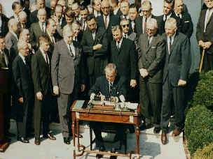
War On Poverty Economic Opportunity Act of 1964
Provided $1 billion to develop a number of programs, including the ones below.
Job Corps, which provided employment for youths 16-21.
Job training for unemployed adults.
Loans for employers to train low-skilled workers.
Head Start Program, intended to improve the early education of economically-challenged youngsters.
VISTA (Volunteers in Service to America).
A domestic Peace Corps, sent to depressed areas to aid in training, education, and establishing schools and other public institutions.

Slide 2
War On Poverty Medicare/ Medicaid
Medicare
Provided hospital insurance and certain post-hospital care for all Americans over the age of sixty-five.
Medicaid
Helped low income families pay for the costs of medical care.

Slide 3
Declare War On Poverty HUD (Department of Housing & Urban Development).
Headed by Robert C. Weaver, the nation’s first African-American Cabinet member.
Job was to oversee housing requirements and standards for the poor, inspect urban areas, and develop programs intended to clean up cities.
Department Of Housing &
Urban Development
http://www.reinvestology.com/wp-content/uploads/2008/11/hud-logo-small.jpg

Slide 4
Environment Water/Air Quality Acts
Purification of Air & Water Act
Enacted to clean up industrial centers, restore polluted waterways, and combat smog-laden air.

Slide 5
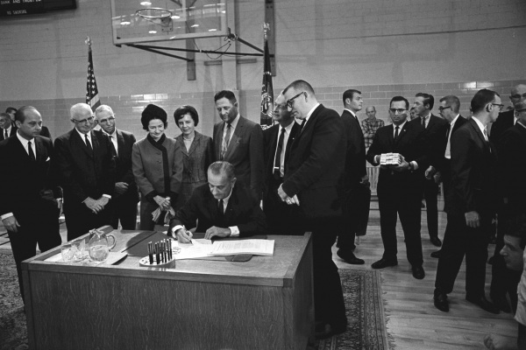
Education
Elementary and Secondary Education Act
Provided education aide to states based on the # of low income students
Higher Education Act
Provided financial assistance for college—Student loans, work study, and grants.

Slide 6
Education
National Foundation of the Arts and Humanities
Encouraged cultural and artistic development in America by providing grants to artists and writers, as well as programs to have new works displayed and disseminated to average Americans and schools.
Public Broadcasting
Educational programing on T.V.
Highway Safety Act
Driver Education and safety standard for motor vehicles.

Slide 7
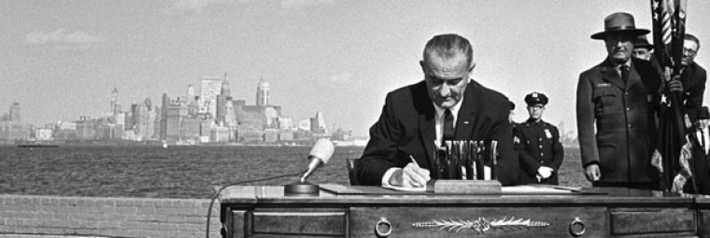
Immigration
Ended the National Origins Quota System
Opened immigration to people from the Middle East, Asia, Africa, and Eastern Europe

Slide 8
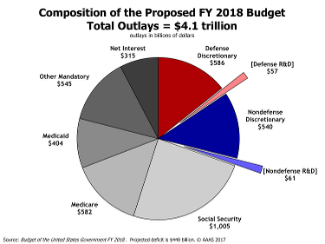

Slide 9
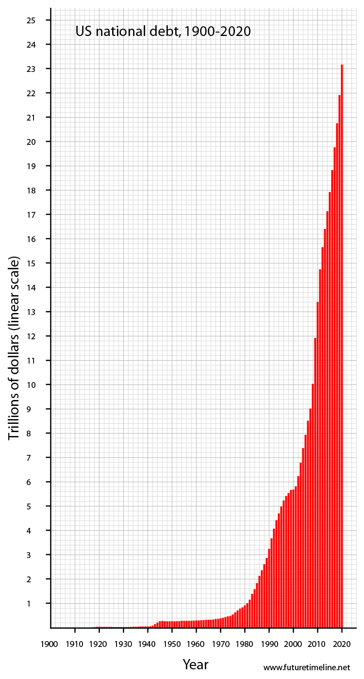
debt clock
Increase my debt limit
Debt Video

Slide 10
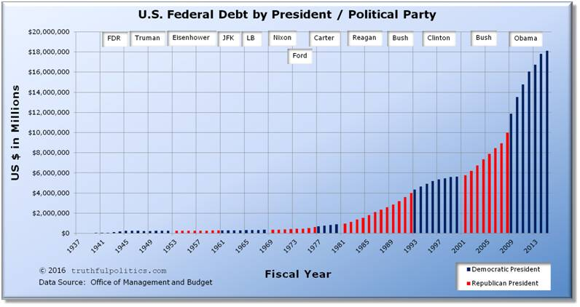

Slide 12
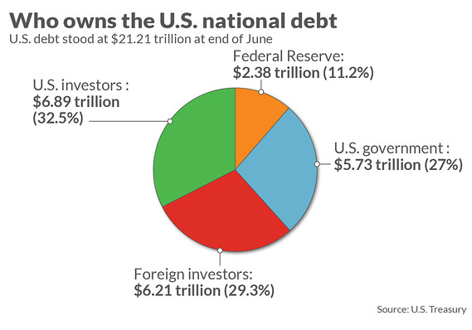

Slide 13
Debt Today
Your groups task is to cut Great Society programs in in today’s budget.
Today we spend 1,415, 700, 000,000.
Your group needs to cut 415.7 billion dollars from the budget.
On your worksheet List:
The programs you will fund fully
The programs you are cutting funding from
The programs you are cutting completely
Then color the pie chart with a key to highlight what you have done.

