Slide 1
Good Morning!

Slide 2
Psychoanalytic Personality
HW Review
Freud Documentary
Id/Ego/Super Ego Theory
Psychosexual Stages
Random Freud Notes
Compare and contrast the major theories and approaches to explaining personality

Slide 3
Personality and Individual Differences

Slide 4
Module 56 Review
What is the collective unconscious?
Explain the following:
Projective Tests
Thematic Apperception Tests (TAT)
Rorschach Inkblot Test
What is the false consensus effect?

Slide 5
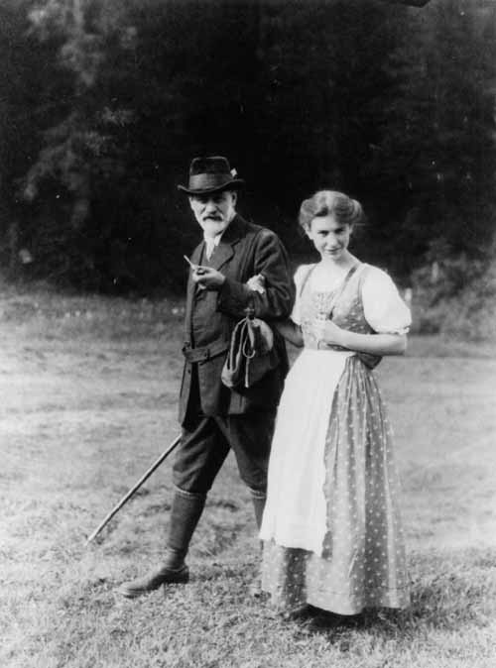
Freud
Sigmund Freud founded a lot of psychoanalytic theories
Psychoanalytic theories are becoming more popular
Documentary Link

Slide 6
Psychoanalytic Personality Theory

Slide 7
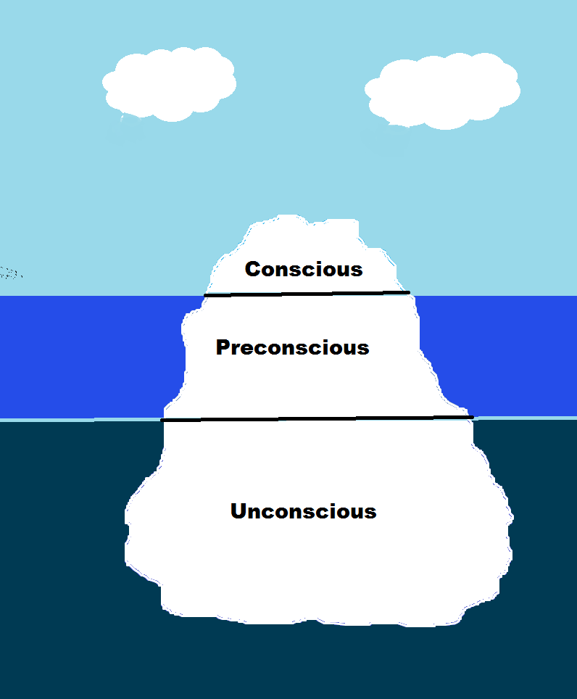
Freud’s Personality Theory
Conscious
Preconscious
Unconscious

Slide 8
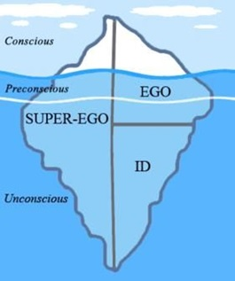
Id, Ego, SuperEgo
ID
Ego
SuperEgo

Slide 9
Psychosexual Influence on Personality

Slide 10
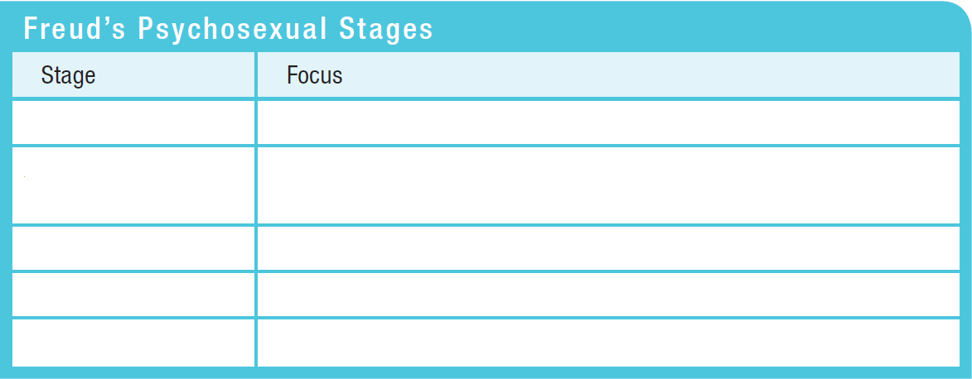
Psychoanalytic Theory’s Core Ideas Personality Development

Slide 11
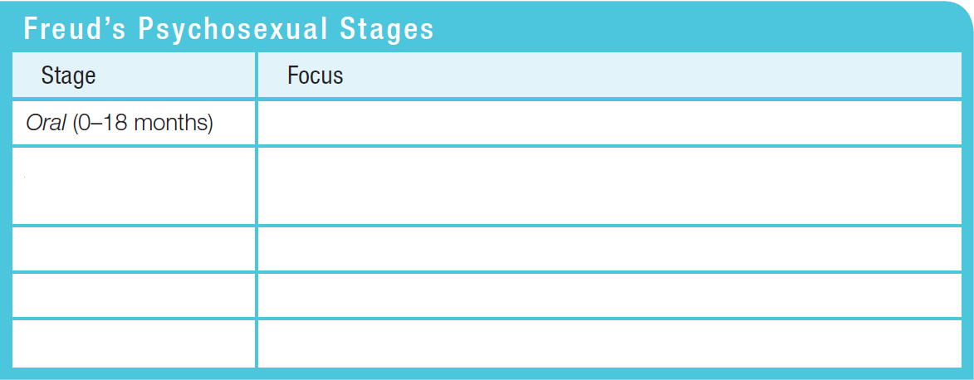
Psychoanalytic Theory’s Core Ideas Personality Development

Slide 12
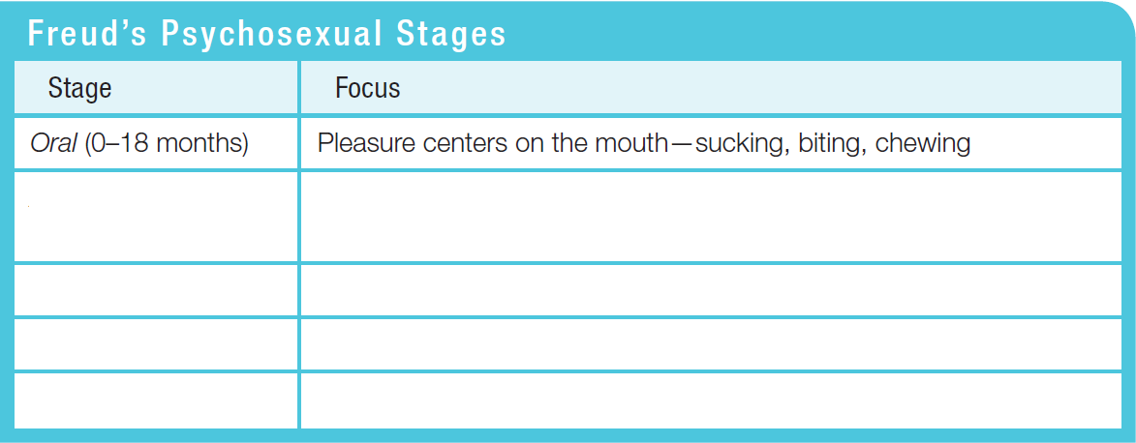
Psychoanalytic Theory’s Core Ideas Personality Development

Slide 13
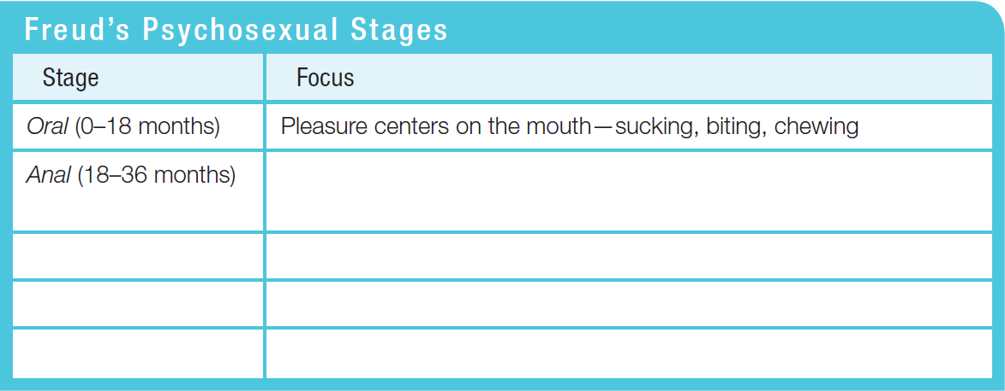
Psychoanalytic Theory’s Core Ideas Personality Development

Slide 14
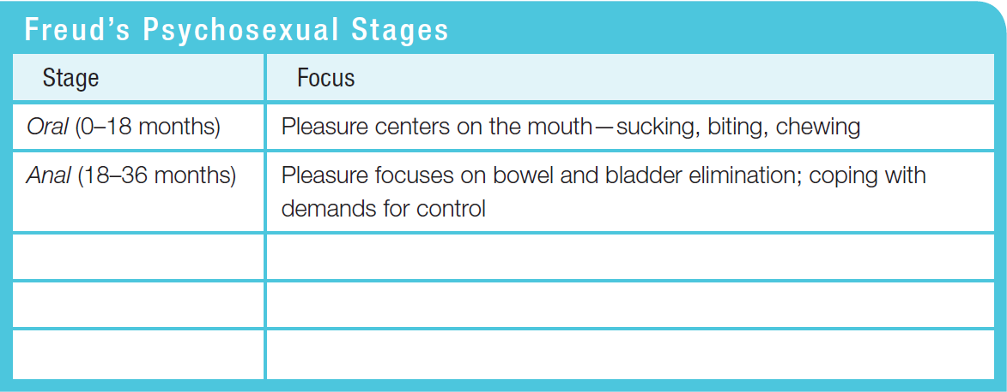
Psychoanalytic Theory’s Core Ideas Personality Development

Slide 15
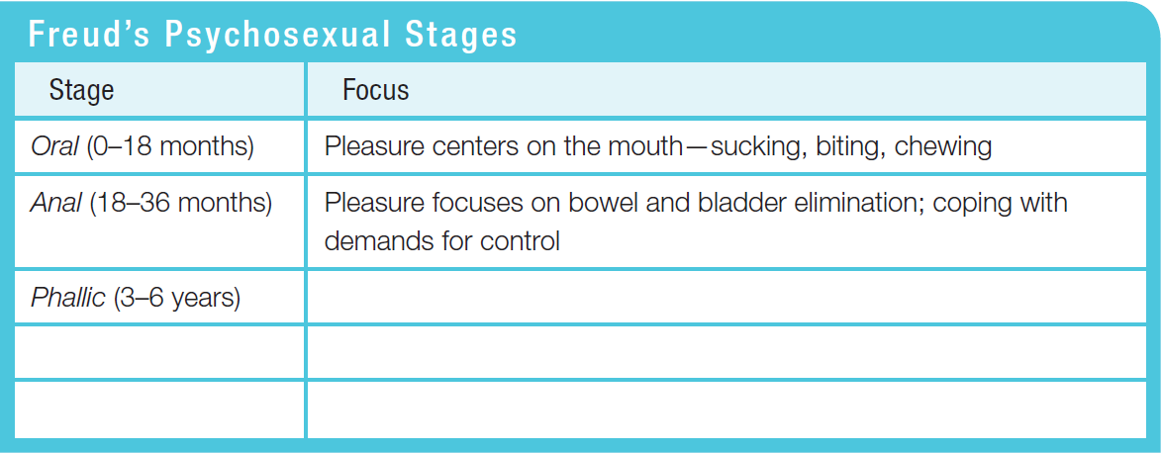
Psychoanalytic Theory’s Core Ideas Personality Development

Slide 16
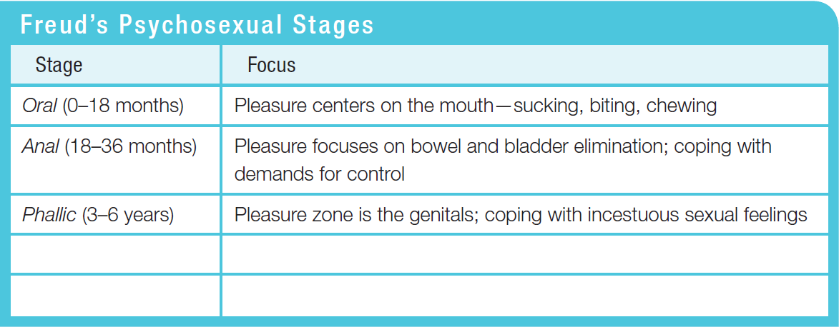
Psychoanalytic Theory’s Core Ideas Personality Development

Slide 17
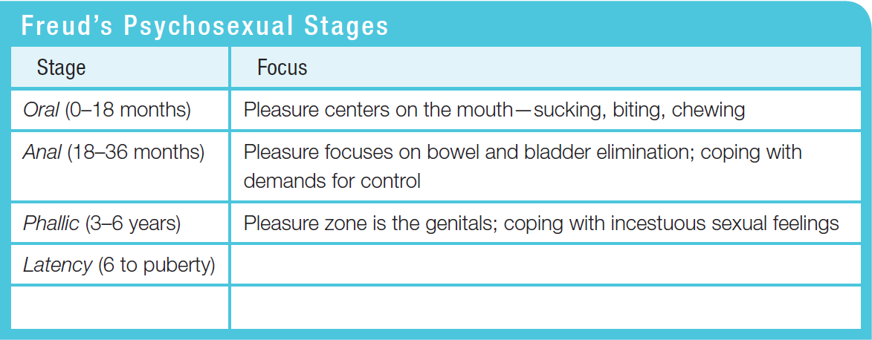
Psychoanalytic Theory’s Core Ideas Personality Development

Slide 18
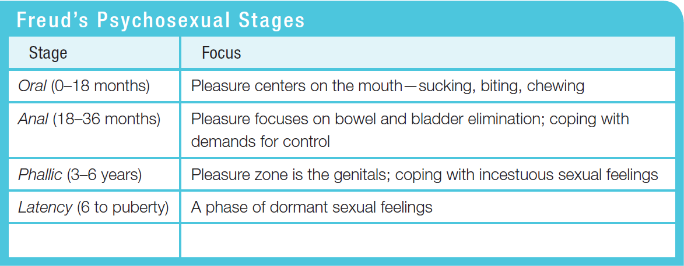
Psychoanalytic Theory’s Core Ideas Personality Development

Slide 19
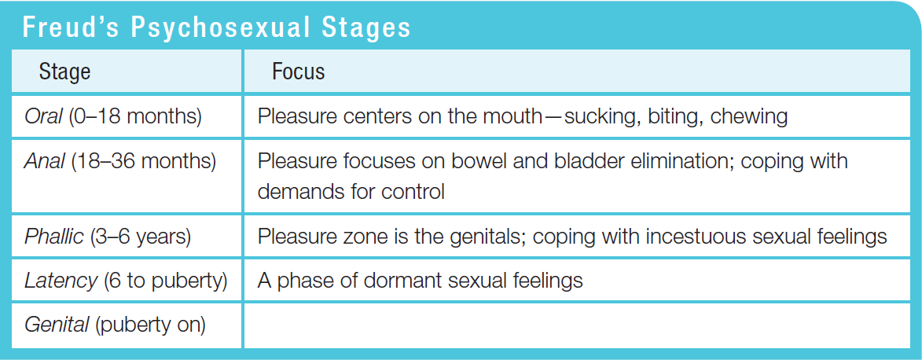
Psychoanalytic Theory’s Core Ideas Personality Development

Slide 20
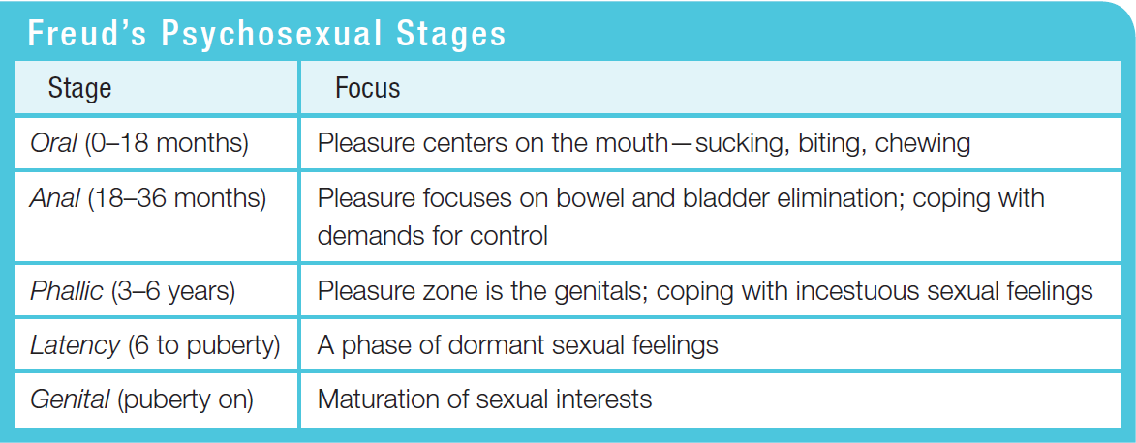
Psychoanalytic Theory’s Core Ideas Personality Development

Slide 21
Modern Criticisms

Slide 22
Modern Criticisms
We can move beyond childhood - we don’t stay fixated.
Overestimated influences from parents and underestimated peers
Several theories are not testable
Largest criticism: explains things after they happen, but cannot predict

Slide 23
Defense Mechanism Article/Handout

