Slide 1
Bell Work 11/18—Page 27
Create a visual comparing and contrasting Truman’s foreign Policy compared to Eisenhower's (hint: Eisenhower had two kinds of foreign policy).
Notes:
Bell

Slide 2
Nationalize
transfer (a major branch of industry or commerce) from private to state ownership or control.

Slide 3
1
Change the Korean Section to Soviet Union

Slide 4
Open Skies Initiative
1955
Proposed Treaty between US & USSR that would allow each country to fly over the other.

Slide 5
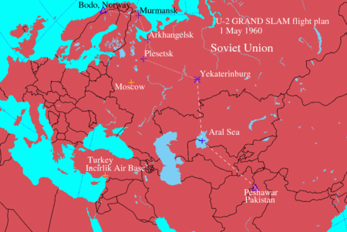
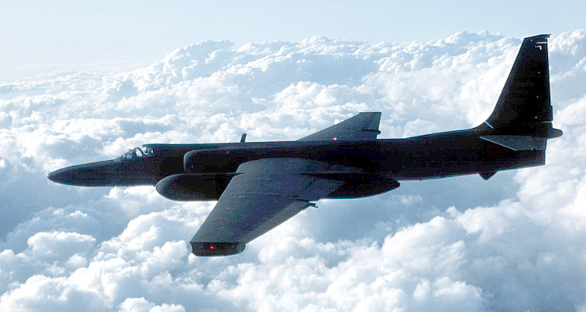
U-2 Spy Plane
July 1957
President Eisenhower received permission from Pakistan for the U.S. to establish a secret intelligence facility called the Peshawar Air Station.
The U-2 spy plane could monitor Soviet missile test sites, key infrastructure, and communications.

Slide 6
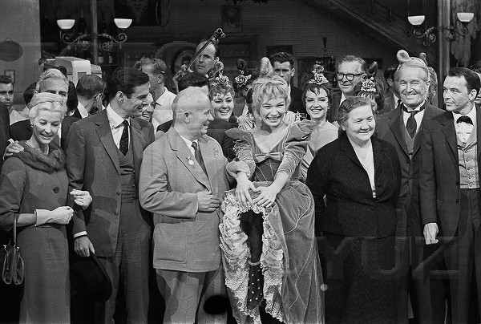
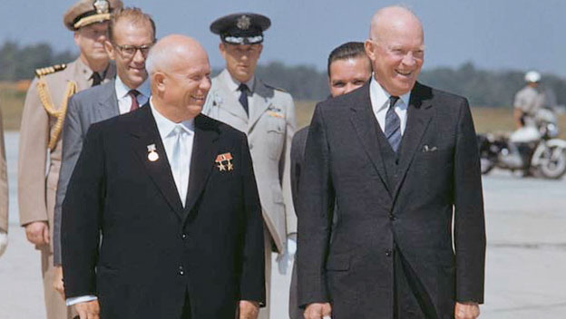
Dealings w/USSR: A Beautiful Day?
Sept. 1959 Nikita Khrushchev was the first Soviet leader to visit the United States
Visits 3 Places
Washington D.C.
Hollywood (CA)
Pittsburgh, PA
Eisenhower and Khrushchev meet and agree to discuss:
Lowering the nuclear bomb #’s and how to deal with the city of Berlin
60’: All is well - see you in Paris in May!
With the “Can-Can” stars Frank Sinatra and Shirley MacLaine

Slide 7
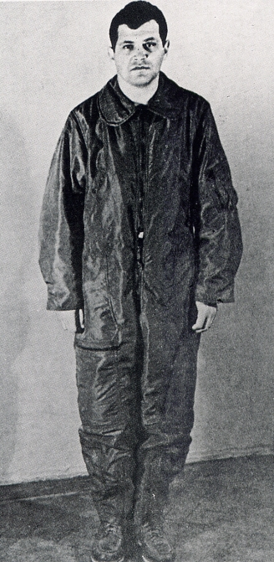
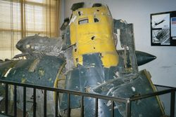
U-2 Spy Incident
May 1 1960
Col. Francis Gary Powers’ plane was shot down over Soviet airspace.
The U-2 spy plane was 15 miles over the Soviet Union
The Soviets shot it down with a guided missile.

Slide 8
U-2 Incident
US denies any knowledge-it’s a weather balloon
Khruschev produces evidence of plane and pilot at Paris Conference
This Incident causes a new rift between the US and Soviets.
U-2

Slide 9
Korean War
“I shall go to Korea.”
Threatened to use nuclear weapons to end the war
Ceasefire signed in July 1953

Slide 10
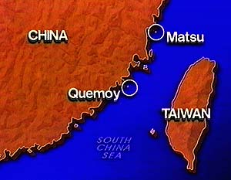
China
Islands of Quemoy & Matsu (1954)
China starts attacking Quemoy/Matsu w/artillery
What does US do? Threaten w/ nukes!!
China threatens again in 1958
Again China backs down!

Slide 11
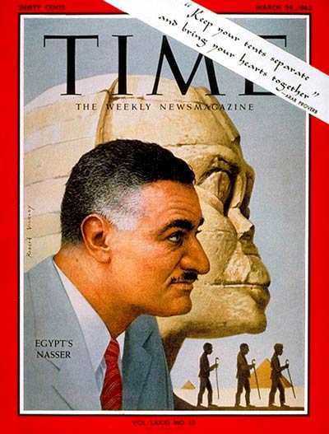
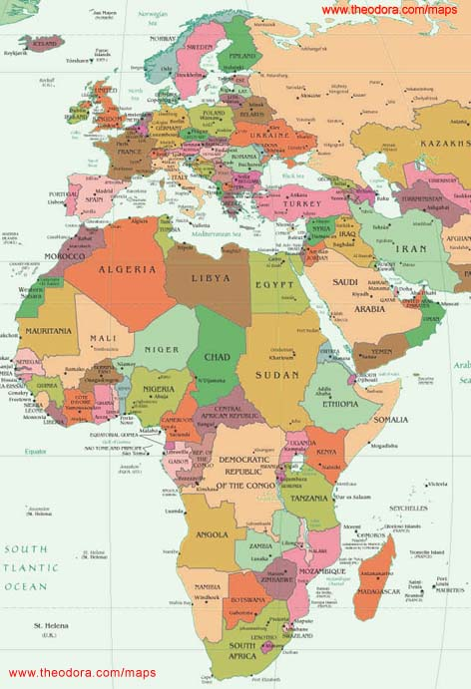
Suez Crisis
In 1956, Egyptian President Gamal Abdul Nasser needed $$ to build the Aswan High Dam—He blockages the Suez Canal
Israel, UK, & France invade
USSR threatens to help on Egyptian behalf
US threatens nuclear war if situation does not end.

Slide 12
Iran
Began in 1953
Iranian leader-Mohammed Mossadegh (mose-a-dean)
Iran wanted to nationalize its oil fields
CIA Operation AJAX-remove Mossadeq from power and install Shah Reza Pahlavi

Slide 13
2. Vietnam (Loss)
Fall of Dien Bien Phu (1954)
US paying 80% of the French costs of the War
French lose battle to Vietminh
Allies set up Geneva Conference to split Vietnam @ 17th parallel
North-Communist-Ho Chi Minh
South-Nationalist-Ngo Dinh Diem
“Laos is the cork in the bottle to contain communism”

Slide 14
Guatemala
July 1954
Second instance of CIA involvement
Overthrew the Arbenz government
Why?
Chiquita Bananas?
United Fruit Company had land taken away

Slide 15
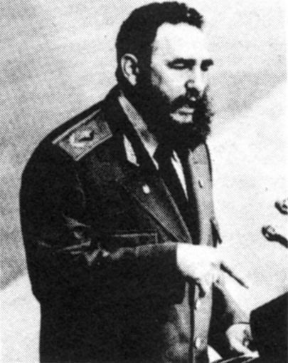
Cuba
Turns communist in 1959
Revolution led by Dr. Fidel Castro (Overthrows the Batista Government)
Castro needs help from someone to consolidate power
Turns to USSR (90 miles from Florida)
U.S. Reaction
US no longer trades w/ Cuba (Sugar)
No more Tourism (Las Vegas)
The CIA begins a program to overthrow Castro

Slide 16
Sputnik
October 4, 1957
Means “Baby Moon”
First Satellite to orbit the Earth
Won the Space Race!
Orbited every 96 minutes
Later versions carried a dog!

Slide 17
US Response to Sputnik
1. NASA-Organized a space program for the country
2. NDEA-National Defense Education Act
US would give billions for educating high-school students in Math and Science.

Slide 18
Bell Work #23—Page 50
Describe where you think Eisenhower did the best job using his foreign policy.
Notes:
Bell

