Slide 1
Bell Work (Left side of #26)
Create a Resume for Dwight Eisenhower
Include:
The two greatest achievements.
His best attribute.
Notes:
Bell

Slide 2
Page 27
Divide your paper into 3 equal sections

Slide 3
Page 27
Section 1:
Describe Eisenhower’s Foreign policy
1

Slide 4
Foreign Policy- “The New Look”
Massive Retaliation
A doctrine: The best way to deter an aggressor is to threaten to retaliate in much greater force in the event of an attack..
Espionage
The practice of spying or of using spies to obtain information and causing revolutions in countries

Slide 5
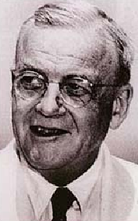
Foreign Policy- “Two Brothers”
Massive Retaliation
John Foster Dulles
Eisenhower's Secretary of State.
He was an avid anti-communist
Push the communists back to their pre-1945 borders by any means necessary
Brinkmanship
Going to the brink of war without actually getting into war.

Slide 6
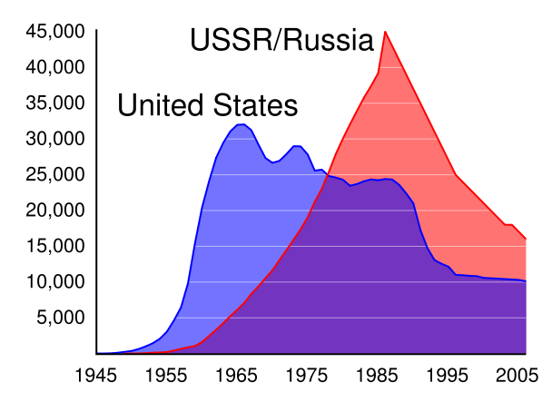
Massive Retaliation
Arms Race
Massive buildup of Nuclear Weapons
It was cheaper than building large military forces
Mutually Assured Destruction
If one country attacks the other, the other will be destroyed-Nuclear Deterrence

Slide 7
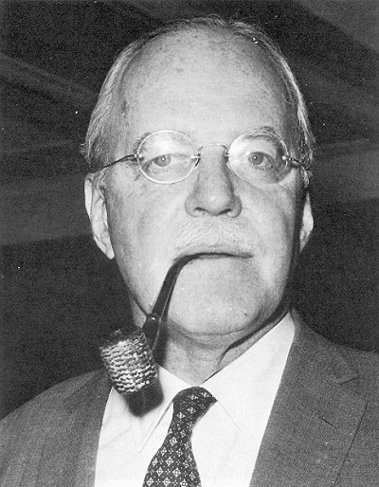
Foreign Policy- “Two Brothers”
Espionage
Allen Dulles
CIA Director
Goal: Stop the spread of communism and liberate those behind the Iron Curtain.
use convert action by the CIA to interfere with communist governments abroad.

Slide 8
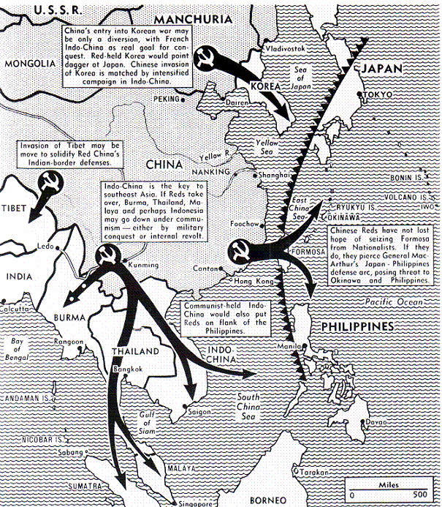
Domino Theory
April 7, 1954
You have a row of dominoes set up, you knock over the first one, and what will happen to the last one is the certainty that it will go over very quickly.
Worried about SE Asia & Japan

Slide 9
Page 27
Section 2:
Describe how the nuclear program changed under Eisenhower
1
2

Slide 10
The Bomb 1:15– 1:36

Slide 11
Section 3:
Nuke Map:
1
2
3

Slide 12
Nuke Map
Type in Keizer Oregon
Choose “fat Man” then “Tzar Bomba”
Click Surface
Click Casualties and Radioactive fallout

Slide 13
Nuke Map
Write down the Fatalities and Injuries for a “Fat Man” and “Tzar Bomba” bomb in Keizer.
Write down the Fatalities and Injuries for a “Tzar Bomba” bomb in Los Angeles and New York.
Which city had more fatalities? Why?
Which area of the United States would have the least fatalities from a “Tzar Bomba” bomb? (write down the place and #)
Which area of the world would have the least fatalities from a “Tzar Bomba” bomb? (write down the place and #)
Which area of the world would have the most fatalities from a “Tzar Bomba” bomb? (write down the place and #)

