Slide 1
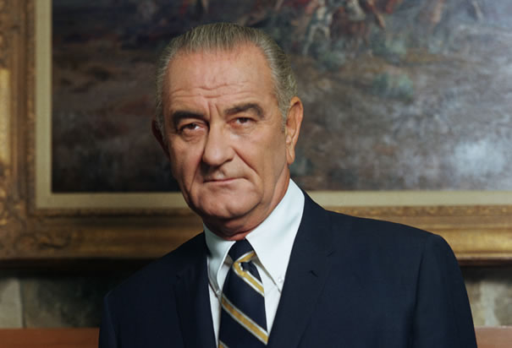
LBJ
Lyndon Baines Johnson (August 27, 1908 – January 22, 1973)

Slide 2
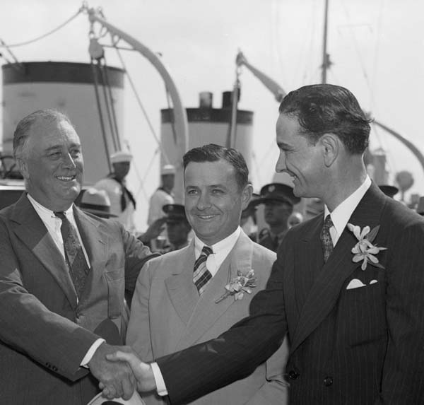
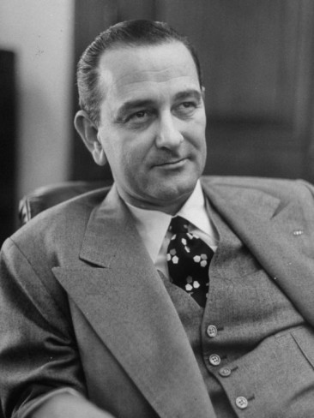
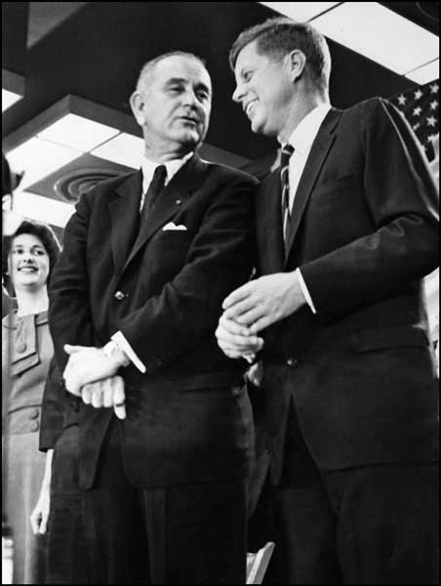
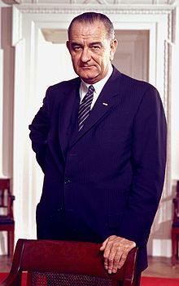
Johnson, a Democrat from Texas, is one of only four people who served in all four elected federal offices of the United States:
Representative-- 1937–1949
Senator-- 1949–1961
2 years as Senate Minority Leader
6 years as Senate Majority Leader
Vice President-- 1961–1963
President--1963–1969
The Other 3:
John Tyler
Andrew Johnson
Richard Nixon
LBJ and Nixon are only 2 ELECTED to all 4 offices.

Slide 3
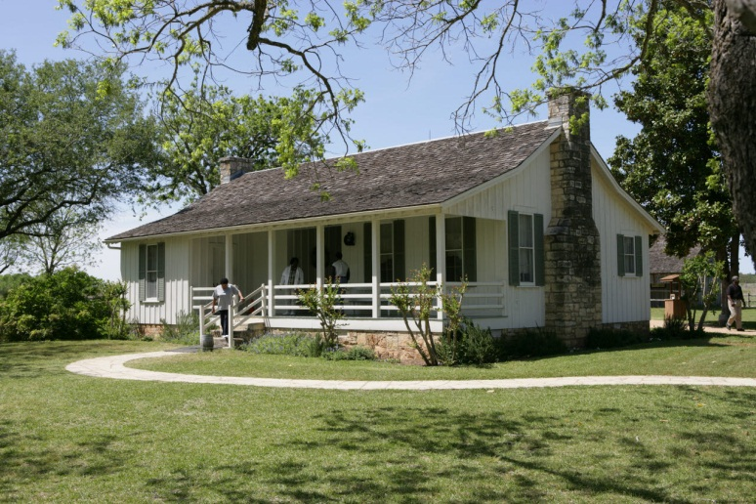
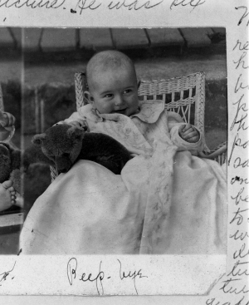
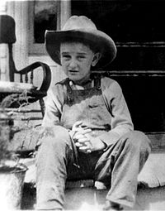
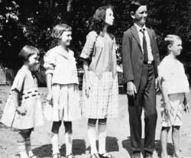
Lyndon Baines Johnson was born in Stonewall, Texas, in a small farmhouse on the Pedernales River, the oldest of five children.

Slide 4
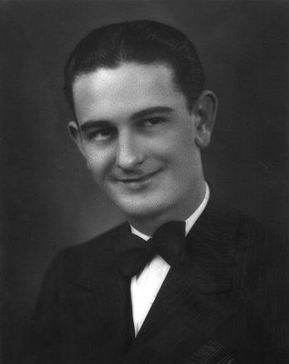
In 1926, Johnson enrolled in Southwest Texas State Teachers' College. He worked his way through school, participated in debate and campus politics, and edited the school newspaper called The College Star.
He graduating in 1930. Johnson taught in Texas from 1927-1930.

Slide 5
In 1930 he was appointed Congressman Richard M. Kleberg’s legislative secretary.
Johnson was elected speaker of the "Little Congress," a group of Congressional aides. Here he cultivated working relationships with Congressmen, newspapermen and lobbyists.
Johnson's friends soon included the aides to President Franklin D. Roosevelt

Slide 6
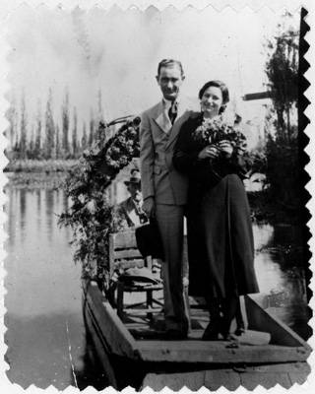
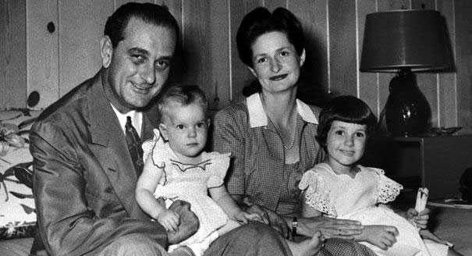
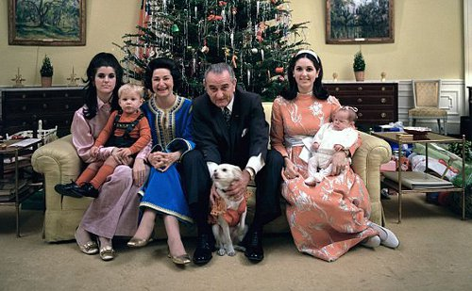
Johnson married Claudia Alta Taylor (nicknamed "Lady Bird") on November 17, 1934.
They had two daughters, Lynda Bird, born in 1944, and Luci Baines, born in 1947.
Johnson had a practice of giving people and animals names with his own initials.

Slide 7
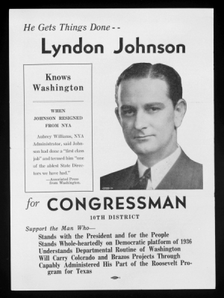
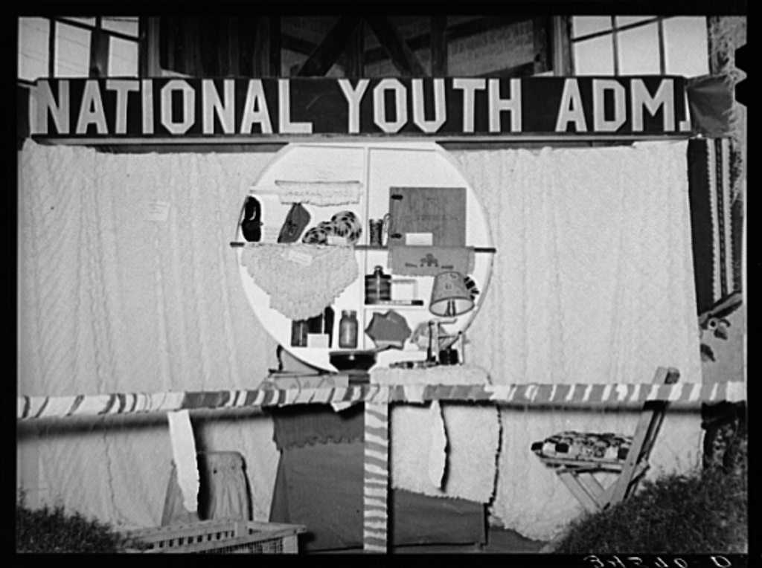
In 1935, he was appointed head of the Texas National Youth Administration. This enabled him to use the government to create education and job opportunities for young people.
He resigned two years later to run for Congress.

Slide 8
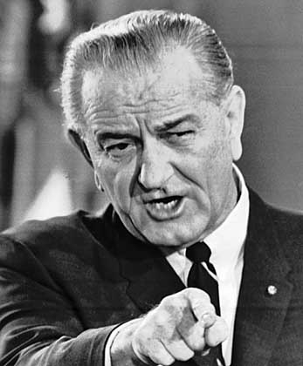
While serving in the House and Senate, Johnson had established a reputation for both his political talent and his ambition.
In 1954, he became Senate Majority Leader.

Slide 9
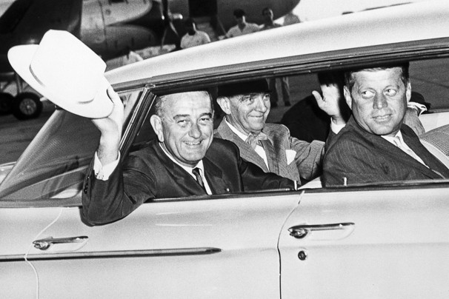
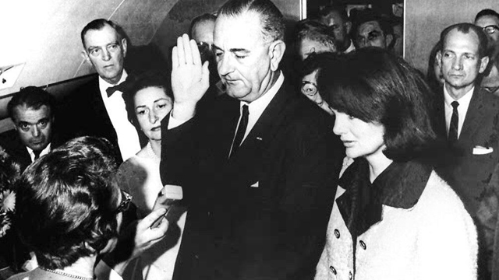
Kennedy had named Johnson his running mate in 1960 after Johnson’s own bid for the Democratic nomination had failed.
Johnson became President immediately after Kennedy’s death, taking the oath of office an hour and a half later.

Slide 10
Johnson

