Slide 1
Bell Work 2/14 Left side of Page 7
Bio-Poem: Lyndon B. Johnson
Your poem should follow this format:
Line 1 - Name
Line 2 - Three traits
Line 3 - He cares deeply about…
Line 4 - He is remembered for
Line 5 - Name

Slide 2
Create your Cornell note paper.
Write in the essential Question.
CORNELL NOTES | TOPIC/OBJECTIVE: | NAME:
 |  | CLASS/PERIOD:
 |  | DATE:
ESSENTIAL QUESTION: What did Johnson do for Civil Rights?
Notes:
Sample note organization styles:
Formal Outline
Informal Outline
Mind maps
Graphic Organizers
etc.

Slide 3
Johnson’s Civil Rights

Slide 4
Civil Rights Act

Slide 5
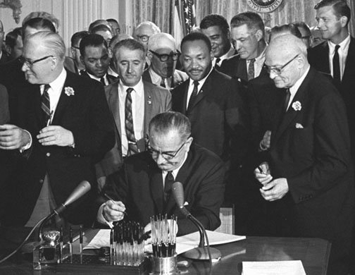
Civil Rights Act 1964
President Johnson signed the Civil Rights Act on July 2, 1964.
The law banned discrimination in employment and in public accommodations.

Slide 6
The South’s Reaction: Stop the Vote
The south kept people of color from voting with voting with:
Grandfather Clause: if your grandfather can vote you can vote.
Voting tests

Slide 7
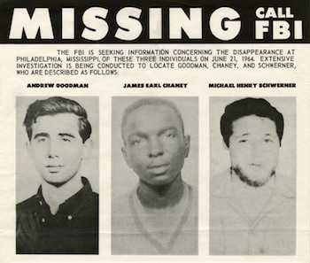
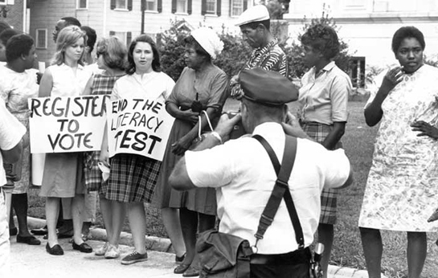
Freedom Summer
In 1964, leaders of the major civil rights groups organized a voter registration drive in Mississippi.
About 1,000 African American and white volunteers participated.
Violence plagued volunteers.
Andrew Goodman, and two CORE workers were killed on June 21, 1964.

Slide 8
Miss. Burning Start 1:10

Slide 9
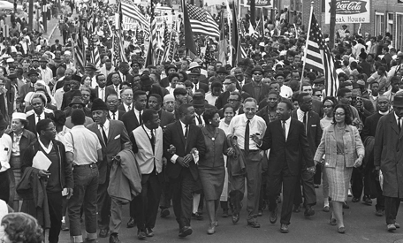
Selma Alabama
In March of 1965, SCLC members employed a direct-action technique in a voting-rights protest.
When protests were unsuccessful, they began to march from Selma to Montgomery, the state capital.

Slide 10
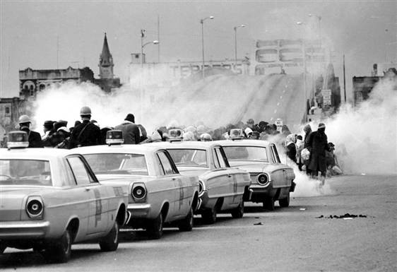
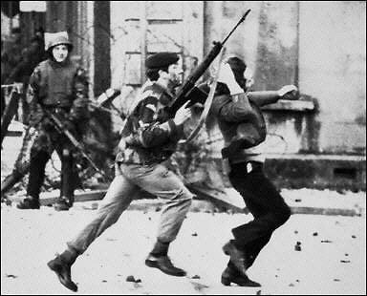
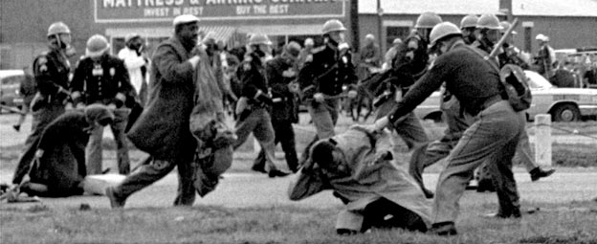
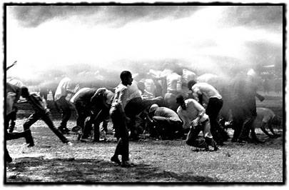
Selma Alabama
As marchers were leaving Selma, mounted police beat and tear-gassed them.
Televised scenes of the violence, called March 7, 1965 Bloody Sunday, shocked many Americans.

Slide 11
Selma

Slide 12
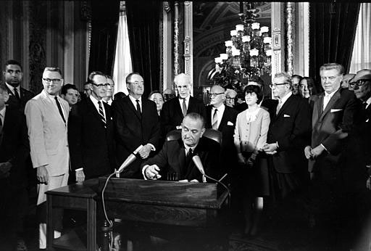
Voting Rights
President Johnson persuaded Congress to pass the Voting Rights Act of 1965.
The Act suspended the use of literacy and other voter qualification tests in voter registration.

Slide 13
Legacy of civil Rights

Slide 14
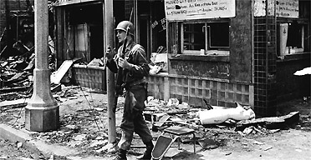
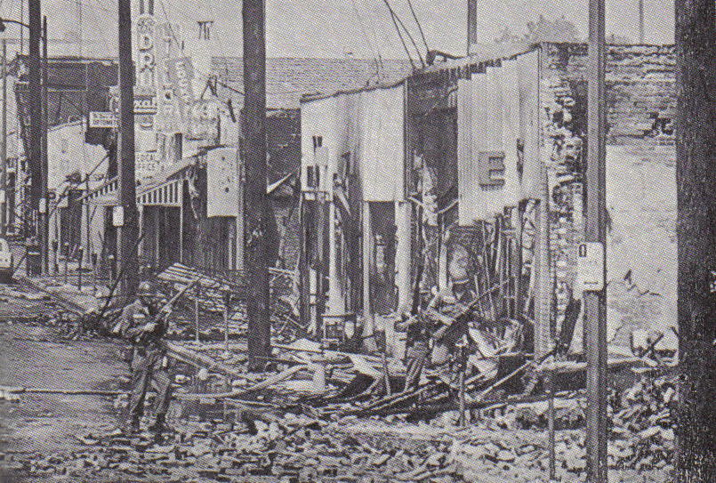
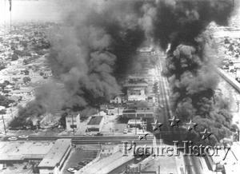
Riots in the Streets
The worst of these occurred in the Los Angeles neighborhood of Watts, August 11-17, 1965.
Encounters between a black man and the police touched off six days of rioting that left many killed or injured.

Slide 15
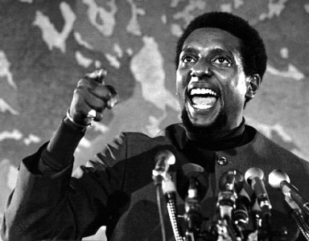
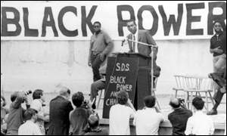
1966 SNCC Shifts Gears
SNCC became more radical under the leadership of Stokely Carmichael.
Carmichael advocated ideas of black power, which called upon African Americans to embrace their heritage, build communities, and lead their own organizations.
Black power fostered racial pride but also led to a major split in the civil rights movement.

Slide 16
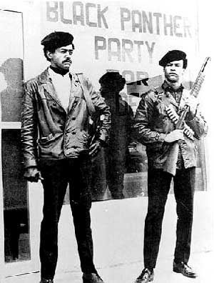
The Black Power Movement
In the fall of 1966, a new militant political party called the Black Panthers was formed.
The Black Panthers wanted African Americans to lead their own communities. They also demanded that the federal government rebuild the nation’s ghettos.
Because the Black Panthers monitored police activity in the ghettos, they often found themselves in violent encounters with police.
Bobby Seale, left, and Huey Newton, co-founders of the Black

Slide 17
Overall Results
The civil rights movement resulted in both advancement and disappointment for many Americans.
On one hand, segregation became illegal, and many more African Americans began to vote. The number of African American officials rose dramatically. Among these officials was Barbara Jordan, the first African American elected to the Texas state senate since Reconstruction.
On the other hand, many Americans were disappointed that change failed to come quickly.

