Slide 1
Video
Video

Slide 2
Bell Work #2 --- Page 6
answer these questions
Was a Foreign country involved in the Assassination?
What are your thoughts about Jack Ruby?
Do you think the U.S. government was involved?
was Oswald capable of executing the Assassination alone?

Slide 3
Kennedy Assassination Socratic Seminar

Slide 4
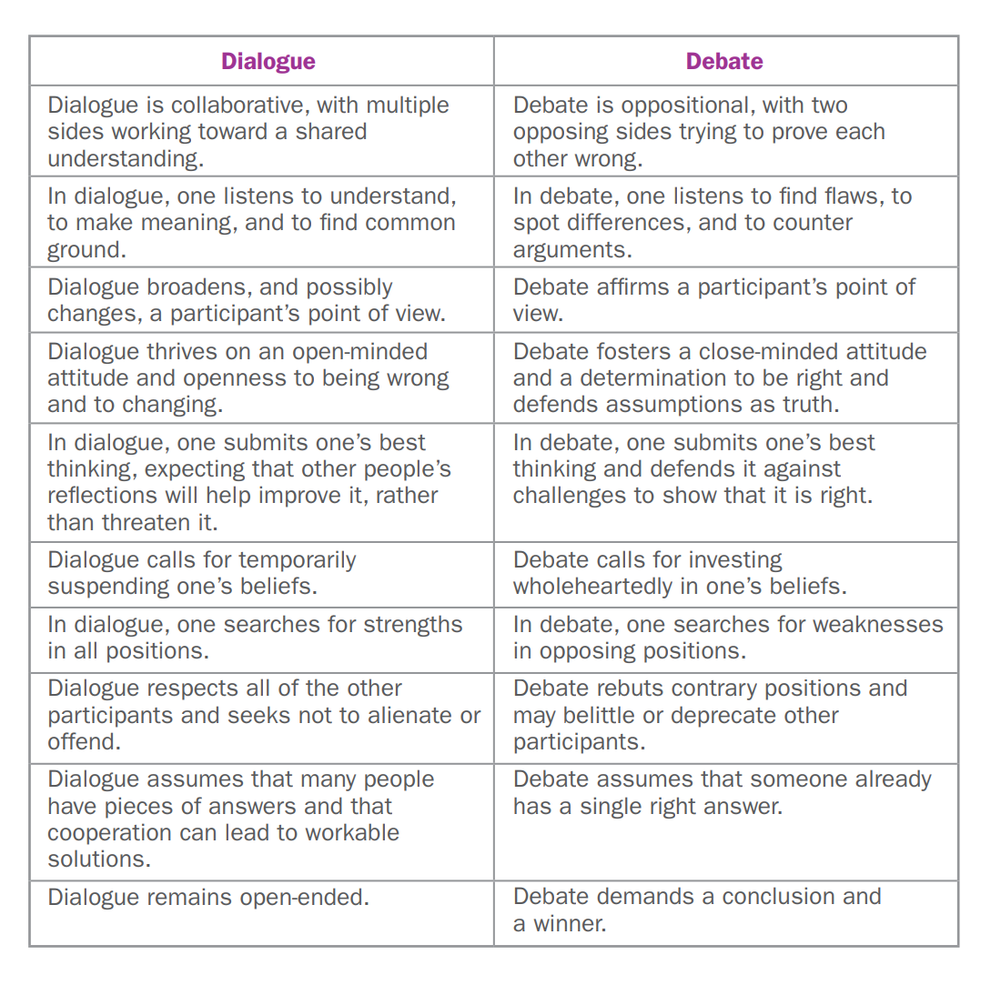

Slide 5
Group Discussion Questions
AS a group be prepared to answer these questions
Was a Foreign country involved in the Assassination?
What are your thoughts about Jack Ruby?
Do you think the U.S. government was involved?
was Oswald capable of executing the Assassination alone?

Slide 6
Question #1
Send the Group member sitting at the red square
Was a Foreign country involved in the Assassination?

Slide 7
Question #2
Send the Group member sitting at the Green square
What are your thoughts about Jack Ruby?

Slide 8
Question #3
Send the Group member sitting at the yellow square
Do you think the U.S. government was involved?

Slide 9
Question #4
Send the Group member sitting at the blue square
was Oswald capable of executing the Assassination alone?

Slide 10
Question #5
Send the last Group member sitting at the table
What do you think happened?

Slide 11
  Thesis/Claim (make sure idea can be proven).
  Content ____(Why do you think this? )___.
  (sources of Evidence) According to Paragraph # from Name of source_____ , it is shown that (evidence to prove thesis as shown in the document ) .
  Conclusion

