Slide 1
Bell Work 1/9 Left side of #38
Rank these JFK programs in order of what you feel are the most impacting:
Peace Corps
New Frontier (combating poverty & econ)
Space
Notes:
Bell

Slide 2
Kennedy’s Civil Rights

Slide 3
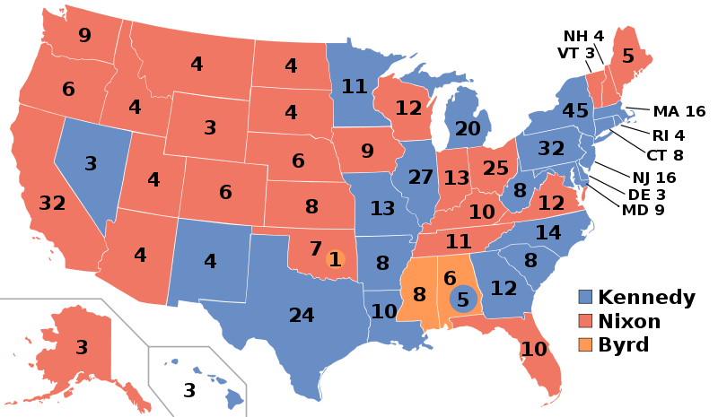
34 Votes

Slide 4
Sit-Ins
On February 1, 1960, four African American college students from North Carolina A&T University began protesting racial segregation in restaurants by sitting at “White Only” lunch counters and waiting to be served.
Within weeks sit-ins were taking place in cities across the South.

Slide 5
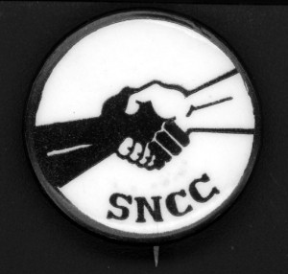
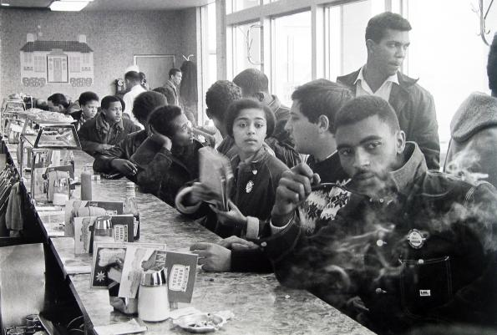
Sit-Ins
In April 1960, the Student Nonviolent Coordinating Committee (SNCC) was founded in Raleigh, North Carolina, to help organize and direct the student sit-in movement.
7,000 Students participate. 3,600 are arrested.

Slide 7
34 Votes

Slide 8
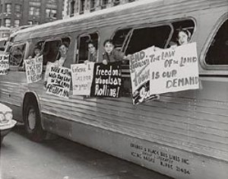
Freedom Riders
In 1961 SNCC members participated in the Freedom Rides organized by CORE.
The Freedom Riders, both African American and white, traveled around the South in buses to test the effectiveness of a 1960 U.S. Supreme Court decision declaring segregation illegal in bus stations open to interstate travel.

Slide 10
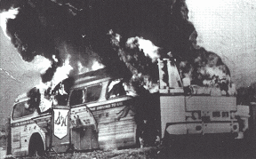
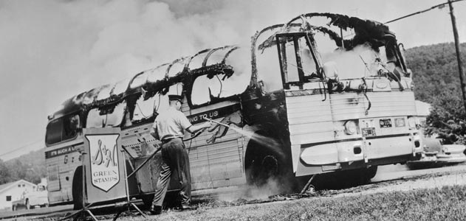
Freedom Riders
May 14,In Anniston, Alabama, one bus was burned and some riders were beaten.

Slide 11
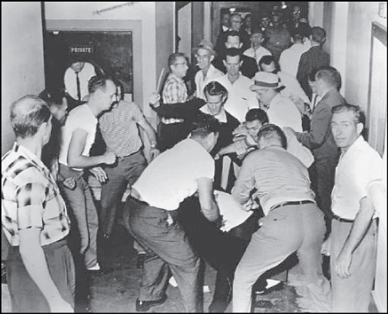
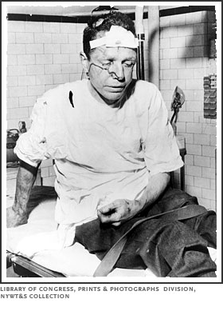
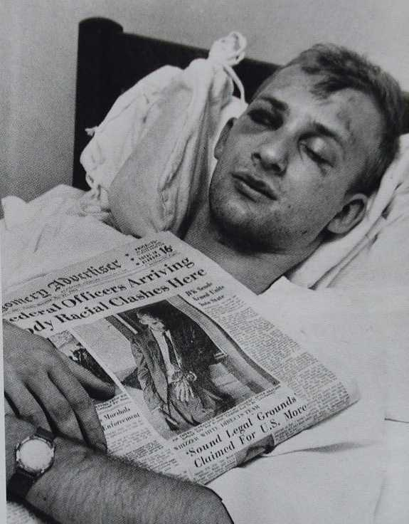
Freedom Riders
May 17, In Birmingham, a mob attacked the riders when they got off the bus.
May 20, The riders suffered even more severe beatings in Montgomery.

Slide 12
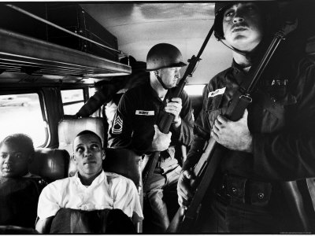
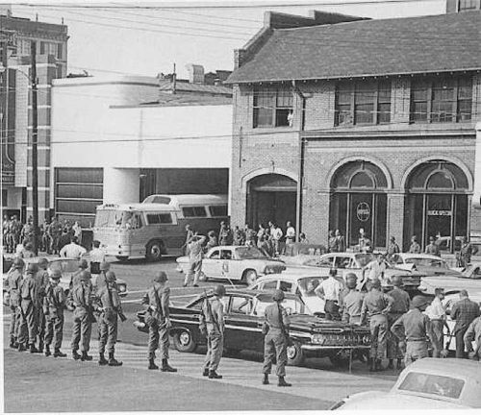
Freedom Riders
The violence brought national attention to the Freedom Riders.
The Kennedy administration stepped in to protect the Freedom Riders when it was clear that Alabama officials would not guarantee their safe travel.

Slide 13
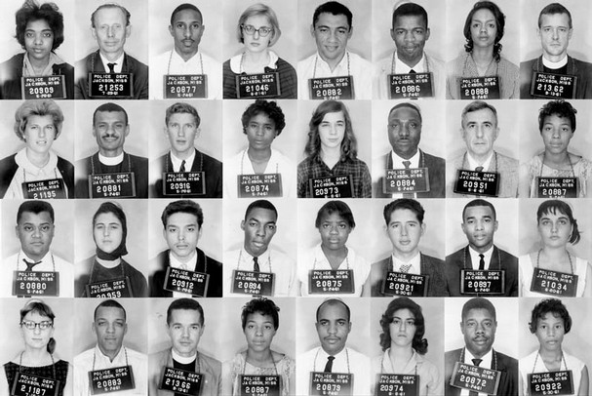
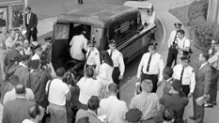
Freedom Riders
The riders continued on to Jackson, Mississippi, where they were arrested and imprisoned at the state penitentiary, ending the protest.
The Freedom Rides did result in the desegregation of some bus stations, but more importantly they caught the attention of the American public.

Slide 14
34 Votes

Slide 15
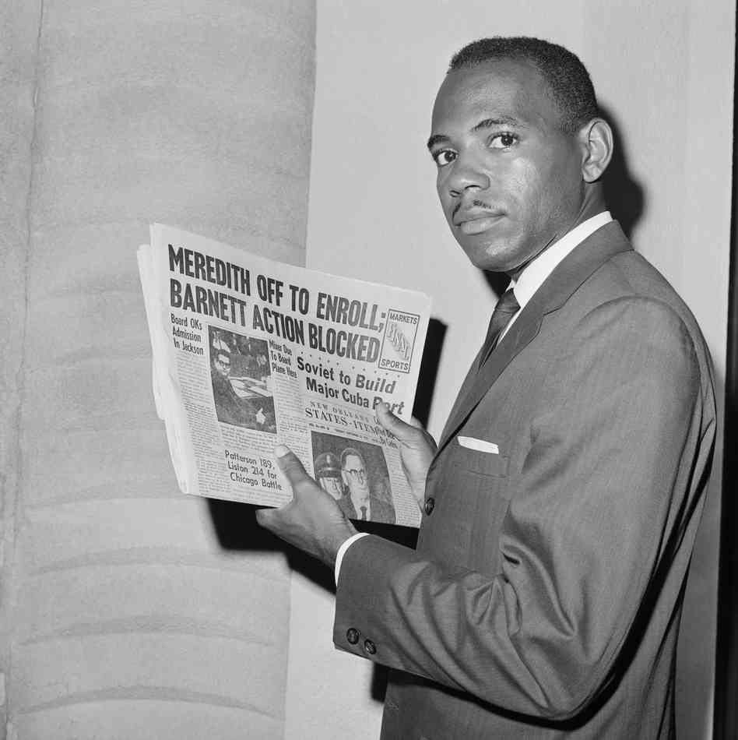
Desegregating Southern Universities
In 1962, James Meredith—an African American—was denied admission to the University of Mississippi.
After working through the state courts, Meredith was successful when a federal court ordered the university to desegregate and accept Meredith as a student.

Slide 16
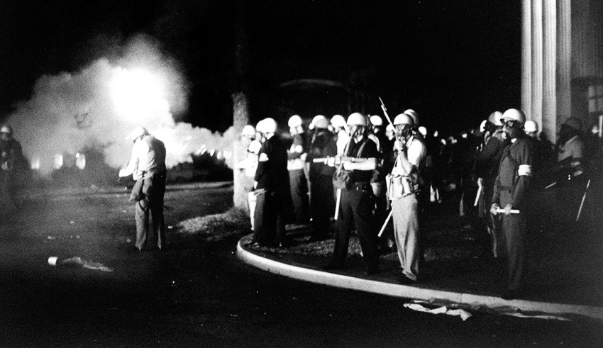
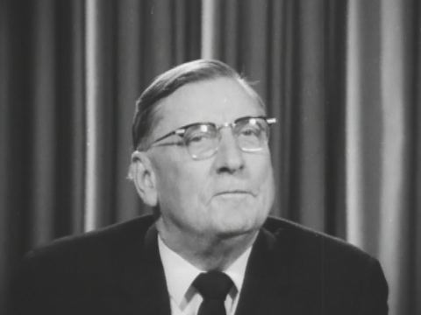
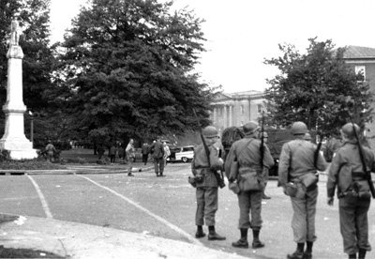
Desegregating Southern Universities
The Governor of Mississippi, Ross Barnett, defied the court order and tried to prevent Meredith from enrolling.
Kennedy sent federal troops to protect Meredith when he went to enroll.
During his first night on campus a riot broke out.
In the end, two people were killed and several hundred were wounded.

Slide 17
34 Votes

Slide 18
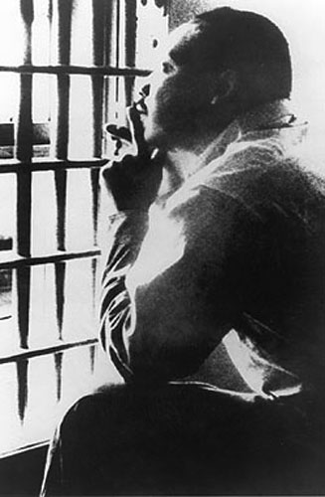
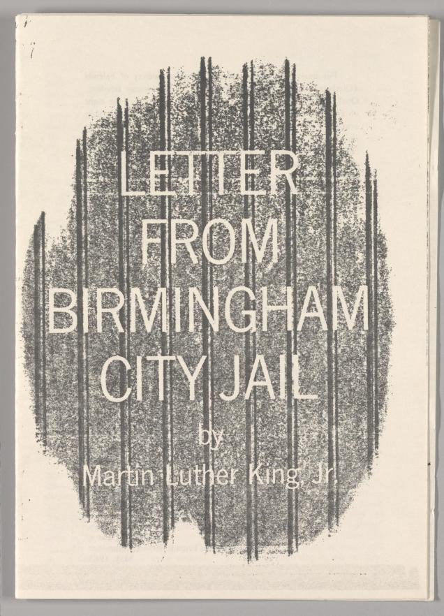
The Birmingham Campaign
City officials ordered civil rights protesters to end their work in Birmingham. When they did not, King and others were arrested.
While in Birmingham Jail, King wrote a famous letter defending his tactics and his timing.

Slide 19
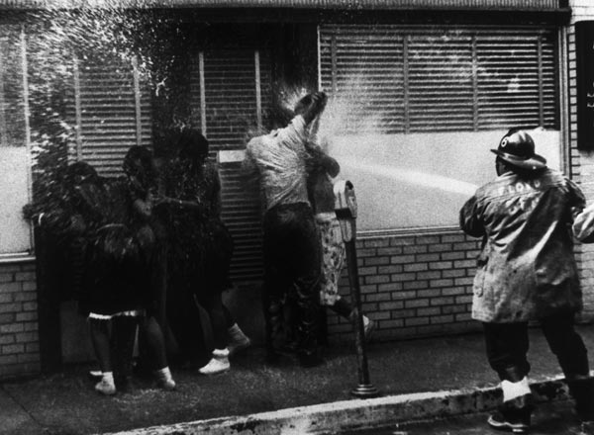
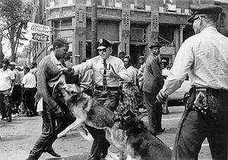
The Birmingham Campaign
May 1963, King raised money to fight Birmingham’s segregation laws.
A SCLC leader convinced King to use children for his protests.
Police Chief Eugene “Bull” Connor used police dogs and fire hoses to break up a group of about 2,500 student protesters. 900 children between ages six and eighteen were arrested.
Clip

Slide 20
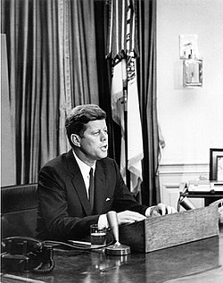
Result: Civil Rights Act 1964
A bill that gave all Americans the right to be served in facilities which are open to the public.

Slide 21
34 Votes

Slide 22
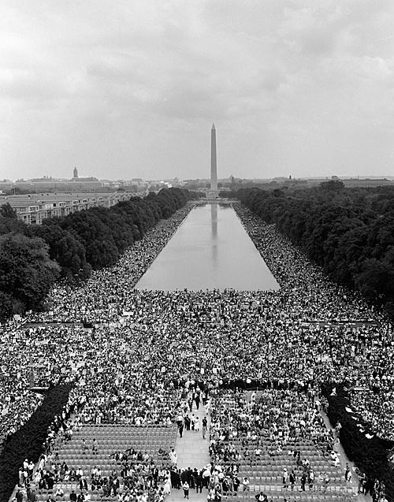
The March on Washington
August 28, 1963, planned by the NAACP, CORE, SCLC, the Urban League, and SNCC.
Martin Luther King, Jr., delivered a moving address to an audience of more than 200,000 people.

Slide 23
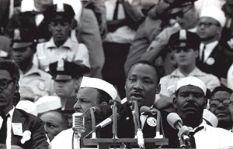
The March on Washington
His “I Have a Dream” speech—delivered in front of the giant statue of Abraham Lincoln—became famous for the way in which it expressed the ideals of the civil rights movement.
Speech

Slide 24
34 Votes

Slide 25
Unit 4
60. Blank
61. Unit 4 Guide
62. Bell Work 28
63. Kennedy Bio
64. Bell Work 29
65. Bay of Pigs
66. Bell Work 30
67. Cuban Missile Crisis
68. Bell Work 31
69. 1960 Election/New Frontier
70. Bell Work 32
71. Malcolm X and MLK
72. Bell Work 33
73. Kennedy’s Civil Rights

