Slide 1
Bell Work 11/5 (left side of page 22 )
Look at your map of Korea. If you were to attack them, where exactly would you do it?

Slide 2
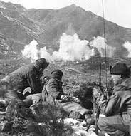
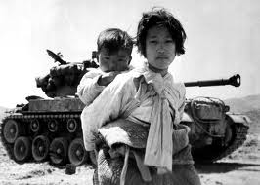
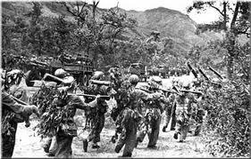
The Korean War 1950-1953
The Cold War: Development & Impact Globally

Slide 3
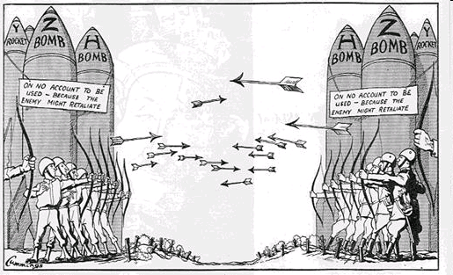
Proxy Wars
The Korean conflict is known as a Proxy war.
A proxy war or proxy warfare is a war that results when opposing powers use third parties as substitutes for fighting each other directly.

Slide 4
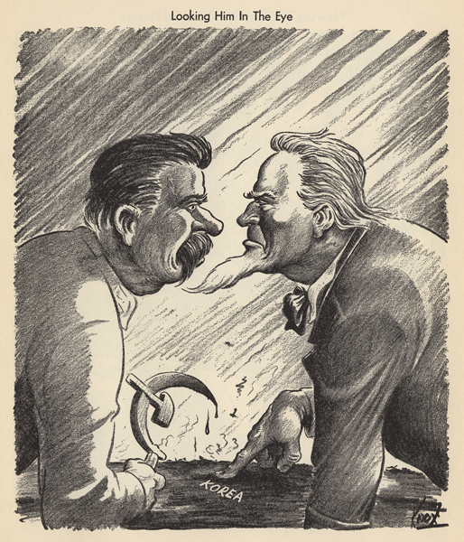

Slide 5
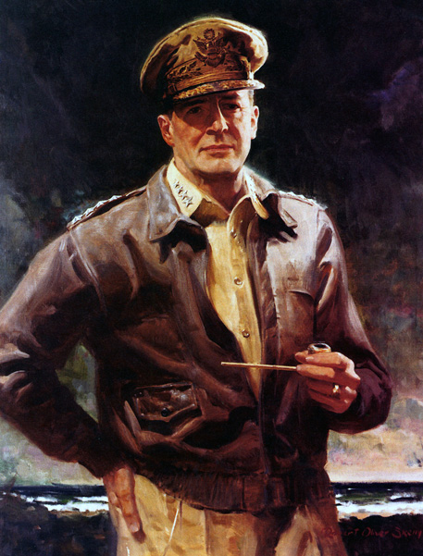
General Douglas MacArthur
Biography 2:05-10:12 19:40-23

Slide 6
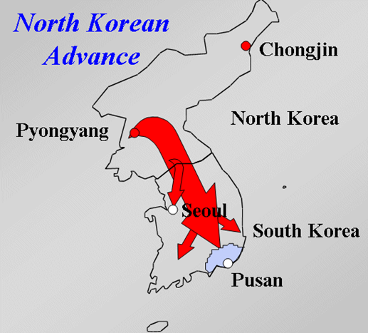
Korean War: Phase 1
North Korea Attacks South Korea
The North’s surprise attack pushes the South Korean army to the end of the Korean Peninsula.
The UN (United States) forces under the leadership of Douglas MacArthur mobilize.

Slide 7
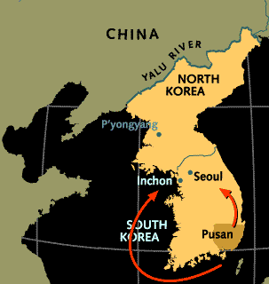
Korean War: Phase 2
The UN Forces Attack
2 Part Attack
Pusan
Inchon
Surprise attack to cut off the North Korean Army in the South.
Inchon
Within a month he retook Seoul & drove the North Koreans back to the 38th parallel

Slide 8
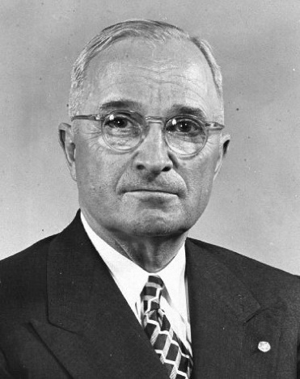
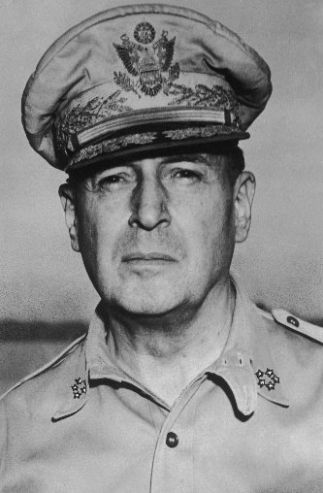
Decision 1
Truman’s Plan
MacArthur’s Plan
Containment Policy
The North Korean’s have been pushed back to the 38th Parallel
Use our forces to keep them there.
Rollback Policy
Liberate North Koreans from Communist rule & reuniting Korea

Slide 9
Decision 1
Truman’s Plan
MacArthur’s Plan
Decision: Rollback Policy
MacArthur promises Truman that the Chinese will not dare enter the war.

Slide 10
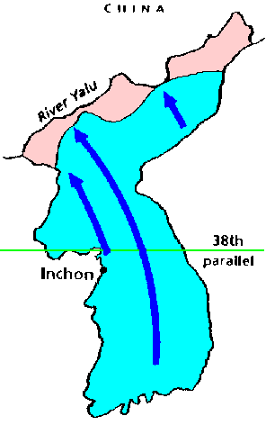
Korean War: Phase 3
The UN Forces Take North Korea
The UN forces pushed the North Koreans to the Chinese border.
Movement North 18:40 -23:52

Slide 11
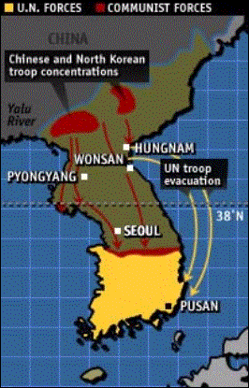
Korean War: Phase 4
The Chinese Attack
November 27,1950, a force of 200,000 Chinese joined 150,000 North Koreans & sent the UN troops into a rapid retreat.
Pyongyang was recaptured in December
End of 1950 North & their allies had retaken all land past the 38th parallel
Chosin Reservoir

Slide 12
Decision 2
Truman’s Plan
MacArthur’s Plan
Containment Policy
Only push the North Koreans/Chinese back to the 38th Parallel
Use our forces to keep them there.
Rollback Policy
Use nuclear weapons to defeat China and North Korea.

Slide 13
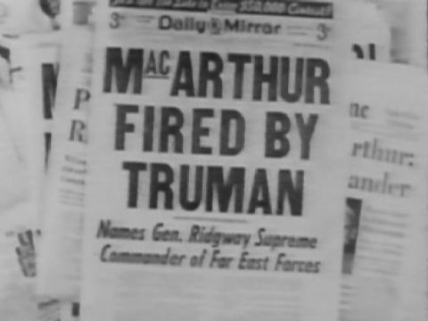
Decision 2
Truman’s Plan
MacArthur’s Plan
Decision: Containment
Truman and the Joint Chiefs were against MacArthur’s Plan
They are scared Stalin would retaliate by using it’s own nuclear weapons ---Start WWIII
MacArthur relieved of command in April 1951
The decision 1:47-

Slide 14
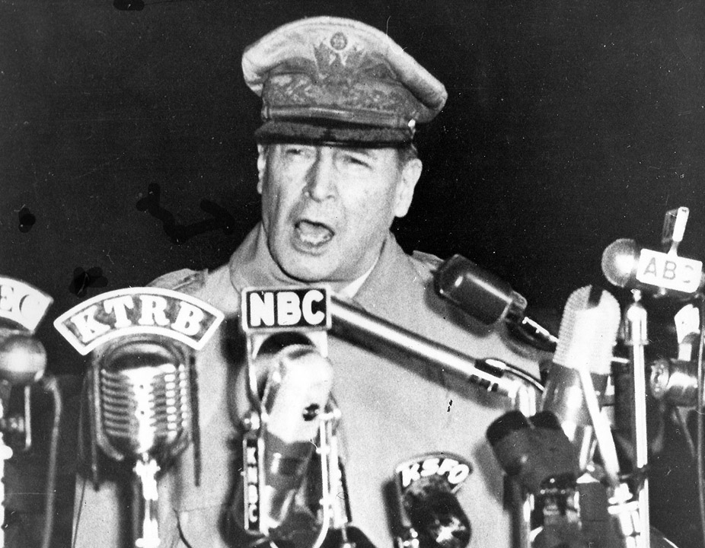
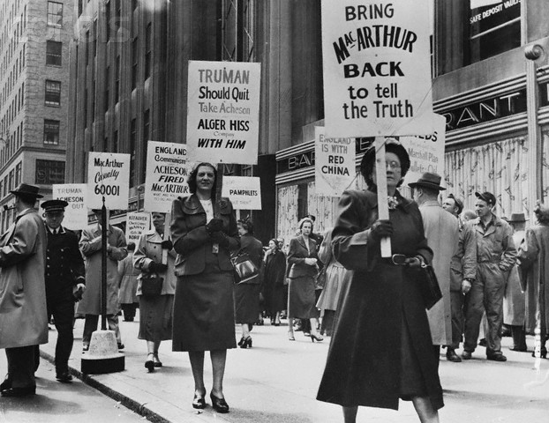
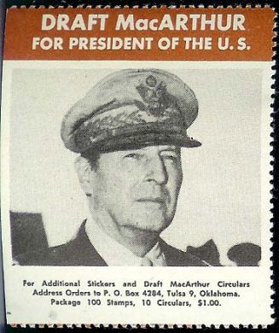

Slide 15
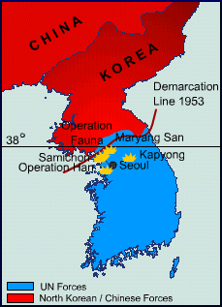
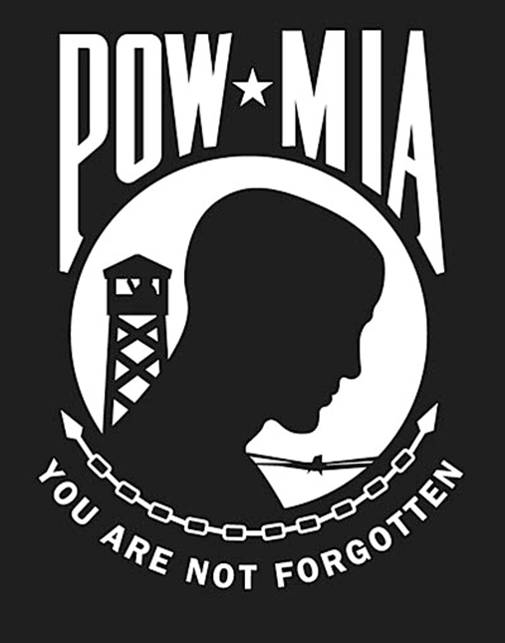
Korean War: Phase 5
Back to the 38th Parallel
Battle lines stabilized near the 38th parallel → stalemate 1951-1953
Main conflict: repatriation of POW’s
US & UN argued for voluntary returns
Chinese would only agree if a majority of North Koreans would return voluntarily, but this did not happen

Slide 16
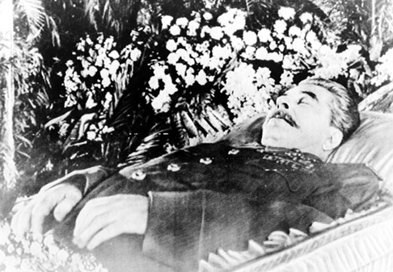
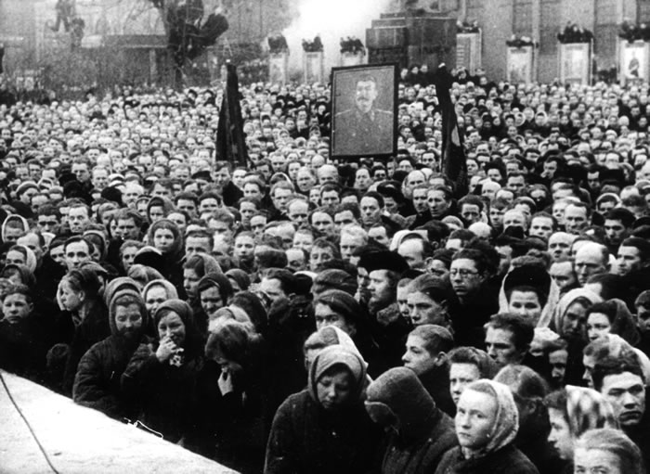
The End of Stalin
Stalin did not want to accept a Communist defeat in Korea
His death in March 1953 = critical to the end of the Korean War
Power struggle ensued in Soviet leadership → Korea no longer regarded as crucial to Soviet Power & influence

Slide 17
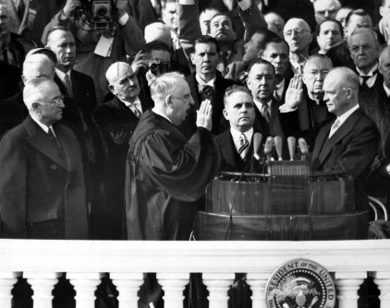
Change of Power In USA
New US president was Dwight Eisenhower
The election was partly based on withdrawal from Korea
Therefore, the 2 main powers did not see Korea as vital to their interest

Slide 18
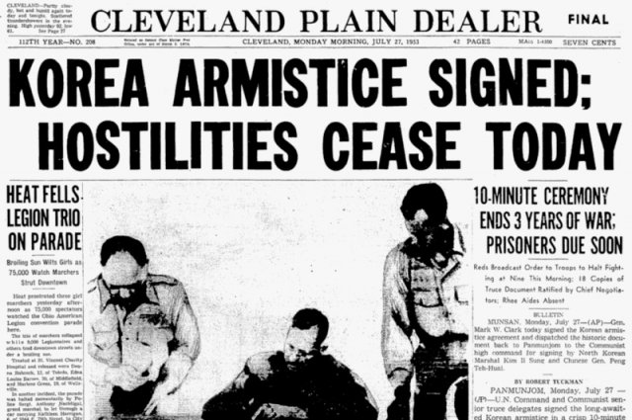
End of the Korean War
The war ended in a ceasefire; there was no victory
Ended on July 27th, 1953 with a truce; armistice signed
North Korea and South Korea remain divided
Tensions still exist today

Slide 19
The Korean Armistice Agreement:
Suspended open hostilities
Withdrew military forces and equipment from a 4000 meter wide zone (created a buffer between the two zones)
Prevented both sides from entering the air, ground, or seas on opposing sides
Released POWs
Establishes the Military Armistice Commission (MAC) + other agencies – used to ensure that the truce terms were followed

Slide 20
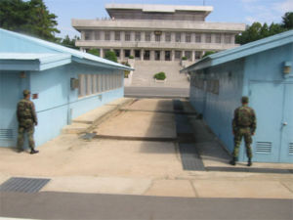
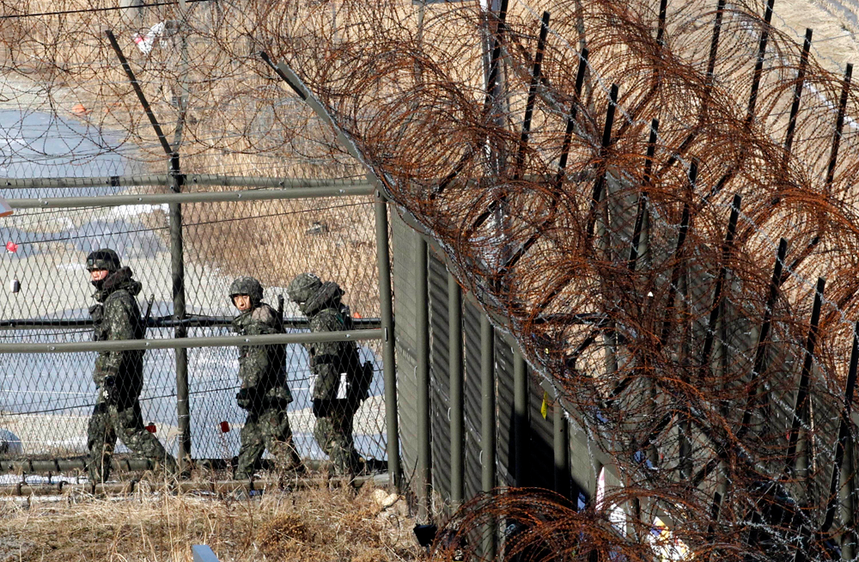
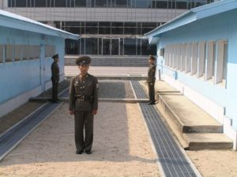
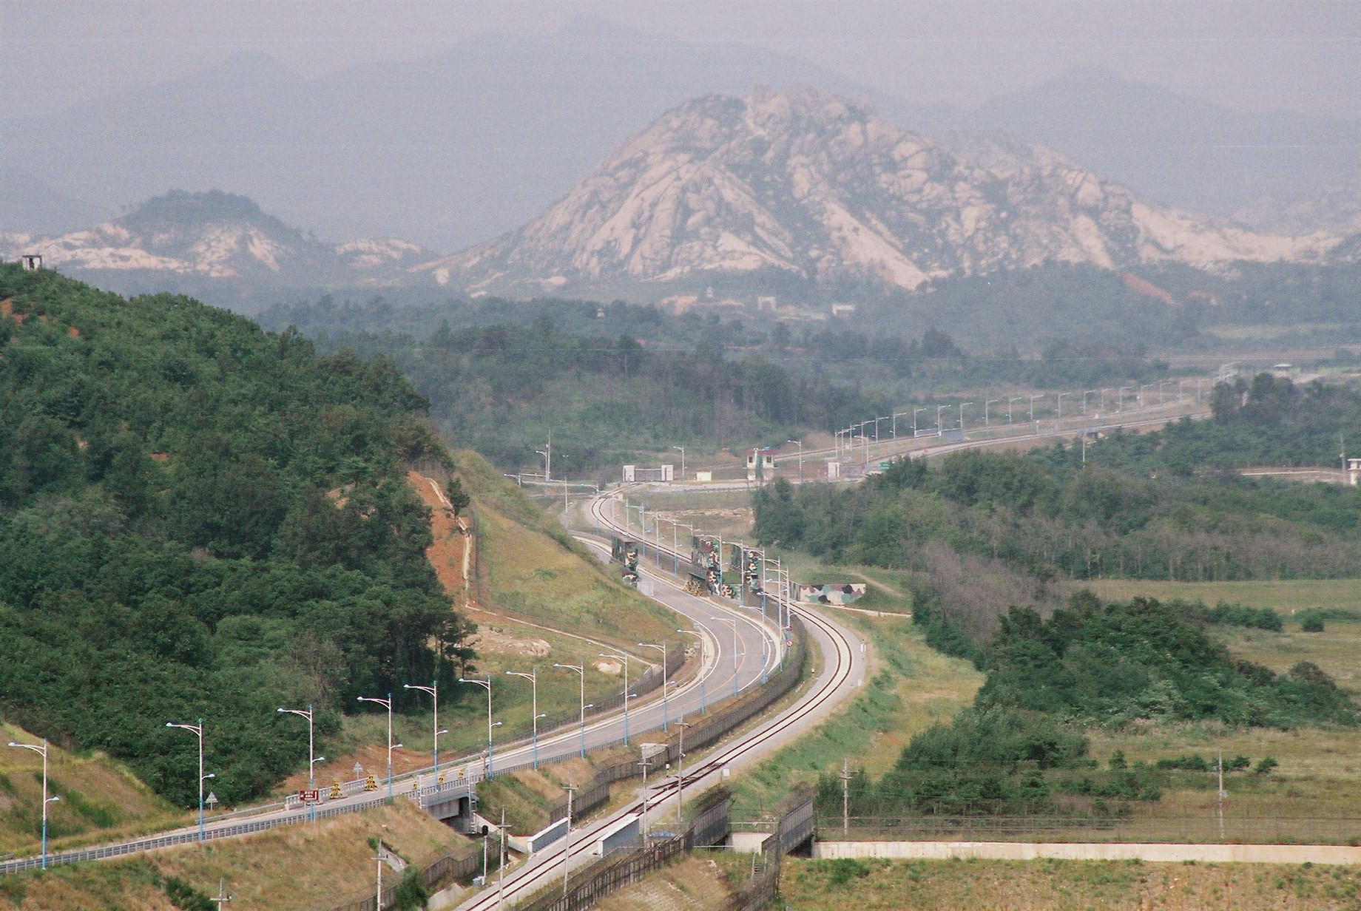
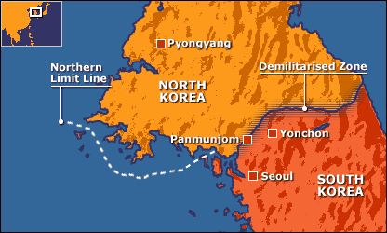
The DMZ
The Korean Demilitarized Zone is a strip of land running across the Korean Peninsula that serves as a buffer zone between North and South Korea. It is 155 miles long and approximately 2.5 miles wide, and is the most heavily armed border in the world
South Side
North Side

Slide 21
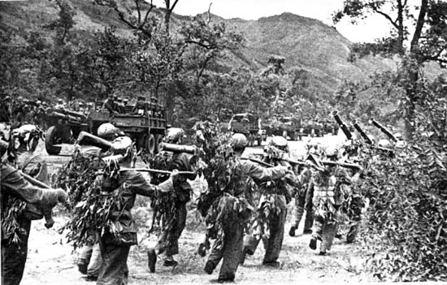
Korean War Changes in America
Warfare — Limited war, limited victory
Integration of the Military — First war in which white Americans and African Americans served in the same units

Slide 22
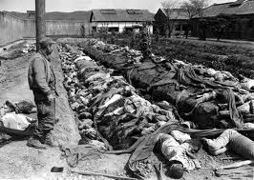
Cost of the War
For Korea
Cost in human lives & property was vast
$67 billion (1953 dollars); $670 billion (2016 dollars)
Much of North Korean land was severely damaged due aerial bombing
For the US
NSC-68’s recommendation to triple the defense budget was implemented
US defense spending increased dramatically turning at around 10% of American GNP in 1950
Heavy American casualties and many were taken as POW’s
DMZ today

