Slide 1
Language

Slide 2
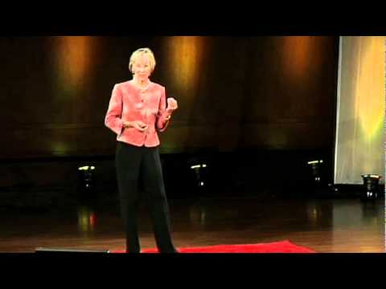
Patricia Kuhl - The linguistics of babies - Right Side
Why are babies geniuses compared to us?

Slide 3
One Pager Directions (pg 372-378)
Title appropriately to reflect the content of the Module
Use full color and fill the page.
2 meaningful quotes from the Module
At least 3 visual images that create focus to the ideas of the Module
Focus on the Concept of “how do we develop language”

