Slide 1
Bell Work 2/13 Left side of Page 7
Bio-Poem: Lyndon B. Johnson
Your poem should follow this format:
Line 1 - Name
Line 2 - Three traits
Line 3 - He cares deeply about…
Line 4 - He is remembered for
Line 5 - Name

Slide 2
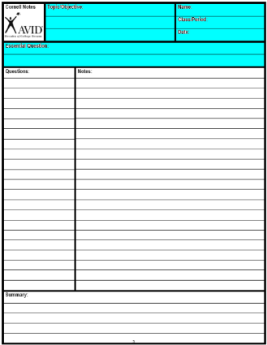
Create your Cornell note paper.
Write in the essential Question.
CORNELL NOTES | TOPIC/OBJECTIVE: | NAME:
 |  | CLASS/PERIOD:
 |  | DATE:
ESSENTIAL QUESTION: What did Johnson do for Civil Rights?
Notes:
Sample note organization styles:
Formal Outline
Informal Outline
Mind maps
Graphic Organizers
etc.

Slide 3
Johnson’s Civil Rights

Slide 4
Civil Rights Act

Slide 5
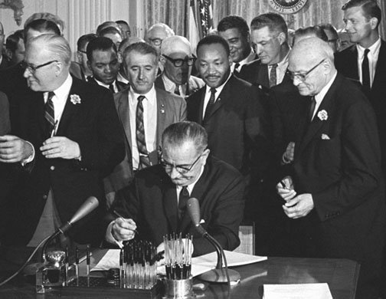
Civil Rights Act 1964
President Johnson signed the Civil Rights Act on July 2, 1964.
The law banned discrimination in employment and in public accommodations.

Slide 6
The South’s Reaction: Stop the Vote
The south kept people of color from voting with voting with:
Grandfather Clause: if your grandfather can vote you can vote.
Voting tests

Slide 7
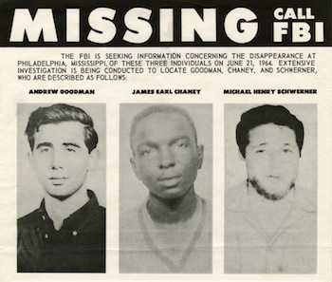
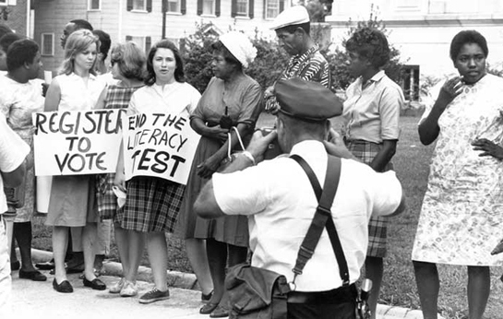
Freedom Summer
In 1964, leaders of the major civil rights groups organized a voter registration drive in Mississippi.
About 1,000 African American and white volunteers participated.
Violence plagued volunteers.
Andrew Goodman, and two CORE workers were killed on June 21, 1964.

Slide 8
Miss. Burning Start 1:10

