Slide 1
Look at your notes on Civil Rights on page 55 –chunk your notes into three catagories and create a question.

Slide 2
Unit 3 Notebook
42. Blank
43. Unit 3 Guide (ivory)
44. Bell Work # 18
45. Ike Bio
46. Bell Work # 19
47. Ike’s Foreign Policy
48. Bell Work # 20
49. Ike around the World
50. Bell Work #21
51. 1950’s At Home
52. Bell Work #22
53. Separate but Equal
54. Bell Work #23
55. Ike’s Civil Rights
56. Bell Work #24
57. Little Rock

Slide 3
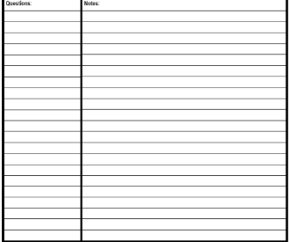
EQ: How did the NAACP force desegregation?
Divide your paper into three categories
Label the categories
  Gaining Access
  The School Year
  Results
Notes:
Sample note organization styles:
Formal Outline
Informal Outline
Mind maps
Graphic Organizers
etc.

Slide 4
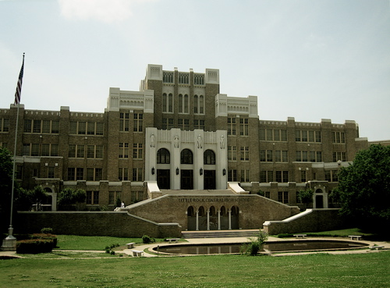
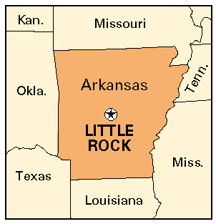
Little Rock Central High School, Arkansas

Slide 5
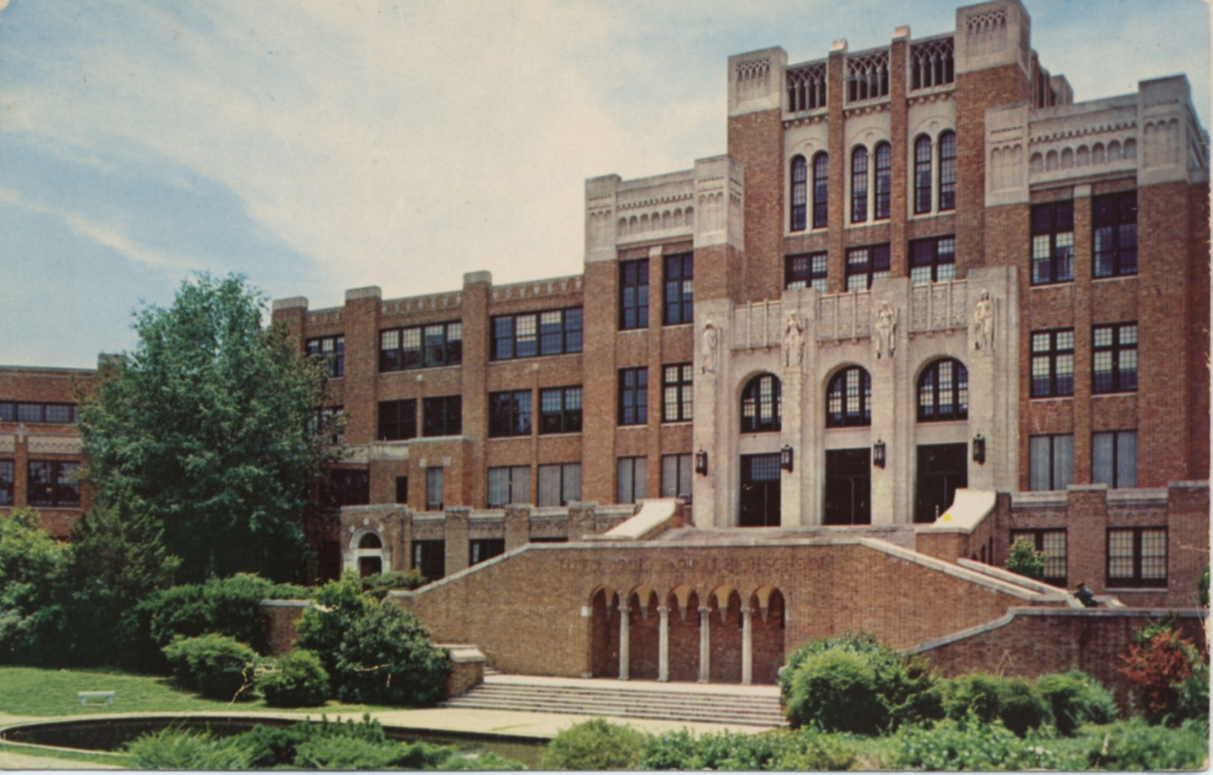
January 23, 1956
Twenty-seven black students attempt to register in all-white Little Rock schools, but are turned down.

Slide 6
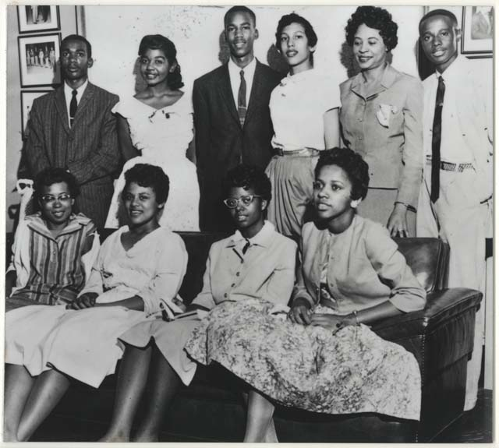
Spring, 1957
There were 517 black students who lived in the district and were eligible to attend Central in the fall.
Eighty expressed an interest
Following interviews with the Superintendent and staff, 17 are selected
Eight of those later decide to remain at all-black Horace Mann High School.
Ernest Green
Elizabeth Eckford
Jefferson Thomas
Terrence Roberts
Carlotta Walls Lanier
Minnijean Brown Trickey
Gloria Ray Karlmark
Thelma Mothershed-Wair

Slide 7
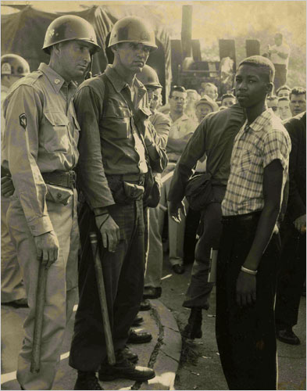
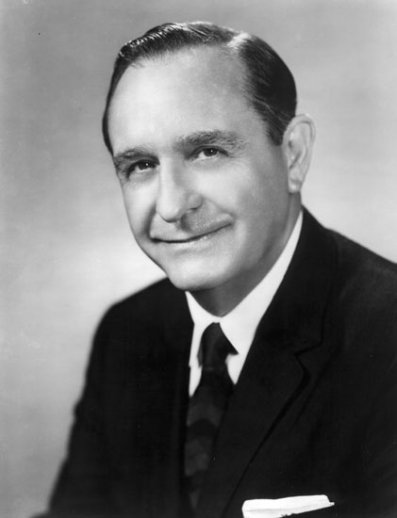
September 2, 1957
Governor Orval Faubus calls out the Arkansas National Guard to surround Little Rock Central High School to preserve the peace and avert violence
Faubus risked losing political support if he showed support for integration.

Slide 8
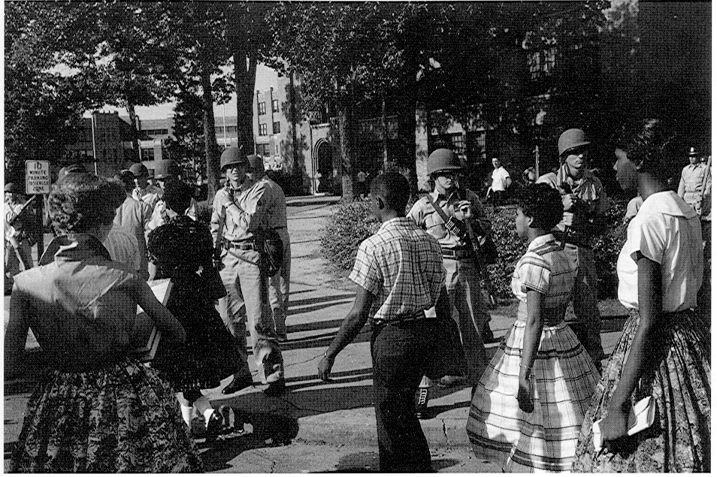
September 4, 1957
The nine black students attempt to enter Central High but are turned away by the National Guard.

Slide 9
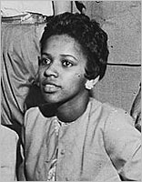
Elizabeth Eckford’s First day
Elizabeth didn’t get the message to meet the others and enter the school together----She goes to school alone on he first day and gets surrounded by the mob.
Elizabeth Eckford, recalled ‘’They moved closer and closer ... Somebody started yelling ... I tried to see a friendly face somewhere in the crowd someone who maybe could help. I looked into the face of an old woman who seemed to have a kind face, but when I looked at her again, she spat on me.’’

Slide 10
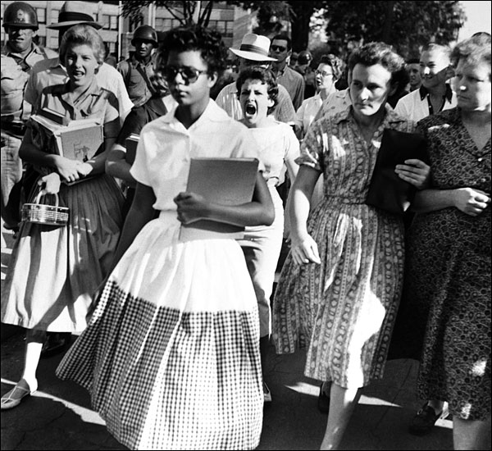

Slide 11
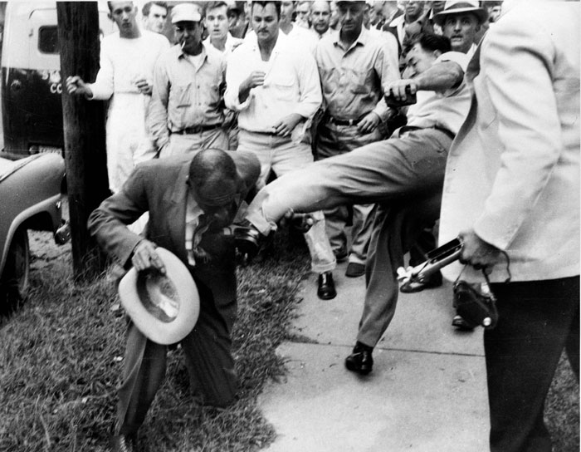
The First Day of School
Reporter Alex Wilson is attacked by the mob.

Slide 12
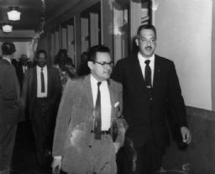
Result
A Judge granted NAACP lawyers Thurgood Marshall & Wiley Branton an injunction that prevented the Governor from using the National Guard to deny the nine black students admittance to Central High.
Governor Faubus announced that he would comply with the court order but suggested that the nine stay away for their own safety.

Slide 13
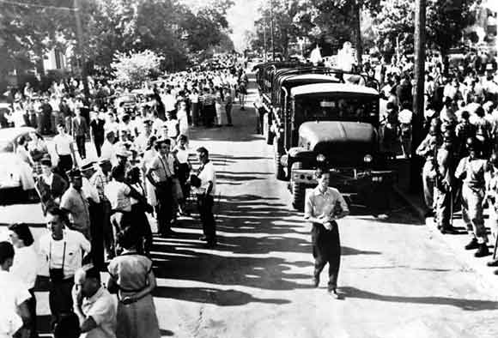
September 23, 1957
As a crowd of 1,000 mills around in front of the school, the nine black students go inside through a side door.

Slide 14
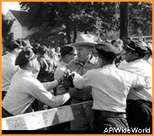
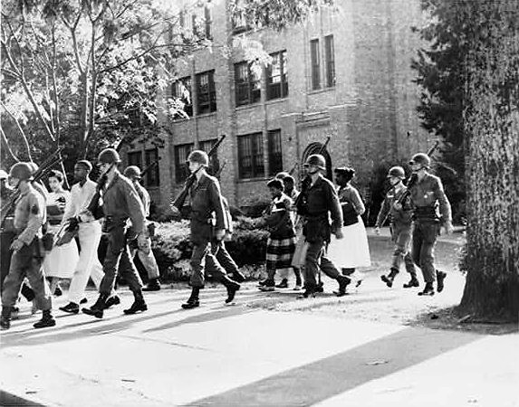
September 23, 1957
When the mob learns the students are inside, it becomes unruly and the police fear they will be unable to maintain control. The black students are taken out of the school through a side door.

Slide 15
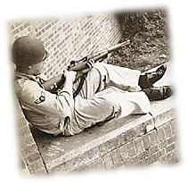
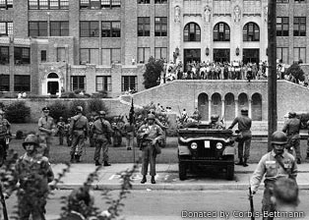
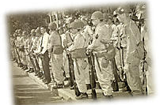
September 24, 1957
President Eisenhower announces he is sending 1,000 members of the 101st Airborne Division to Little Rock. He federalizes the 10,000-man Arkansas National Guard.

Slide 16
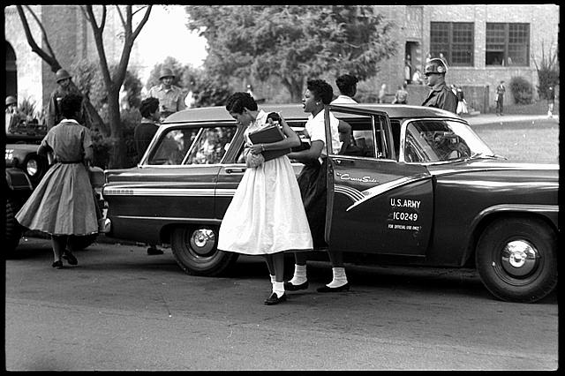
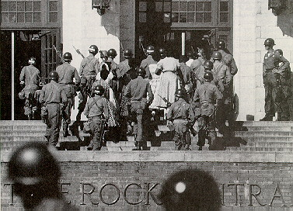
September 25, 1957
Under escort by the Army troops, the nine black students are escorted back into Central High.

Slide 17
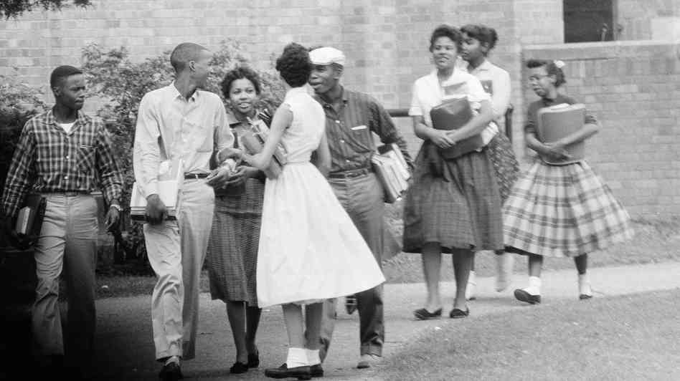
A Tense Year
After a few weeks the patrollers left the nine students to fend for themselves.
Minnijean Brown said ‘’I was one of the kids 'approved' by the school officials. We were told we would have to take a lot and were warned not to fight back if anything happened.

Slide 18
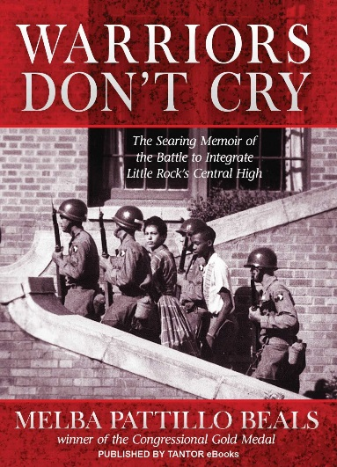
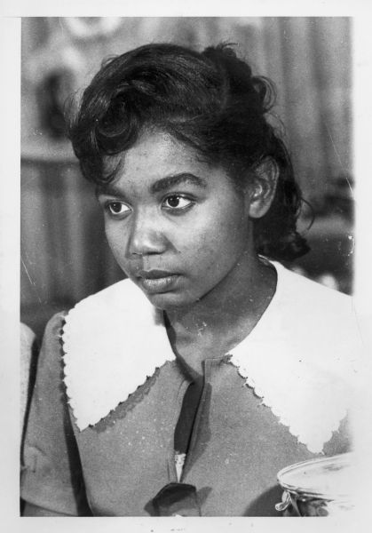
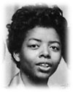
The First Few Weeks
Even though the nine were admitted to Little Rock Central High under the protection of the U.S Army, the students were still subjected to physical and verbal abuse by many of the white students.
A group of students stabbed Melba Patillo and sprayed acid into her eyes. If it weren’t for the 101st patroller throwing water over her eyes she would have been blind for the rest of her life.
Minnijean Brown was suspended for dumping her lunch on two white males because they were insulting her.

Slide 19
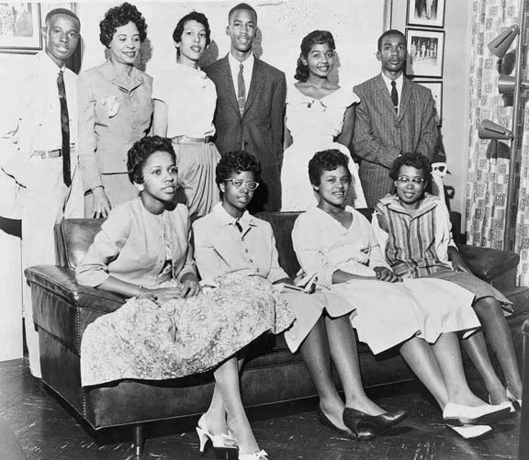
The Result
The other 8 did finish out the year.
After that year
  Three of the students moved away.
  The remaining five took correspondence courses from the University of Arkansas.

Slide 20
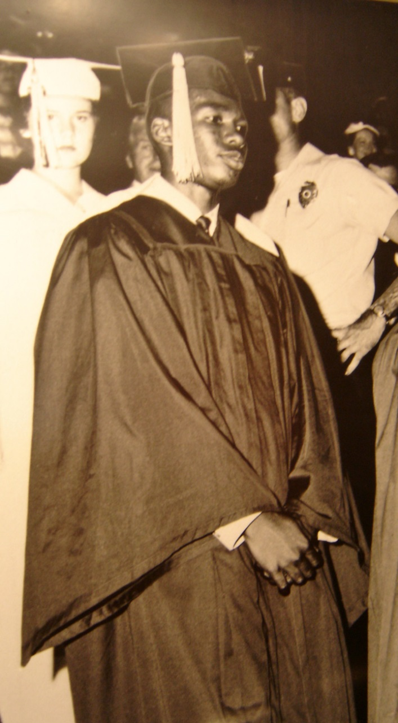
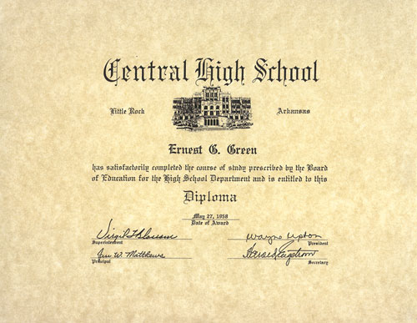
Ernest Green graduated that year. He was the first black to ever graduate from Central High.

Slide 21
September 1958
Because of Governor Faubus’ orders, the public high schools in Little Rock closed, leaving students searching for alternatives.
The majority of the students ended up in private schools, while others simply moved out of the state.
In having to deal with all of this chaos, students felt frustration, and some school board members who were fed up decided to resign.
With open spots in the school board, many segregationists decided to run for office so that school integration would cease.
As school board members, segregationists fired those who publicly supported integration.
Finally, in the fall of 1959 the schools reopened due to a federal court decision that declared it unlawful for public schools to be closed to the public.

Slide 22
Fall, 1972
All grades in Little Rock public schools are finally integrated.

Slide 23
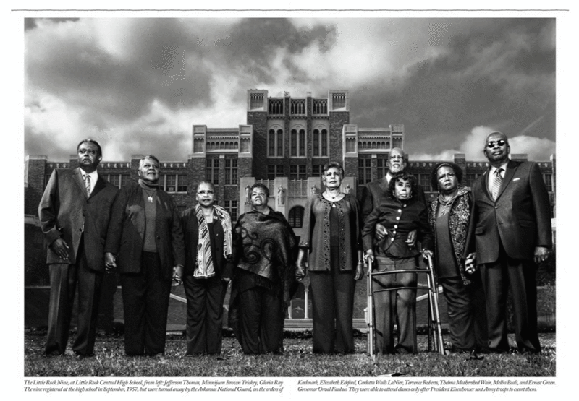

Slide 24
The Future of the Nine
Ernest Green In 1958, he became the first black student to graduate from Central High School. He graduated from Michigan State University and served as Assistant Secretary of Housing and Urban Affairs under President Jimmy Carter.
Elizabeth Eckford The only one of the nine still living in Little Rock, Elizabeth made a career of the U.S. Army that included work as a journalist. In 1974, she returned to the home in which she grew up and is now a part-time social worker and mother of two sons.
Jefferson Thomas graduated from Central in 1960, following a year in which Little Rock's public high schools were ordered closed by the legislature to prevent desegregation. Today, he is an accountant with the U.S. Department of Defense and lives in Anaheim, Calif.
Dr. Terrence Roberts Following the historic year at Central, his family moved to Los Angeles where he completed high school. He earned a doctorate degree and teaches at the University of California at Los Angeles and Antioc College. He also is a clinical psychologist.
Carlotta Walls Lanier One of only three of the nine who eventually graduated from Central, she and Jefferson Thomas returned for their senior year in 1959. She graduated from Michigan State University and presently lives in Englewood, Colorado, where she is in real estate.
Minnijean Brown Trickey was expelled from Central High in February, 1958, after several incidents, including her dumping a bowl of chili on one of her antagonists in the school cafeteria. She moved with her husband to Canada during the Vietnam War of the 1960s and today is a writer and social worker in Ontario.
Gloria Ray Karlmark graduated from Illinois Technical College and received a post-graduate degree in Stockholm, Sweden. She was a prolific computer science writer and at one time successfully published magazines in 39 countries. Now retired, she divides her time between homes in Amsterdam, The Netherlands, and Stockholm.
Thelma Mothershed-Wair graduated from college, then made a career of teaching. She lives in Belleville, Illinois, where she is a volunteer in a program for abused women.
Melba Pattillo Beals is an author and former journalist for People magazine and NBC and lives in San Francisco.

Slide 25
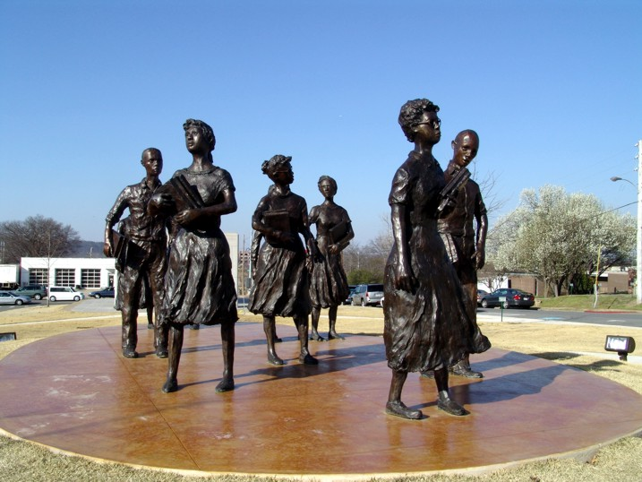
Tribute
The Little Rock Nine depicted in Testament, a 2005 sculpture by John and Cathy Deering, on the grounds of the Arkansas State Capitol
clip

Slide 26
Symbol | Revision
1,2,3… or A,B,C… | 1. Number the notes for each new concept or main idea.
Key Word | 2. Circle Vocabulary/Key terms
Main Idea | 3. Underline or highlight main ideas
^ | 4. Fill in gaps of missing info or reword.
Unimportant | 5.Cross out unimportant info.
? | 6. Identify points of confusion
* | 7. Identify info to be used on a test
Visual/Symbol | Create a visual symbol to represent information
Revise Notes

Slide 27
Bell Work #26—Page 56
Rank the 4 Civil Rights achievement for Ike. #1 is the most important to history and #4 is the least.
Explain your rankings.
  (Brown v. Board, Emmitt Till, Montgomery Bus Boycott, and Little Rock 9)
Notes:
Bell

Slide 28
Bell Work #27—Page 58
In “Remember the Titans”, would there have been a difference if Coach Yoast would have been named head coach instead of Coach Boone.
Explain your answer
Notes:
Bell

