Slide 1
Bell Work #15 (Page 30)
Work together as a table to write a paragraph—
Writing prompt: Which person is correct about the Cold War? Paragraph Format:
Thesis/Claim (pick a person)
Content ____(tell me what you know)____________
Proof: According to Document/Source ____(Letter or #)___, from __(Name of source)_____, it is shown that___(evidence to prove thesis as shown in the document)_____.
Conclusion

Slide 2
22. Bell Work #11 23. Unit 2 Study Guide 24. Bell Work # 12 25. Truman Bio 26. Bell Work #13 27. Cold War Map 28. Bell Work #14 29. The Beginning of the Cold War 30. Bell Work #15 31. Problems Truman Faced 32. Bell Work #16 33. The Containment Policy

Slide 3
PRESIDENT HARRY S. TRUMAN'S ADDRESS BEFORE A JOINT SESSION OF CONGRESS, MARCH 12, 1947
“At the present moment in world history nearly every nation must choose between alternative ways of life. The choice is too often not a free one.
One way of life is based upon the will of the majority, and is distinguished by free institutions, representative government, free elections, guarantees of individual liberty, freedom of speech and religion, and freedom from political oppression.
The second way of life is based upon the will of a minority forcibly imposed upon the majority. It relies upon terror and oppression, a controlled press and radio; fixed elections, and the suppression of personal freedoms.
I believe that it must be the policy of the United States to support free peoples who are resisting attempted subjugation by armed minorities or by outside pressures.
I believe that we must assist free peoples to work out their own destinies in their own way.
I believe that our help should be primarily through economic and financial aid which is essential to economic stability and orderly political processes.”

Slide 4
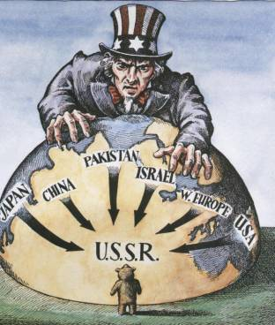
Containment
The American policy of containment accepted the fact that Eastern Europe was under Communist control, but sought to prevent Communist governments from forming elsewhere in the world.
It called for the United States to resist Soviet attempts to form Communist governments elsewhere in the world

Slide 5
The Marshall Plan
The Marshall Plan was created in 1947 by U.S. Secretary of State George C. Marshall as a means to achieve the goals of containment and the Truman Doctrine.
According to the Marshall Plan, participating nations would design recovery programs and would receive financial aid from the United States if they promised not to create a communist government.
Seventeen Western European nations joined the plan, receiving a total of $17 billion in aid.
Marshall Plan

Slide 6
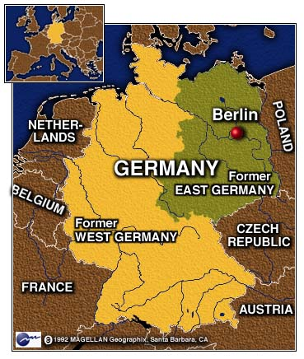
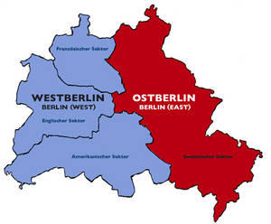
Germany
As part of the postwar division of Germany, the city of Berlin, located in Communist East Germany, was divided into West Berlin (capitalist) and East Berlin (Communist).

Slide 8
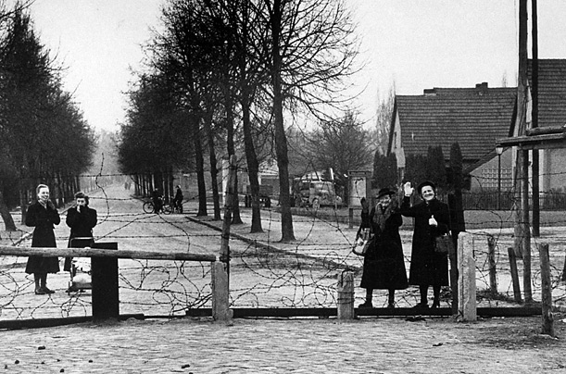
Early Division

Slide 9
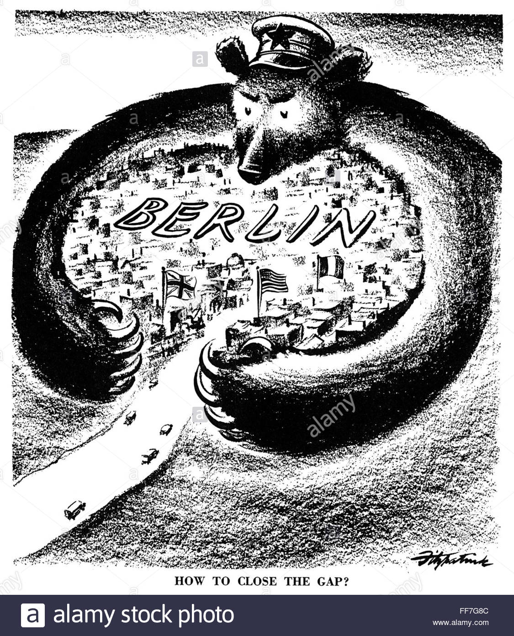
The Berlin blockade
In June 1948, Stalin banned all shipments to West Berlin through East Germany, creating a blockade which threatened to cut off supplies to the city. No food or electricity would be allowed to be supplied in the Western region.
In the winter of 1948-1949 , Berliners found their stockpiles of food and coal gone. They chopped down all the trees in the city for fuel and scavenged garbage cans for food.

Slide 10
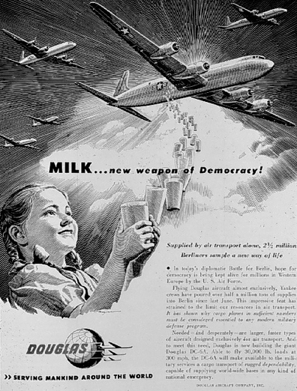
The Berlin Airlift
In response, Allied nations began the Berlin airlift, which delivered thousands of tons of food and other supplies to West Berlin via air.

Slide 11
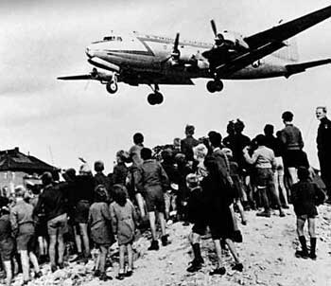
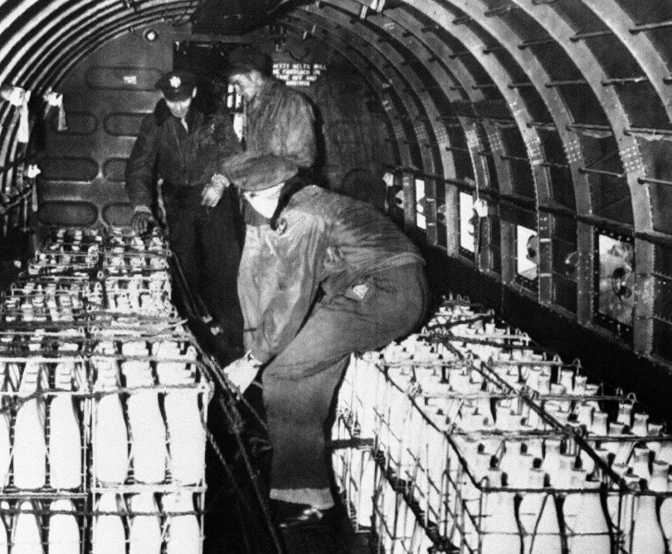
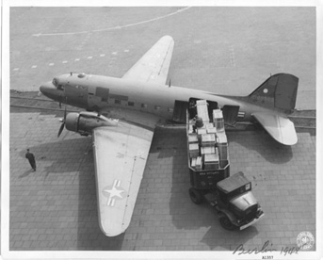

Slide 12
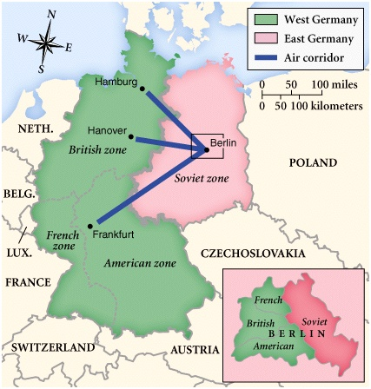

Slide 13
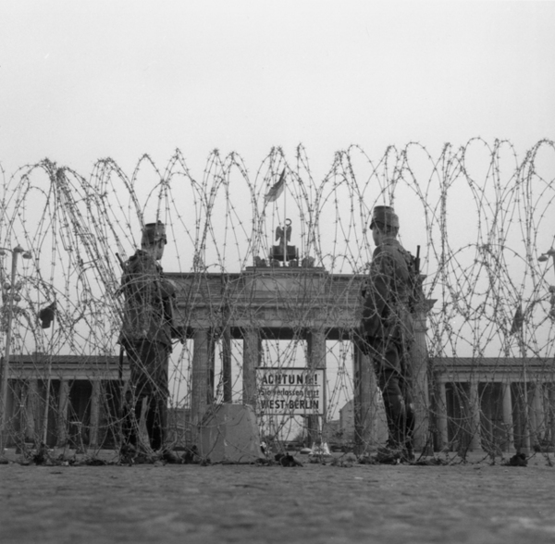
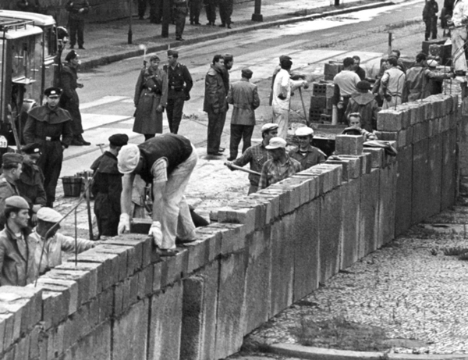
The Berlin Wall

Slide 14
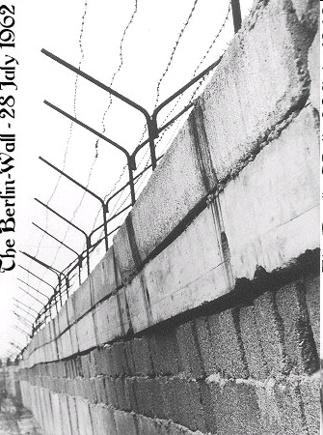
The division of Berlin was planned as a temporary measure.
The Soviet Union demanded that the division of the city be made permanent.
They hoped this would reduce the flow of East Germans escaping through Berlin to West Germany.

Slide 15
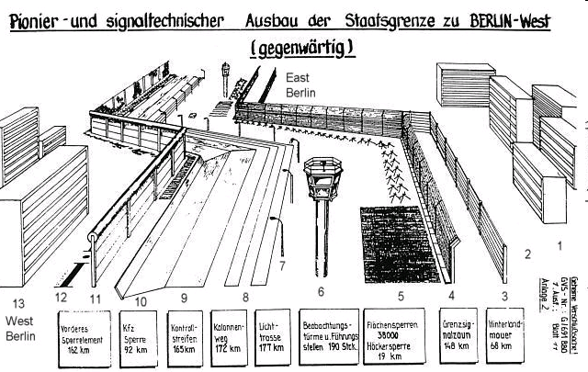

Slide 16
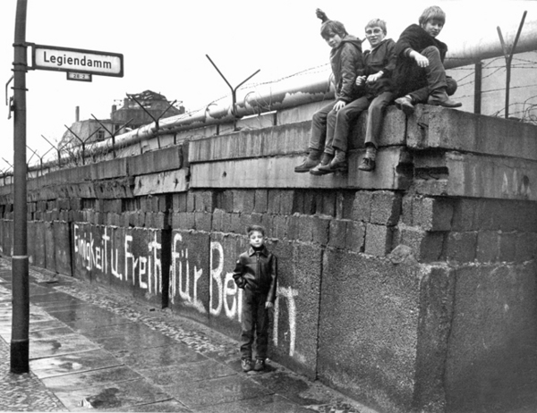

Slide 17
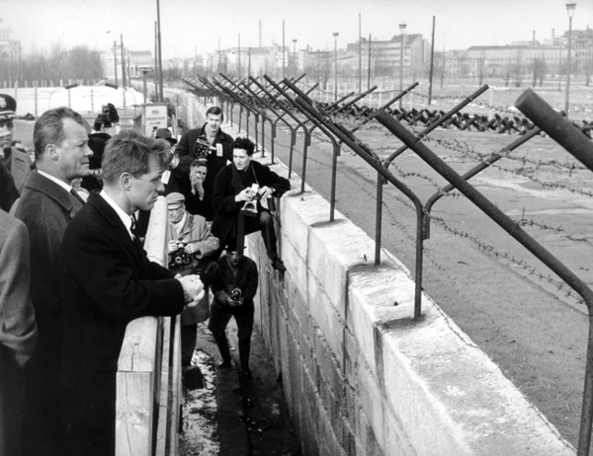

Slide 18
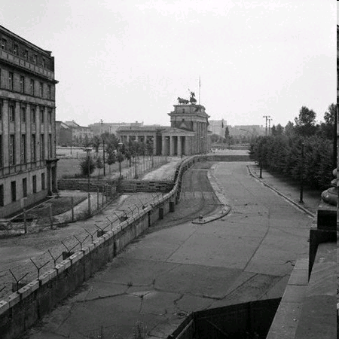
Known as the "death strip," the area between the walls included guard towers, barbed-wire fences, anti-vehicle trenches and guard dogs.

Slide 19
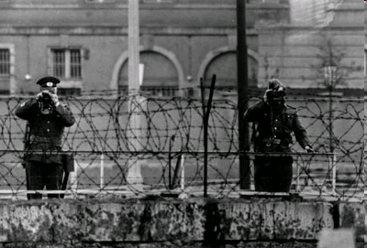

Slide 21
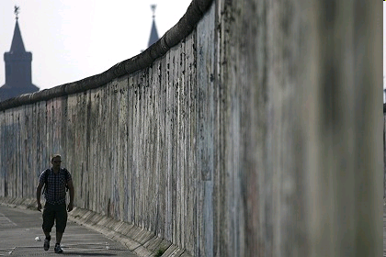

Slide 22
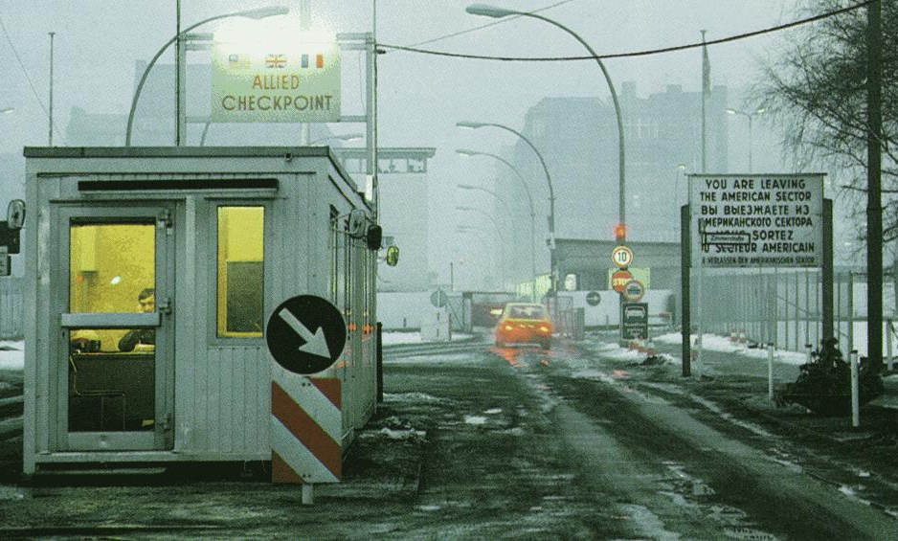
Checkpoint Charlie

Slide 23
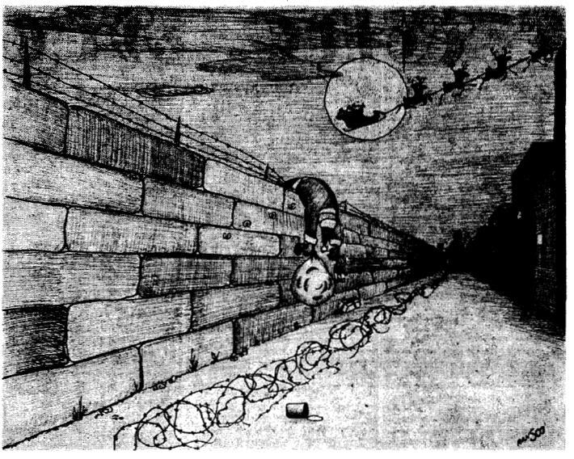

Slide 24
NATO
What was NATO?
The North Atlantic Treaty Organization (NATO) was formed in April 1949.
In joining NATO, the United States, Canada, and ten Western European nations pledged to support one another against attack, a principle known as collective security.

Slide 25
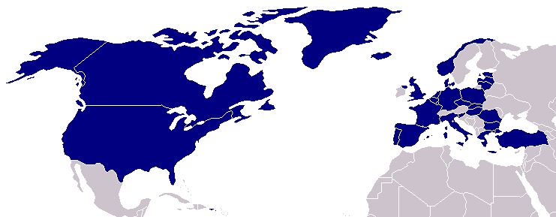
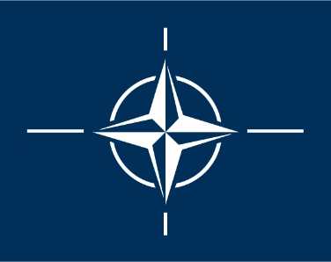
North Atlantic Treaty Organization (1949)
United States
Belgium
Britain
Canada
Denmark
France
Iceland
Italy
Luxemburg
Netherlands
Norway
Portugal
1952: Greece & Turkey
1955: West Germany
1983: Spain

Slide 26
Warsaw Pact
In response, the Soviet Union created a military alliance between the Soviet Union and its satellite nations.

Slide 27
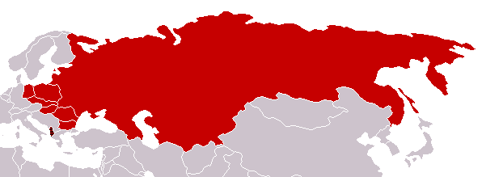
Warsaw Pact (1955)
U. S. S. R.
Albania
Bulgaria
Czechoslovakia
East Germany
Hungary
Poland
Rumania
Berlin/Nato

Slide 28
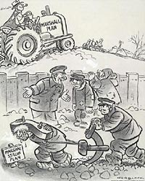
Your Last Task
In the box on your handout, Create a political cartoon that visually demonstrates each Term.

