Slide 1
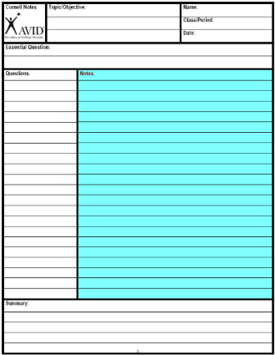
Divide notes into 3 “chunks” of information that go together.

Slide 2
On B.W. 9/16
Write a test a question for each chunk of notes.
The questions should be higher level.
If you can answer this question you will understand the main idea of the chunk.

Slide 3
Costa’s Level of thinking
1- Gathering | 2- Processing | 3- Applying
On the Page | Between the Lines | Off the Page
Complete Identify Recite Define List Select Describe Observe | Compare Sort Infer Contrast Distinguish Analyze Classify Explain (Why) | Evaluate Judge If/Then Generalize Predict Hypothesize Imagine Speculate Forcast

Slide 4
Answer on Page 5 of your Notebook
Create two comic strips
#1: Marx’s 5 step theory
#2: Lenin’s 5 step Theory
Remember: The largest thing in the picture is the most powerful.

