Slide 1
Nervous and Endocrine Systems
Neurotransmitter Review
Nervous/Endocrine System - Notes
Describe the nature and functions of the endocrine systems and its interaction with the nervous system.
H.W. Mod 11

Slide 2
Neuron Review
Draw and label a neuron with 5 parts

Slide 3
Neurotransmitter Review

Slide 4
Dopamine

Slide 5
Dopamine
 | Role | Too Many | Too Few
 | Influences movements, learning & attention | Schizo- phrenia, increased impulsive behavior | Tremors/ decreased mobility associated with Parkin- son’s, anxiety, ADHD

Slide 6
Serotonin

Slide 7
Serotonin
 | Role | Too Many | Too Few
 | Affects mood, hunger, sleep, arousal | Reduces hunger and sex drive | Depression, blood pressure, OCD, trouble sleeping, anxiety

Slide 8
Endorphins

Slide 9
Endorphins
 | Role | Too Many | Too Few
 | Natural opiates | Euphoria | Discomfort, Grumpy mood

Slide 10
Acetylcholine

Slide 11
Acetylcholine
 | Role | Too Many | Too Few
 | Muscle action, learning, memory | Muscle contraction, seizure | Alzheimer’s paralysis

Slide 12
Norepinephrine

Slide 13
Norepinephrine
 | Role | Too Many | Too Few
 | Regulates alertness and arousal, sleep, stress, sex drive | Agitation, elevated mood and arousal, high blood pressure, | Depression and chronic stress
Notes:
Serotonin and Norepinephrine can work as reuptake inhibitors or antagonists

Slide 14
The Nervous System

Slide 15
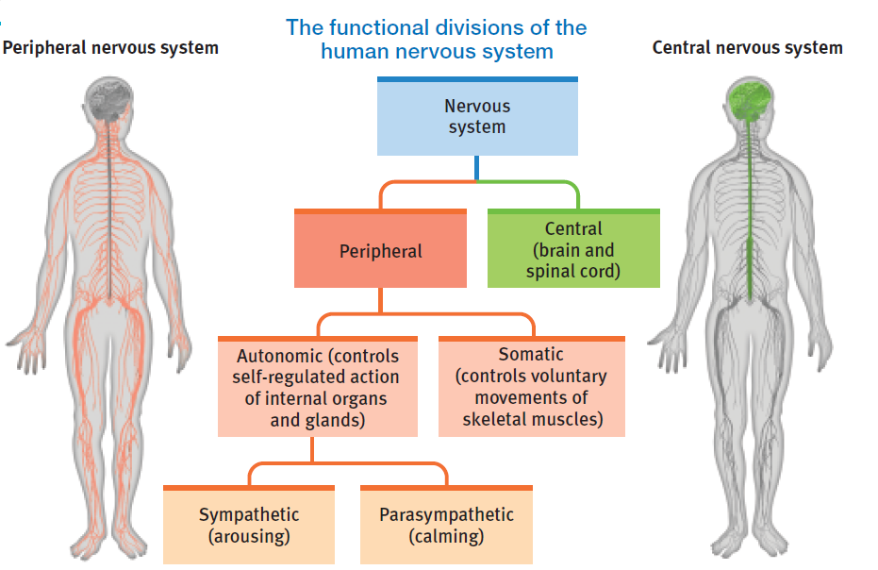
The Nervous System

Slide 16
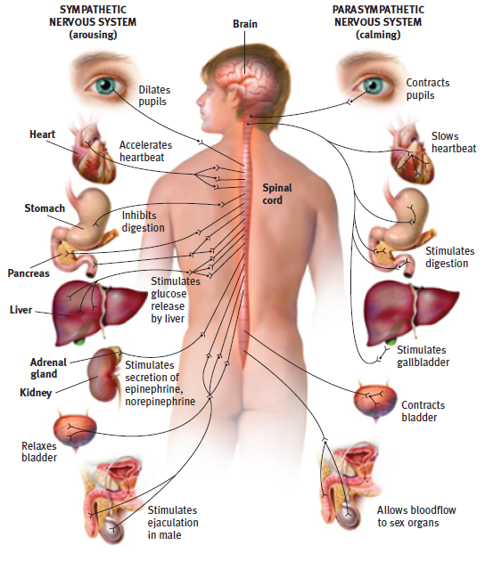

Slide 17
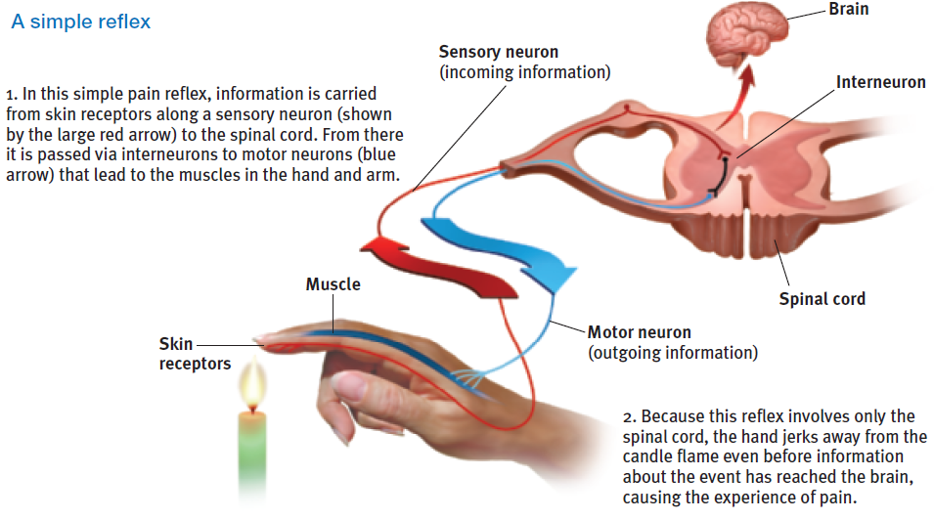
The Nervous System The Central Nervous System Simple Reflex

Slide 18
The Endocrine System

Slide 19
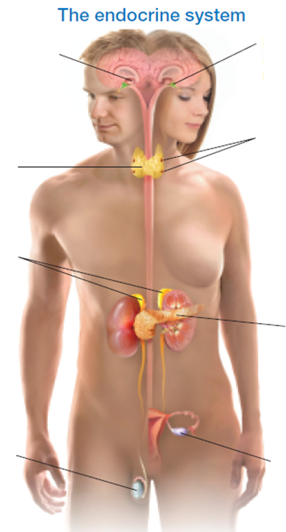
The Endocrine System
Endocrine system
Hormones
Adrenal glands
Epinephrine and norepinephrine
Adrenaline and noradrenaline
Fight or flight response
Pituitary gland

Slide 20
