Slide 1
The Brain
The Brain Lobes - Review
Phineas Gage
Neurogenesis/Plasticity
Designer Babies
Molecular Genetics
Split Brain
Finish Brain Hats
Identify the various regions of the cerebral cortex and explain its basic functions
HW: Study for exam
*Exam is next class. Mult Ch only

Slide 2
Essential Question: Why do people commit atrocities?
Using your notes, and Module 11 and Module 12 notes write as many ways as you can in the first column.
In which parts of the criminal’s brains could there be a problem?

Slide 3
Essential Question: Why do people commit atrocities?
As you read the article add specific ways to this column
In which parts of the criminal’s brains could there be a problem? | What potentially could have been wrong in the Las Vegas Shooter’s brain?

Slide 4
Module 12 Review

Slide 5
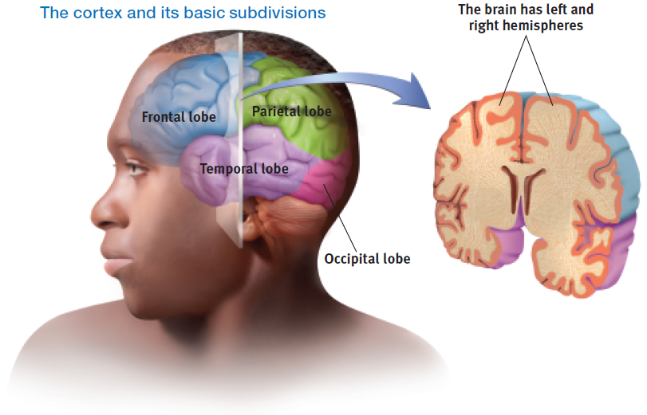
Structure of the Cortex
Lobe Overview Unfixed Brain

Slide 6
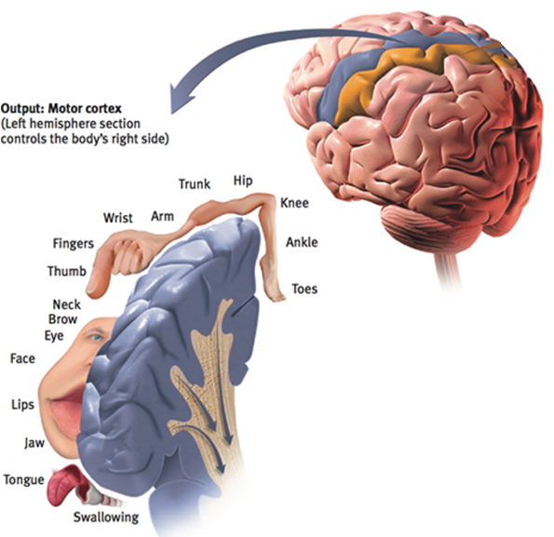
Functions of the Cortex Motor Functions
Motor Cortex

Slide 7
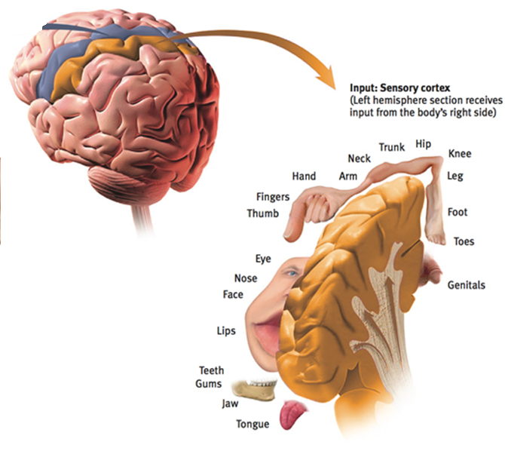
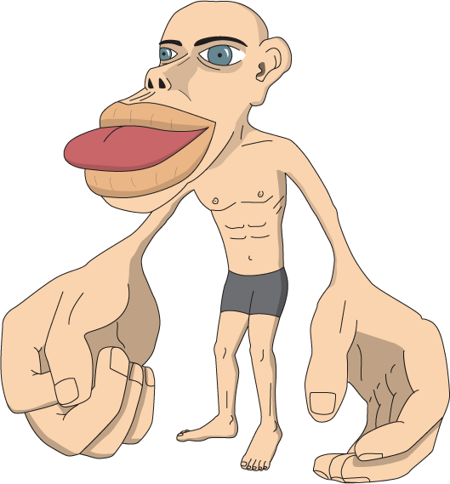
Functions of the Cortex Sensory Functions
Sensory cortex

Slide 8
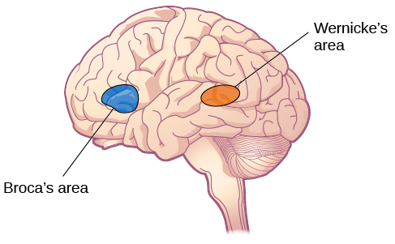
Video: Minor Stroke
Broca’s area - can comprehend, but cannot speak (sounds jumbled)
Wernicke’s area - can speak, but cannot comprehend

Slide 9
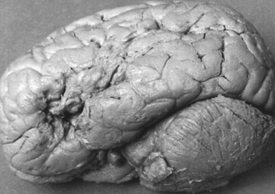
Paul Broca’s Discovery

Slide 10
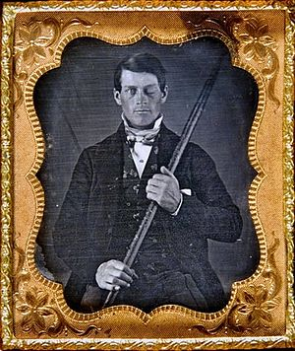
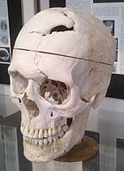
Phineas Gage
First look at the frontal lobe and personality
Phineas Gage Video

Slide 11
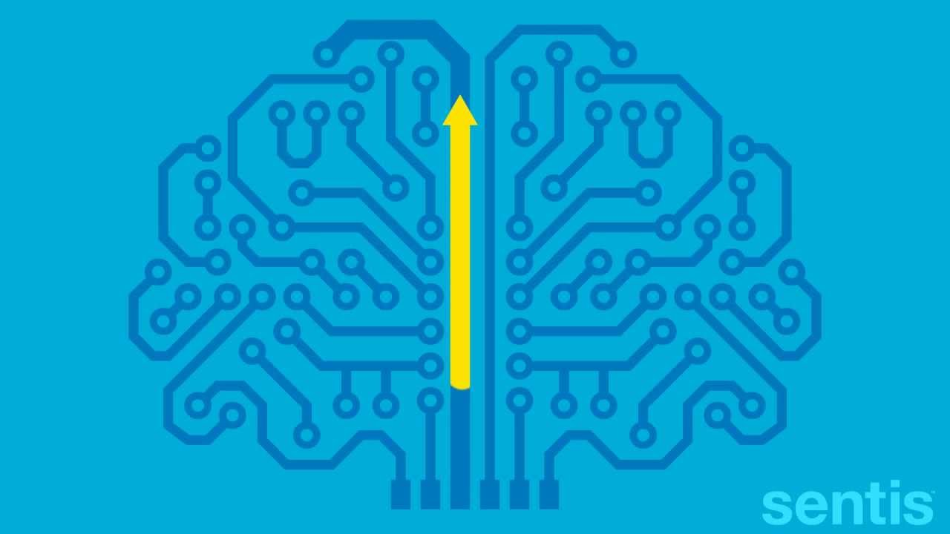
Neurogenesis/Neuroplasticity
Neurogenesis - the brain's ability to generate new brain cells
Neuroplasticity - brain is flexible and can change.
Ted Talk: The Brain May Be Able to Repair Itself

Slide 12
Module 13 Review
Notes:
30 min

Slide 13
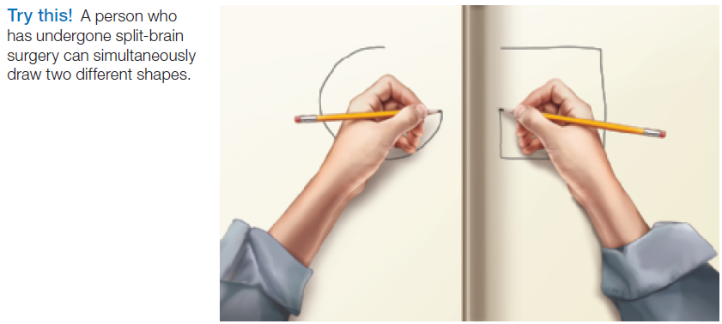
Our Divided Brain Splitting the Brain

Slide 14
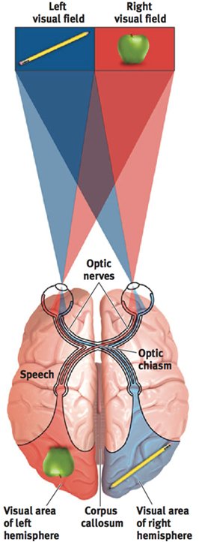

Slide 16
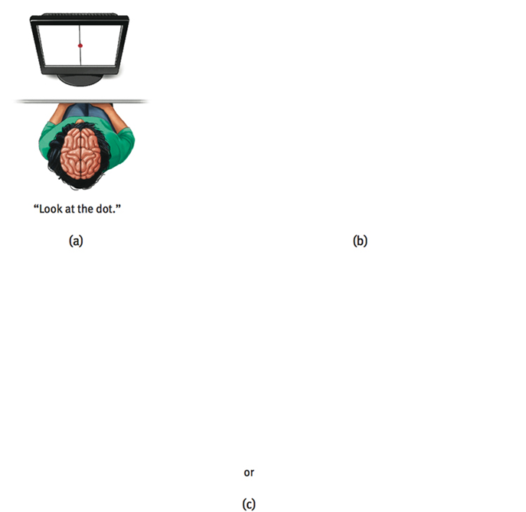

Slide 17
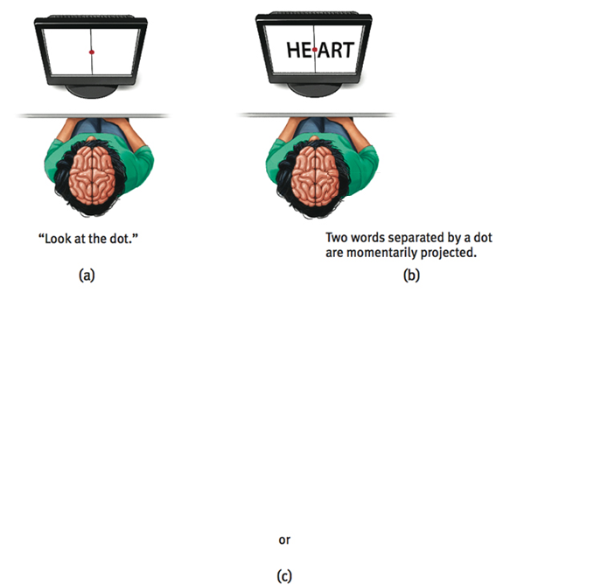

Slide 18
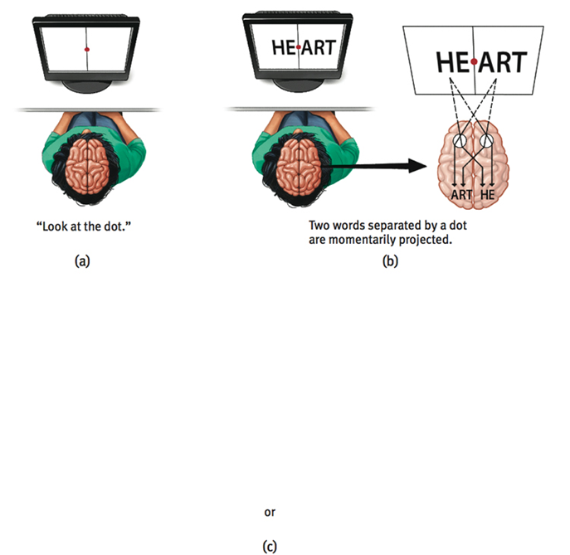

Slide 20
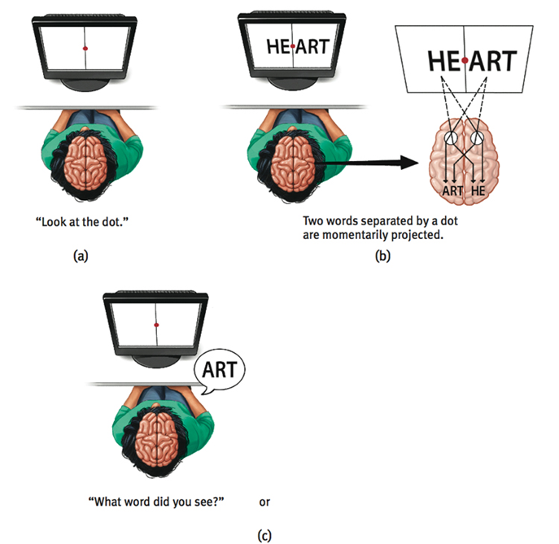

Slide 21
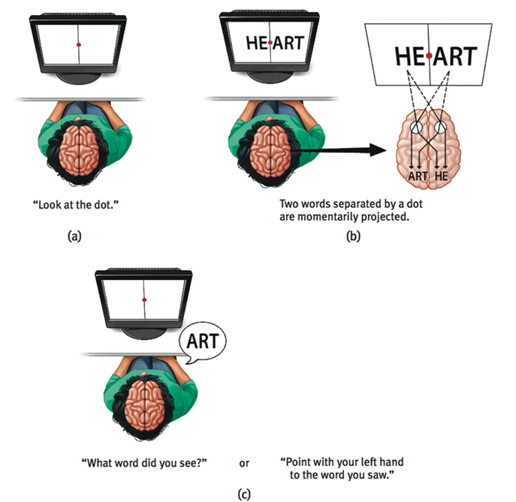

Slide 22
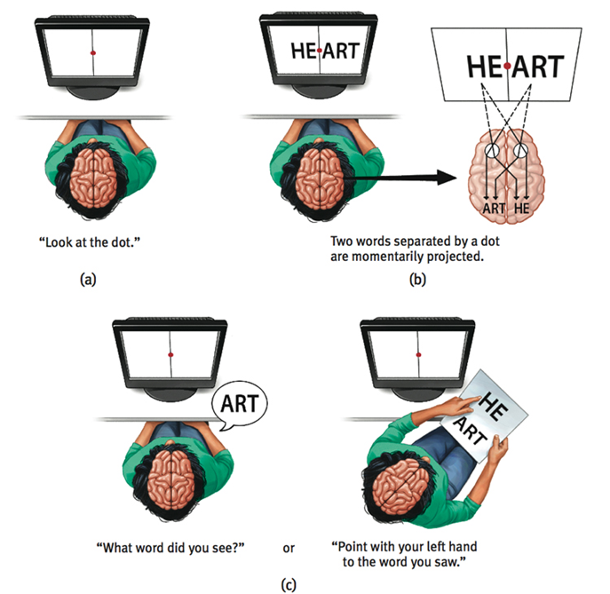

Slide 23
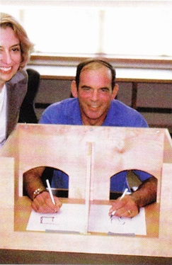
Split Brain Joe!
Joe suffered from a series of seizures due to epilepsy
To treat, his corpus callosum was severed.
Joe - Video
You is Two - Video

Slide 24
Module 14

Slide 25
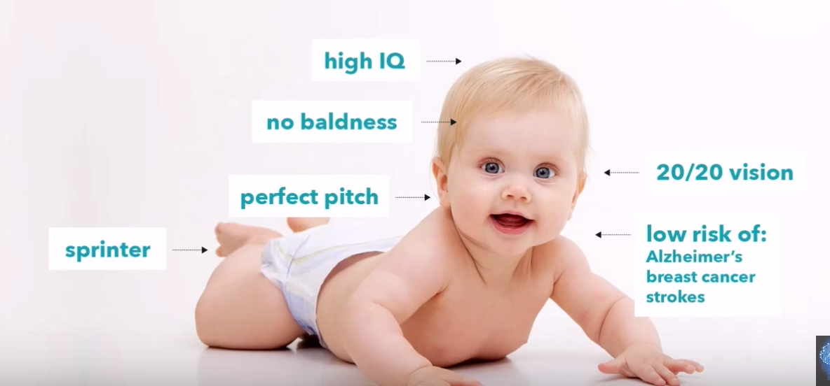
Designer Babies

Slide 26
Designer Babies
-DNA
-Chromosomes
-Genes
Books
Chapters
Words
Behavioral Genetics = study of genetic and environmental influences on behavior

Slide 27
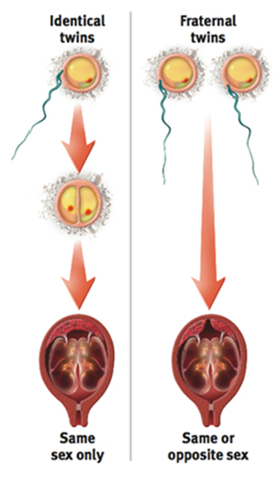
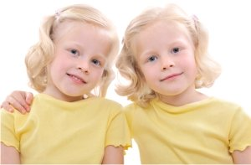
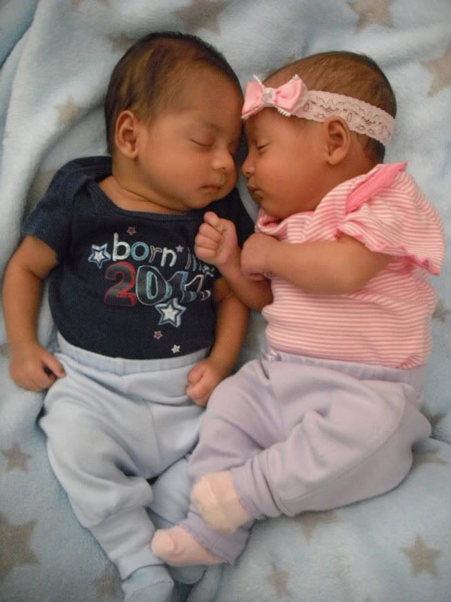
TWINS
Identical
(monozygotic)
Fraternal
(dizygotic)
Notes:
monozygotic
mono-zy-go-tic
di-zy-go-tic
Identical twins share extremely similar DNA structure - interesting thing about fingerprints. Fingerprints will differ depending on distance of umbilical cords

Slide 28
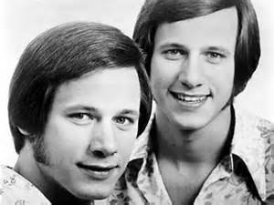
Twins
Why would psychologists study twins?
Most famous case: Bouchard’s - Jim Twins
Notes:
Things the twins had in common:
-married and divorced women named Linda
-second marriages with women named Betty.
-police training and worked part-time with law enforcement agencies
-childhood pets named Toy
-identical drinking and smoking patterns
-chewed their fingernails to the nub
How can some of these be explained? Culture could have something to do with it. Think: popular names at the time etc.

Slide 30
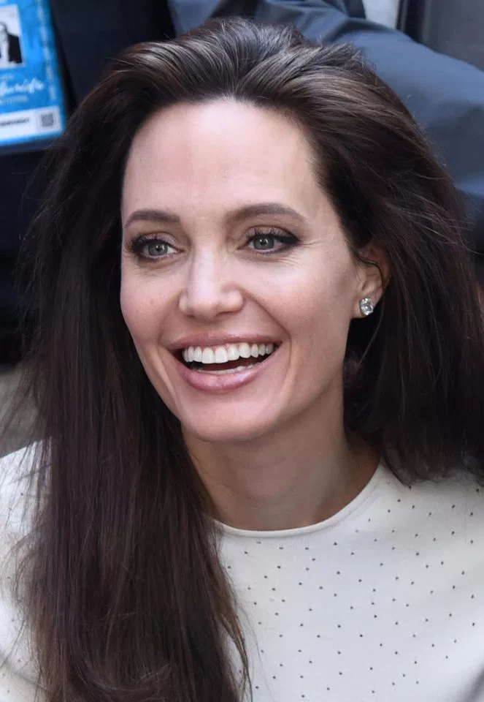
Molecular Genetics
How genes are structured and how they function.
Example: BRCA-1 gene found in most (not all) breast cancer cases.

Slide 31
Finish Brain Hat/proj

