Slide 1
Neurons
Unit Overview
Diagrams of:
Neuron
Neuron Communication
Agonists/Antagonists
Describe parts of a neuron and explain how its impulses are generated.

Slide 2
Good Morning!
HW: Module 9/10

Slide 3
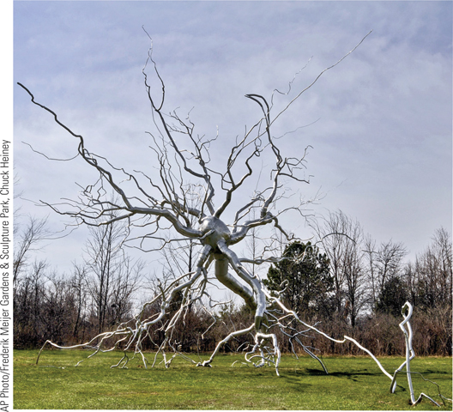
Neurotransmission

Slide 4
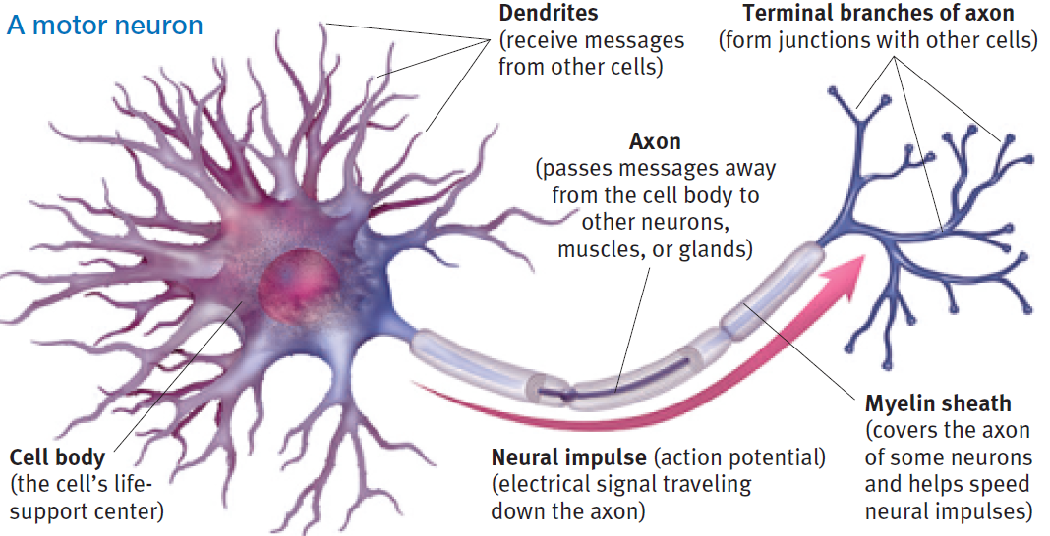
Neurons

Slide 5
Neurons
Speed of a neuron impulse
Range from 2 to 180 MPH
Measured in milliseconds
(thousandths of a second)
Notes:
Neuron Chain!

Slide 6
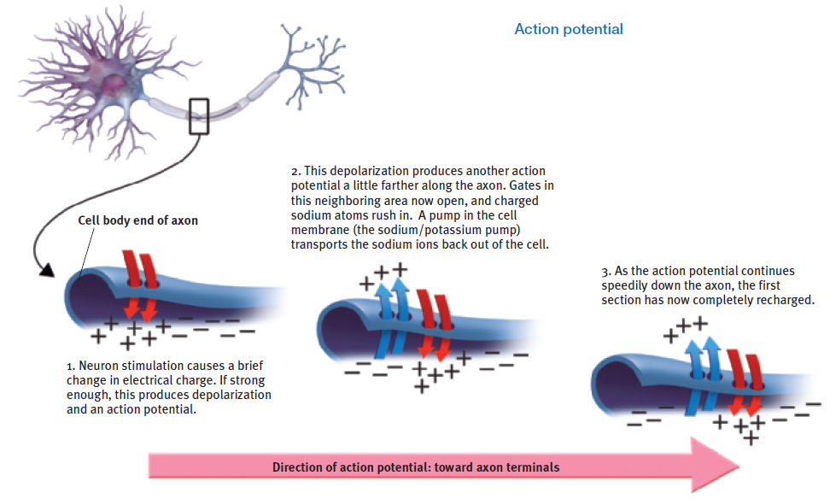
Action Potential

Slide 7
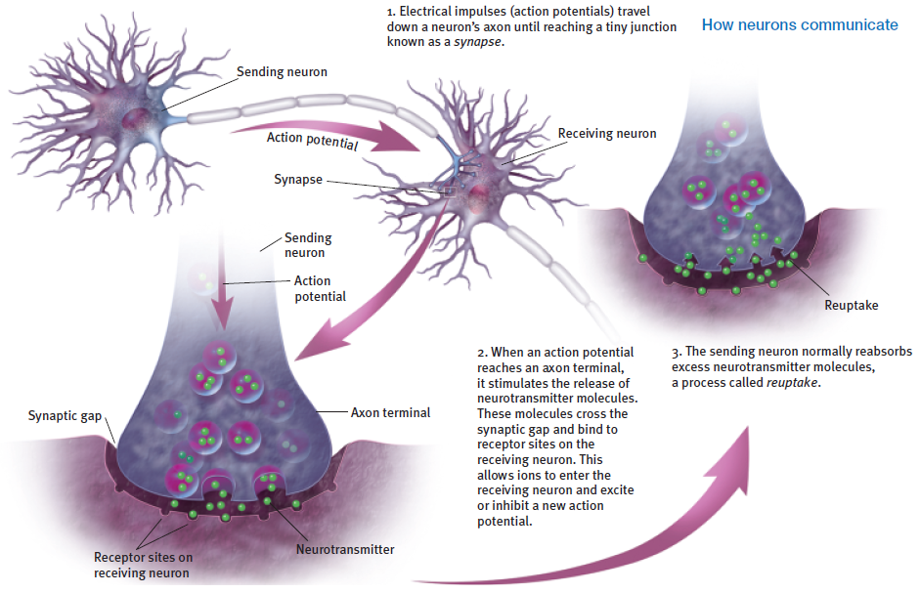
Neuron Communication

Slide 8
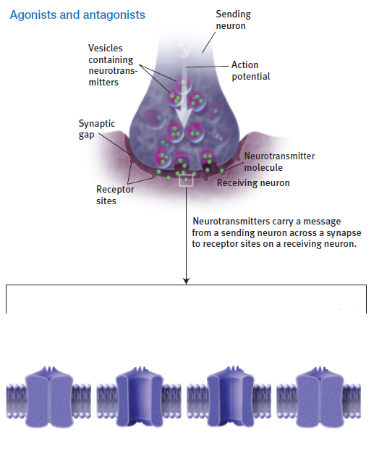
Agonists and Antagonists

Slide 9
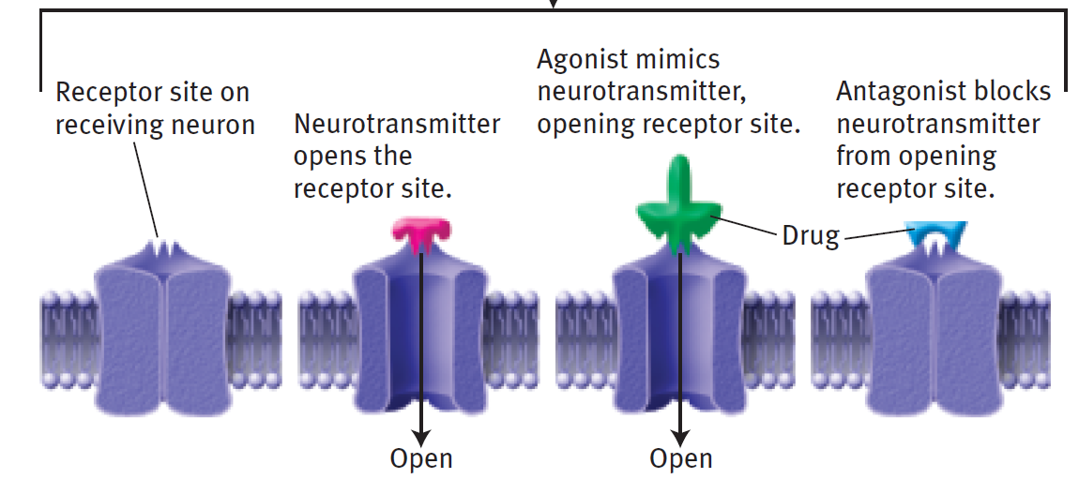
Agonists and Antagonists

