Slide 1
SCIENTIFIC METHOD
Unit Overview
Theory V. Hypothesis
Sampling/Survey
Start Dice Activity
Describe how theories advance psychological science.

Slide 2
GOOD MORNING!
HW: Module 7 Outline
We will do Module 4 in class

Slide 3
RESEARCH METHODS (8-10%)
Module 4
Module 5
Module 7
Module 6
Module 8
Unit 2 Exam: 50 Multiple Choice and one FRQ

Slide 4
THEORY V. HYPOTHESIS
Theory: often describe a large set of observations.
Ex: exercise increases energy levels
Hypothesis: something that can be tested - often created by a theory. Normally an “if, then” statement.
Ex: if I exercise for an hour a day, then I will have more energy.

Slide 5
PRACTICE
With your table partner, come up with three theories and then make a hypothesis from those theories.

Slide 6
Types of Description Methods in Psychology

Slide 7
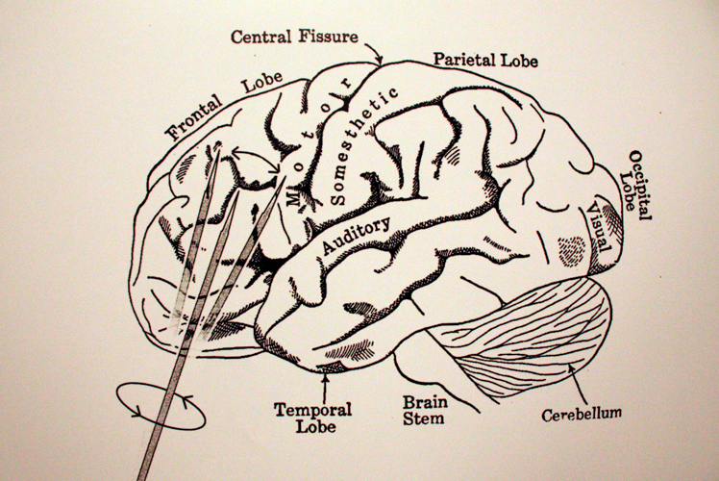
THE CASE STUDY
Case Study
Hyper focus on one or certain individuals to reveal truths
Many early brain studies were completed through case studies
Ex: Lobotomy

Slide 8
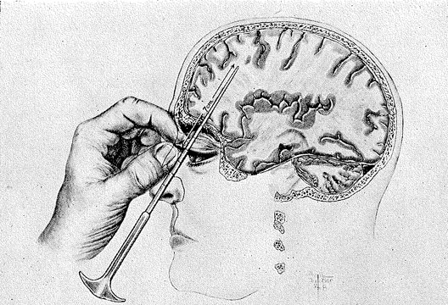
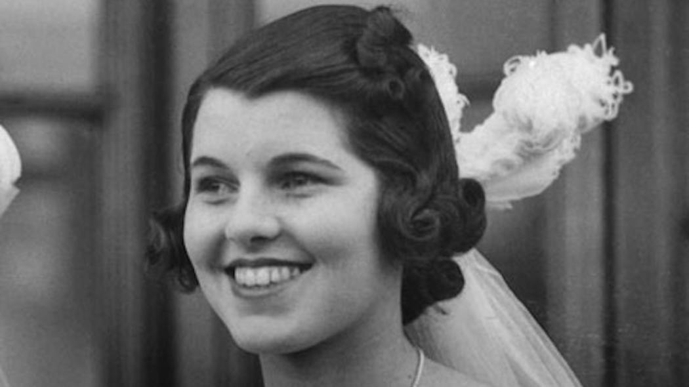

Slide 9
NATURALISTIC OBSERVATION
Naturalistic Observation
Describes behavior
Does not explain behavior

Slide 10
THE SURVEY
Survey
Less in depth
Wording Effects
Ex: “aid to the needy” over “welfare”
“Not allow” over “ban”

Slide 11
SURVEY
Birthday
Shoe size
Favorite color
Favorite restaurant
Mothers name

Slide 12
Practice
Come up with the following for a mock research proposal:
Theory
Hypothesis
Survey (Yes, create questions!)

Slide 13
THE SURVEY
Sampling
Random Sample
Representative sample*
Sampling bias

Slide 14
Reflection
Analyze your survey for wording effects. To what extent are your questions leading participants to an answer.
What type of sample would you use?
Random Sample
Representative Sample

Slide 15
Dice Activity

