Slide 1
Bell Work
Think about the norms of a 1950’s woman, man, and teen and compare and contrast them to today.
 | How are they the same? | How are they different?
Women
Men
Teens
Notes:
Bell

Slide 2
Step 1: First Impressions
As a table group study each document and write down your first impressions of that document in the left hand column of your paper.

Slide 3
Step 2: The Law
Write down a brief definition for each Amendment and Supreme Court Case.

Slide 4
Reconstruction Legislation
Amendment XIII
Section 1. Neither slavery nor involuntary servitude, except as a punishment for crime whereof the party shall have been duly convicted, shall exist within the United States, or any place subject to their jurisdiction.
Section 2. Congress shall have power to enforce this article by appropriate legislation.

Slide 5
Reconstruction Legislation
Amendment XIV
All persons born or naturalized in the United States, and subject to the jurisdiction thereof, are citizens of the United States and of the state wherein they reside.
No state shall make or enforce any law which shall abridge the privileges or immunities of citizens of the United States; nor shall any state deprive any person of life, liberty, or property, without due process of law; nor deny to any person within its jurisdiction the equal protection of the laws.

Slide 6
Reconstruction Legislation
Amendment XV
The right to vote shall not be denied … on account of race, color, or previous condition of servitude.

Slide 7
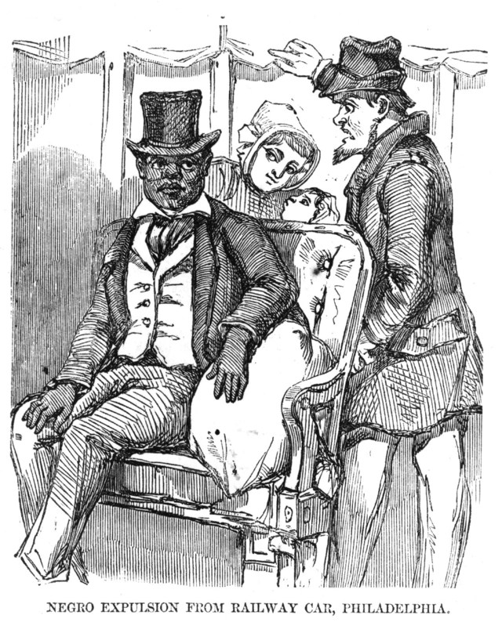
Plessy v. Ferguson
Homer Plessy tried to sit in the “White’s Only” car on a train, but he was not allowed because a Louisiana state law banned blacks from sitting there.

Slide 8
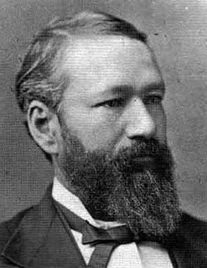
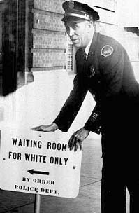
Homer Plessy sued the state, saying they violated the 14th Amendment. The case was eventually taken up by the Supreme Court.
It just doesn’t seem right that white people were getting all of these special privileges.
Meh, it seems alright to me.

Slide 9
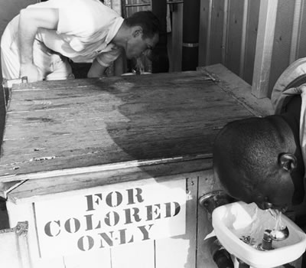
Plessy v. Ferguson (1896) Supreme Court Landmark Case
Plessy v. Ferguson:
Segregation was legal in United States as long as things were “separate but equal”

Slide 10
Step 3: Are we following the law?
As a table group go back through each document and decide if that documents follows the 13th, 14th, 15th Amendments and Plessy v. Ferguson.
Write your answer and a reason for it in the right-hand column of your paper.

Slide 11
Step 4: The Map
Shade in the segregated states on the map:
Alabama, Arkansas, Delaware, Florida, Georgia, Kentucky, Louisiana, Maryland, Mississippi, Missouri, North Carolina, Oklahoma, South Carolina, Tennessee, Texas, Virginia, and West Virginia.
Four other states permitted school segregation only if the local government wanted it (Shade these states differently): Arizona, Kansas, New Mexico, and Wyoming
What patterns do you notice from the map? Why do you think this was the case?

Slide 12
Step 4: The Map
Locate the five cases that represent the Supreme Court Case Brown v. Board of Education (Numbers on the Map). How would you describe each location?
Why do you think the Supreme Court decided to consider the five cases together?

Slide 13
Step 4: The Map
Read this Quote by Justice Clark---Think about the map—What do you think he meant?
“We consolidated them and made Brown the first so that the whole question would not smack of being a purely Southern one.”

Slide 14
Step 5: The Case
Write down 3 major point from the court case
Brown v Board

Slide 15
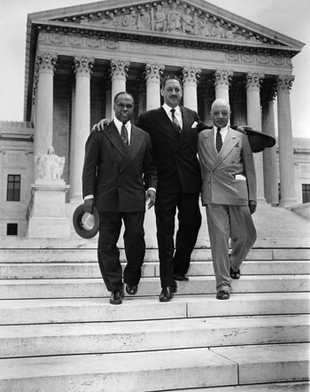
What case did they try to enforce?
In 1954 the Supreme Court ruled in Brown v. Board of Education that segregated schools were unconstitutional because although they were separate, they were not equal.
George E.C. Hayes, left, Thurgood Marshall, center, and James M. Nabrit, the lawyers who led the fight before the U.S. Supreme Court for abolition of segregation in public schools, descend the court steps in Washington, D.C., on May 17, 1954.

