Slide 1
Social-Cognitive

Slide 2
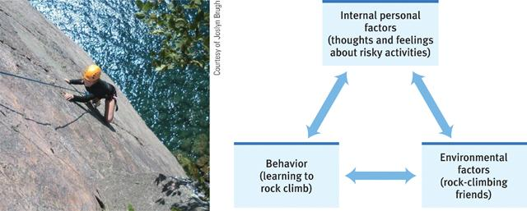
Reciprocal Determinism
How internal factors, environmental factors and behaviors all influence our personality.

Slide 3
Positive Psychology
Is true happiness a decision?
Definition: strategies and mindsets to help further optimal human functioning.
Positive Psychology Strategies
Power of Positivity - Experiment Video

Slide 4
Situational Assessments
Assessment centers for personality adjustments during actual job tasks.
If not, employers will use previous behavior.

Slide 5
Self-Serving Bias
Self-Serving Bias: people view themselves more favorably than others.
People take more credit for good than bad
Narcissism: excessive self-love and self-absorption
The Psychology of Narcissism

