Slide 1
Bell Work Opposite page 6
3-2-1 Summary
Draw this to fill up your page:
3 - In the bottom 3 spaces, write three important facts from assignment 6 notes
2 – In the middle 2 spaces, identify two important people
1 – In the top space, write one question that can be answered by using the other two levels.

Slide 2
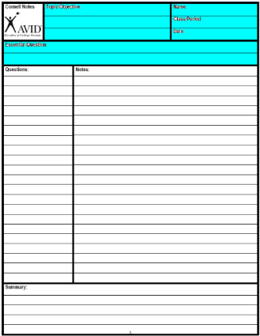
Create your Cornell note paper.
Write in the essential Question.
CORNELL NOTES | TOPIC/OBJECTIVE: | NAME:
 | Stalin/Understand Stalin’s Government | CLASS/PERIOD:
 |  | DATE:
ESSENTIAL QUESTION: How did Stalin take control of the Soviet Union?
Notes:
Sample note organization styles:
Formal Outline
Informal Outline
Mind maps
Graphic Organizers
etc.

Slide 4
Characteristics of a Totalitarian State
Dictatorship- Absolute Authority
Dynamic Leader- Vision for the nation
State Control Over All Sectors of Society
Business, Family Life, Labor, youth groups, housing, religion, education, the arts
State Control Over the Individual
Obedience
Denies basic liberties
Organized Violence
Uses force to crush opposition

Slide 5
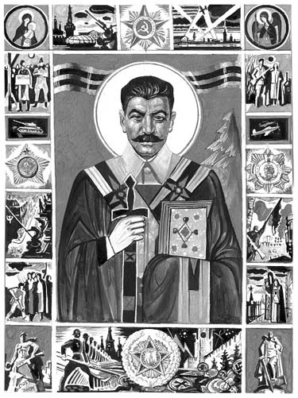
Stalin’s Totalitarian State
Religious Persecution
All Religion was banned.
Notes:
5

Slide 6
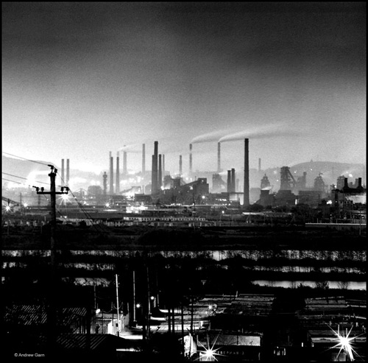
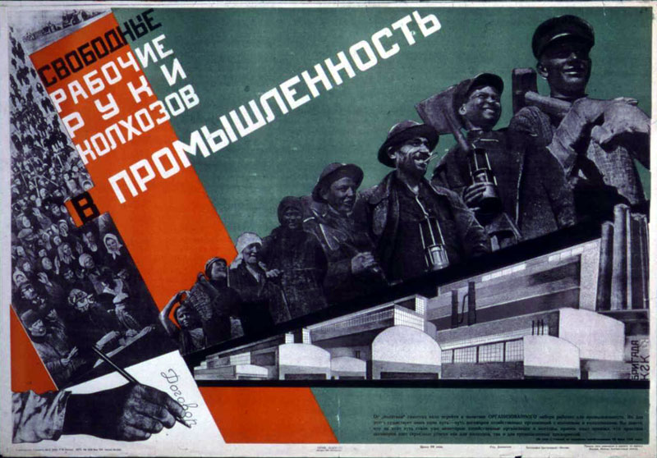
Stalin’s Totalitarian State
State Control of the Economy
5 year plan—To Industrialize Russia
Notes:
6

Slide 7
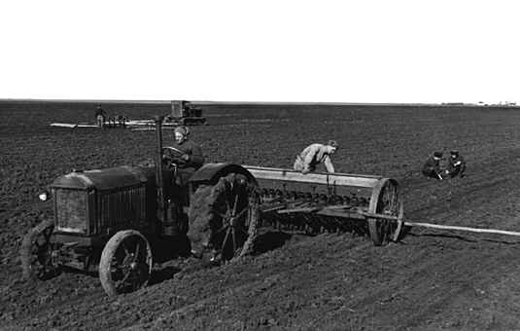
Stalin’s Totalitarian State
State Control of the Economy
Collective Farms

Slide 8
Stalin’s Totalitarian State
Education
Controlled by the government
Notes:
8

Slide 9
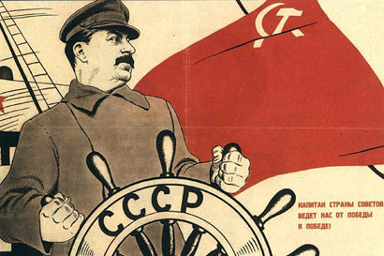
Notes:
Soviet Propaganda – 1930s – Stalin at the helm
Soviet propaganda – 1930s – Stalin at the helm

Slide 10
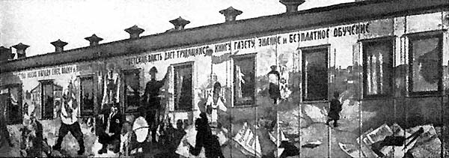

Slide 12
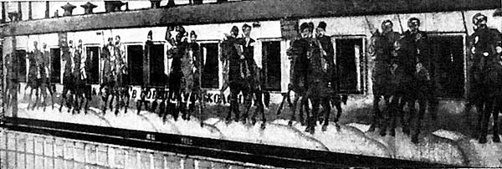

Slide 13
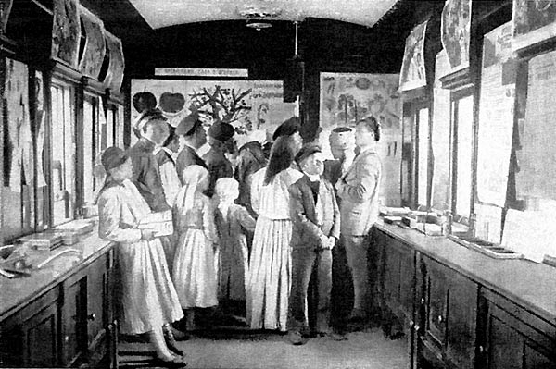

Slide 14
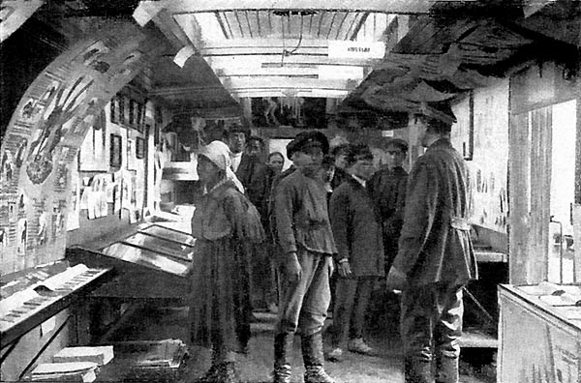

Slide 15
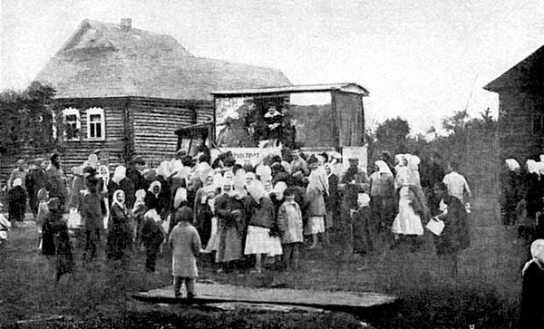

Slide 16
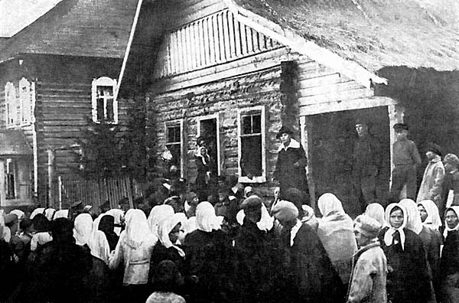

Slide 17
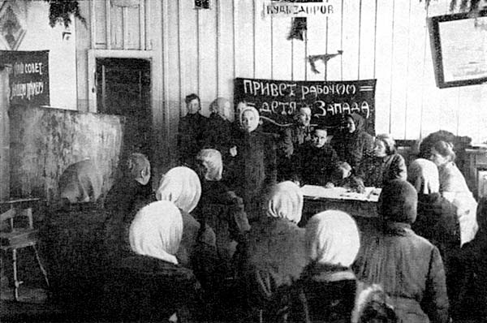
Notes:
Meeting of women in a village 192?

Slide 18
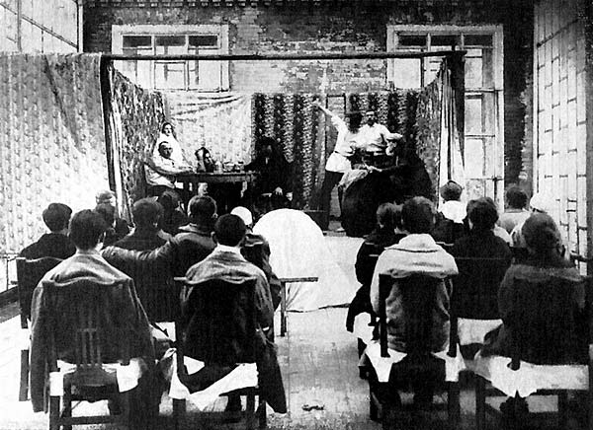
Notes:
Performance of a play in which political questions addressed

Slide 19
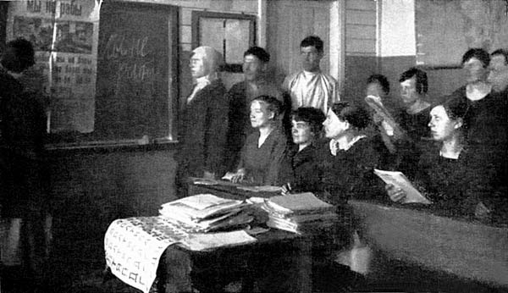
Notes:
School – “liquidation of illiteracy campaign”

Slide 20
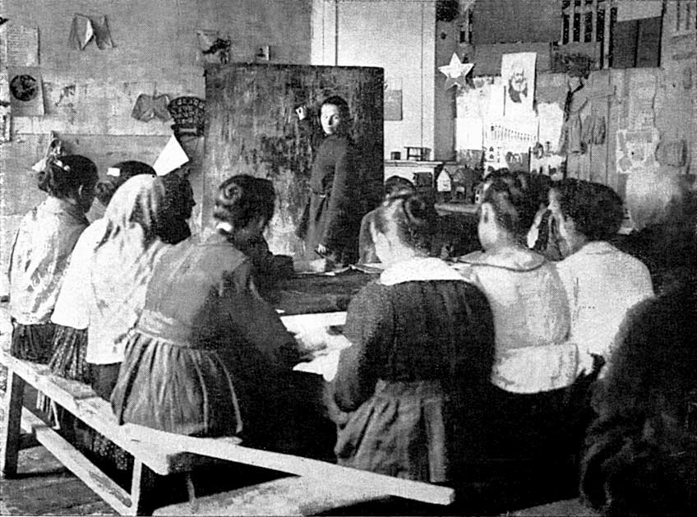
Notes:
School for illiterates

Slide 21
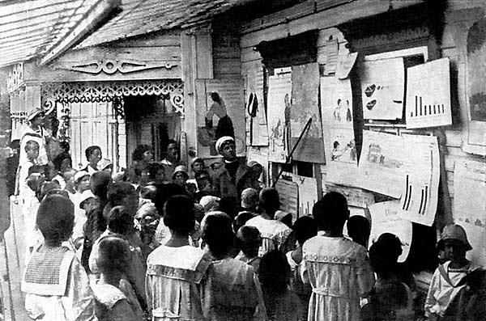
Notes:
Travelin gschool for peasant children

Slide 22
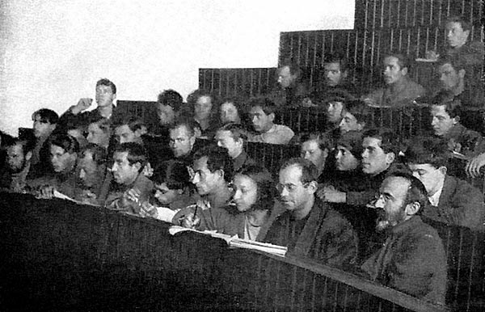
Notes:
Lecture room of a workers university

Slide 23
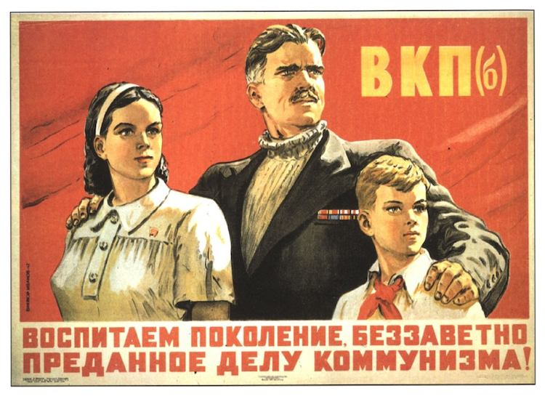
Stalin’s Totalitarian State
Propaganda (socialist realism)
Molding peoples minds
Notes:
23

Slide 24
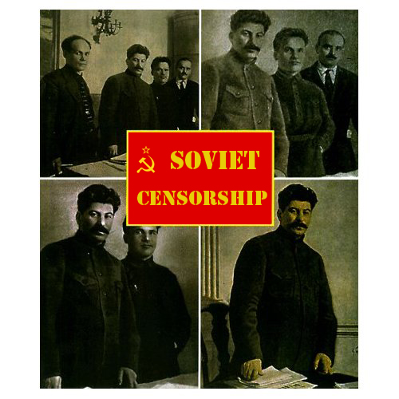

Slide 25
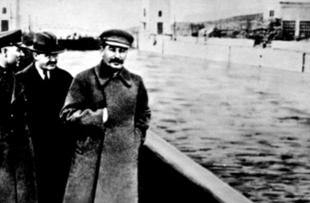
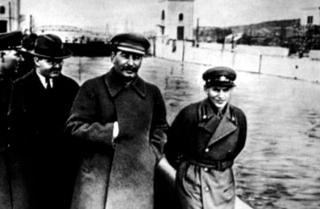

Slide 26
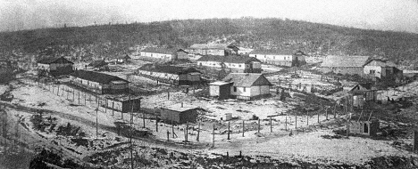
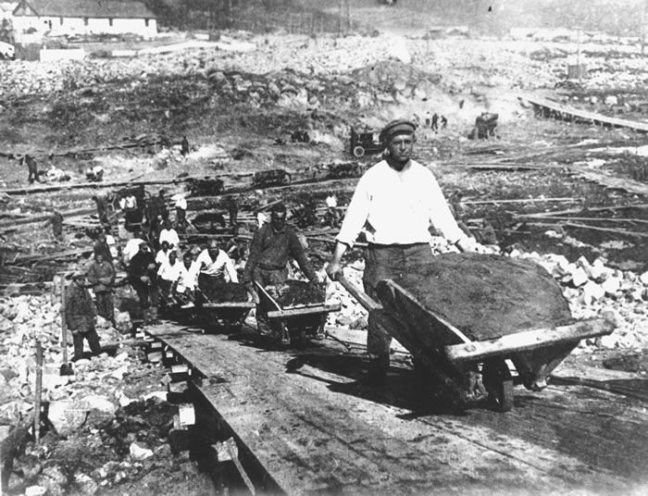
Stalin’s Totalitarian State
Police Terror
Great Purge, crush opposition
Notes:
26

Slide 27
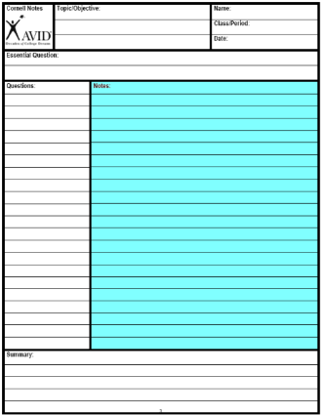
Step 4 (10-2-2)
Revise Notes

Slide 28
Symbol | Revision
1,2,3… or A,B,C… | 1. Number the notes for each new concept or main idea.
Key Word | 2. Circle Vocabulary/Key terms
Main Idea | 3. Underline or highlight main ideas
^ | 4. Fill in gaps of missing info or reword.
Unimportant | 5.Cross out unimportant info.
? | 6. Identify points of confusion
* | 7. Identify info to be used on a test
Visual/Symbol | Create a visual symbol to represent information

Slide 29
Step 5 (10-2-2)
Fill in gaps with a partner.

Slide 30
Stalin Biography
Who did Stalin purge and why? (document at least 5 examples)
https://youtu.be/gpc7SaTpRk0

Slide 31
Step 4 (10-2-2)
Revise Notes

Slide 32
Symbol | Revision
1,2,3… or A,B,C… | 1. Number the notes for each new concept or main idea.
Key Word | 2. Circle Vocabulary/Key terms
Main Idea | 3. Underline or highlight main ideas
^ | 4. Fill in gaps of missing info or reword.
Unimportant | 5.Cross out unimportant info.
? | 6. Identify points of confusion
* | 7. Identify info to be used on a test
Visual/Symbol | Create a visual symbol to represent information

Slide 33
Step 5 (10-2-2)
Fill in gaps with a partner.

