Slide 1
Bell Work # 8 (Page 16)
Describe two ways that the United States changed during the Red Scare.

Slide 2
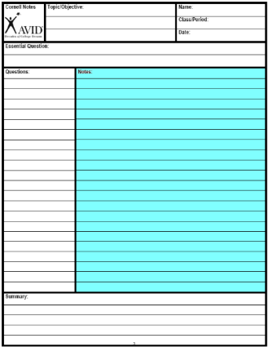
Step 6
Divide notes into “chunks” of information that go together.

Slide 3
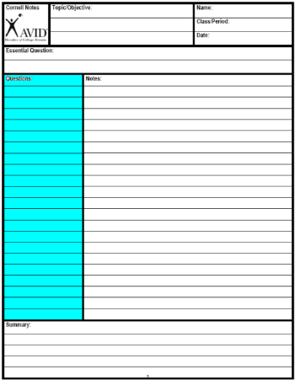
Step 7
Write a question for each chunk of notes.
The questions should be higher level.
If you can answer this question you will understand the main idea of the chunk.

Slide 4
Costa’s Level of thinking
1- Gathering | 2- Processing | 3- Applying
On the Page | Between the Lines | Off the Page
Complete Identify Recite Define List Select Describe Observe | Compare Sort Infer Contrast Distinguish Analyze Classify Explain (Why) | Evaluate Judge If/Then Generalize Predict Hypothesize Imagine Speculate Forcast

Slide 5
20th II Notebook Pages
Course Outline
Bell Work #1
Unit 1 Guide
Bell Work #2
Russian Geography
Bell Work #3
Russian Revolution
Bell Work #4
Notes on Communism
Bell Work #5
Contrasting Cold War Terms
Bell Work #6
WWI Treaties
14. Bell Work #7
15. Stalin Notes
16. Bell Work #8
17. The Red Scare
18. Bell Work #9
19. The Bomb

Slide 6
The Nazi-Soviet Non-Aggression Pact Game

Slide 7
You are Stalin’s advisers:
Background information
In 1917, there was a Communist revolution which overthrew the capitalist system in Russia. You hate capitalism and dislike capitalist countries like Britain, France and America.
Britain, France and America all tried to destroy your revolution, sending money and weapons to the ‘White troops’ who fought against you. It took you three years to defeat their ‘White’ army. You have never forgotten this.
The revolution and the war almost ruined Russia, and left you very weak. Your ‘Five Year Plans’ are slowly making Russia stronger, but it is a slow process, and Russia is still weak.
At first, the Communist revolutionaries tried to cause revolution all over the world, but after a series of failures, Stalin introduced a new policy of ‘Communism in one country’. His idea is to make Russia a strong world power first, then to spread the revolution.
Your two BASIC foreign policies are, therefore:
a. PEACE - so Russia can continue to grow strong (and also so Stalin can stay in power).
b. A BUFFER ZONE of countries in between you and your enemies - especially Finland and Poland.
You consider your main enemies to be:
• Germany (who may attack by land) and
• Britain (who may attack by sea).
Your foreign policy options are:
a. Go to war with Germany
b. Offer to make an alliance with Britain
c. Join the League of Nations
d. Do nothing
e. Leave the League of Nations
f. Offer to make an alliance with Germany
g. Go to war with Britain
Until Hitler’s takeover of power in 1933, you have DONE NOTHING.

Slide 8
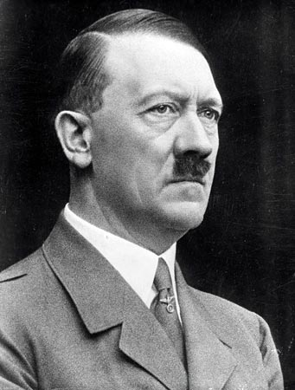
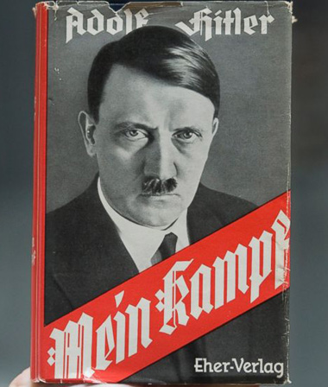
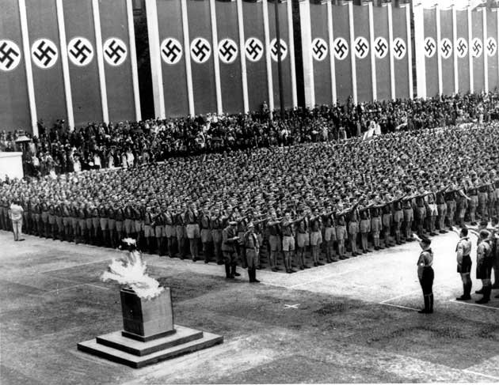
Decision One: It is 1933
Hitler has come to power in Germany, and you are afraid of his intentions.
In his book, Mein Kampf, Hitler has openly said that you are the Dungervolk (dung people) and that he wants to conquer you, take your land and give it to the German people, who you will serve as slaves.
Nazism is the exact opposite of Communism, and you hate the Nazis. On coming to power, Hitler arrested many German Communists, and either shot them or put them in concentration camps.
Hitler has started to re-arm Germany, against the Treaty of Versailles, although his army is still very small and weak.
Russia is still VERY weak.
What will you do?

Slide 9
Decision 1
a | b | c | d | e | f | g
1 | 2 | 5 | 2 | 0 | 1 | 0
Germany is weak: maybe you‘d win. But this breaks your policy to stay out of war | To seek an ally against Hitler would be quite wise. | Excellent: this is what Russia did; the League is bound to uphold Versailles. | Not very wise; Germany is growing stronger all the time; you must defend yourself. | Ridiculous decision; you are not a member yet! | An alliance with your greatest enemy? And would Hitler keep it? | Ridiculous; Britain is your best hope against Germany.

Slide 10
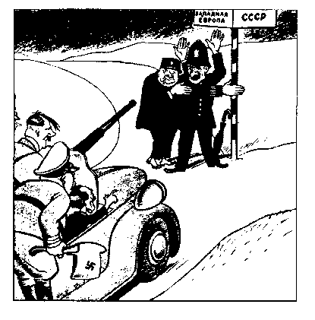
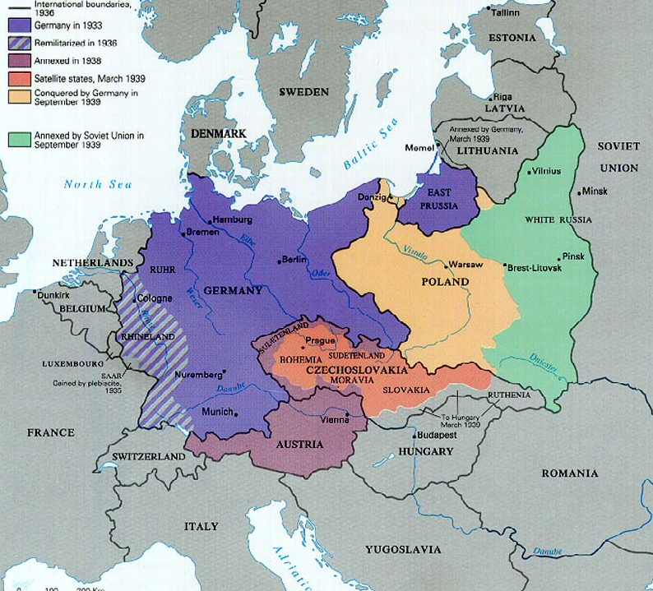
Decision Two: It is 1938
Hitler’s power has grown.
Hitler has re-occupied the Rhineland and taken over Austria. Now he has claimed and taken over the Sudetenland in Czechoslovakia. You are convinced that these are merely the first steps in his policy of lebensraum - taking ‘living space’ for Germans in eastern Europe and Russia. You are VERY frightened of his intentions.
In Germany his propaganda minister, Goebbels, blames you and the Jews for all the troubles of the world. Meanwhile, Russian newspapers are ‘shoveling sh**’ (as Stalin calls it) onto Germany’s reputation.
Meanwhile, Britain and France are simply appeasing Hitler - giving him what he wants. They gave him the Sudetenland without even asking Stalin what he thought. You are disgusted by their weakness. With them in control, the League of Nations is useless - it has failed in Manchuria, in Abyssinia and now in the Sudetenland.
Some Russians think that Britain and France are trying to encourage Germany to attack Russia (see cartoon).
Russia is growing stronger all the time - the Five Year Plans are really beginning to work. But you are nowhere near as strong as Germany.
What will you do?

Slide 11
Decision 2
a | b | c | d | e | f | g
0 | 2 | 0 | 3 | 5 | 0 | 1
Silly. You are too weak; and it breaks your policy to stay out of war. | To seek an ally against Hitler would be wise; but do you trust the capitalist countries? | Ridiculous decision; you are already a member! | Not very wise; staying in the League will make you look as weak as the League. | Good: this is what Russia did. You do not want to share the League’s humiliation. | An alliance with your greatest enemy? And would Hitler keep it? | Ridiculous; Germany is the real problem; and it breaks your policy to stay out of war.

Slide 12
Decision Three: It is March 1939
Hitler has just torn up the Munich agreement and marched into the rest of Czechoslovakia.
Now he is claiming Danzig and the Polish corridor; it is clear that he intends to continue to expand westwards - into Russia.
Poland is the buffer between you and Germany; if it falls to Hitler, then you have lost one of your basic principles of foreign policy.
Britain has promised to defend Poland if Hitler attacks it - but it is clear that this is a bluff; Britain cannot send a land army to Poland. The only country that could defend Poland is the Soviet Union (you).
You are much stronger than you were ten years ago.
What will you do?

Slide 13
Decision 3
a | b | c | d | e | f | g
2 | 5 | 0 | 1 | 0 | 1 | 0
Not wise. You are too weak; and it breaks your policy to stay out of war. | You are in danger and need an ally against Hitler. This is what Russia did. | Ridiculous. You do not want to share the League’s humiliation. | Not very wise; Germany is growing stronger all the time; you must defend yourself. | Ridiculous decision; you are no longer a member. | An alliance with your greatest enemy? And would Hitler keep it? | Ridiculous; Britain has promised to defend your buffer against Germany.

Slide 14
Decision Four: It is August 1939
Here is a list of events since your last decision:
22 July You hear rumors that the British government wants to make a trade agreement with Hitler. The British government denies it, but you do not believe them. You are frightened that Britain is going to give Hitler what he wants again.
2 August Many British MPs are saying that Britain and Russia ought to be allied together. You ask to meet Lord Halifax, the British foreign secretary, but he refuses. Chamberlain, the British Prime Minister, is openly saying that he does not like Russian Communism or Stalin’s dictatorship.
17 August You are very insulted, but ask Britain to talk about what you both will do if Hitler invades Poland. Britain sends an unimportant foreign office official on a slow boat and train. When he arrives, he cannot negotiate because he does not have the authority to make decisions. You are convinced that Britain is going to give in to Hitler.
23 August The German foreign minister Von Ribbentrop asks to visit. When he arrives he proposes a peace pact whereby Russia and Germany will promise not to invade each other, but will invade Poland together and divide it between them. You are convinced that Germany is going to invade Poland.
Here are two questions for you:
•IF you make an alliance with Britain, and then Germany invades Poland, what will be the result for you?
•If you make an alliance with Germany and then Germany invades Poland, what will be the result for you?
You are stronger than ever, but you are still not strong enough to go to war with Germany.
What will you do?

Slide 15
Decision 4
a | b | c | d | e | f | g
1 | 0 | 0 | 3 | 0 | 5 | 0
Not wise. You are too weak; and it breaks your policy to stay out of war. | Not wise. You will end up fighting Britain’s war in Poland. | Irrelevant; the League of Nations is dead. | Not very wise; Germany is going to invade Poland; you must act. | Ridiculous decision; you are no longer a member. | Gives you time to prepare for war AND gives you half of Poland. This is what Russia did | Ridiculous; Britain is too far away; and it breaks your policy to stay out of war.

Slide 16
The Manhattan Project
The Bomb (stop at 36:19) Answer the video questions on the attached handout.

