Slide 1
Treaty Questions

Slide 2
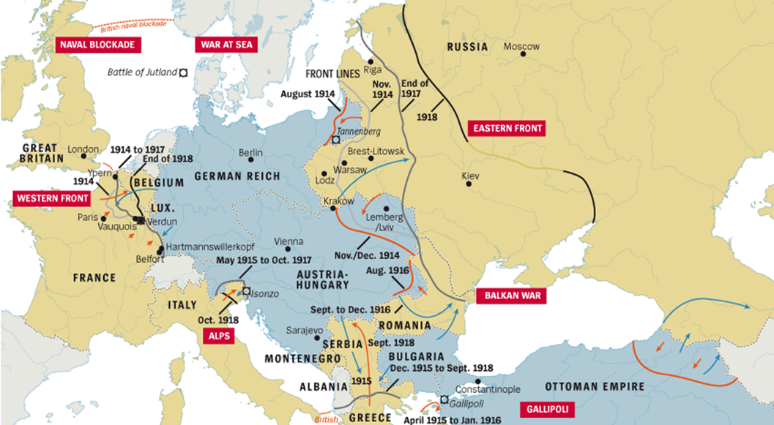
Part 1: The Soviet Union Quits WWI
Why did the Soviet Union Quit WWI?
Why does Germany have the upper hand in the negotiations?

Slide 3
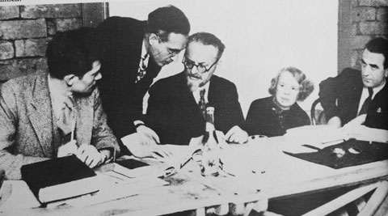
Part 2: The First Negotiations
How does Germany take advantage of the first delegates?
What does Trotsky want?
How did Trotsky mess up the negotiations?

Slide 4
Part 3: Return to War
Describe the disagreement between the Soviet leaders.
What does Germany do?

Slide 5
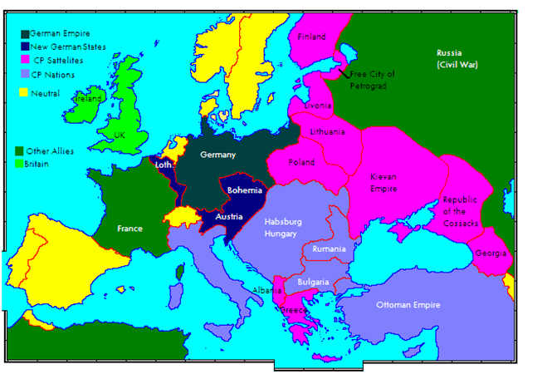
Part 4: The Treaty of Brest-Litovsk
How were Germany’s demands different from the first negotiation?
Why did the Soviets agree to this treaty?

Slide 6
Treaty of Versailles

Slide 7
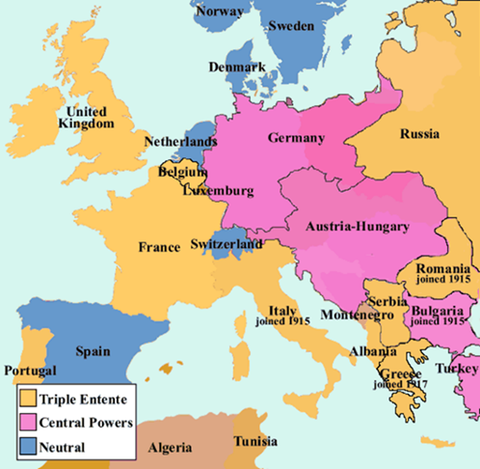
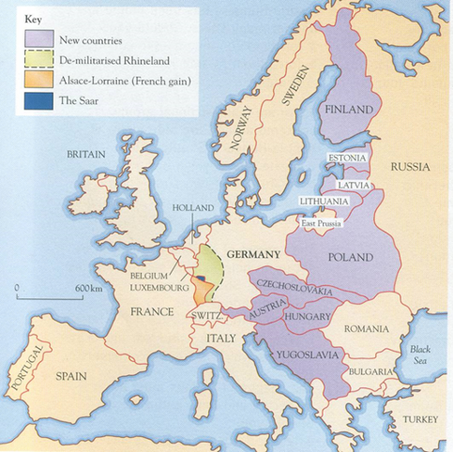
Part 5: The Treaty of Versailles
What are the 2 reasons that the Soviet Union is left out of the treaty negotiations?
Describe Lenin’s reactions to the treaty.

Slide 8
Writing prompt: Why is Russia unhappy with the United States and the rest of the Western powers after WWI?
Paragraph Format:
Thesis/Claim
Content ____(why you picked this one over the other )____________
Proof (2 of these sentences) According to Document/Source ____(Letter or #)___, from __(Name of source)_____, it is shown that___(evidence to prove thesis as shown in the document)_____.
Conclusion

