Slide 1
22. Bell Work #11 23. Unit 2 Study Guide 24. Bell Work # 12 25. Truman Bio 26. Bell Work #13 27. Cold War Map 28. Bell Work #14 29. Problems Truman Faced 30. Bell Work #15 31. The Beginning of the Cold War 32. Bell Work #16 33. The Containment Policy
34. Bell Work #17
35. Truman’s Domestic Policy

Slide 2
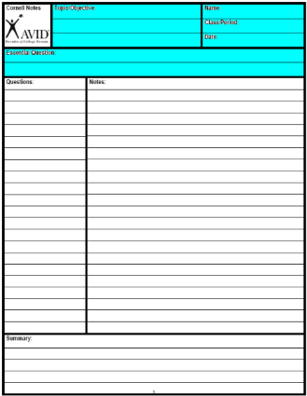
Create your Cornell note paper.
Write in the essential Question.
CORNELL NOTES | TOPIC/OBJECTIVE: | NAME:
 | The Truman Domestic Policy | CLASS/PERIOD:
 |  | DATE:
ESSENTIAL QUESTION: How did life in America change following WWII?
Notes:
Sample note organization styles:
Formal Outline
Informal Outline
Mind maps
Graphic Organizers
etc.

Slide 3
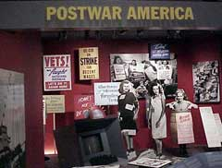
Reconversion
The social and economical transition from war time to peace time.

Slide 4
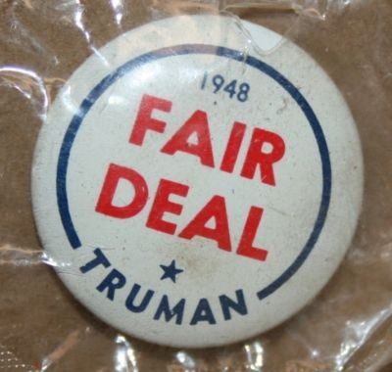
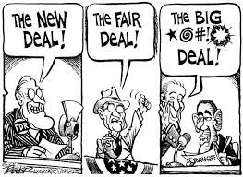
Truman’s Fair Deal
21 point program:
Full employment
Minimum wage
An increase Unemployment compensation
National Health Care
Atomic Energy Regulation
Congress failed to pass any of these programs

Slide 5
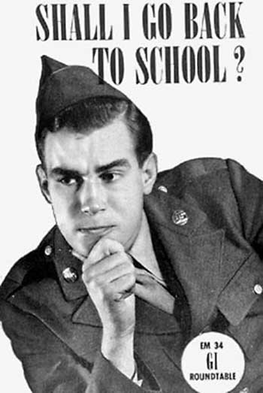
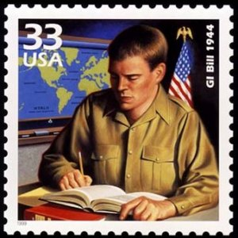
THE G.I. BILL
Provided college for returning World War II veterans (commonly referred to as GIs)
or
Provided one year of unemployment compensation

Slide 6
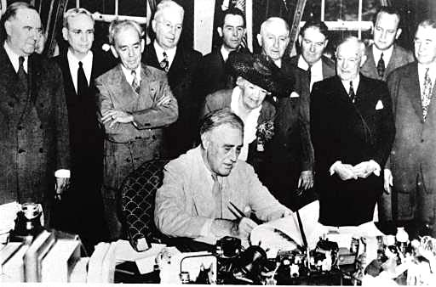
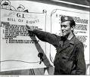
THE G.I. BILL
VA Mortgages paid for nearly 5 million new homes, by making homes affordable with low interest rates and 30 year loans.
President Franklin Roosevelt signs the GI Bill in 1944
Between 1945 and 1954, the U.S. added 13 million new homes to its housing stock

Slide 7
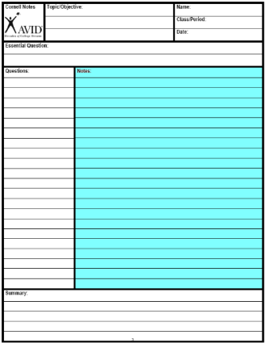
Step 4 (10-2-2)
Revise Notes

Slide 8
Symbol | Revision
1,2,3… or A,B,C… | 1. Number the notes for each new concept or main idea.
Key Word | 2. Circle Vocabulary/Key terms
Main Idea | 3. Underline or highlight main ideas
^ | 4. Fill in gaps of missing info or reword.
Unimportant | 5.Cross out unimportant info.
? | 6. Identify points of confusion
* | 7. Identify info to be used on a test
Visual/Symbol | Create a visual symbol to represent information

Slide 9
We must defend ourselves!
In response, Truman organizes the Federal Civil Defense Administration
This new agency tries to tell the country that they are safe from a nuclear attack
Even so, it floods the nation with posters and other information about how to survive a nuclear attack

Slide 10
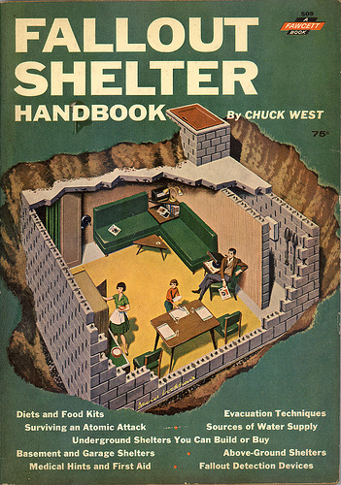
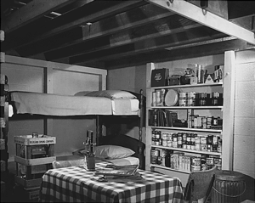
Build bomb shelters!

Slide 11
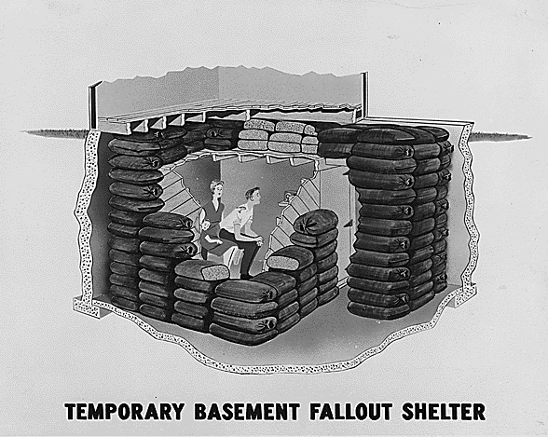
The Government suggests this one!
Shelter

Slide 12
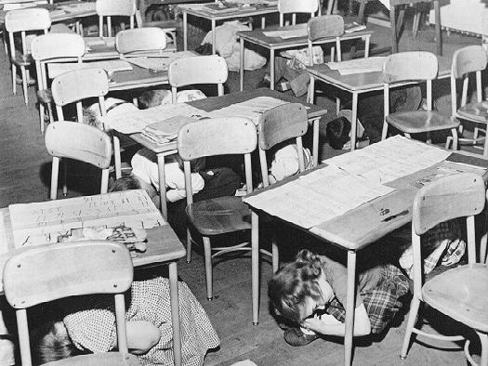
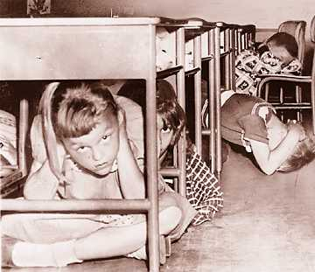
Practice Air Raid Drills!
Nuclear air raid drills were part of everyday life for schoolchildren in the late 1940s and early '50s. Children were taught to "duck and cover" under their desks and were herded into school basements for periodic air raid drills.

Slide 13
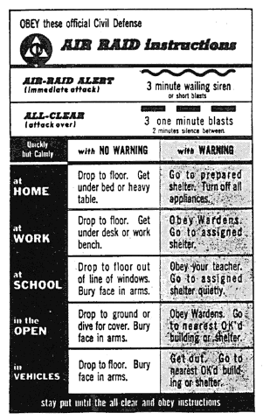
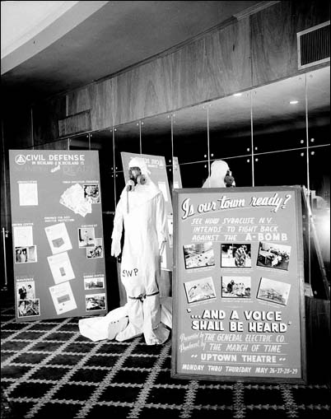
Are we ready?

Slide 14
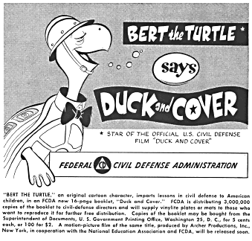
Duck and Cover!!
The Federal Civil Defense Administration promoted the "Duck and Cover" campaign in 1951. Consisting of an animated film, a radio program, a record album, and a pamphlet, the effort was designed to teach the nation's youth what to do in case of atomic attack by the Soviet Union.

Slide 15
Duck and Cover
SP Duck and Cover

Slide 16
Step 4 (10-2-2)
Revise Notes

Slide 17
Symbol | Revision
1,2,3… or A,B,C… | 1. Number the notes for each new concept or main idea.
Key Word | 2. Circle Vocabulary/Key terms
Main Idea | 3. Underline or highlight main ideas
^ | 4. Fill in gaps of missing info or reword.
Unimportant | 5.Cross out unimportant info.
? | 6. Identify points of confusion
* | 7. Identify info to be used on a test
Visual/Symbol | Create a visual symbol to represent information

Slide 18
Normalcy
Immigration
The First
Red Scare
Palmer Raids
Deportation
Sacco and
Vanzetti

Slide 19
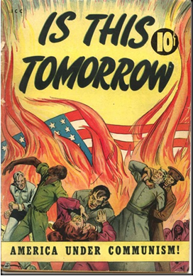
What is the U.S. government telling the American People?

Slide 20
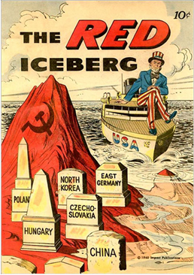
What is the U.S. government telling the American People?

Slide 21
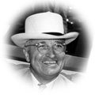
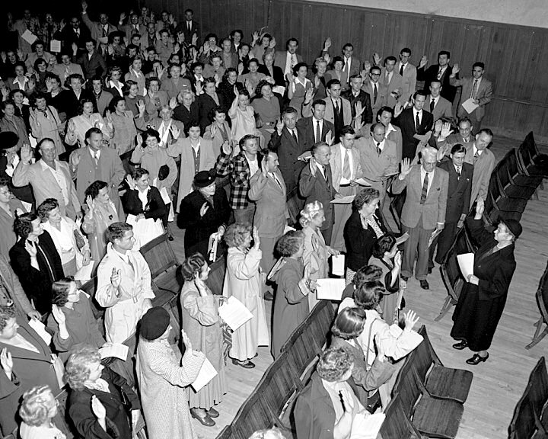
The Loyalty Program
During the late 1940s, fear of Communist spies created a climate of suspicion in the United States.
Truman established a federal employee loyalty program in 1947, checking the backgrounds of all new and existing federal employees.
Over 2,000 federal employees quit and 212 were fired.

Slide 22
Bell Work 10/28
Explain 2 things Truman did to ensure a strong economy after WWII

Slide 23
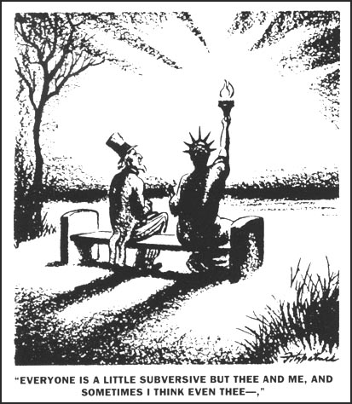

Slide 24
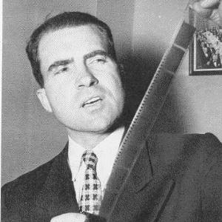
HUAC
1938 The House Un-American Activities Committee (HUAC)
Formed to investigate “activities against America”
Led by Richard Nixon (CA)

Slide 25
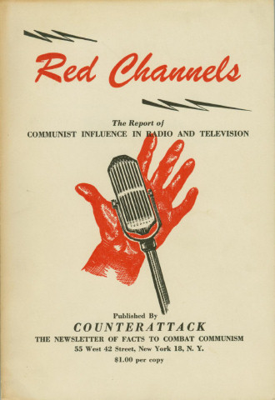
HUAC
The House Un-American Activities Committee (HUAC) began investigating Hollywood personalities who, the committee claimed, had Communist leanings.
The committee also believed that actors and writers were putting subliminal pro-Communist ideas in their films

Slide 26
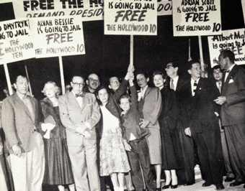
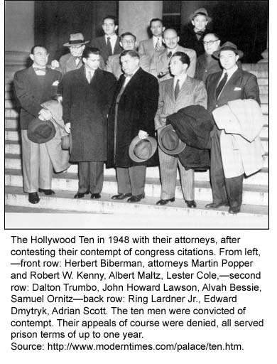
The Hollywood 10
-Ten Hollywood directors and writers refused to appear before the committee.
They were convicted of contempt. Their appeals of course were denied.
All served prison terms of up to one year.

Slide 27
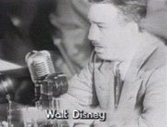
Hollywood
-Even W. Disney had to appear before HUAC.

Slide 28
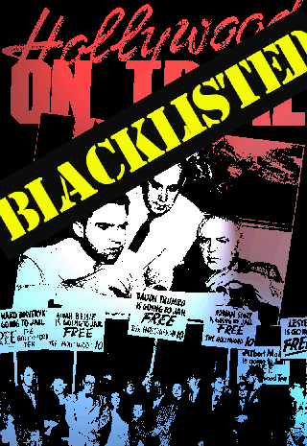
The Hollywood Blacklist
Hollywood studios compiled a blacklist, a list circulated to employers naming persons who should not be hired.
Blacklisted individuals came from all sections of the industry and included anyone who seemed subversive.
A Graylist was then created. Graylisted individuals were accused of associating with people on the blacklist.

Slide 29
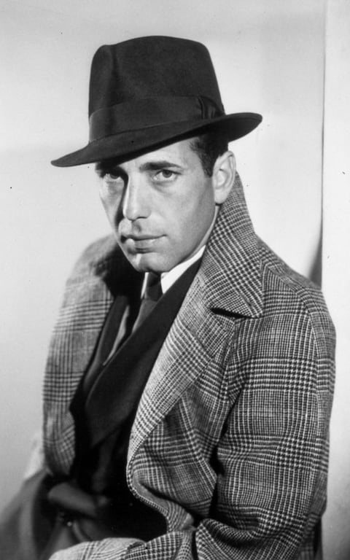
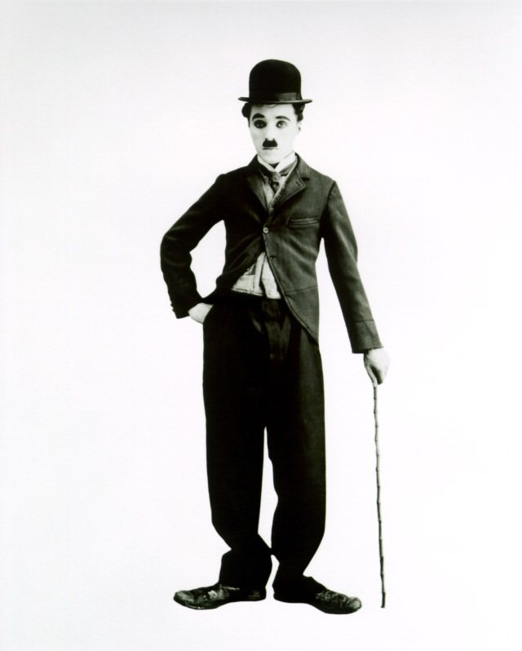
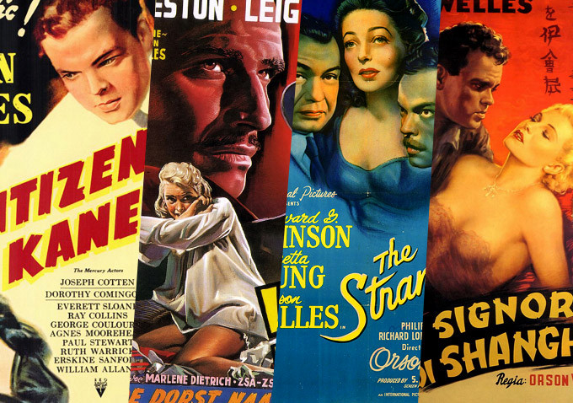
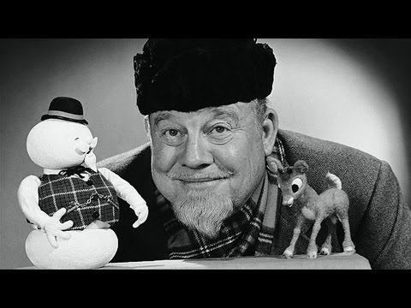
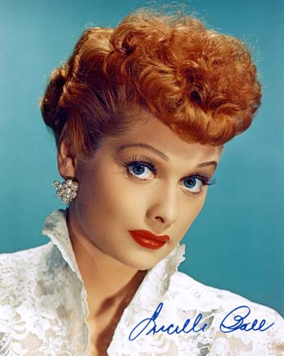
notable people on blacklist:
Orson Welles
Charlie Chaplin
W.E.B. DuBois
Langston Hughes
J. Robert Oppenheimer
Lucille Ball
Humphrey Bogart
Burl Ives

Slide 30
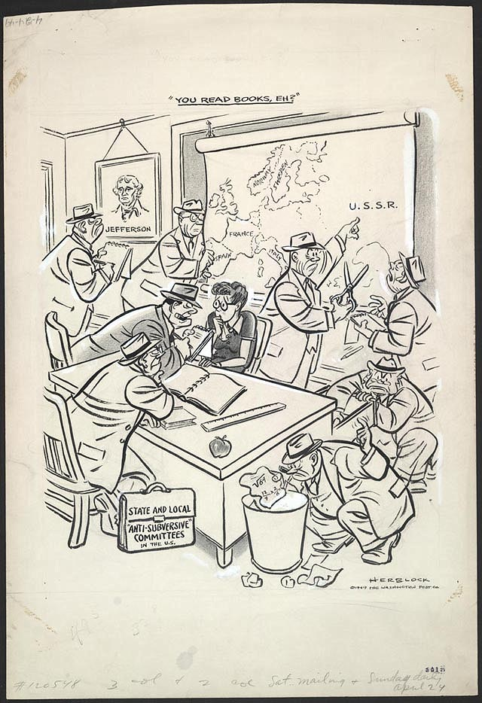
-April 1949-
During the postwar anti-communist campaign hundreds of elementary and high school teachers were investigated and lost their jobs, sometimes as a result of being named by proliferating "anti-subversive" groups and individuals. Some individuals compiled and circulated their own blacklists, which were accepted by frightened employers and casting directors who feared being blacklisted themselves if they sought facts and fair play. The motives of some self-serving or vindictive accusers were summed up by Herb Block in a phrase: "If you can't crush the commies, you can crush a neighbor."

Slide 31
Step 4 (10-2-2)
Revise Notes

Slide 32
Symbol | Revision
1,2,3… or A,B,C… | 1. Number the notes for each new concept or main idea.
Key Word | 2. Circle Vocabulary/Key terms
Main Idea | 3. Underline or highlight main ideas
^ | 4. Fill in gaps of missing info or reword.
Unimportant | 5.Cross out unimportant info.
? | 6. Identify points of confusion
* | 7. Identify info to be used on a test
Visual/Symbol | Create a visual symbol to represent information

Slide 33
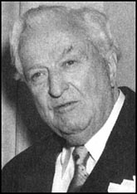
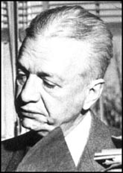
The McCarran-Walter Act
Americans feared disloyal immigrants.
1952 McCarran-Walter Act reestablished the immigration quota system from 1924. Limited immigrants from Asia and Southern and Central Europe.
Truman Vetoed bill. He called the bill “the most racist bill he had ever seen.”
Congress passed it without him.
Pat Warren
Francis Walter

Slide 34
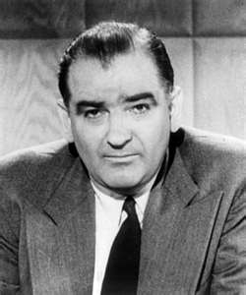
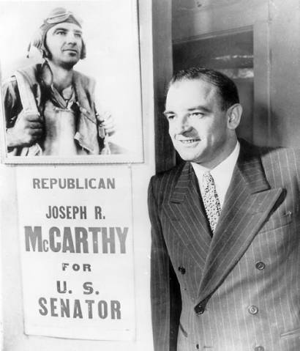
Witch Hunts
Joe McCarthy
Republican senator from Wisconsin
Felt he was unlikely to win reelection
Decided to use fear of communism to boost his career

Slide 35
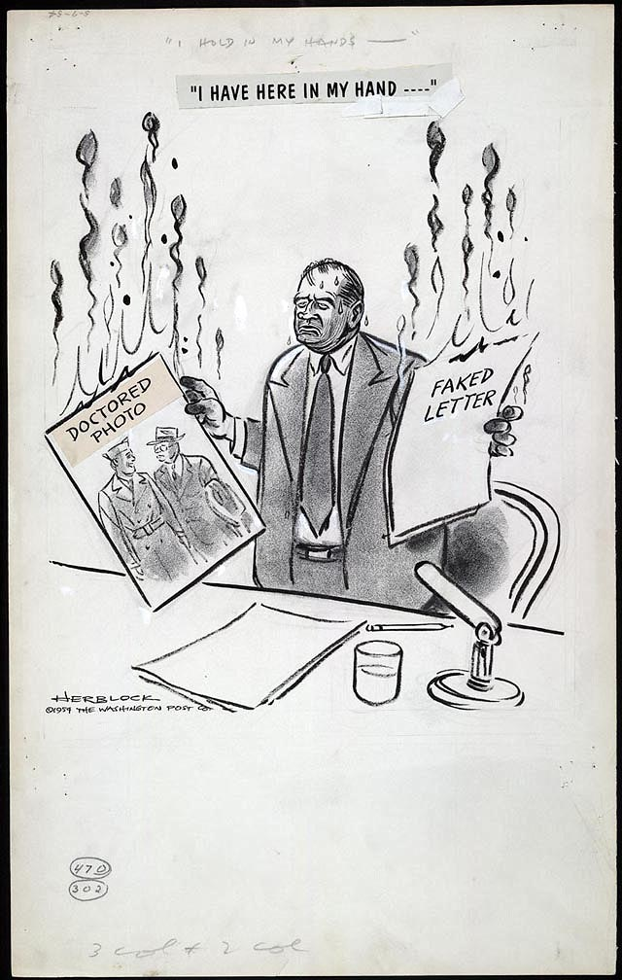
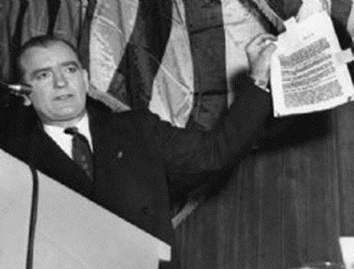
McCarthyism
McCarthy went on a rampage, announcing that the government was stuffed with ‘reds’
Made claims that he had inside knowledge and proof (for example, he’d say ‘I have a list of 205 people in the government who are members of the communist party’, but then would refuse to produce the names.
Senators, when speaking in the senate, are immune from the charge of slander (knowingly telling lies to hurt another person’s reputation)

Slide 36
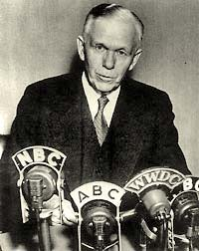
McCarthyism
McCarthy soon took on larger targets. He went after:
Secretary of State George Marshall
Senators feared him, worried that opposition to him would brand them as Communist sympathizers.

Slide 37
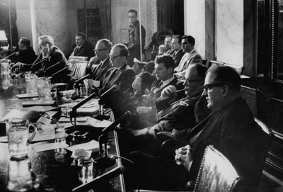
In 1954 McCarthy charged that the Army was full of Communists after one of his assistants was drafted.
Army officials charged him w/ seeking special treatment for his aide.
The army then charged McCarthy for seeking special treatment.
A subcommittee voted to investigate.

Slide 38
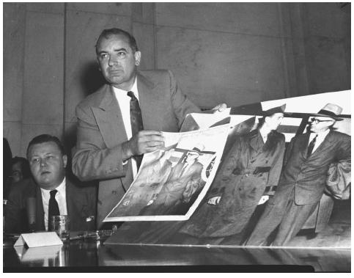
Televised broadcasts of the hearings were shown to Americans that way Americans could see McCarthy for what he was.
Many Americans were horrified by his bullying

Slide 39
McCarthy began losing his supporters after the trials.
The Senate condemned him
McCarthy began charging all against him as Communist tools…he no longer held his credibility though
54’ censure
He died 3 years later from cirrhosis of the liver.
McCarthyism

Slide 40
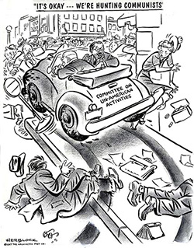

Slide 41
Step 4 (10-2-2)
Revise Notes

Slide 42
Symbol | Revision
1,2,3… or A,B,C… | 1. Number the notes for each new concept or main idea.
Key Word | 2. Circle Vocabulary/Key terms
Main Idea | 3. Underline or highlight main ideas
^ | 4. Fill in gaps of missing info or reword.
Unimportant | 5.Cross out unimportant info.
? | 6. Identify points of confusion
* | 7. Identify info to be used on a test
Visual/Symbol | Create a visual symbol to represent information

