Slide 1

Come up with answers to these questions as a table group.
What is the Supreme Court?
What is the Bill of Rights?
What was the Warren Court?

Slide 2
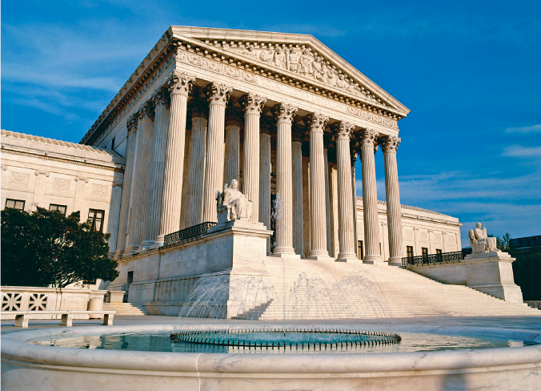
The Supreme
Court
Notes:
The Supreme Court’s term runs from the first Monday in October through the end of June.

Slide 3
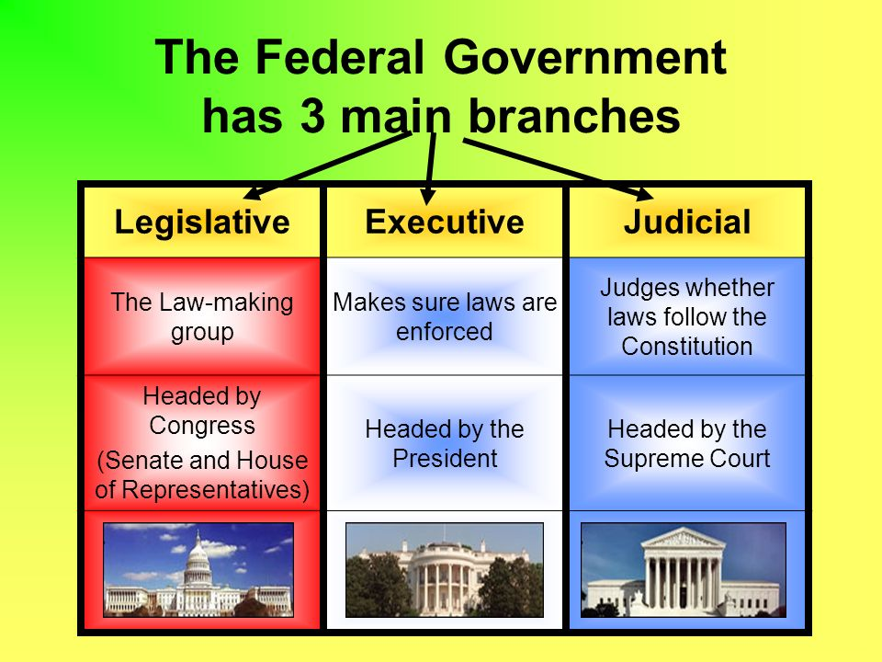

Slide 4

Judicial Review
The power of a court to refuse to enforce a law or government regulation that, in the opinion of the judges, conflicts with the U.S. Constitution or, in a state court, the state constitution
Only a constitutional amendment or a later Supreme Court can modify the Court’s decisions

Slide 5
Another Route to Supreme Court
Supreme Court
State Supreme
Court
Court of Appeals
State Court
of Appeals
District Court
Superior Court

Slide 6

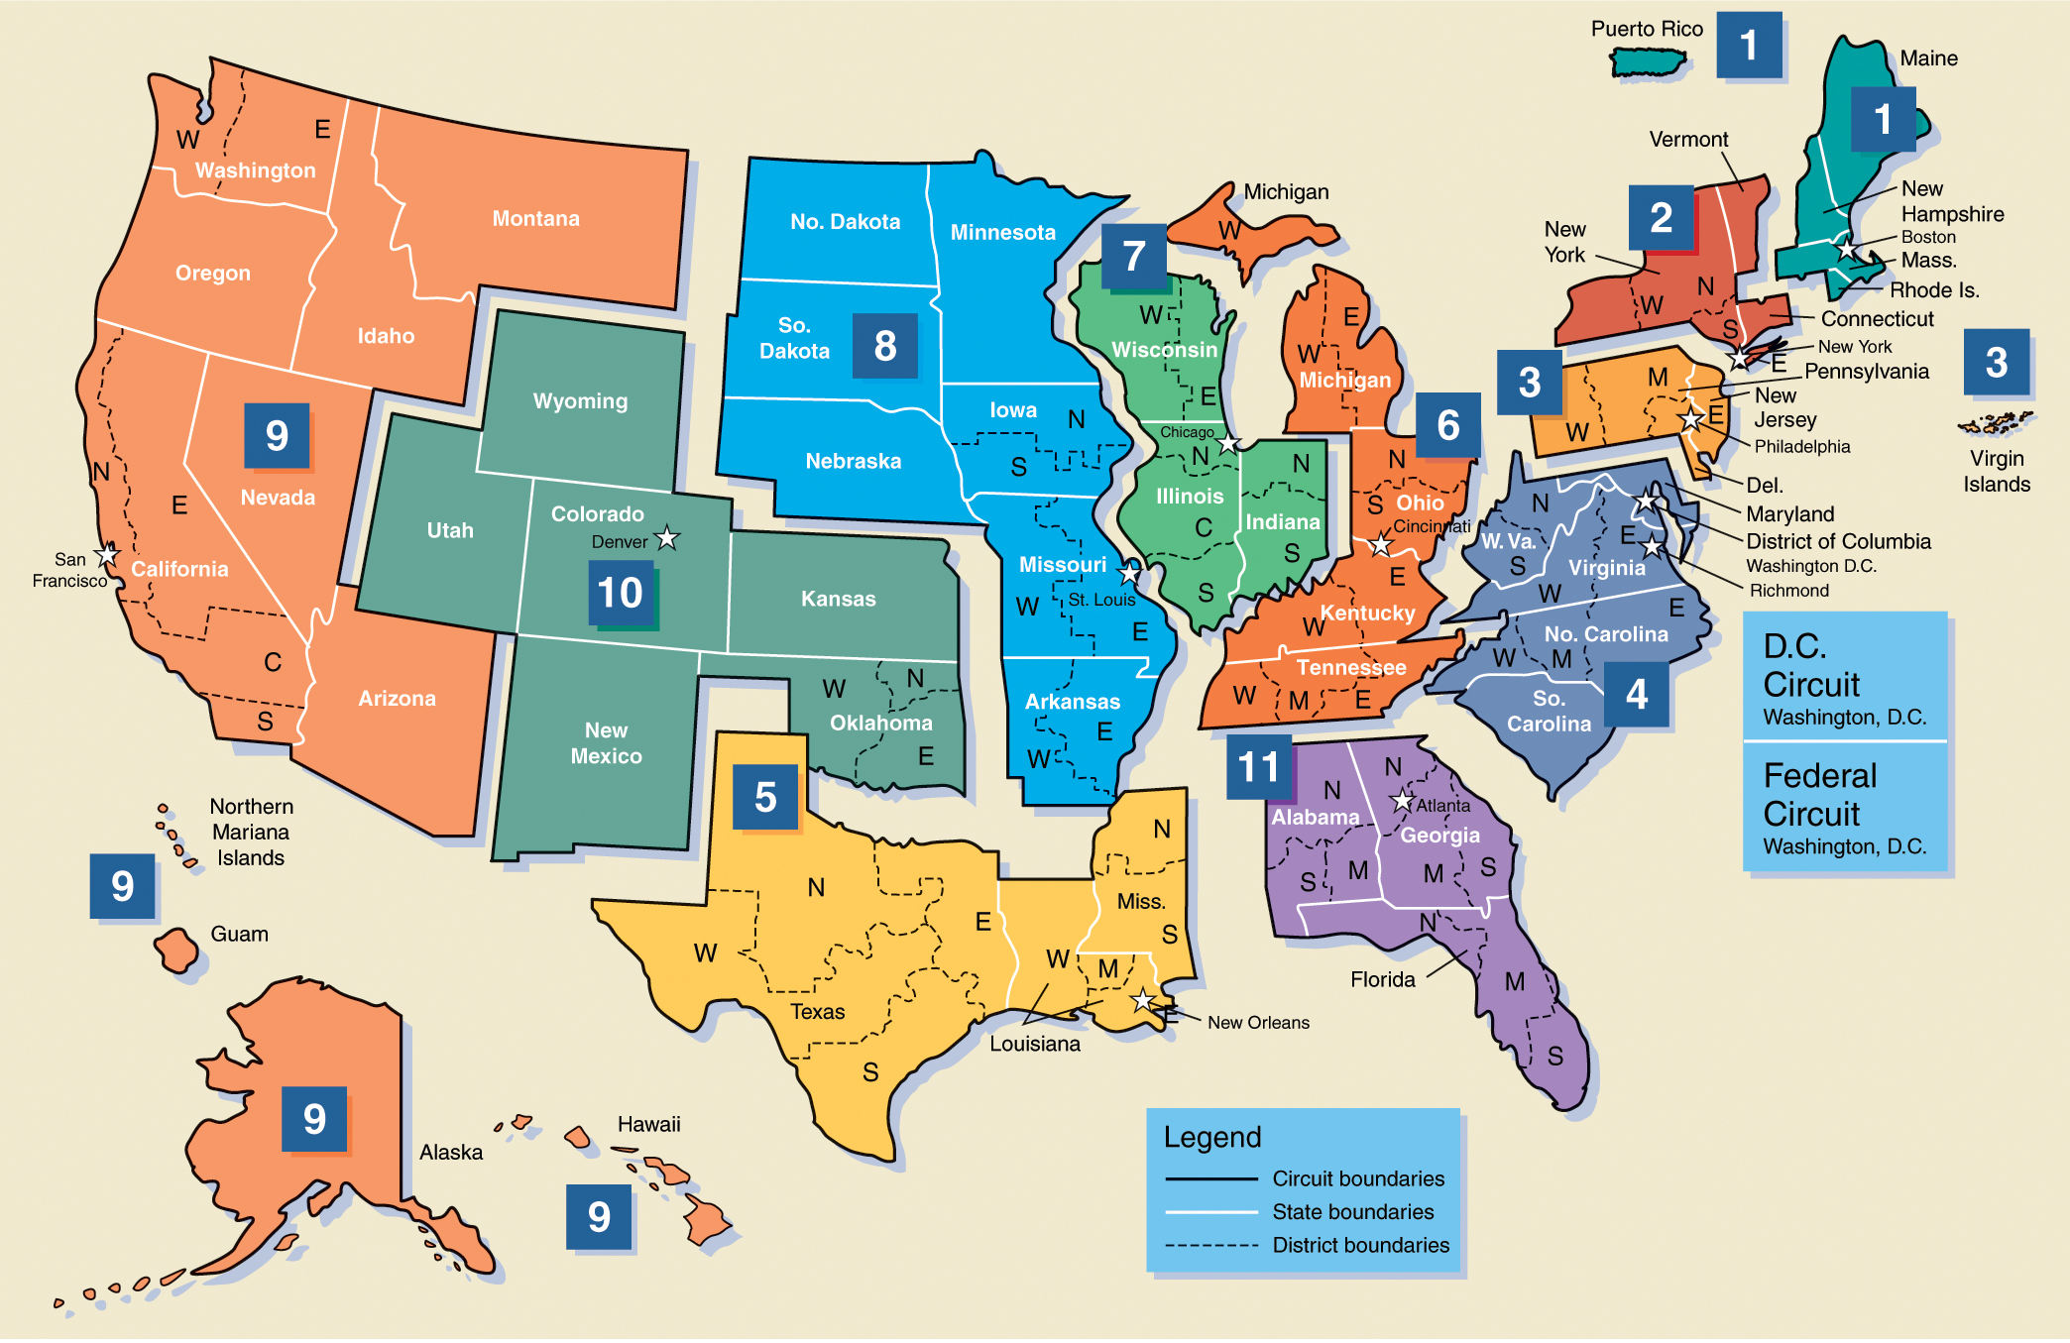
The Eleven U.S. Circuit Courts of Appeal

Slide 7
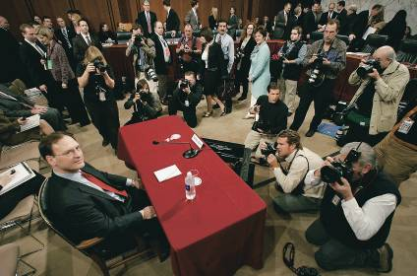
The Role of Politics in Selecting Judges
There are no Constitutional requirements
The process of judicial selection is a highly partisan and political process
Because of the power wielded by the Supreme Court, presidents take a personal interest in selecting appointees
Judge Samuel A. Alito prior to the start of his second day of questioning before the Senate Judiciary Committee
Judicial Tenure
The Constitution stipulates that federal judges “shall hold their Offices during good Behavior”
Judges cannot be removed for any reason by a President
Congress cannot impeach judges because they don’t like their decisions
Notes:
Interpreted to mean a life term

Slide 8
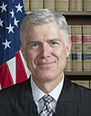
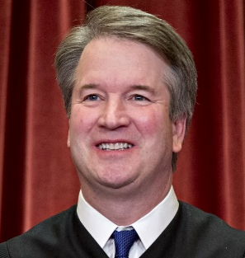
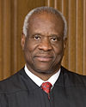
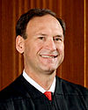
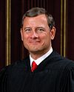
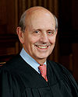
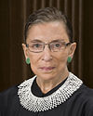
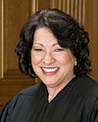
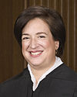
Today’s Supreme Court
Brett Kavanaugh (R)
Age: 54
Clarence Thomas (R)
Age: 69
Samuel Alito (R)
Age: 67
Neil
Gorsuch (R)
Age: 50
Sonia Sotomeyor (D)
Age: 63
Stephen Breyer (D)
Age: 79
Ruth Bader Ginsburg (D)
Age: 84
Elena Kagan (D)
Age: 57
Chief Justice John Roberts (R)
Age: 63

Slide 9
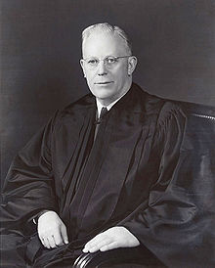
The Warren Court
During the Kennedy-Johnson years the Supreme Court was headed by Chief Justice Earl Warren.

Slide 10
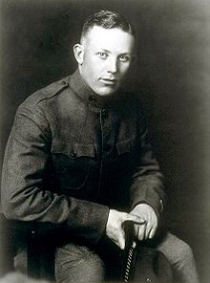
The Warren Court
Earl Warren (March 19, 1891 – July 9, 1974) was born in Los Angeles, California.
Earl grew up in Bakersfield, California.
It was in Bakersfield that his father was murdered during a robbery by an unknown killer.
Warren graduated from the University of California, Berkeley, (B.A. 1912) in Legal Studies, and Boalt Hall Law School in 1914.

Slide 11
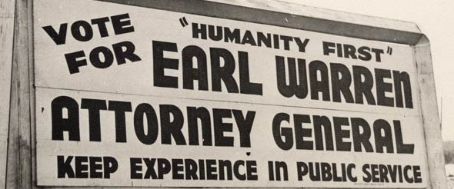
The Warren Court
Warren was appointed district attorney of Alameda County. Warren was re-elected to three four-year terms.
He was elected California Attorney General in 1938.
  As Attorney General, Warren is most remembered for being the moving force behind Japanese internment during the war.

Slide 12
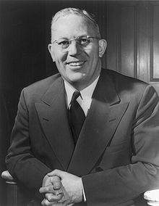
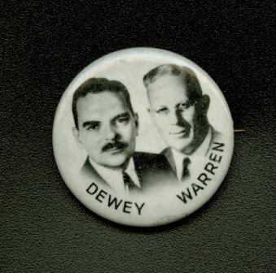
The Warren Court
Warren was elected Governor of California on November 3, 1942
He was re-elected two more times and left office in 1953.
Gov. Warren ran for Vice President of the United States in 1948 on the Republican ticket with Thomas E. Dewey. They lost in a stunning upset to the incumbent Democratic President Harry S. Truman

Slide 13
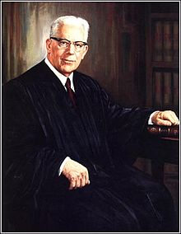
The Warren Court
Chief Justice Fred M. Vinson died suddenly in September 1953 and Eisenhower picked Warren to replace him as Chief Justice of the United States

Slide 14
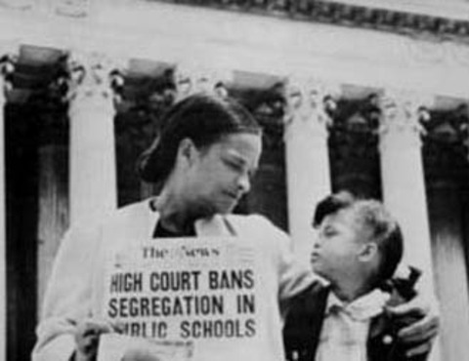
The Warren Court
Brown v. Board of Education
1954(1954)
  Banned the segregation of public schools.

Slide 15
Symbol | Revision
1,2,3… or A,B,C… | 1. Number the notes for each new concept or main idea.
Key Word | 2. Circle Vocabulary/Key terms
Main Idea | 3. Underline or highlight main ideas
^ | 4. Fill in gaps of missing info or reword.
Unimportant | 5.Cross out unimportant info.
? | 6. Identify points of confusion
* | 7. Identify info to be used on a test
Visual/Symbol | Create a visual symbol to represent information

Slide 16
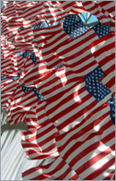
The Bill of Rights
The first 10 amendments
Contain basic rights of all American citizens
Ratified in 1791

Slide 17
Bill of Rights
Go to pages 80-82 and as a group define the first 10 Amendments to the constitution

Slide 18
The 1st Amendment
Primacy of Position
Freedom of religion and “free exercise thereof”
Freedom of speech
Freedom of the press
Freedom to assemble and petition the government
The Big 4

Slide 19
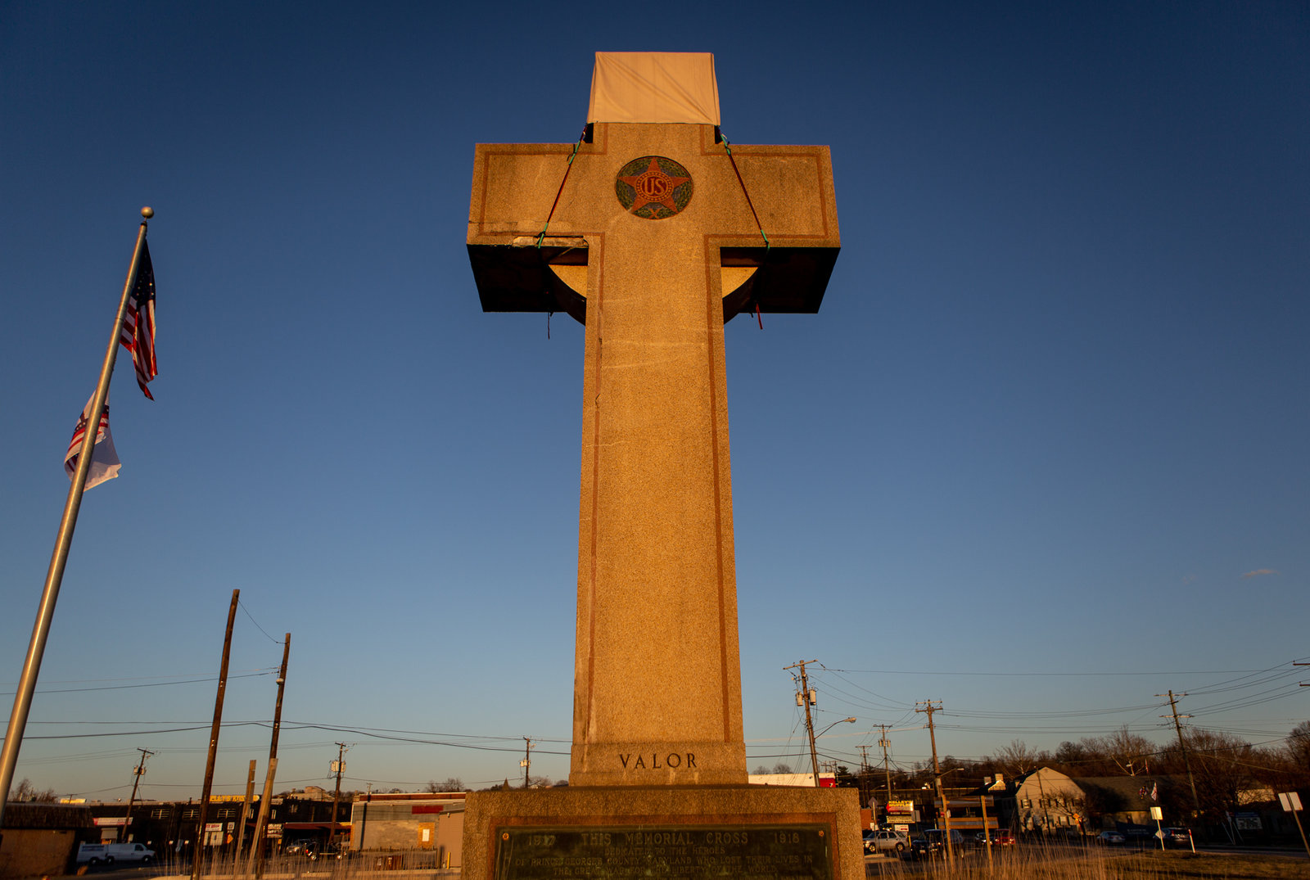

Slide 20
The 2nd Amendment
Right to bear arms

Slide 21
The 3rd Amendment
Freedom from quartering troops in private homes without their consent.

Slide 22
The 4th Amendment
Protects individual’s right to privacy
No unreasonable searches and seizures
Government must have “probable cause” to search

Slide 23
The 5th Amendment
Rights of accused persons
No double jeopardy
Cannot be forced to be a witness against yourself

Slide 24
The 6th Amendment
Right to speedy trial
Right to fair trial
Right to confront witnesses
Right to counsel

Slide 25
The 7th Amendment
Right to trial by jury

Slide 26
The 8th Amendment
No excessive bail
No excessive fines
No cruel and unusual punishments

Slide 27
The 9th Amendment
People’s rights are not limited to those mentioned in the Constitution.

Slide 28
The 10th Amendment
The states or the people retain all powers except those denied to them or those specifically granted to the federal government.

Slide 29
Read the case as a group, discuss how you will approach your position (Plaintiff or Defense)
Plaintiff
Create opening arguments that explain why you are suing the defense. What have they done that disrupts the plaintiffs Constitutional rights? Be sure to include background information on the case.
Using poster paper write out and create a visual that will help explain your side of the case.
Create closing arguments that will ensure your victory. Re-state key points and evidence.
Defense
Create opening arguments that explain why you have done nothing wrong, and that you have not broken the Constitution. Be sure to include background information on the case.
Using poster paper write out and create a visual that will help explain your side of the case.
Create closing arguments that will ensure your victory. Re-state key points and evidence.

