Slide 1
The 1st Amendment
Primacy of Position
Freedom of religion and “free exercise thereof”
Freedom of speech
Freedom of the press
Freedom to assemble and petition the government
The Big 4

Slide 2
The 2nd Amendment
Right to bear arms

Slide 3
The 3rd Amendment
Freedom from quartering troops in private homes without their consent.

Slide 4
The 4th Amendment
Protects individual’s right to privacy
No unreasonable searches and seizures
Government must have “probable cause” to search

Slide 5
The 5th Amendment
Rights of accused persons
No double jeopardy
Cannot be forced to be a witness against yourself

Slide 6
The 6th Amendment
Right to speedy trial
Right to fair trial
Right to confront witnesses
Right to counsel

Slide 7
The 7th Amendment
Right to trial by jury

Slide 8
The 8th Amendment
No excessive bail
No excessive fines
No cruel and unusual punishments

Slide 9
The 9th Amendment
People’s rights are not limited to those mentioned in the Constitution.

Slide 10
The 10th Amendment
The states or the people retain all powers except those denied to them or those specifically granted to the federal government.

Slide 11

Other Amendments
# 11 - 27

Slide 12

11th Amendment
Lawsuits brought against a state must be tried in a state court, not federal court.
1795

Slide 13
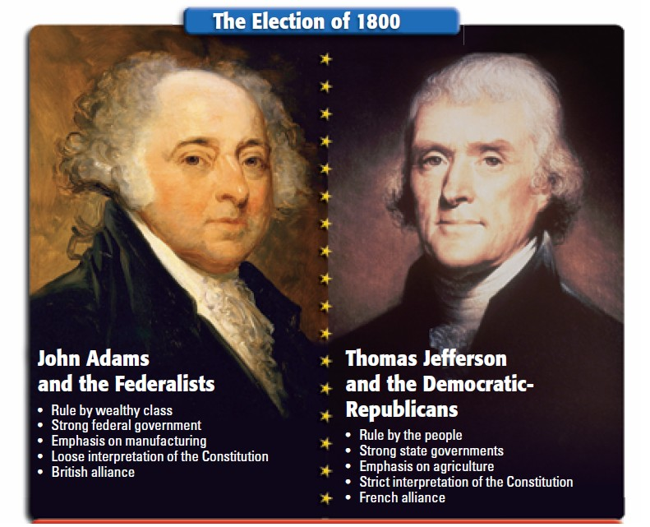
The 12th Amendment
By the 3rd presidential election, they realized there were some problems in the process. The electors must cast separate ballots for the office of President and Vice President .

Slide 14

The 13^{h} Amendment
(1865)
Abolished Slavery

Slide 15

The 14th Amendment
(1868)
Grants citizenship to former slaves and grants them equal protection of the laws.

Slide 16
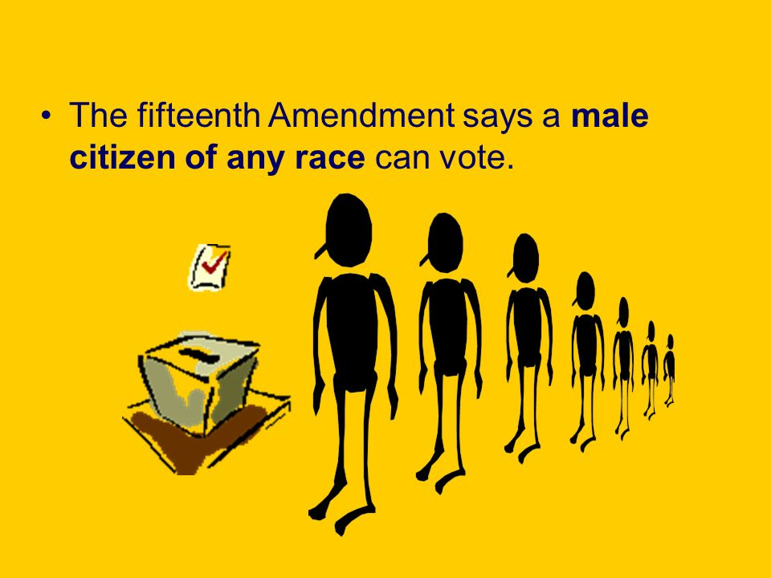
The 15th Amendment
(1870)
Grants right of all citizens to vote.

Slide 17
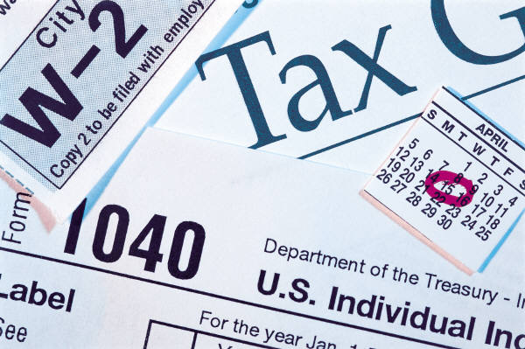
16th Amendment
The Supreme Court had declared a federal income tax to be unconstitutional. This amendment was passed to alter the Supreme Court’s decision for the future and expressly allow an income tax to be levied directly on the people by the federal government.
1913

Slide 18

The 17th Amendment
1913
Direct election of senators

Slide 19
The 18th Amendment
Prohibition of the
  Manufacture
  Sale
  Transportation
Of alcoholic beverages.
1919

Slide 20



The 19th Amendment
1920
Womens’ Suffrage

Slide 21
20th Amendment
1933
The “Lame Duck” Amendment
Moved the date for new President to take office from March to January.
Moved the date for new session of Congress to begin from March to January.
Provided for VP-elect to succeed if President-elect dies.
Provides for selecting a President and VP if they die before the election is decided.

Slide 22
The 21st Amendment
1933
Repealed Prohibition

Slide 23
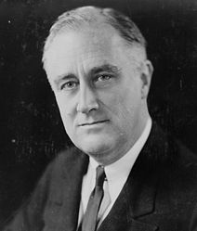
The 22nd Amendment
Limits Presidents to only two terms in office.
1+1+1+1 = 4
1951
F.D.R.

Slide 24


23rd Amendment
1961
Granted people living in Washington, D.C., the right to vote in presidential elections.

Slide 25
24th Amendment
Abolished the Poll Tax
1964

Slide 26
The 25th Amendment
How to replace the President in case of disability.
How to replace the Vice-President.
1967

Slide 27
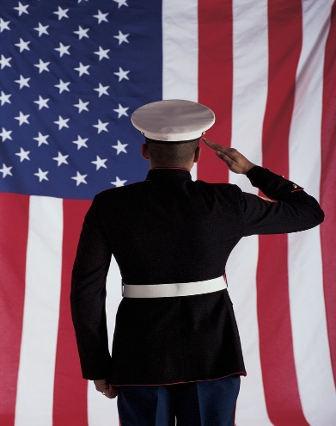
The 26th Amendment
Lowered voting age to 18.
1971

Slide 28
27th Amendment
1992
If members of Congress vote themselves a raise, it cannot go into effect until they have stood for reelection.

Slide 29
Bell Work: 3/4 Left of page 13
If you could only keep 3 of the first 10 Amendments, which Amendments would you keep? Why?

Slide 30
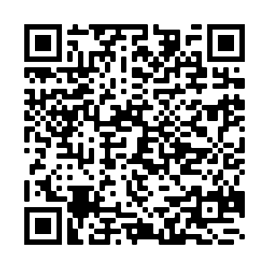
Bell Work:
Today you need to pick your Social Studies class for next year. Go to this cite on your phone.
https://tinyurl.com/s44jwf8

Slide 31
Cases will be heard in the following order:
You will be graded in 4 Categories:
1. Prep Day (1-4) (Group)
2. Court Performance (1-4) (Group)
3. Justice Performance (1-4) (Inv.)
4. Test Sheet (1-4) (Inv.)
1. Mapp. V Ohio 1961
2. Engle v. Vitale 1962
3. Gideon v Wainwright 1963
4. Escobedo v. Illinois 1964
5. Griswold v. Connecticut 1965
6. Miranda v. Arizona 1966

Slide 32
How your Handout is set up
Title
  The Title will have: the Case Name, Date, and your side of the case
  Ex. Engle v. Vitale 1962 ----Engel
Circumstances of the Case
  This tells you the history of the case
  This information is the same for both groups
Constitutional Issues
  This tells you the cases history in the court system
  This information is the same for both groups
Arguments
  This information tells you what arguments were used for your side in the case.
  This information is not the same as the other side—Make sure you don’t share it with them

Slide 33
Read the case as a group, discuss how you will approach your position (Plaintiff or Defense)
Plaintiff
Create opening arguments that explain why you are suing the defense. What have they done that denied the plaintiffs of their Constitutional rights? Be sure to include background information on the case.
    You must explain the events (Circumstances of the Case) from your point of View.
Using poster paper write out and create a visual that will help explain your side of the case.
Try to predict what the other side will argue and have an answer to those arguments.
Create closing arguments that will ensure your victory. Re-state key points and evidence.
Defense
Create opening arguments that explain why you have done nothing wrong, and that you have not broken the Constitution. Be sure to include background information on the case.
  You must explain the events (Circumstances of the Case) from your point of View.
Using poster paper write out and create a visual that will help explain your side of the case.
Try to predict what the other side will argue and have an answer to those arguments.
Create closing arguments that will ensure your victory. Re-state key points and evidence.

Slide 34
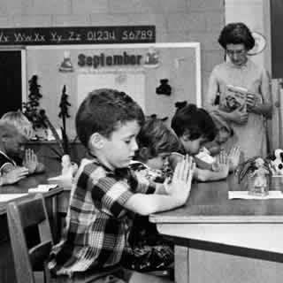
Engle vs Vitale
Prayer be said in public schools voluntarily
New Hyde Park Long Island parent sued school
Court ruled against the school district
Led to “Separation of church and state”
Prayer in schools was to be considered unconstitutional

Slide 35
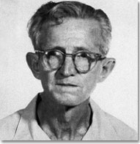
Gideon vs Wainwright
Gideon was convicted for breaking and entering
Not granted a lawyer
  Said only for people in capital cases who can no afford and lawyer
Forced to defend himself
  Five years in jail
Hand wrote a note to Supreme Court
  The supreme court unanimously decided “All citizens must be provided a lawyer if they can not afford one. This is regardless of crime type.”

Slide 36
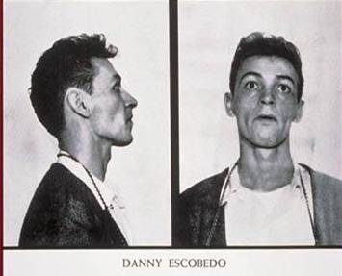
Escobedo vs Illinois
Danny Escobedo arrested in connection with a murder
Repeatedly requested for his lawyer but was denied to even leave the interrogation room
  His lawyer even went down there and was denied
“Escobedo Rule”
  “Holds that individuals have the right to an attorney when an investigation is no long a general inquiry…but has begun to focus on a particular suspect…”

Slide 37
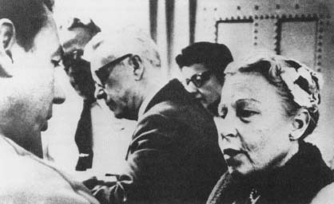
Griswold v. Connecticut (1965)
At issue was an 1879 Connecticut law prohibiting the aiding, abetting, counseling or use of birth control, even by married couples.
The Director of Planned Parenthood, Estelle Griswold who was also a physician, opened a clinic to purposely challenge the law. She was arrested, tried, and convicted of violating the law.
Used constitutional right of privacy to strike down a law
  Justice Douglas: It is implied in the language in the Bill of Rights
    Free speech and assembly = freedom to associate, which implies a right to privacy in one’s associations
    Third Amendment: right not to quarter solders: zone of privacy

Slide 38
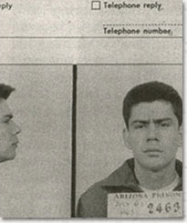
Miranda vs Arizona
Ernest Miranda arrested for kidnapping and rape of four young girls
Interrogated for two hours and confessed
Acquitted
Led to “Miranda Rights, must read constitutional rights at time of arrest”

